Slide 1
End-of-year Financial Reporting
4-H & Master Gardeners
With No Private Bank Account

Slide 2
Financial Reporting Periods
Active 4-H clubs and groups report on calendar-year basis
January 1st through December 31st
Active Master Gardeners clubs report on calendar-year basis
January 1st through December 31st

Slide 3
Due Dates and Where to Send
Reports are due within 90 days of the end of the financial reporting period from the Staff Chair to the Chief Operating Officer at the LRSO.
4-H & MG – Due at LRSO - March 31st

Slide 4
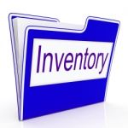
For all active clubs/groups without a private bank account but with individual inventory or equipment items valued at $500 or more OR any firearms, the following reports are required:
Statement of Financial Position
Annual Group Property-Inventory Report
Notes:
Send a list of any clubs/groups that were inactive during the entire reporting period – 4-H during the fiscal year – MGs during the calendar year – and we will keep that information on file. This is to ensure the group didn’t fail to report. If they are listed on the 4-H Online Report, I will check for any clubs/groups that have not reported or been designated as inactive during the reporting period.

Slide 5
Download or Print Report Forms
The end-of-year financial reports and the link to the Financial Guidelines for 4-H and Master Gardener Groups are located on the Information for Clubs web page on uaex.edu at the following short link:
www.uaex.edu/clubs-groups

Slide 6
Excel Forms vs. Printable Version (PDF)
There are two versions of the following forms on the Information for Clubs web page:
Statement of Financial Position
Annual Group Property-Inventory Report
You can use the Excel forms which include formulas to calculate many of the totals for you.
Or if you prefer to print out the forms and write in the information and totals, you can use the PDF version.

Slide 7
Statement of Financial Position
The Statement of Financial Position is a “snapshot” of the club’s/group’s financial position at a specific point in time, i.e., on the last day of the financial reporting period.
4H & Master Gardeners December 31st

Slide 8
Instructions for Clubs/Groups without a Private Bank Account but with individual inventory or equipment valued at $500 or more
Assets:
Cash and/or Checking Account:
Write or type “no private bank account.” List any cash on hand.
Inventory/Equipment:
List individual inventory or equipment items valued at $500 or more.
Enter the Total Assets.
Liabilities:
Clubs/groups without a private bank account should not have any liabilities.
Notes:
3

Slide 9
Net Assets:
Net Assets - Beginning:
Include inventory or equipment valued at $500 or more that was purchased or acquired before the first day of the financial reporting period;
4-H & Master Gardeners January 1st
If all inventory or equipment valued at $500 or more was purchased or acquired during the financial reporting period, the Net Assets – Beginning will be zero.
Current Year’s Net Increase or Net Loss:
Normally, this will be zero for clubs/groups without a private bank account. However, you can include inventory or equipment valued at $500 or more as the Net Increase if purchased or acquired during the financial reporting period.
Notes:
2

Slide 10
Net Assets (cont’d):
Net Assets – Ending:
Add the Net Increase to the Net Assets – Beginning to determine the Net Assets – Ending; in other words, the Net Assets on the last day of the financial reporting period.
Add the Total Liabilities to the Net Assets and enter the amount. This amount should always equal the Total Assets at the top of the form.
Read the certification and be sure to include all reports as indicated.
Sign and date the form.
Notes:
2

Slide 11
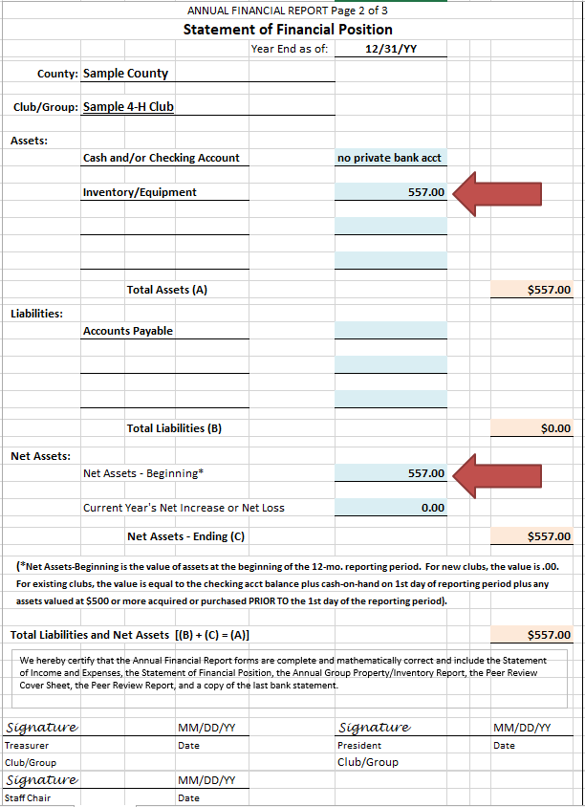
Sample: Statement of Financial Position (no private bank account but with inventory or equipment valued at $500 or more)
For the purposes of this example, the club/group had individual inventory or equipment items valued at $500 or more.
Report the total value of those items as assets.
The total value of the inventory and equipment items included above will also be reported as Net Assets – Beginning if purchased or acquired prior to the beginning of the financial reporting period.
Total Liabilities and Net Assets equal Total Assets - $557.00.

Slide 12
Annual Group Property-Inventory Report
The Annual Group Property-Inventory Report is to record all individual inventory or equipment items valued at $500.00 or more and ANY AND ALL firearms regardless of value (including guns, rifles, shotguns, muzzleloaders, and pistols; as well as, BB guns, air guns, and bows).
NOTE: The inventory or equipment included on this report may be different from the inventory or equipment included as assets on the Statement of Financial Position since all firearms are required to be listed on this report regardless of value.

Slide 13
Sample: Annual Group Property-Inventory Report
Notes:
NOTE: The total inventory value of this report may be different from the inventory or equipment included as assets on the Statement of Financial Position since all firearms are required to be listed on the Annual Group Property-Inventory Report regardless of value.

Slide 14
For active clubs/groups without a private bank account AND no individual inventory or equipment items valued at $500 or more AND no firearms, the staff chair can include the club/group on the Certification – No Group Bank Account and No Inventory-Equipment form, sign and date the form, and submit it with the county’s other end-of-year financial reports.
NOTE: Any clubs/groups registered on 4-H Online that were inactive during the entire reporting period may be identified as “inactive” in an e-mail. A copy will be kept in the county file to document the club/group had no activity.
Notes:
Send a list of any clubs/groups that were inactive during the entire reporting period – 4-H during the fiscal year – MGs during the calendar year – and we will keep that information on file. This is to ensure the group didn’t fail to report. If they are listed on the 4-H Online Report, I will check for any clubs/groups that have not reported or been designated as inactive during the reporting period.

Slide 15
Sample – Certification – No Group Bank Account And
No Inventory/Equipment
The Staff Chair can list clubs/groups that meet the above criteria on the Certification – No Group Bank Account And No Inventory/Equipment.

Slide 16
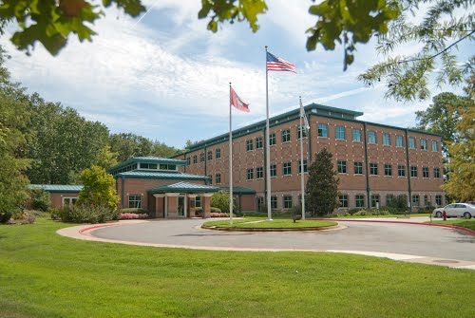
WHERE TO SEND: Once completed, clubs/groups are to send the required reports to the Staff Chair at the County Extension Office. The Staff Chair will review the reports for completion and, once approved, will sign the reports before sending to the LRSO at the address listed below:
Sam Boyster, Chief Operating Officer
U of A – Division of Agriculture
Cooperative Extension Service
2301 South University Avenue
Little Rock, AR 72204
Questions may be directed to Jessica Smith at jlsmith@uaex.edu or 501-671-2045.

