Slide 1


Fresh Produce Safety
By Serena M. Fuller
Associate Professor - Nutrition and Food Safety

Slide 2
Produce Safety Objectives
Identify safe practices for handling fresh produce
Identify safe practices for washing fresh produce
Identify safe practices for storing fresh produce
Demonstrate safe produce handling, washing and storing

Slide 3
Food Safety Situation
Annually 1 in 6 individuals fall ill due to foodborne illness - that’s 494,395 Arkansas! (FoodNet: Trends in Foodborne Illness in the United States, 2012)
Every year about 28 cases of foodborne botulism occur (CDC: Botulism: Epidemiological Overview for Clinicians)
Cost of foodborne illnesses estimated up to $152 billion dollars annually (USDA ERS: EIBN 118, 2013)

Slide 4
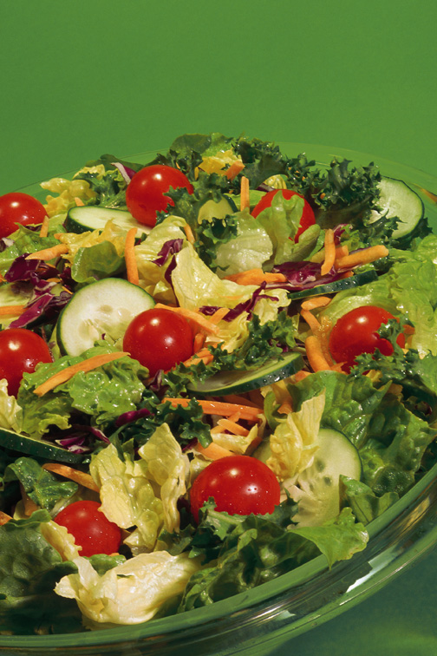
Why I Should I be Informed?
While the US food supply is very safe, certain populations are at greater risk
  Older people
  Young children
  Pregnant women
  Immune compromised
Preventable!
Fresh fruits & veggies are important for health

Slide 5
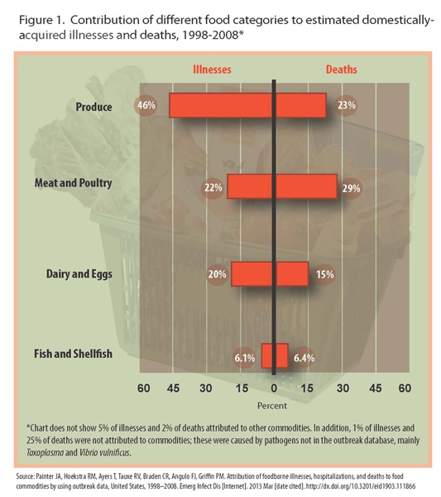
Why Focus on Produce?
Surprise! Produce is the number one cause of foodborne illnesses
Why?
We think it is safe (and in theory it should be)
We don’t cook it
Notes:
Heat is how most foodborne pathogens are destroyed, however, we don’t heat fresh produce which means we don’t have the safe guard of heat to destroy potentially dangerous microbes. Yet fresh produce is an important part of a healthy diet and we should consume lots. This presentation provides you tips that will help you keep your fresh fruits and veggies safe to eat so you can enjoy them without worry.

Slide 6
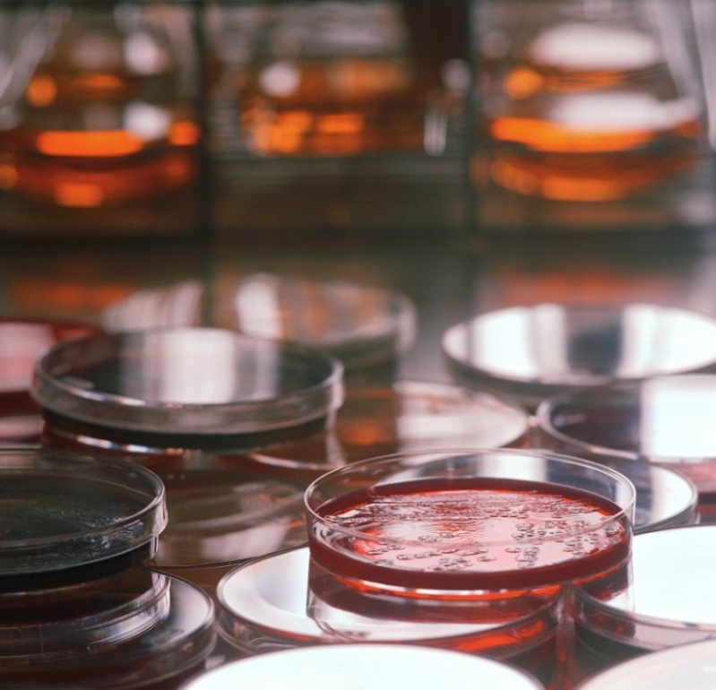
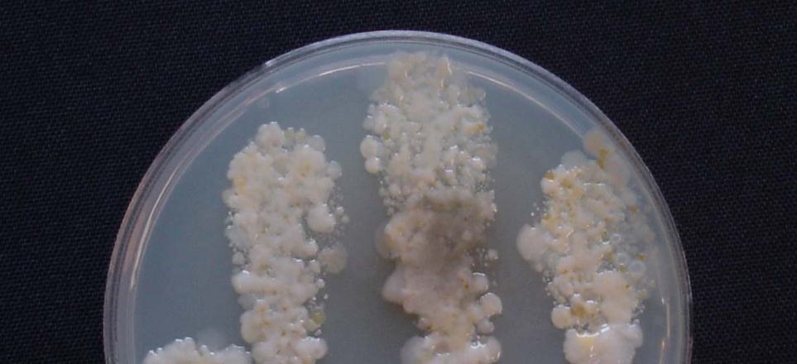
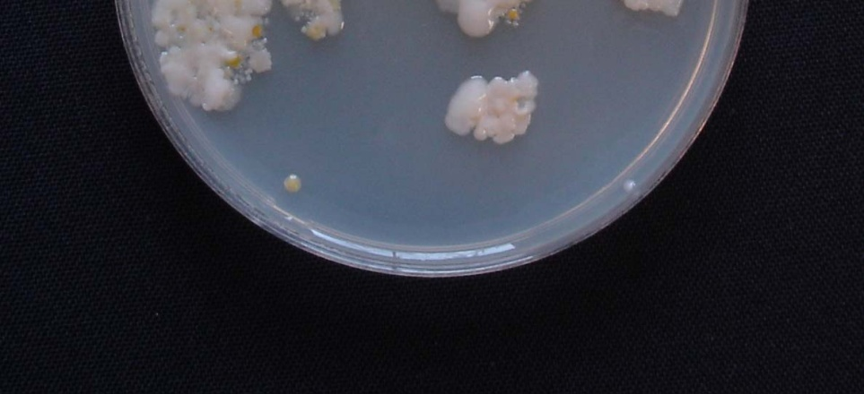
What is a Contaminant?
A bacteria or substance that is where is shouldn’t be
Some common contaminants:
  Salmonella
  Shigella
  Norovirus
  Campylobacter
  E. Coli
Notes:
A contaminant is essentially some substance or bacteria that is where it is not supposed to be and can cause harm to its new home. Salmonella, Campylobacter and E. Coli generally come from raw or undercooked meat, poultry, or eggs and are spread onto produce through unsafe handling and storing practices. Norovirus and Shigella are often spread through poor hygiene, like someone at the grocery store with unwashed hands touching the fresh spinach. All of these contaminants cause severe symptoms like diarrhea and vomiting, and can be serious illnesses.

Slide 7
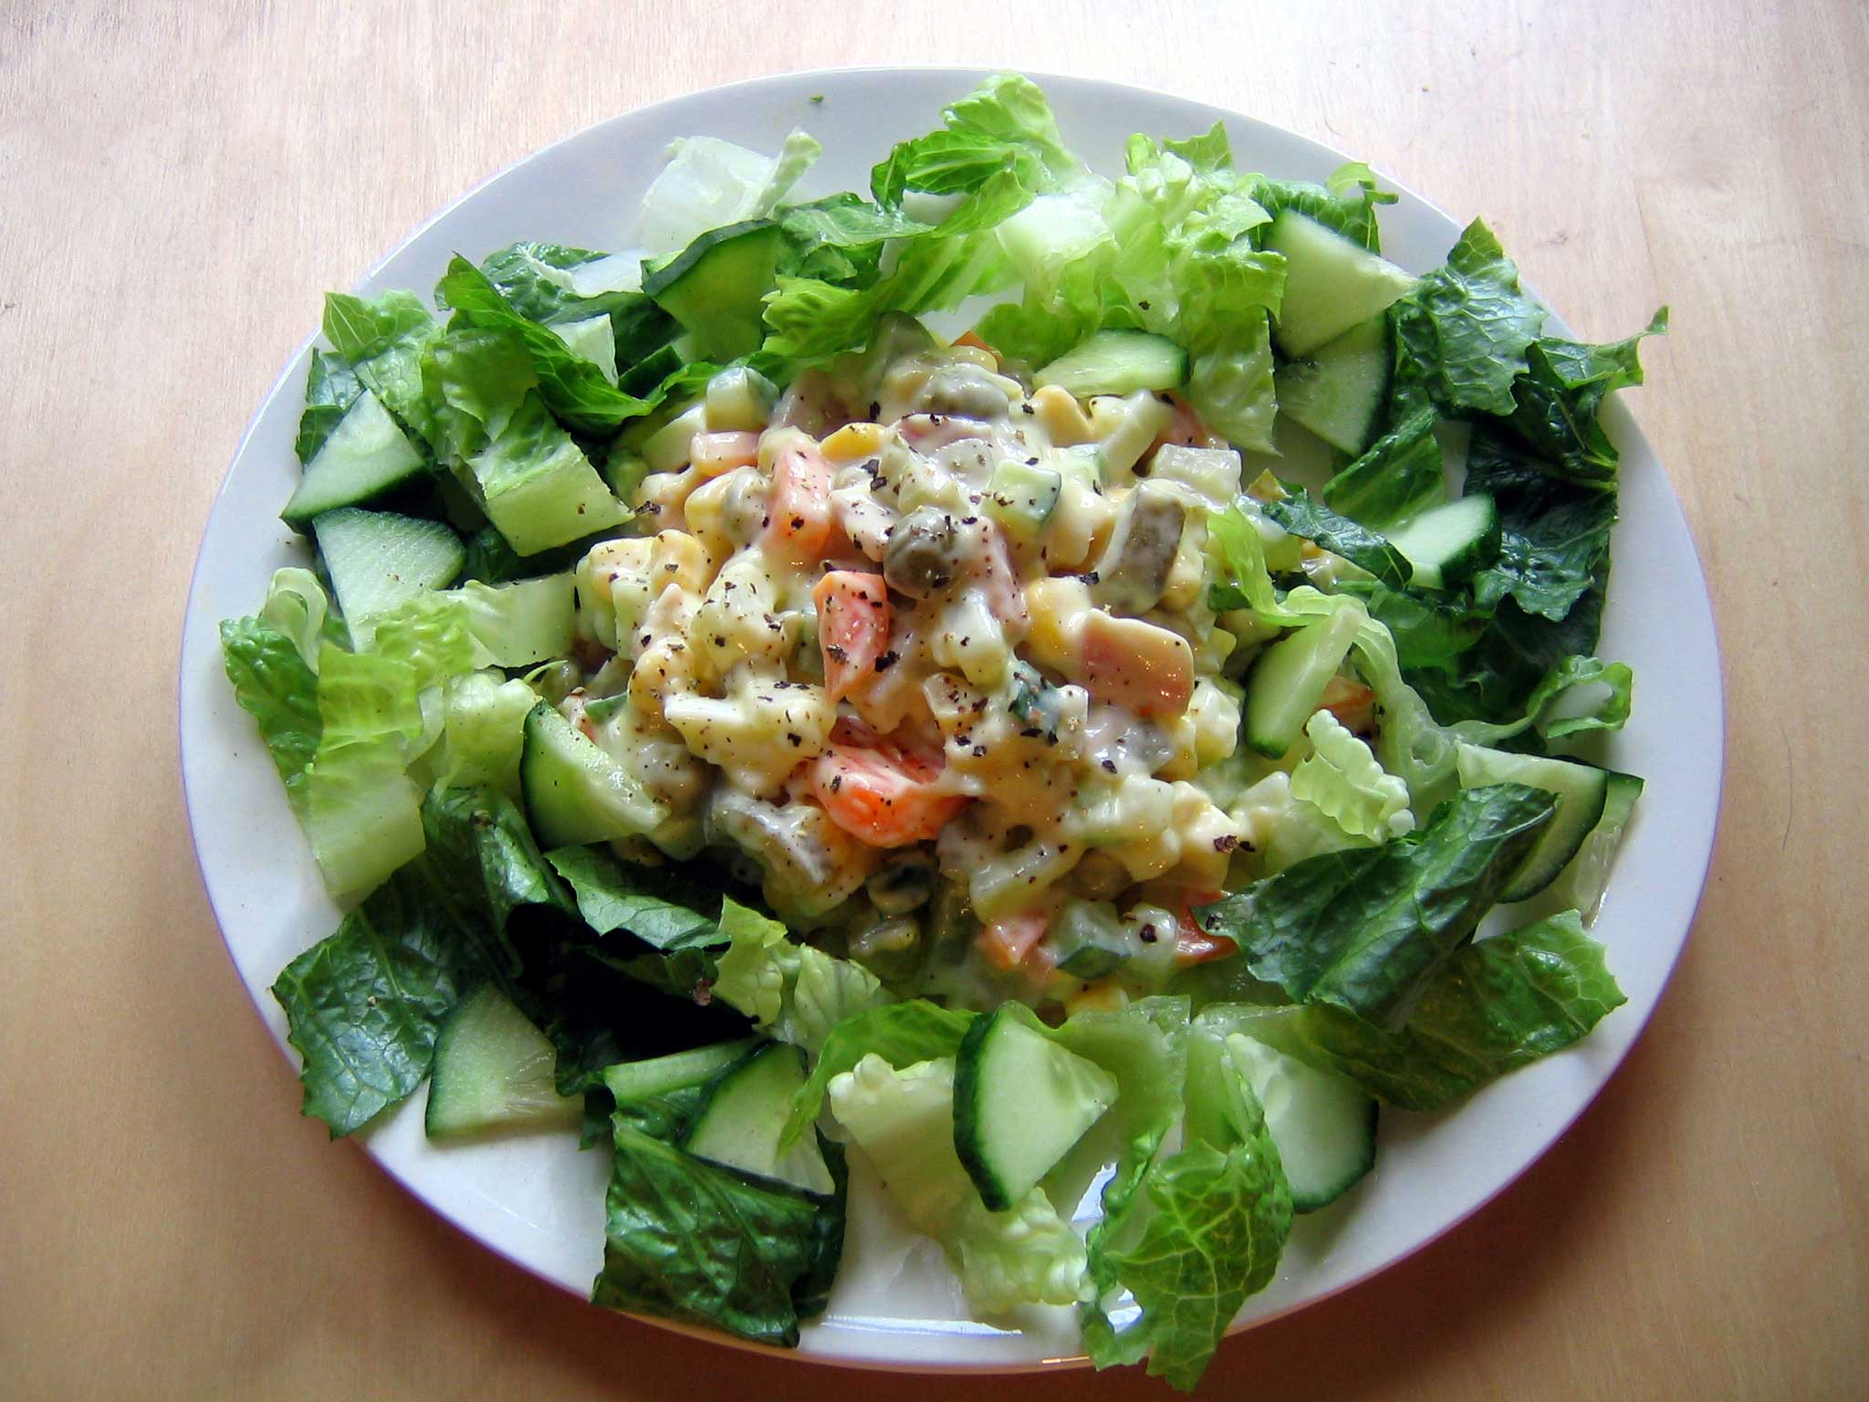
Do I Matter?
Manufacturing
Transport
Transport
Storage
Producer
Transport
Storage
Prep
Notes:
The journey of produce begins on the farm (the producer), is transported to the wholesaler (manufacturer), who then transports it to storage (the grocery store or market), where it is then picked up by you, and transported and stored in your home until you’re ready to use it. Each of the red arrows here indicate an opportunity for contamination BEFORE you pick it up from the market.

Slide 8
Where do I Fit?
Manufacturing
Transport
Transport
Storage
Producer
Transport
Storage
Prep
Notes:
Produce is at the grocery store or farmers market, where it is then picked up by you, and transported and stored in your home until you’re ready to use it. Each of the red arrows here indicate an opportunity for contamination AFTER you pick it up from the market and when it is your control.
Surprise at all points in the process of farm to table there is risk for contamination.

Slide 9
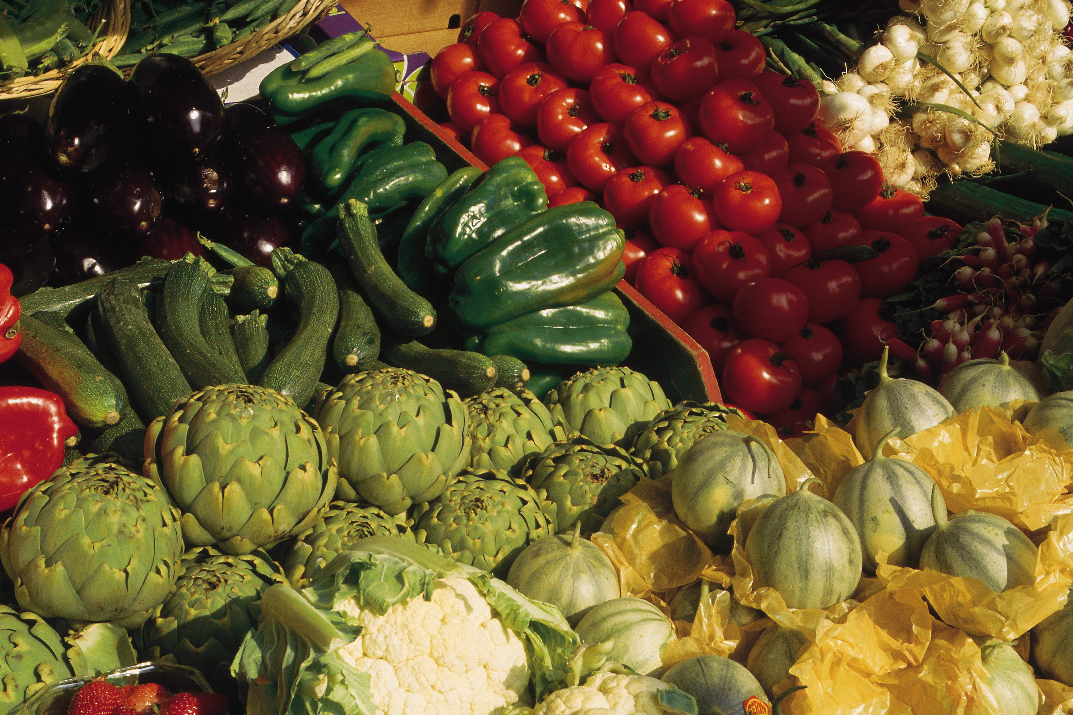
All Produce is at Risk of Contamination
  farmers market = organic = grocery store = big box store when it comes to safe handling
Notes:
As we mentioned before, there are many opportunities for contamination before the fruits and vegetables get to you. We don’t know who handled the produce or how they handled it before it got to the market or the store, which is why it is so important to use safe handling practices to all produce to reduce our risk.

Slide 10
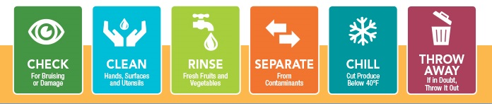
Principles for Safe Handling
Check what you buy
Clean your hands, surfaces and utensils
Rinse (most of) your produce before eating
Separate fresh produce from contaminants
Chill pre-cut fruits and vegetables
Throw away produce that may be contaminated
Notes:
These are some easy rules to follow to make sure your fruits and vegetables are safe to eat. Remember to always: check what you buy; clean your hands, surfaces and utensils before touching any foods; rinse your produce before eating; separate fresh fruits and vegetables from any contaminants; chill pre-cut produce; and throw away produce that may be contaminated.
Info graphic credit: Fight Bac® at home to enjoy safe and healthy fresh fruits and vegetables - fightbac.org

Slide 11
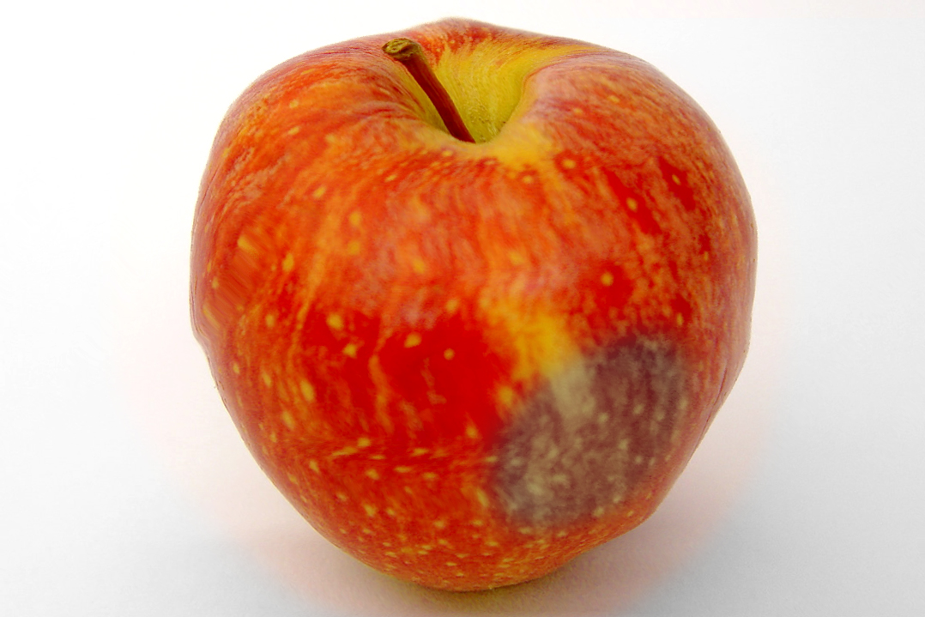
If it’s Bruised, You Lose!
Check what you buy
  Look for:
    Bruises
    Scratches
    Oozing juices
    Punctures
Only purchase chilled pre-cut or washed bagged items
Notes:
Be sure to check your fruits and vegetables before purchasing them at the market. Bruised, cut, or oozing produce indicates the potential for to bacteria to enter into the “meat” of the produce, so there’s no washing it off. Checking your produce beforehand can prevent you from grabbing contaminated produce that you’ll just have to throw out when you get home anyway, so checking before you buy can save you money.

Slide 12

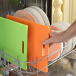
Scrub a Dub Dub!
Wash your hands before and after
  Warm soapy water for 20 seconds
  Sing the “Happy Birthday” song
Don’t forget to clean surfaces and utensils
Notes:
Remember to always wash your hands before and after handling food items, using the restroom, or touching unclean surfaces like doorknobs, people, and un-sanitized countertops. Bare in mind that whatever is on your hands can get into your food. For safest hand washing method, always use warm water and soap and wash for 20 seconds, or the amount of time it takes to sing the Happy Birthday song.
Don’t forget the surfaces and utensils! Make sure to wipe down cutting boards and countertops with warm soapy water, and be sure to use clean knives, peelers, or other utensils to cut or peel your fruits or vegetables.

Slide 13
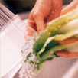
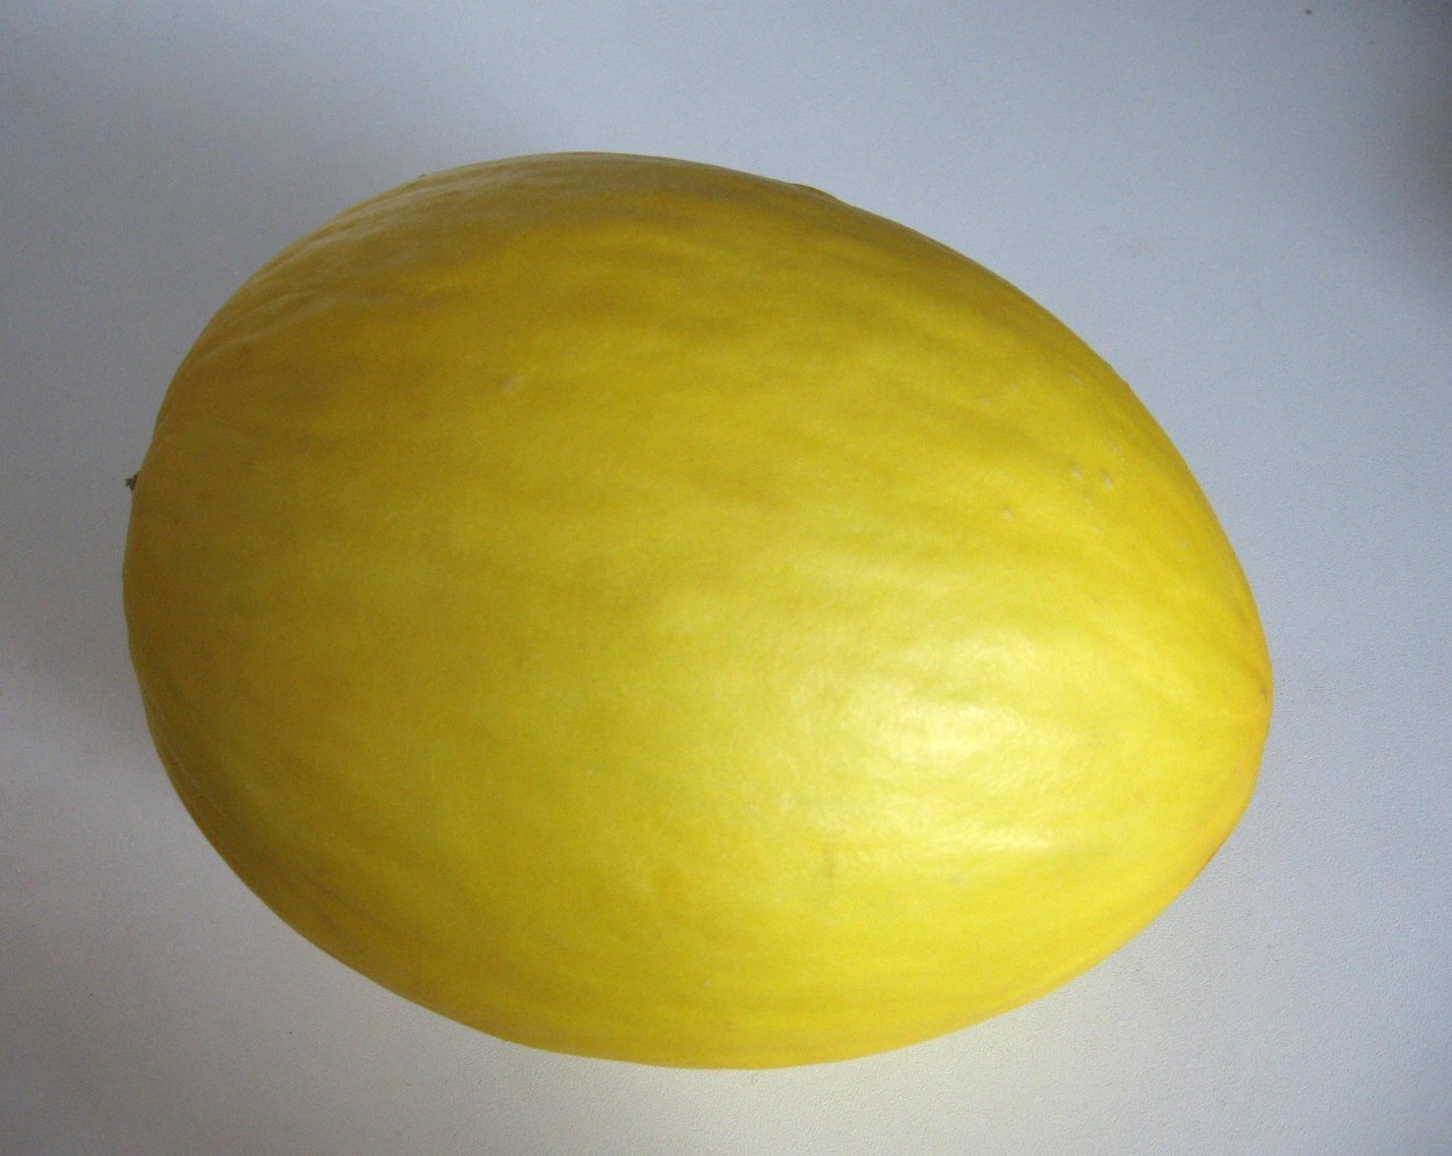
Keep it Clean
Wash fresh fruits and vegetables under running water
Don’t forget to wash produce with skins even if you don’t plan to eat the skin!
For produce with a tougher skin, rub or scrub with clean vegetable brush
Then dry washed produce to remove any contaminated water droplets
Notes:
When washing fresh fruits and vegetables, be sure to use running water as opposed to wiping it off with a paper towel or handkerchief to make sure all the possible contaminants are being washed off instead of just moved around. It’s important to wash fresh fruits and vegetables even if you’re not going to eat the skin. Peeling or cutting through the un-cleaned skin from a fruit or vegetable allows the bacteria from the skin of the produce to seep into the part you plan to eat.
It is actually recommended that you do not wash produce that is bagged and labeled as “pre-washed” because it is already cleaned and the more you handle it, the more likely it is to become contaminated.

Slide 14
Myth Busted
  It is safer to NOT wash bagged, pre-washed produce. Look for the words “ready-to-eat”, “triple rinsed” and/or “pre-washed”.
  Washing increases the risk of contamination.
Notes:
When washing fresh fruits and vegetables, be sure to use running water as opposed to wiping it off with a paper towel or handkerchief to make sure all the possible contaminants are being washed off instead of just moved around. It’s important to wash fresh fruits and vegetables even if you’re not going to eat the skin. Peeling or cutting through the un-cleaned skin from a fruit or vegetable allows the bacteria from the skin of the produce to seep into the part you plan to eat.
It is actually recommended that you do not wash produce that is bagged and labeled as “pre-washed” because it is already cleaned and the more you handle it, the more likely it is to become contaminated.

Slide 15
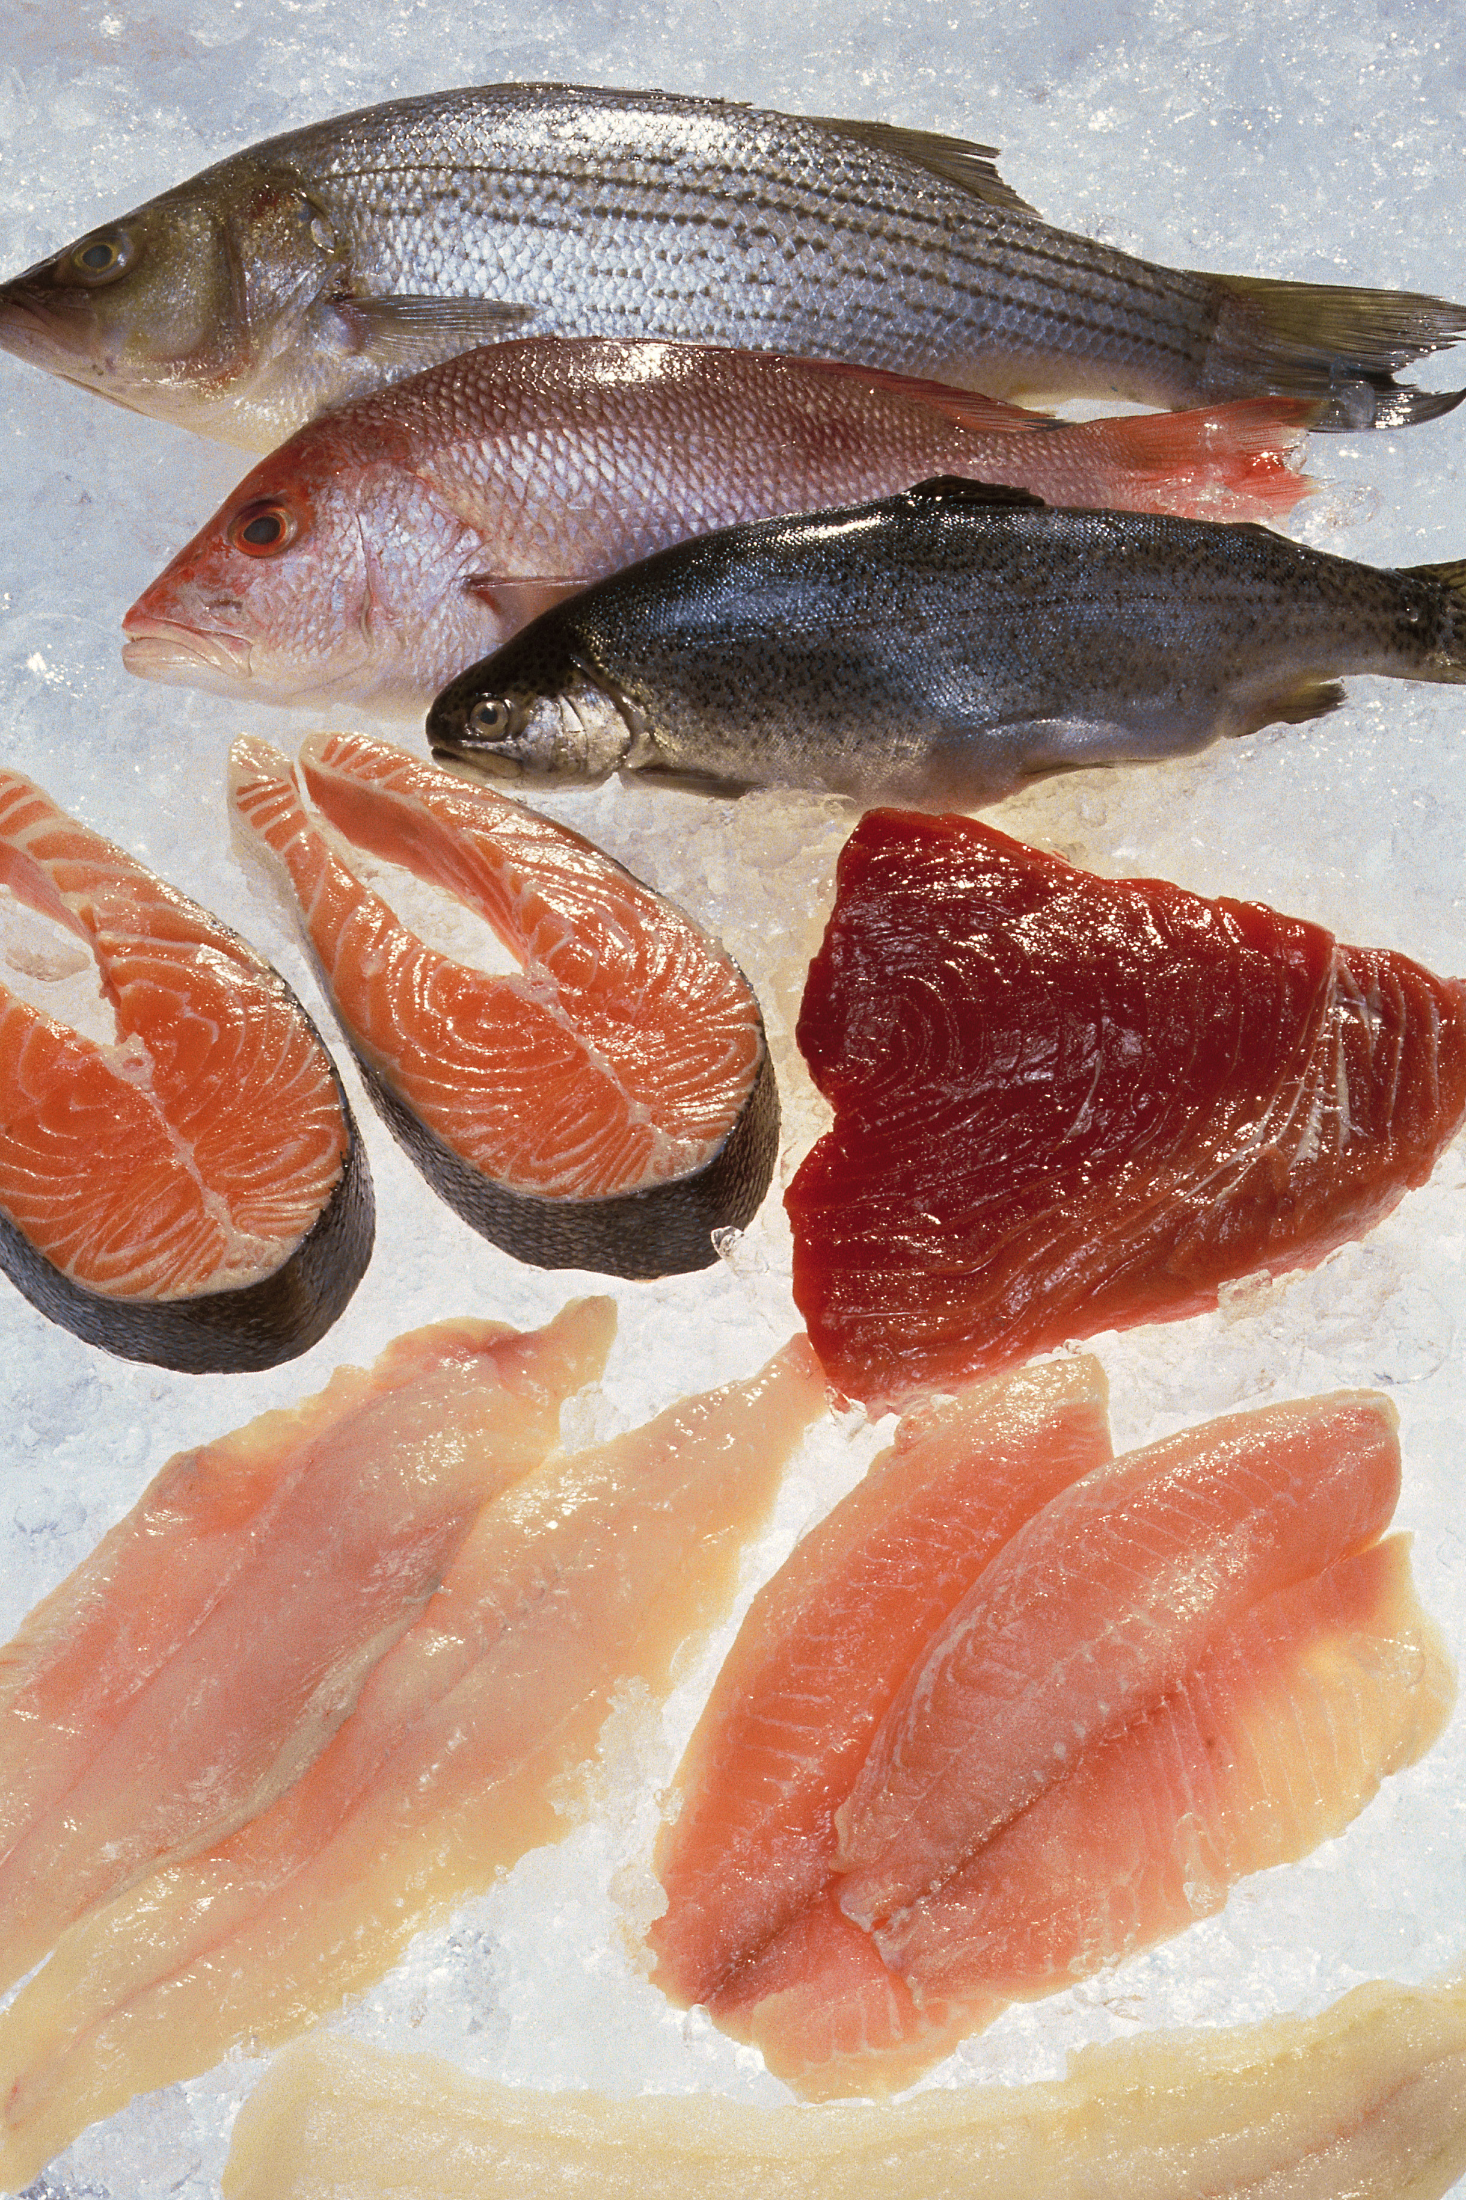
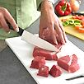
Keep Produce Separate
Start early and separate in the grocery store
  Place in different bags and away from chemicals too
In the refrigerator store produce above raw meats or in produce crispers
Use separate utensils and cutting boards
Notes:
Contamination can occur at any given point before you get your fruits and vegetables home and cleaned, so keeping your produce separate from your meats and eggs and also any household cleaners/chemicals that you may pick-up in the grocery store is always a safe bet. A great way to do this is to bag your produce and your meats in separate bags.
Even in the refrigerator, raw meats, seafood, and eggs can still contaminate your fresh fruits and vegetables. The best way to avoid this is to store your raw meats at the bottom of the refrigerator in a separate storage bin and keep your fruits and vegetables above and away from those meats. This will keep the juices from the meats from leaking out onto any fresh produce you may eat later.
To avoid contamination, always use a separate non-porous cutting board for raw meats. Non-porous means water or liquids can’t get through it; an example would be a plastic cutting board instead of a wooden cutting board. Also, never use the same knife for raw meats and fresh produce without thoroughly washing it in warm soapy water after each use.

Slide 16
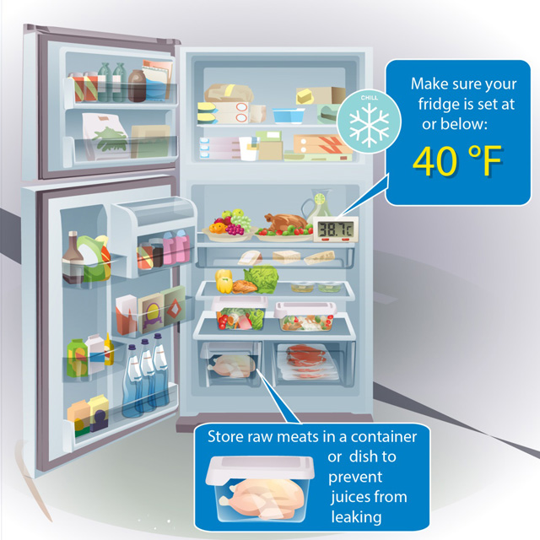
Chill
Check refrigerator temperature
  Should be 40⁰F - 32⁰F
Refrigerate all prepared produce within 2 hours of cutting
Most unprepared produce can be refrigerated for quality purposes
Notes:
Your refrigerator should always be set at or below 40 degrees because bacteria thrive at temperatures above 40 degrees Fahrenheit. Keeping a thermometer in your fridge is a great way to make sure your refrigerator is set at the right temperature.
Remember, bacteria thrive at room temperature, so be sure to refrigerate any peeled or cut produce in an air-tight container within 2 hours of cutting or peeling. Why? Because when you cut produce you expose the “meat” of the produce to potential pathogens which can’t be washed off. Pathogens can “eat” the “meat” and grow too making the shelf-life of cut produce shorter than non-prepared, whole produce.
Some noted exceptions of produce not to store in your refrigerator, for quality purposes only, are: bananas, tomatoes, potatoes, fresh ginger root, fresh garlic and onions.

Slide 17

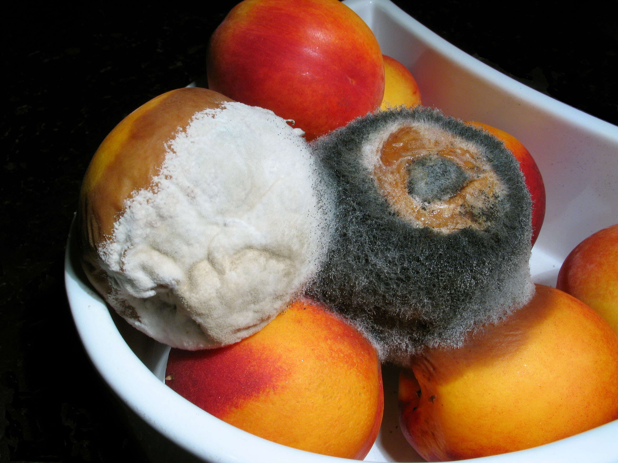
When in Doubt, Throw it Out!
If it appears rotten
If there’s a chance it could have been contaminated
Notes:
Don’t take any chances! If there’s a chance your fresh produce may be rotten or may have been touching raw meats in the refrigerator, DON’T EAT IT! It’s best to go ahead and throw it away to make sure you and your family avoid foodborne illnesses.

Slide 18
Review
Annually 1 in 6 people fall ill due to foodborne illness
Produce is the leading cause of foodborne illness
All produce is at risk for contamination
Prevent foodborne illness from produce by following these steps:
  Check, Clean, Rinse, Separate, Chill, and Throw away

Slide 19
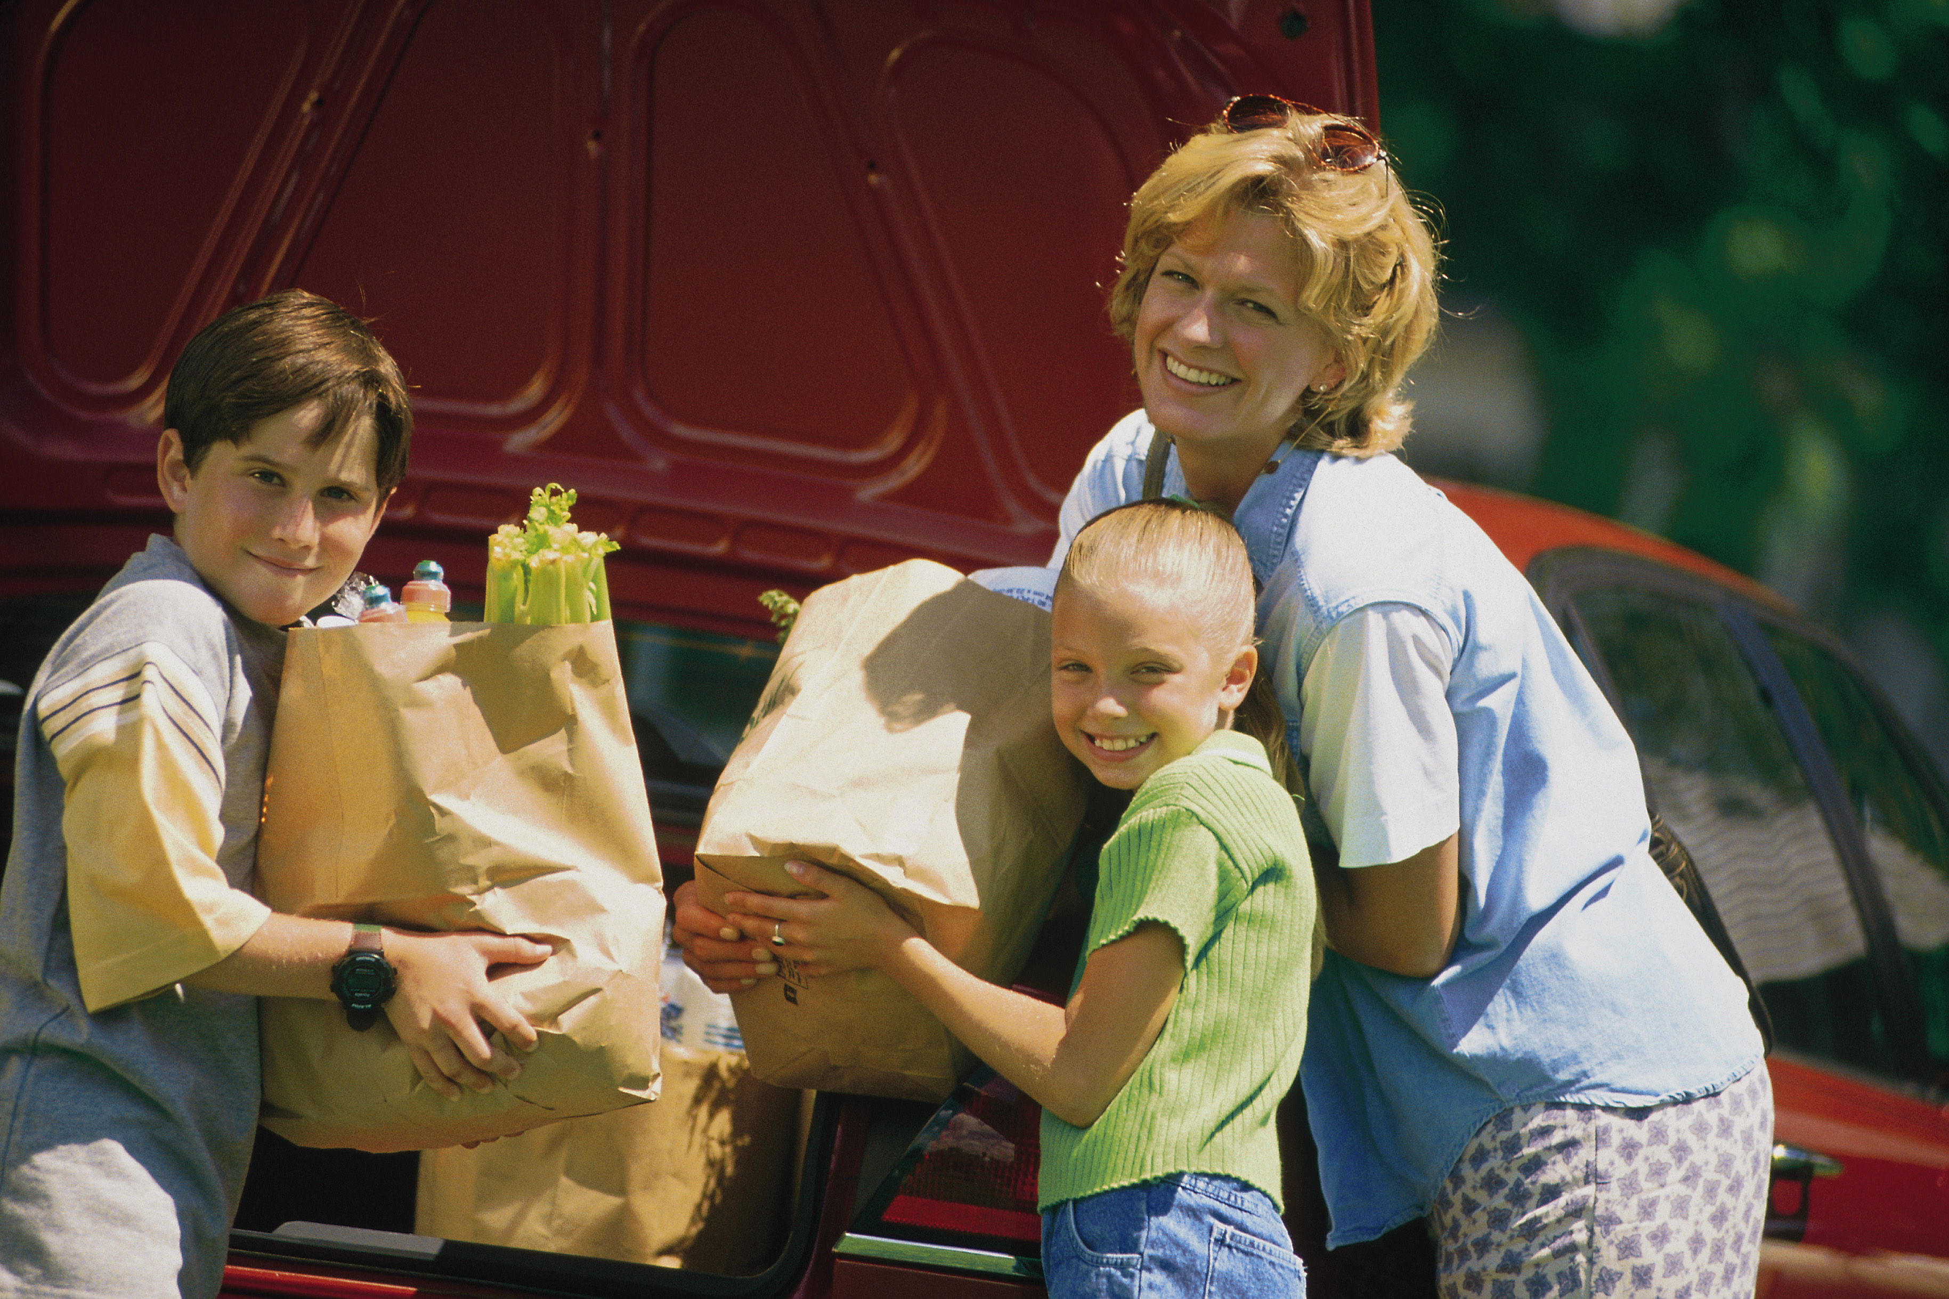
In Case You Missed It
FDA Produce Safety
Notes:
This is a short video 4 minute video that briefly goes over the safety precautions we just talked about, just in case you missed it.

Slide 20
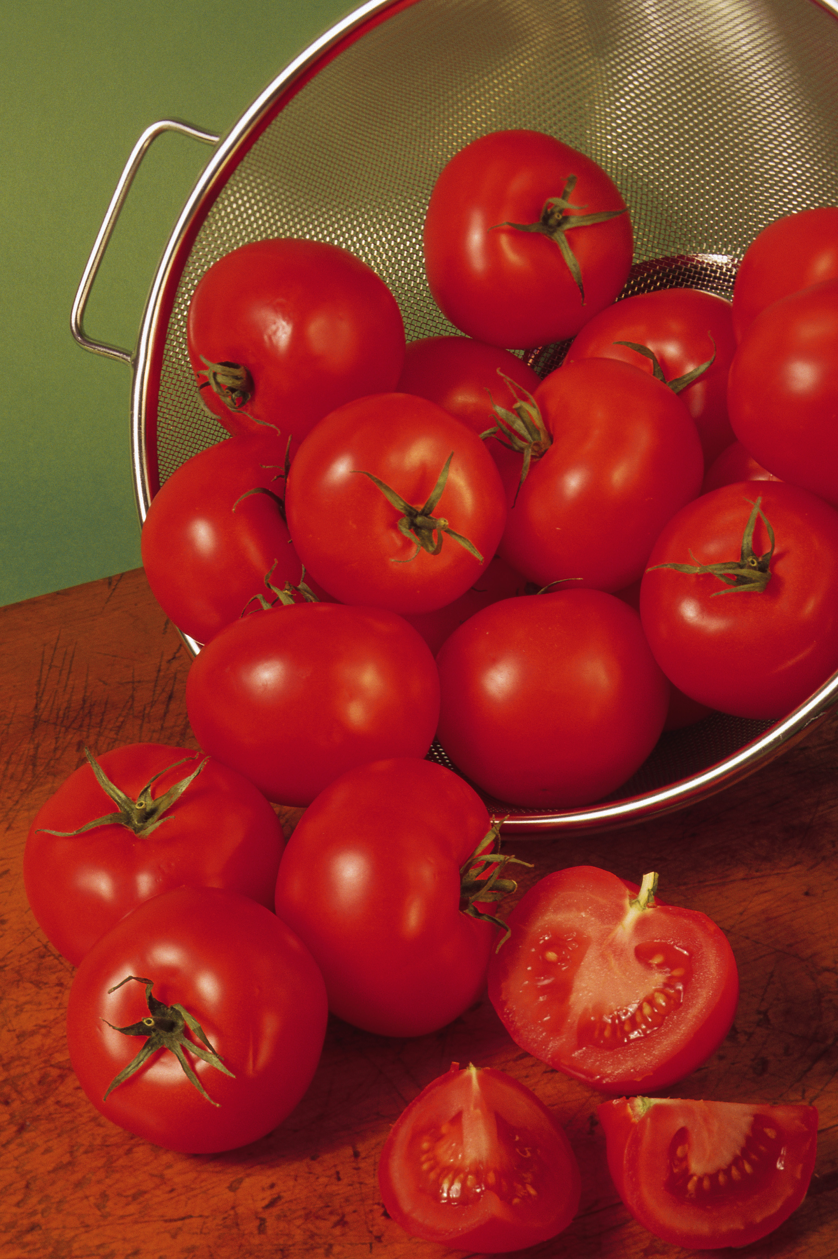
Activity
How much did you learn about Produce Safety?
Notes:
Suggested Activity: 15 minutes
Supplies: Real or fake (such as pictures or models) fruits and vegetables (preferably watermelon and un-bagged spinach), vegetable brush, knife, cutting board, grocery bags, and raw meat
Demonstrate unsafe produce handling:
Place the watermelon in a grocery bag with the raw meat
Take the watermelon out of the bag and begin cutting it without washing hands, cutting board or knife
Ask the participants “What went wrong?” and allow them to identify which precautions you should have taken.
Have the participants split into groups of 3-4, each group with a fake raw fruit or vegetable, cutting board, and fake knife and have each group member demonstrate safe produce handling practices by washing their hands, knives, and cutting boards, and rinsing the fruit or vegetable (scrubbing with vegetable brush if touch skin).
Observe, answer questions, and correct if needed.
Alternative:
Trivia- True or False 10 minutes (answers are in bold).
Supplies: two colors of index cards.
Pass out index cards, identify which color indicates true and which color indicates false, and then ask participants to hold up correct card when asking the true or false question.
(Show a picture/model of a watermelon) Since I’m not eating the rind, I don’t have to wash this: True or False
I must always wash my hands and my fruit before eating an apple: True or False
It’s okay for my refrigerator to stay at 45⁰F: True or False
“God made dirt, dirt won’t hurt” so I don’t need to wash my produce: True or False
My fruits and vegetables should always be kept separate from my raw meat: True or False
If I rinse my knife with running water after cutting raw chicken it’s okay to use to cut my raw carrots: True or False
Hard or tough-skinned produce should be cleaned under running water with a clean vegetable brush: True or False
Raw meats are the number one cause of foodborne illnesses: True or False
I can still eat my apple fresh even though it was touching the raw chicken in the refrigerator: True or False
I can prevent foodborne illnesses in my family by following safe produce handling rules: True or False
*Go over the answer and why the answer is or isn’t correct with each trivia question.

Slide 21
Produce Safety Resources
Uaex.edu
Foodsafety.gov
fns.usda.gov
Fightbac.org
Produce Safety Webinar
Search term: produce safety

