Slide 1
Endless Gardening
LaVona Traywick, Ph.D.
Jessica Vincent, M.Ed., CHES
Notes:
How many of you love to garden?
What are some of the benefits of gardening? (Relieves stress, can ease depression, a form of physical activity, get to be outdoors and enjoy nature)
Are there any down-sides to gardening? (can cause joint pain, back pain, etc.)
Today we are going to talk about ways you can still enjoy gardening while overcoming some of the obstacles that can get in the way.

Slide 2
Benefits of Gardening
Gardening should be a joy, not a chore.
Gardening can be a form of exercise.
The most important gardening
tool is your body!
Notes:
Your garden can be that special, wonderful place for recovering your bearings, not losing them.
“Getting it done” should not be the objective because gardening is a work in progress.
If you feel rushed and anxious to get it all done, you will attempt to complete more than you can comfortably manage; you will miss the pleasure of the act of gardening.
By definition, exercise an intentional activity that increases your heart rate and is done for at least ten minutes. So gardening can be a form of exercise.
Make sure you respect the most important tool while gardening – your body. Proper body mechanics, well-designed gardening tools, and frequent breaks can help keep you a healthy gardener and reduce your risk for injury.

Slide 3
Changes Caused by Aging
Vision
Muscular and Skeletal
Disease and Chronic Conditions
Temperature Adaptability
Notes:
Our vision naturally deteriorates as we age. Our clarity can be reduced and certain colors can become hard to see – such as blues, violets and greens.
Also, our depth perception can also diminish.
Our agility, balance and strength can also decrease as we age making it difficult to lift and move objects and increase our risk for falls.
Arthritis is one of the most common disabling conditions…affecting nearly 21 million Americans. It can cause a decrease in strength and an increase in pain.
As we age, our bodies don’t adjust as quickly or as well to temperature, especially high and low temperatures.

Slide 4
Universal Design Principles
“Universal Design” encompasses the design of products and environments that can serve and be usable by as many people as possible – regardless of age, ability, or circumstance.
Notes:
To create a gardening atmosphere you can continue to use as your age and abilities change, incorporate universal design principles.

Slide 5
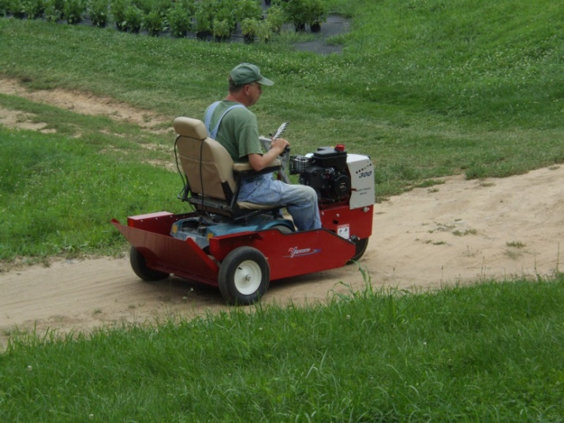
Universal Design Principles
Pathways
Firm, smooth, level
Accessible width of at least 36”
Follow ADA guidelines for ramps
Clearly marked beginning and ending
Avoid abrupt drop-offs
Notes:
Pathways can be made out of almost any material, but make sure they are firm, smooth and level. Avoid surfaces that become slippery when wet.
They need to be at least 3 foot wide to accommodate a wheelchair or walker. For persons to walk side-by-side, pathways should be 5 foot wide.
If a ramp is installed, make sure to follow ADA guidelines for the proper slope and length ratio.
Because our vision naturally deteriorates as we age, make sure pathways have a clearly marked beginning and ending, make sure borders are visible or brightly colored, and avoid fall hazards such as abrupt drop-offs.

Slide 6
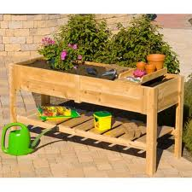
Universal Design Principles
Raised Garden Beds
Reduce the need to bend or stoop
Edges can provide a place to sit
Can be made wheelchair accessible
Styles are endless
Actual raised beds
Hanging baskets and large pots
Vertical gardens
Notes:
Whether you are planting flowers, herbs, or vegetables, raised garden beds can make gardening easier by reducing the need to bend or stoop.
Semi-ambulatory raised beds are built 2 ½ to 3 feet tall and have a wide ledge all the way around to provide you a place to sit.
Wheelchair accessible raised beds are built 2 to 2 ½ feet tall to allow ample room for a wheelchair or other type of chair to roll directly under and all 4 sides are accessible.
Raised beds can be built out of any material – wood, stone, concrete, blocks, etc but they should meet certain width guidelines. If the raised bed is accessible by all 4 sides, it should be no more than 4 foot wide. If it is against a building it should be no more than 2 foot wide. This is to make sure you can reach all areas of the bed.
Besides actual raised beds, you can used containers on wheels so they can be moved easily or hanging baskets for smaller plants. Also , vertical gardens can be made out of trellises and arbors.

Slide 7
Universal Design Principles
Adaptive Tools
Long-handled tools
Ergonomic handled tools
Pistol grip tools
Kneelers/Stools
Caddies
Notes:
There are a variety of gardening tools available that have been adapted to meet certain needs.
Choosing the right ones can make your gardening experience more enjoyable.

Slide 8
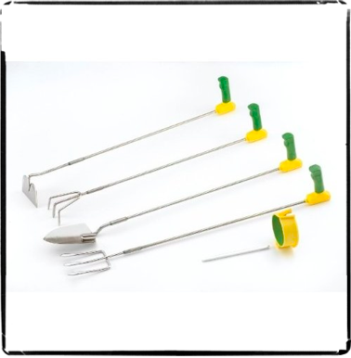
Universal Design Principles
Long-Handled Tools
Ease lower back strain
Can be used standing or sitting
Extend your reach
Notes:
Long- handled or telescoping tools extend your reach which, in turn, can ease the strain on your lower back. They can also be used while standing or sitting down.

Slide 9
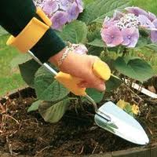
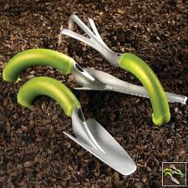
Universal Design Principles
Ergonomic and Pistol Grip Tools
Feature specially shaped handles
Reduce stress on joints
Provide additional leverage
Notes:
Ergonomic tools are designed to help keep your body in a neutral position which can reduce the amount of stress placed on your joints.
They also come in a variety of shapes and sizes so make sure you choose one that best fits your hands.
The handle should be small enough that you can hold it comfortably, but large enough that your thumb barely overlaps your fingers.
Pistol grip tools can be modified with a forearm attachment that reduces the amount of stress placed on your wrist and fingers by allowing you to use your forearm and elbow to do the majority of the work.

Slide 10
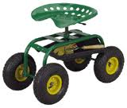
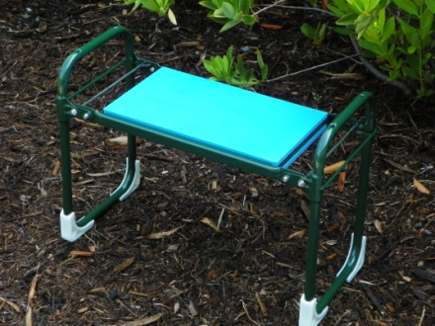
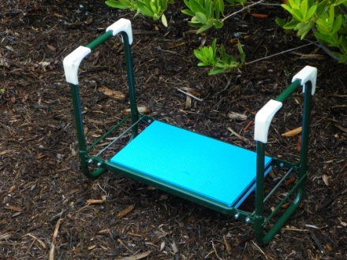
Universal Design Principles
Kneelers, Stools, and Caddies
Can help with knee and back pain
Can help with mobility
Provide rest from standing
Notes:
Garden stools and kneelers can both help with knee and back pain. Combination kneelers serve a dual purpose by providing handles to assist you when getting up and can be turned over and used as a stool.
Garden stools with locking wheels can help with mobility and aid against repetitive standing and sitting. Most also come with rotating, adjustable seats that can allow you to garden at multiple angles and heights.
Caddies and garden aprons help to keep your tools within reach.

Slide 11
Gardening Tips & Tricks
Respect Pain
Posture
Switch Tasks Often
Wear Gloves
Use Your Largest Strongest Joints
Sun Protection
Avoid Dehydration
Notes:
Here are some gardening tips and tricks for you to follow when out in your garden.
Respect Pain – If you feel severe pain, STOP gardening and rest. Consult a healthcare provider if the pain continues.
Posture – Try not to slouch over while you garden. Poor posture can cause pain, fatigue, and even strains.
Switch tasks often – Staying in one position too long or repetitive tasks can cause stiffness and joint pain. Stretch often and alternate bending and stooping jobs with standing and reaching jobs.
Wear gloves – Protect your hands from blisters, thorns and cuts. There are several styles to choose from depending on what you are doing.
Use your Largest Strongest Joints – Use your legs instead of your back when lifting. When troweling, use your forearm and elbow instead of your wrist and fingers. Use the palms of your hands to push levers and tools instead of your fingers.
Sun Protection – Always remember to protect yourself from the harmful effects that can be caused by the sun. Wear lightweight, protective clothing, large brim hat, sunglasses, and a sunscreen with an SPF of at least 15.
Avoid Dehydration – Drink plenty of decaffeinated fluids and avoid being outdoors between 10 and 2. Allow time for breaks in the shade.

Slide 12
Questions?
Contact your local
Cooperative Extension Service
or visit
www.uaex.edu
Notes:
Are there any questions?

