Slide 1
Volunteering
By: Rachael Price
Notes:
During this session, we will go over the reasons you should volunteer and how it can affect you. Helping others also helps us. It helps us mentally, physically, emotionally and gives us a sense of purpose. Finding your volunteering style will also help you achieve a positive outcome from volunteering. This lesson also recognized problems and finds solutions for volunteering.

Slide 2
Objectives
Gain understanding about volunteering.
Learning what type of volunteer you are.
Becoming a productive volunteer
Notes:
Understand why volunteering is important to you and the benefits volunteering has. Realize how you can change things in your club and organization. Learn to be a leader or find volunteering jobs that best suits your personality. If you have been volunteering for a long time find ways to fight burnout in yourself and others.

Slide 3
Why should you volunteer?
Do you ever think about volunteering but don’t know where to start?
AEHC is a great place to start your volunteering career.
AEHC has over 4,000 volunteers across the state of Arkansas.
Notes:
Becoming a volunteer is an essential tool in helping others during a time of need, giving back to the community, participating in a cause you believe in but the benefits can be great for you, the volunteer. Being a volunteer and giving back can help you reduce stress, fight depression, maintaining mental stability, and gives a sense of purpose. Volunteering is unique in the fact that you pick your hours. You can dedicate 40+ hours a week or 1. It all depends on you and what you choose to give. Giving back in the simplest ways can help others and improve your health and happiness.

Slide 4
Benefits of Volunteering
Volunteering helps prevent the effects of stress, anger, and anxiety.
Volunteering fights depression.
Volunteering increases your self-confidence.
Volunteering provides a sense of purpose.
Volunteering helps you stay physically healthy.
Notes:
One of the benefits of becoming a valued volunteer is the impact you have on your community. Volunteering connects you to your community and helps make it a better place. Regardless of what you do in your community makes a difference in the lives of people, animals, and the organizations in need. Volunteering also benefits you and your family as much as you help others. You have the opportunity to make new friends, expand your network, and boost your social skills. Becoming a volunteer is a great way to connect with others in your community and it helps you make new friends who are passionate about the same things.

Slide 5
Volunteering Wisely
Think of things that mean something to you. Can they be incorporated into your volunteering?
Career
Hobbies
A cause close to you
County Agents
Notes:
Look for causes that mean something to you. It could be a cause you already give to, and that might be a great place to start. Pick something that is important to you and others who feel passionate about the same cause. Donating money is not the only way to give back. Volunteering time is always accepted. Try to incorporate aspects of things you like when you volunteer.

Slide 6
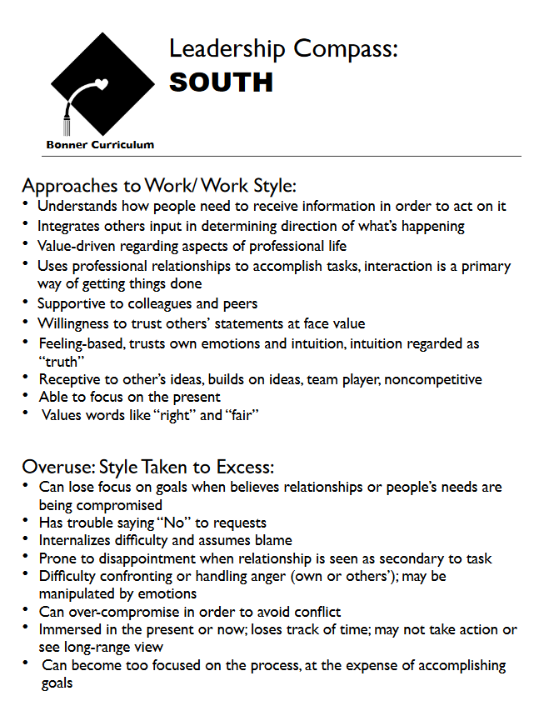
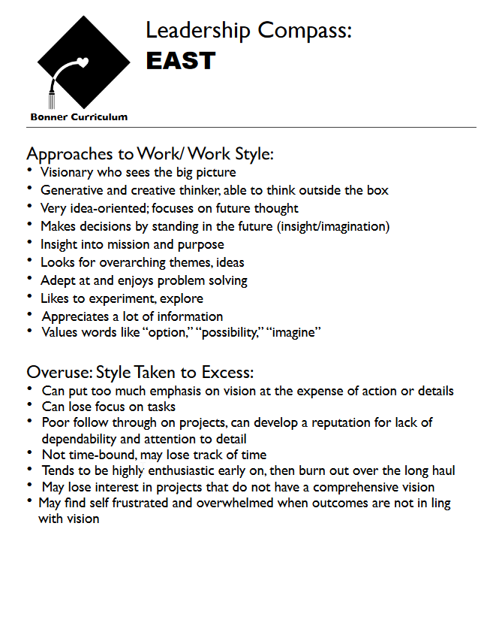
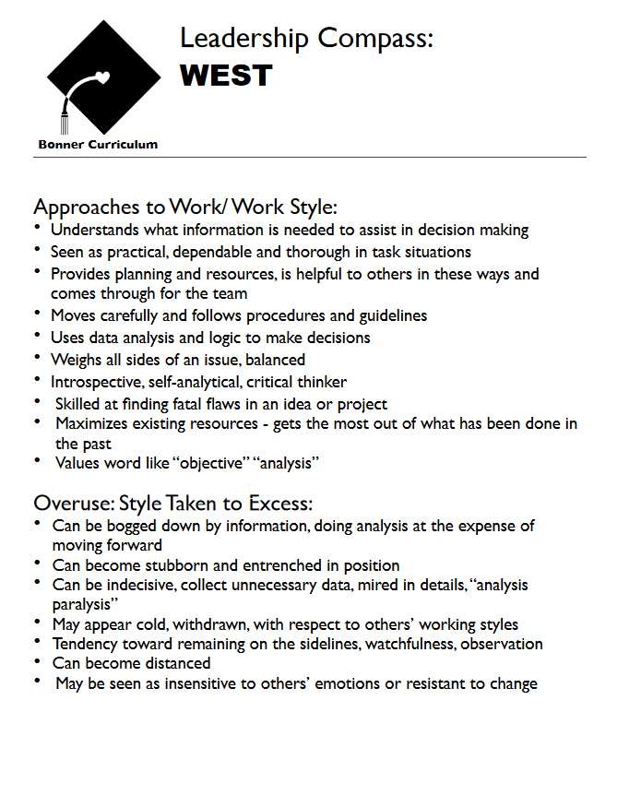
Leadership Compass
Notes:
*Teaching Tip: Ask these questions and have an open discussion while the members are looking at the leadership handouts. Think of things you are good at or familiar with. What did/do you do for a living? Can that help your AEHC club? AEHC clubs have many working aspects, what do you bring to the table?*

Slide 7
Problems and Solutions
What motivates volunteers?
Praise
Achievement/Accomplishment
Affiliation
Power/Influence
How do you recognize volunteers for good work?
How well do you know your club members in their volunteering?
What type of recognition works best?
Notes:
This worksheet is a great way to think/talk about positive experiences AHEC members has had volunteering.
This is also a great way to start a conversation in a club about problems and solutions in their clubs.
Things to think about:
*Teaching Tip: This would be a great open ended question after the handout worksheet.*
What motivates volunteers?
Praise
Achievement/Accomplishment
Affiliation
Power/Influence
How do you recognize volunteers for good work?
How well do you know your club members in their volunteering?
What type of recognition works best?

Slide 8
Burnout
Burnout is one of the biggest problems in volunteer organizations.
Review the handout Avoiding Burnout.
Have you experienced burnout in volunteering?
Notes:
Look at the handout titled Avoiding Burnout.
Burnout is one of the biggest problems in volunteer organizations. Review the handout Avoiding Burnout, this should give help
Once you have figured out the volunteer burnout, it is time to focus on yourself. Make sure you do not fall victim to burnout. Try not to burn the candle at both ends, get sleep, exercise, once you are done with a task focus on something else. Preventing burnout is important for you and your organization.

Slide 9
Final Thoughts
Decide why you are volunteering
Picking your volunteering activity
Your role in volunteering
Realizing problems and finding solutions
Avoiding Burnout
Notes:
Decide why you are volunteering
Picking your volunteering activity
Your role in volunteering
Realizing problems and finding solutions
Avoiding Burnout

Slide 10
Helpful Resources
https://www.networkforgood.org/volunteer/volunteertips.aspx
http://artcenter.org/support/volunteer/qualities-look-volunteer/
https://blogs.volunteermatch.org/engagingvolunteers/2013/12/02/6-ways-nonprofits-can-prevent-volunteer-burnout/
https://hbr.org/2016/11/beating-burnout
https://www.helpguide.org/articles/healthy-living/volunteering-and-its-surprising-benefits.htm

