Slide 1

Tips to Prevent Medicare Fraud
Notes:
Tips to Prevent Medicare Fraud
Healthcare fraud affects all Americans. It affects everyone who pays taxes by wasting billions of tax dollars. It affects those who depend on Medicare or Medicaid by diminishing the quality of the treatment they receive. Money lost to fraud and abuse means less money is available for medical services that benefit seniors. This lesson will define Medicare fraud and provide tips for consumers to guard against it.

Slide 2

Educating consumers to prevent fraud.
Notes:
UA System Extension: Strengthens families and communities by connecting trusted research to the adoption of best practices. Helps consumers gain the knowledge and skills they need to build financial security.
Arkansas SMP (Arkansas Senior Medicare Patrol) is part of the Department of Human Services Division of Aging and Adult Services. Arkansas SMP teaches Medicare recipients how to protect information, report errors, recognize illegal marketing and identify unnecessary services.

Slide 3

What is healthcare fraud?
False charges or false use of identity.
Billing for services that were:
  Never provided
  Unnecessary
  Inflated cost
Notes:
Healthcare fraud occurs when someone intentionally misrepresents charges or falsely uses a person’s identity for the purpose of gaining money or benefits.
Medicare/Medicaid fraud generally involves billing for services that were:
Never provided
Unnecessary
Inflated cost
Remember: Most health care professionals are honest, trustworthy and responsible. The goal is to weed out the few health care providers who operate deceitfully.

Slide 4

Types of Medicare fraud:
Services never performed
Supplies not ordered
Returned equipment
Unnecessary items/services
False identity
Double Billing
Upcoding
Unbundling
Kickbacks
Notes:
Here are some examples of Medicare fraud:
Billing for services never performed or medical equipment or supplies not ordered.
Billing for services or equipment that are different from what was provided.
Billing for home medical equipment after it has been returned.
Continuing to provide medical services or supplies when they are no longer necessary.
Falsely claiming that services are medically necessary when they are not.
Using another person’s Medicare card to get medical care, supplies, or equipment.
Double Billing - charging more than once for the same service.
Upcoding - billing for a more expensive or covered item when a less expensive or non-covered item was provided. Otherwise altering claim forms to obtain a higher payment amount.
Unbundling - billing related services separately to charge a higher amount than if they are combined and billed as one service or group of services.
Kickbacks - soliciting, offering or receiving bribes, rebates or kickbacks. A kickback is an arrangement between two parties which involves an offer to pay for Medicare business. Health care providers engaging in kickback activities are subject to criminal prosecution and exclusion from the Medicare and Medicaid programs.

Slide 5
Do’s and Don’ts
Notes:
You can help to prevent healthcare fraud. Here are several “do’s” and “don’ts”.

Slide 6

Prevention “do’s”
Protect your number
Ask questions.
Educate yourself.
Record medical services.
Review your Medicare summary.
Report suspicious charges.
Notes:
DO Protect your Medicare Health Insurance Claim Number (on your Medicare card). Treat your Medicare card like it is a credit card. Don't ever give it out except to your physician or other Medicare provider. Never give your Medicare/ Medicaid number in exchange for free medical equipment or any other free offer. Unscrupulous providers will use your numbers to get reimbursed for services they never delivered.
DO Ask questions! You have a RIGHT to know everything about your medical care, including the costs billed to Medicare.
DO Educate yourself about Medicare and common scams. Know your rights and know what a provider can and cannot bill to Medicare. Remember that nothing is ever “free.” Don’t accept offers of money or gifts for free medical care. Be cautious of any provider who maintains he has been endorsed by the federal government. Be wary of the “We know how to bill Medicare” scam. Avoid providers who tell you that the item or service is not usually covered, but they know how to bill Medicare.
DO Use a calendar to record all of your doctor's appointments and what tests or X-rays are conducted. Then check your Medicare statements carefully to make sure you received each service listed and that all the details are correct.
DO review your Medicare summary notice for errors. The payment notice shows what services or supplies were billed to Medicare, what Medicare paid, and what you owe. Make sure Medicare was not billed for health care services or medical supplies and equipment you did not receive. If you spend time in a hospital, make sure the admission date, discharge date, and diagnosis on your bill are correct. Always inventory medical supplies and check against your statement.
DO Report suspected instances of fraud.

Slide 7
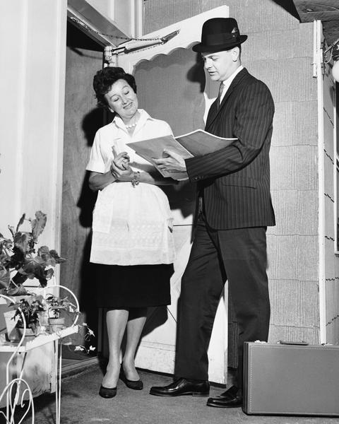
Prevention “don’ts”
Don’t allow everyone access to records.
Don’t request a service you don’t need.
Don’t deal with door-to-door salesmen.
Don’t be influenced by advertising.
Notes:
DON’T allow anyone, except appropriate medical professionals, to review your medical records or recommend services.
DON’T contact your physician to request a service that you do not need. Don’t let anyone persuade you to see a doctor for care or services you don’t need.
DON’T accept medical supplies from a door-to-door salesman. If someone comes to your door claiming to be from Medicare/Medicaid, remember that Medicare and Medicaid do not send representatives to your home.
DON’T be influenced by media advertising concerning your health. Television and radio ads are intended to raise money for someone. They do not have your best interest at heart.

Slide 8
Protect, Detect, Report
Protect
Your personal information — Medicare Number, Social Security Number, Bank Account Information
Detect
Fraud, errors and abuse by reading your Medicare Summary Notice (MSN)
Report
Fraud, errors and abuse to your Arkansas SMP —
866-726-2916

Slide 9
How to Read Your Summary Notice
Ask yourself these questions:
Are there charges for any medical services or equipment that you didn’t get?
Are the dates of service accurate?
Was Medicare billed for the same thing twice?
Have you received any collection notices for medical services or equipment you didn’t receive?
Notes:
(Optional: Leader provides copies of How to Read Your Medicare Summary Notice)
Ask yourself these questions when checking your medical bills, Medicare Summary Notices (MSNs),
and Explanation Of Benefits (EOBs):
• Are there charges for any medical services or equipment that you didn’t get?
• Are the dates of service accurate?
• Was Medicare billed for the same thing twice?
• Have you received any collection notices for medical services or equipment you didn’t receive?

Slide 10

Who to Contact:
Kathleen Pursell
AR SMP Program Director
501-320-6457
Fraud Hotline
1-866-726-2916
Notes:
What should you do if you suspect fraud?
Contact Arkansas SMP at 501-320-6457 or contact the Fraud Hotline at 1-866-726-2916.
You can also contact Arkansas SMP for more information about Medicare fraud.

Slide 11
Fraud & Scam Activity
Identify the potential fraud or scam.
Suggest ways the consumer could respond.
Notes:
Medicare Fraud & Scams Scenarios Activity
You will need copies of the scenarios and the SMP Scam Alerts.
Instructions - Divide the audience into small groups. Give each group a scenario to discuss. Instruct them to identify possible Medicare fraud or scam concerns and to come up with a plan for how the consumer should respond. Allow a few minutes for group discussion. Have each group select a spokesperson. Each spokesperson will present the scenario and their group’s decisions.
SMP Scam Alerts have additional information about these scams and what consumers can do. Use these documents to provide the audience with additional information as needed.

Slide 12
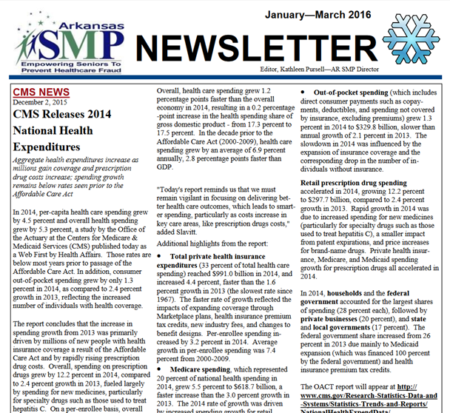
On the
SMP
website
http://www.daas.ar.gov/asmp.html#hfraud
Notes:
For more information about Medicare fraud, visit the Arkansas SMP website. Check out the quarterly newsletter for the latest information.

Slide 13
You can help prevent fraud!
For presentations to your local group:
Kathleen Pursell, AR SMP Program Director
501-320-6457
Notes:
You can help prevent healthcare fraud. Please complete your evaluation. For more information about consumer protection and healthcare fraud, contact:
UA System Extension: Strengthens families and communities by connecting trusted research to the adoption of best practices. Helps consumers gain the knowledge and skills they need to build financial security.
Arkansas SMP (Arkansas Senior Medicare Patrol) is part of the Division of Aging and Adult Services. Arkansas SMP teaches Medicare recipients how to protect information, report errors, recognize illegal marketing and identify unnecessary services.
For presentations to your local groups, contact Kathleen Pursell at 501-320-6457

