Slide 1


The Mind-Body Connection
Lisa Washurn, DrPH, Assistant Professor - Health
Notes:
We usually think of stress as a mental or emotional issue – something for the brain to handle. But think about this: When you feel stressed, does it stay “in your head” or does it seep out, affecting you physically? Today’s discussion will focus on how the mind and body are connected. Specifically, we’ll talk about that connection related to stress – how stress affects the body and how to manage or reduce stress by changing the way you think about it.
Activity: Distribute copies of the Day-to-Day Experiences Questionnaire. Allow several minutes for participants to complete.

Slide 2
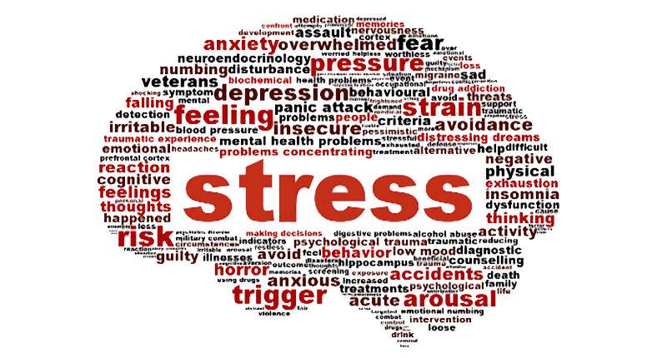

Notes:
To get started, we are going to do a short activity called “stress barometer.” The purpose of this activity is to show how what is stressful to one person is not to another.
Materials needed: 1) Two pieces of paper with the words “relaxed, no stress” and “high stress” and 2) tape or pushpins
Directions: Designate one side of room as “relaxed, no stress” and the other as “high stress.” Place a printed sign with these labels on each wall. Ideally, there will be a clear path from “no stress” to “high stress” so participants can form a line by placing themselves as a continuum or “meter” between points.
Ask participants to stand up. Explain that the opposing walls represent two ends of a “stress meter.” You will a read a stressor from the list, and they will move to a point on the stress meter that represents how they perceive the stressor. For example, if it makes them very stressed, they might go stand near the wall. But if they feel neutral about the stressor, they might stand in the middle.
Stressors:
Coming to today’s meeting
Going grocery shopping
Driving in heavy traffic
Dealing with difficult EHC members
Presenting this leader lesson to your club
Dealing with family members
Going to the doctor
Sitting in a boring meeting
Riding a roller coaster
Dealing with illness of a family member
Standing in a long check-out line
Christmas
(you may add stressors of your own specific to your county or group)
Debrief: After participants have responded to the list of stressors, discuss how stressors are perceived differently by people.
Ask: Why is it that what stresses one person out is no big deal to another person? From this activity, what about the responses surprised you? How might these differences affect how we interact with each other?

Slide 3
What Is Stress?
It depends
No single definition
Acute
Chronic
Notes:
As we just saw in the “stress meter” activity, stress is subjective. The term “stress” first came about in 1936 and was defined as “the non-specific response of the body to any demand for change” (Scientist Hans Selye). Since then, others have come up with their own definitions. There is no single agreed upon definition for stress. What is stress? It depends. What is stressful to one person may be no big deal to another.
There are two main types of stress: acute and chronic.
Ask: Who can give me an example of acute stress? (Possible answers: slamming on your breaks to avoid an accident, being chased by a wild animal, a pressing deadline, rushing to the post office before it closes, losing a contract or big sale, burning the turkey at Thanksgiving.) Acute stress is shorter in length, and does not have time to do the physical damage that long-term stress does. Acute stress is usually recognized by people and is highly manageable.
Ask: Who can give me an example of chronic stress? (Possible answers: dealing with a serious, long-term personal illness; being primary caregiver for a spouse with dementia or Alzheimer’s disease; being trapped in an unhappy marriage; being part of a dysfunctional family; living in poverty; living in an unsafe neighborhood; caring for a child with special needs). Chronic stress is long-term and often occurs when one does not see an end to an unhappy or unpleasant situation. This type of long-term stress causes physical and mental damage gradually and can cause a person to feel worn-down and result in illness.

Slide 4
Symptoms of Stress
Jaw clenching
Gritting, grinding teeth
Neck ache, back pain
Ringing, buzzing or “popping” sounds
Dry mouth
Problems swallowing
Frequent colds, infections
Heartburn, stomach pain
Constipation
Diarrhea
Excess anxiety, worry, nervousness, guilt
Difficulty breathing, frequent sighing
Difficulty concentrating
Notes:
Ask: When you are stressed? Do you feel it in your body? How does it feel?
Refer to Handout 1: How Stress Affects Your Body. A table listing signs and symptoms of stress is on page 3 of the handout. Review the list and ask which symptoms or signs are surprising.

Slide 5
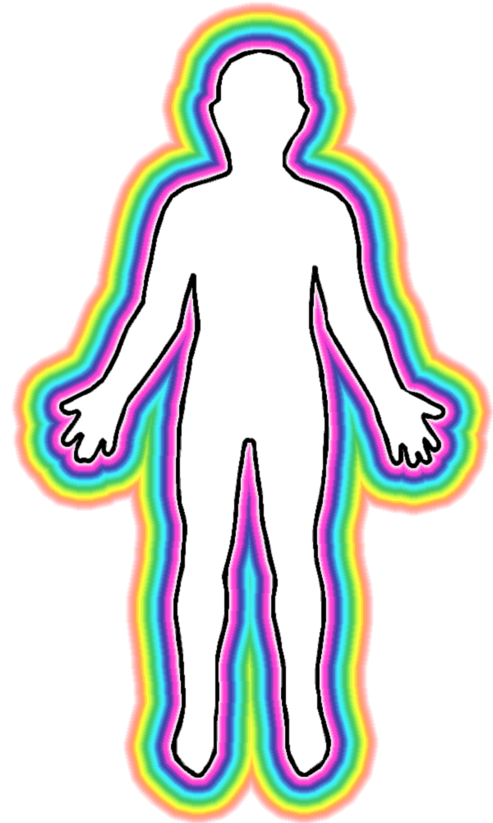
Physical Effects of Stress
Nervous system
Musculoskeletal system
Respiratory system
Cardiovascular system
Endocrine system
Gastrointestinal system
Reproductive system
Notes:
We’ll spend just a few minutes talking about the negative effects of stress. Then we’ll shift to discuss ways to manage and reduce stress.
Note: Refer to Handout 1: How Stress Affects Your Body for detailed information.

Slide 6
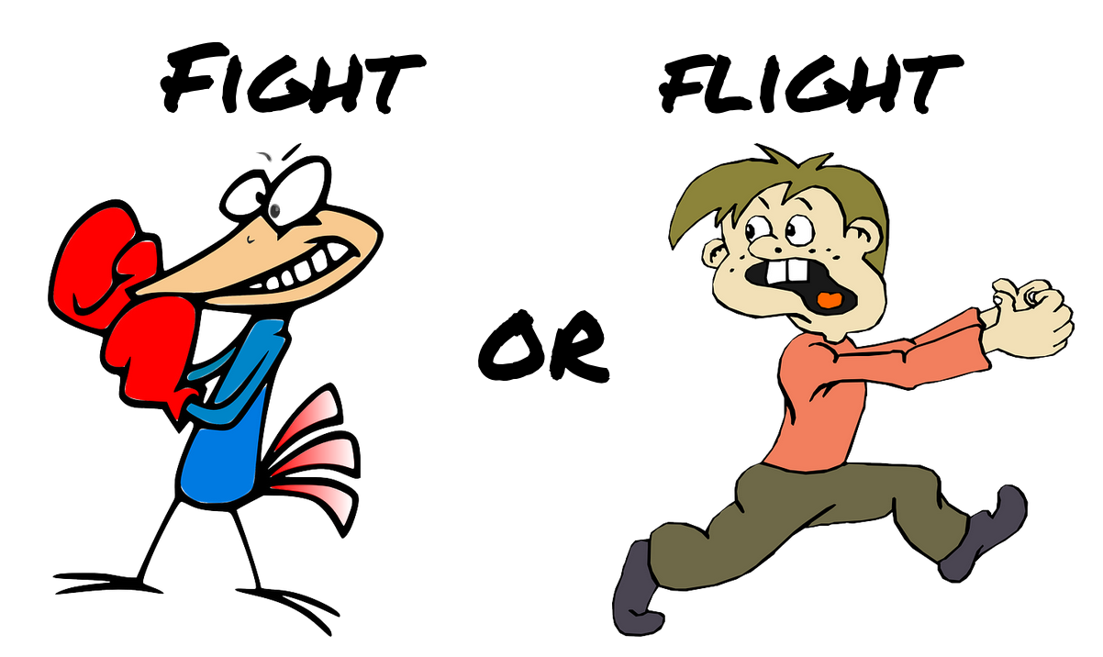
Nervous System
Notes:
NERVOUS SYSTEM
The body shifts into “fight or flight” when confronted with a threat or sudden stressor. Threats can be physical or psychological, and may be real or perceived. The “fight or flight” response causes the body to release adrenaline and cortisol. These hormones make the heart beat faster, raise blood pressure, and increase glucose in the bloodstream. Body systems usually return to normal after the crisis passes.

Slide 7

Musculoskeletal System
Notes:
MUSCULOSKELTAL SYSTEM
Muscles tense up when the body is under stress. Tension headaches, migraines, and other musculoskeletal conditions may be triggered when muscles are contracted or “tense” for a long time.

Slide 8

Respiratory System
Notes:
RESPIRATORY SYSTEM
Stress can make you breathe harder. Rapid breathing can lead to hyperventilation and trigger panic attacks in some people. Stress can also worsen asthma.

Slide 9
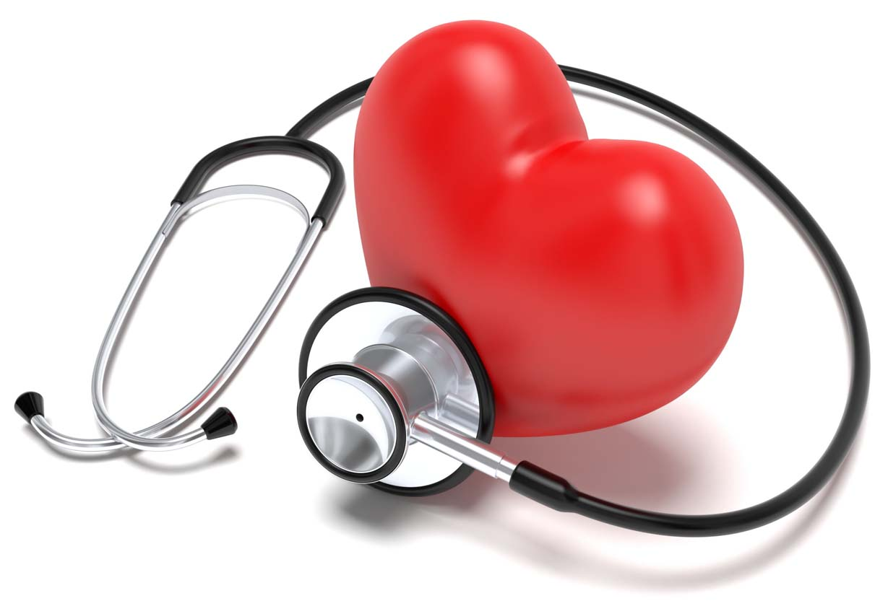
Cardiovascular System
Notes:
CARDIOVASCULAR SYSTEM
Acute stress increases heart rate and makes the heart work harder. Blood vessels expand to increase blood supply to the heart and large muscles. Arteries that supply blood to the heart can become inflamed when acute stress happens too often. This may lead to a heart attack.

Slide 10
Endocrine System
Stress!
Blood Sugar ↑
Cortisol ↑
Insulin ↑
Notes:
ENDOCRINE SYSTEM
Stress hormones cortisol and epinephrine are released by the adrenal glands when the body is stressed. The liver produces more glucose when cortisol and epinephrine are released. This glucose, or “blood sugar,” would provide energy needed to deal with a true “fight or flight” emergency. This is not very useful in situations of chronic stress.
High cortisol can have negative health effects. It can increase blood pressure; increase blood sugar levels, which may affect people with diabetes or a family history of diabetes; lower ability to fight off disease and infections; and causes an increase in fat storage, especially around the abdomen. All of this can contribute to increased chances of heart problems.

Slide 11
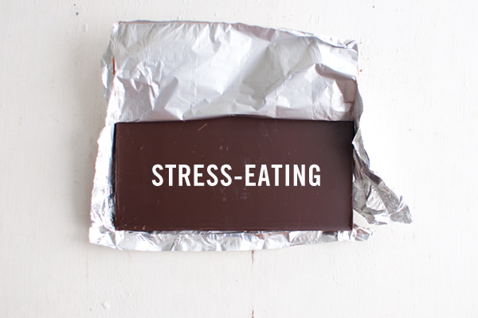
Gastrointestinal System
Notes:
GASTROINTESTINAL SYSTEM
Stress can cause you to eat more or less than usual. Eating more or eating different foods, or increased use of tobacco or alcohol, can cause heartburn or acid reflux. Stress can affect your stomach and cause “butterflies,” nausea, or pain. Severe stress can even cause vomiting. Stress can affect digestion and cause diarrhea or constipation. Stress can affect nutrient absorption by the intestines and affect how quickly food moves through the digestive tract.

Slide 12

Reproductive System
Notes:
REPRODUCTIVE SYSTEM
For women, stress can cause menstrual cycles to be irregular or stop. It can also cause periods to be more painful and reduce sexual desire. For men, excess cortisol produced while under stress can affect normal functioning of the reproductive system. Chronic stress can impair testosterone and sperm production and cause impotence.

Slide 13
Stress…
Reduce
Manage
Notes:
Now that we know about the physical effects of stress, let’s discuss measures we can take to reduce or manage stress. This is where the mind can do a whole lot to help the physical body. While there are measures we can take to reduce stress, some level of stress will remain. Stress cannot be completely eliminated. We can learn strategies for managing stress that will change our stress response. One way to better deal with stress that comes your way is through mindfulness.

Slide 14
Mindfulness
“The awareness that emerges through paying attention on purpose, in the present moment, and non-judgmentally to the unfolding of experience moment to moment.”
~ Kabat-Zinn, 2003
Mindlessness
Notes:
While mindfulness may be a new term for you, there are several decades of research that support effectiveness of practicing mindfulness for stress reduction. Mindfulness is defined by Dr. Jon Kabat-Zinn, the leading researcher of the mindfulness movement, as “The awareness that emerges through paying attention on purpose, in the present moment, and non-judgmentally to the unfolding of experience moment to moment.” Another definition of mindfulness is being aware of what’s going on in the present moment. When you practice mindfulness, you see life experience clearly, as it happens, without an emotional charge. This means that we avoid labeling things as bad or good, positive or negative, and instead experience life as it unfolds.
To help us better understand mindfulness, it may help to talk about mindlessness.

Slide 15
Mindfulness vs. Mindlessness
Mindfulness
Mindlessness
A practice
A state of mind
Attention
Awareness
Focus
Presence
Distractedness
Inattention
Lack of engagement
Notes:
Mindfulness is both a practice and a state of mind. Just like any skill, mindfulness increases with practice. And as you increase mindfulness in many aspects of your life, it will become a state of mind.
Acting mindlessly is characterized by distraction, inattention, and a lack of engagement.
Being mindful means being “in the moment,” fully present, and engaged. This is hard to do in a world where there are so many distractions. The practice of mindfulness can be as simple as focusing your attention (not zoning out) on when a coworker or family member tells a story for the third time. For many of us, it can be difficult to focus when being told a story for the first time. Practicing mindfulness can mean that, instead of pulling a phone out of your purse or pocket to pass time standing in line at Walmart, you focus your attention on observing the people around you, their interactions, and perhaps interacting with them as well.
Let’s look back at your responses on the Day-to-Day Experiences questionnaire. How many of you feel you could benefit from having more mindfulness in your life?
Mindfulness does not necessarily involve meditation, but it can. Mindfulness and meditation are closely related, but they are not exactly the same. There are ways to practice mindfulness that do not involve meditation. Likewise, there are some types of meditation that are not tied to mindfulness.
Paying attention to breath is one of the most basic ways to “tune in” to the connection between our mind and body. We’ll talk more about that and other ways to practice mindfulness in a few minutes. The main idea is that we can train ourselves to be more mindful, being more mindful will change the way we respond to stress.

Slide 16
Practicing Mindfulness

Slide 17

Breath
Notes:
One of the most basic ways to practice mindfulness is by tuning in with the breath.
Note: You may have participants practice focused breathing by taking deep breaths, or use the Seated Mindfulness Meditation practice from Handout 2.

Slide 18
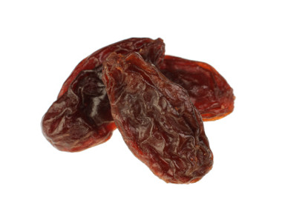
Raisin Meditation
Notes:
Note: Give each participant several raisins. Read the script from Handout 2. Allow for discussion after the activity if time allows.

Slide 19

Meditation is like training a puppy…
Notes:
There are many ways to be more mindful in our everyday lives, and not all involve a form of meditation. It has been said that meditation is like training a puppy. The mind wanders away, and we must bring it back over and over again. Over time and with training, the puppy learns to stay when we say “stay.” So too will your mind become more focused after weeks and months of practice.
Practicing mindfulness is simple, but not easy. I hope you have learned more about mindfulness and how it can improve your physical health.

