Slide 1
Living in the Digital World
How to be a good digital citizen
By: Rachel Chaney and Ashley Foster
Notes:
Introduction
At a young age, we are taught the proper etiquette, rules to live by, and manners when it comes to how we interact with people, eating at the table, and how to be a good citizen. However, sometimes people forget or do not realize that the digital world has its own rules of etiquette. This session will provide you with proper etiquette techniques for the digital world.

Slide 2
What is Digital Citizenship?
Notes:
Video: What is Digital Citizenship?
Note: If you do not have access to PowerPoint read the video script below.
It’s a way of thinking, being, and acting online. It's thinking critically and not trusting everything you see. It’s being safe with your information and who you connect with. It’s acting responsibly in how you communicate and behave. Because let’s face it the digital world is a big part of the real world.
So how do you become a digital citizen?
Link to video: https://www.youtube.com/watch?v=toK_BAYnjoU

Slide 3
Objectives
To gain a better understanding of Digital Etiquette.
To learn how to utilize phone, social media, and email properly.
Participants will learn how to make informed decisions about what to share and how.
Notes:
Objectives
You represent EHC and Extension daily. Technology is used in everyday life, but it also puts you under a microscope. How you act online can negatively impact EHC and Extension. In this lesson, you will gain a better understanding of Digital Etiquette as well as learn how to utilize phone, social media, and email properly. You will also learn how to make informed decisions about what to share and how.
Presenter note: If doing this with a group that is not EHC, adapt the paragraph to fit the audience.

Slide 4
Have you seen the following?
Oversharing
A post or pictures making fun of someone.
A fight on social media.
Inappropriate post about job, coworker, or a boss.
!!!!!!!, ?????????, or ALL CAPS in an email, comments, and texts.
Are these examples of a good digital citizen?
Notes:
Have you seen the following?
Oversharing: People sharing too much information online when it comes to their daily life.
A post or pictures making fun of someone. They may not even say the name of the person, but we all know who they are talking about.
A fight on social media. This could start out as an innocent post or video, but with one comment or reply it turns into an argument.
Inappropriate posts about job, coworker, or a boss. You never know who might be watching your post.
All CAPS,!!!!!!!, Or ????????? in an email, comments, and texts. While these are eye catching they can also come across as someone being upset or angry.
Do these sound like good or bad examples of digital citizenship? While they may seem like a good idea at the time, these are all examples of being a bad digital citizen. Can you think of any other examples of bad digital citizenship?

Slide 5
When to be Good Digital Citizen?
Everyone should be a good digital citizen when using:
Email
Social Media Websites and Applications
Telephone (Text, phone calls, and Messaging)
Online Forums and Blogs
Things in the digital world can be seen by friends, friends of friends, and everyone.
Notes:
When to be a good Digital Citizen?
While we should try to be a good digital citizen at all times. Everyone should be a good digital citizen when using:
Email
Social Media Websites and Applications
Telephone (Text, Phone Calls, and Messaging)
Online Forums and Blogs
Things in the digital world can be seen by friends, friends of friends, and by strangers. We never truly know who can see our posts, emails, and things sent from our phones. With the advancements of technology, nothing is private anymore. Someone can always take a picture and pass it on.

Slide 6
Basic Phone Etiquette
Be Respectful.
Show consideration for the other person’s limitations.
Allow the other person time to speak.
Communicate clearly.
Be pleasant.
Notes:
Basic Telephone Etiquette
Telephone etiquette means being respectful to the person you are talking with, showing consideration for the other person's limitations, allowing that person time to speak, communicating clearly and much, much more. Your voice must create a pleasant visual impression over the telephone.
Most people have cell phones. According to research, the number of mobile phone users in the world is expected to pass the five billion mark by 2019. In 2016, an estimated 62.9 percent of the population worldwide already owned a mobile phone. The mobile phone use is forecasted to continue to grow, rounding up to 67 percent by 2019.
Many people do not even have landlines in their homes or offices anymore. Let’s now talk about cell phone etiquette.

Slide 7
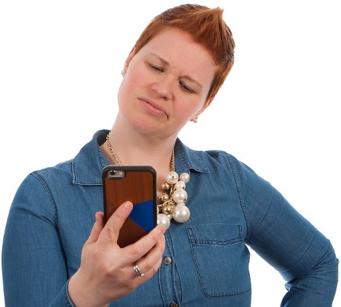
The First Step is Admitting You May Have a Problem
Our phones are designed to be electronic addictions.
What are your triggers?
Phone Calls
Text Messages
Social Media Notifications
Notes:
The First Step is Admitting You May Have a Problem
Because most of us don’t leave home without our cell phones. It can be very tempting to overuse them. So, the first step is admitting you may have a problem. Our phones are designed to be electronic addictions.
What are your triggers?
Phone Calls
Text Messages
Social Media Notifications
Next, we will talk about what you can do to sharpen your phone etiquette skills
It’s hard to fight off temptation in the moment, especially later in the day when our will power is depleted. Think ahead of time how to minimize the use of your phone. Now we will go over some examples of ways you can fight the urge.

Slide 8
Don’t get caught committing cellular crimes
Out of sight out of mind.
Get off!
Don’t kill the vibe for everyone.
Be in the NOW!
Meet a stranger, they don’t bite.
If you must talk …DON’T SHOUT!
Avoid Texting.
Notes:
Don’t Get Caught Committing Cellular Crimes.
Out of sight, out of mind. Put your phone away! Whether it’s at the dinner table, at a meeting, or hanging with a friend. Here’s something you can try. Start off dinner by having everyone put their phones in a stack in the middle of the table.
Get off the phone. End phone conversations before you enter a room.
Don’t kill the vibe! Nothing is more aggravating than trying to have a conversation with someone and they have their face buried in their phone the whole time.
Be in the NOW! We can choose to have lives that are connected and engaged and in the moment. That means paying attention to the people are you. Not mouthing “just one minute” while you check your phone for the zillionth time.
Meet a stranger, they don’t bite. As people, a lot of times we cut ourselves off from others. People are losing the ability to make small talk and basic communication skills are suffering. It used to be that people would talk while waiting in line or other places, but now many people are too busy swiping left and right.
If you must talk, DON'T SHOUT! If it is an emergency and you need to answer, make sure to whisper while you are exiting the room. (Example: If you are in a large room and you need to answer, ask the caller to hold on while you exit the room). A general rule for talking on the phone in public: You should automatically lower your voice when answering the phone. Nobody wants to hear your conversation.
Avoid texting unless it is an emergency.

Slide 9
How to Handle that ONE Friend
Don’t shame them in the moment.
This can cause the same response as fight or flight or they may become defensive.
Take them aside and express how you feel.
Notes:
How to Handle That ONE Friend
What about that one friend who is always scrolling Instagram and tweeting observations about life’s hilarious little quirks as if life depends on it? Whatever you do, don’t shame someone in the moment. This triggers the same chemical response as fight or flight mode and people can get defensive. Instead, take your friend(s) aside at another time and let them know about how you feel when they’re staring at their always-available electronic devices instead of making the most of your quality time together.

Slide 10
YOUR BEHAVIOR EFFECTS OTHER PEOPLE
Notes:
Your Behavior Effects Other People
What this all comes down to is being mindful of your phone use. “The basics of etiquette is thinking about how your behavior impacts other people,” And it’s also thinking about how your phone compulsion affects you. Put your phone down and just engage your real-world friends. Your notifications and text messages will be waiting for you when you’re done. But, if you can’t resist a selfie for your social media page make sure to include your friend.

Slide 11
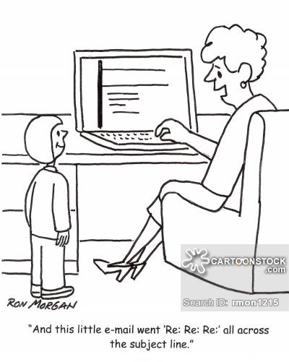
Email Basics
Reply goes to the previous sender only.
Reply All goes to everyone in the message.
Forward is when you pass the email on to someone else.
CC means carbon copy.
BCC blind carbon copy.
Subject Line is where you provide what the email is about.
Read Receipt allows you to see when someone opens and/or read your email.
Option to set the importance level.
Notes:
Email Basics
Before we get into email etiquette, let's go over a few email basics.
Reply goes to the previous sender only.
Reply All goes to everyone in the message. Before you select reply all, make sure that the message is being sent to the correct recipients. Ask yourself: Is this something that all recipients need to know? For example, you are on an email with 40 recipients and they all send a simple “thank you” using reply all this means that you and the 40 recipients will receive at least 40“thank you” emails. Do you think that replying all in this situation was necessary? Did all the recipients need to know this? A good rule of thumb is to reply to the original sender and then they have the option to pass it on to everyone.
Forward is when you pass the email on to someone else. If you pass the email on to someone else, try to include the original sender. This will let them know that you received the email and forwarded them onto the correct person. Forwarding chain emails is unprofessional. Your “wish” is not going to come true because you sent the email on to ten people.
CC means carbon copy. Think of this as you are keeping someone in the loop and everyone involved knows. For example, let’s say that you are on a committee and the president would like to be included in the emails. They are not necessarily going to provide input, but they are aware of what is going on.
BCC means blind carbon copy. Only you and the person who is Bcc'd will know that they are in involved in the email. Sometimes people use this secretly. That is why it is important to be careful when you reply to emails. You never know who else might have been included. An example of when to use Bcc is when you are sending mass mail outs. You use Bcc to keep email addresses confidential.
Subject Line is where you provide what the email is about. This should be a short explanation.
Read Receipt allows you to see when someone opens and/or reads your email. You must set it to send you a receipt prior to sending the email.
Set the importance level. You can let the recipient know whether your email is at high, normal, or low importance level. In some case you can set the sensitivity level which lets the recipient know whether it is personal, private, or work related.
Presenter Note: Feel free show to an example of an email that includes the points made above.

Slide 12
Email Etiquette: Before You Hit Send
Notes:
Email Etiquette: Before You Hit Send Video
This short video goes over a couple of things that you should consider before you hit send on an email. YouTube Video link: https://bit.ly/1Np2ItJ

Slide 13
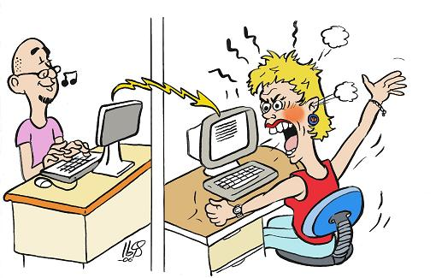
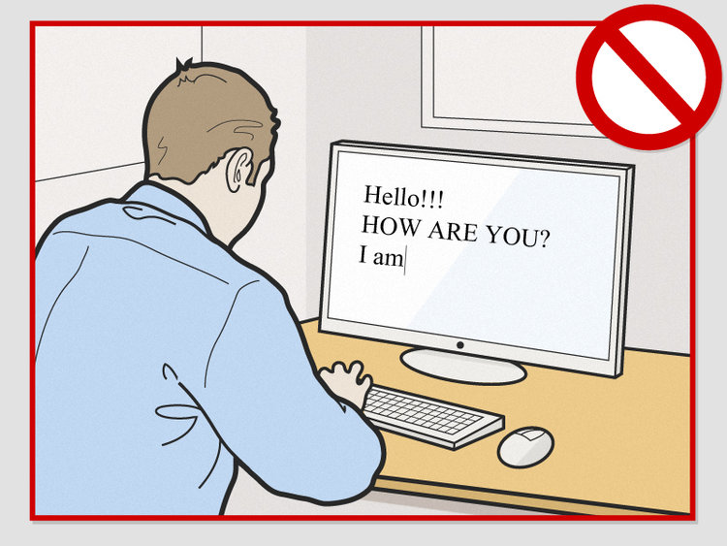
Writing Professional Emails
Take a look at your email username.
Use clear subject lines.
Use small paragraphs.
Watch spelling and grammar.
Choose correct font and coloring.
Think about what tone you are conveying.
Add closing and signature.
Reply Promptly.
Notes:
Writing Professional Emails
Here are some tips to think about when writing an email:
What does your email username say about you? Remember what they say about people making a first impression in the first 7 seconds of when they meet you. The same could be said for your username.
Clear subject lines. Always fill in the subject line with a topic that means something to the recipient. Be sure to keep the subject short and concise. Don’t give the recipient a long subject line that contains most of what is in the body of the email.
Small paragraphs. The body of an email should be easy for someone to scan over to get the important points.
Grammar and spelling. Always proofread your email before hitting send. Try to use proper English and letter format. Avoid using ALL CAPITAL LETTERS or all lower-case letters, multiple punctuation marks (“……...”, “!!!!!!!” Or “??????”), and/or text abbreviations. Using ALL CAPS and multiple punctuation marks come across as you are upset or yelling at the person. Text abbreviations are when you use an acronym for multiple words, for instance “ttyl” means talk to you later, “lol” means laugh out loud, and “idk” means I don’t know. These can be lost in translation and are unprofessional. For example, an email was sent notifying family members that a loved one had passed and instead of saying “lots of love” the sender used “lol” which as you know means laugh out loud.
Think about font and coloring. Make sure your font is professional and easy to read. Different colors and bold can be used to give special attention to important things, but you should use them sparingly.
How do you sound to others? Don’t send an email when you are upset. Read over your e-mail in a flat tone before you send it to look for anything wording that could be misinterpreted. Emoticons are not considered appropriate for a professional email.
Closing and signature. Always make sure to include your full name and contact information in case the recipient needs to get ahold of you.
Try to reply promptly. If you need more than 24 hours to collect information or make a decision, send a brief response explaining the delay.
A good rule of thumb: If you are unsure about how your email sounds and/or whether or not the email has correct grammar and spelling, it is always a good to have someone else read it before you send it.

Slide 14
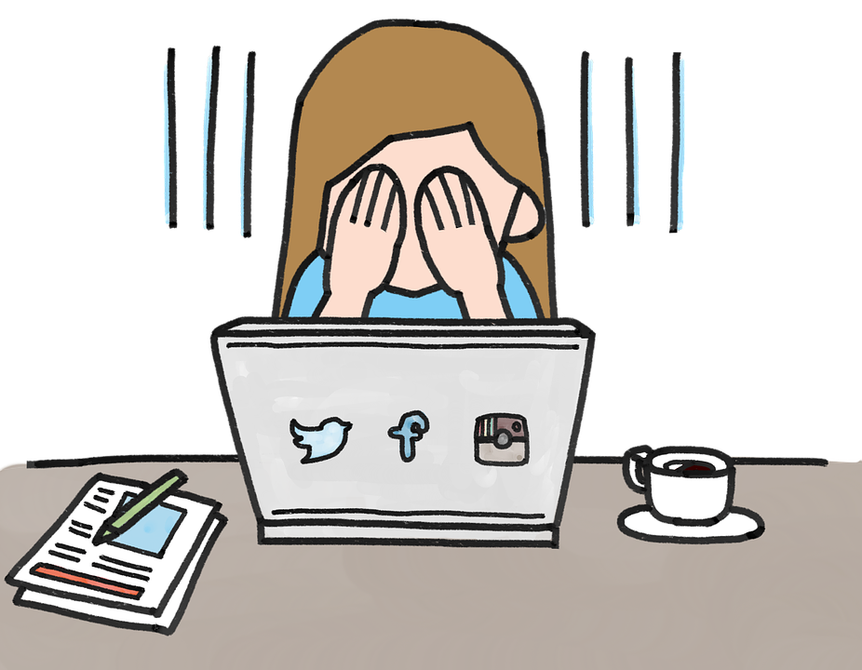
Social Media
T- Is it true?
H-Is it hurtful?
I- Is it illegal?
N- Is it necessary?
K- Is it kind?
Remember nothing is truly private!
Someone can always take a screenshot!
Notes:
Social Media
Social Media includes sites like Facebook, Twitter, Instagram, and Snapchat. Social media is a great way to keep in touch with family members and friends. A good rule to use with social media: Is to THINK before you post and comment.
THINK stands for:
T- Is it true?
H- Is it hurtful?
Is it illegal?
N- Is it necessary?
K- Is it kind?
Always remember that nothing you post or upload on social media is truly private. People can share your posts with the world in just one click or by taking a screenshot on another device. Also, in the terms and conditions of most social media sites they usually have a policy that talks about how they have rights to your information on your profile and have the right to share it with others in some cases.

Slide 15
Social Media Etiquette
PRIVACY
Regularly check your privacy settings.
Your previously public posts may still be visible in some places.
Once something is online, it can never be removed.
CONFIDENTIALITY
Make sure professional social media accounts are only used for information related to the organization you are representing.
Don’t share information about your location, going out of town, phone number, and/or email.
Decided what you are willing to share.
Notes:
Social Media Etiquette
Some important aspects to consider with your social media pages is your privacy and confidentiality.
PRIVACY: You should always know and regularly check your privacy settings. If you change your privacy setting, you should check previous posts because they may be public and are visible in some places. Just because you have privacy doesn’t mean that people can’t see what you post. Just remember that once something is online, it can never be truly removed.
CONFIDENTIALITY: Make sure professional organization social media accounts are only used for information related to that organization that you are representing. Don’t share information about your location, going out of town, phone number, and/or email. People can hack your profile and use this information for all sorts of things. One tip is to never tell people about when you go on vacation or out of town because this lets everyone know that you are not at your home. Decide what you are willing to share. You can share anything on social media, but you do need to decide how private or confidential you are willing to be. This also includes things going on in your personal life. Just remember that even though they may be your friend on social media this doesn’t mean they have your best interest at heart.

Slide 16
Social Media Etiquette
Avoid Oversharing.
Check your Friends.
Be cautious on Social Media Quizzes and Games.
Avoid Clickbait and Ads that could be spam.
Avoid sharing information about others without permission.
Avoid Bad Sources.
Report if you see something inappropriate.
Avoid Mixing your business profile with your personal profile.
Notes:
Social Media Etiquette Continued
Here are some more etiquette guidelines for social media:
Avoid oversharing. We have already talked about this one. However, it is always good to remind you that oversharing can be dangerous and not only for privacy reasons. People’s impression of us also includes what we tell online. Telling people about serious or overly personal matters online can be used later to not only hurt you but others involved. Ask yourself: Would you want a boss or respected family member see what you are about to post?
Check your friends. Due to people getting hacked daily it is important for you to always be careful when accepting a friend request. Make sure that the friend request is not coming from an already existing friend. If someone tells you that they have been hacked make sure to report or delete the hacked profile. Sometimes the person that hacked your friend may try to send you a message with a link to click on. It is best to avoid clicking on links or messages that don’t sound like something your friend would typically send.
Be careful with quizzes and games. Quizzes and games can be fun to use but they can also be dangerous and annoying to others. Constantly sending your friend a game or quiz request can be one way to get blocked. Not everyone wants to play games on social media. If you have been turned down for a game from a friend good etiquette would be to avoid sending to them again. You can always just post the game request to your profile. These games and quizzes can also be dangerous because they are done by a third party and you must grant them access to your social media profile. According to commonsensemedia.org, before you click grant access be sure to do the following:
Check the quiz or games terms of service.
Take a look at the information you’re sharing. Some apps let you edit what information you share with them.
Use privacy settings and review them frequently.
Use two factor authentication. This allows you to authorize only certain devices to access your account. You can also select the option that will email you whenever a new device logs in.
Do a little housekeeping by deleting old accounts and updating your passwords.
Avoid clickbait and ads that could be spam. Clickbait is defined as content whose main purpose is to attract attention and encourage visitors to click on a link to a web page. Typically, these sites have multiple pages that you must click through, the information is false in the article, and/or it is just trying to get you to buy something. Ads can also be attention grabbing, but not always a trusted site.
Avoid sharing information about others without permission. Always ask before you share something about someone else. This can be a violation of privacy and could get you in a lot of trouble. If you are a volunteer or work for an organization that works with children, you must get parents' permission before sharing pictures of children online. Let's say you see someone doing something and you want to share it with the world. You should consider how this could hurt them. Also, think about how you would feel if someone shared that about you without asking.
Avoid bad sources. Always check the sources of your articles before you share them.
Report if you see something inappropriate. If you see a post, sponsored article, or ad on social media that seems fishy you can always report it, hide the post, or unfollow the page. For information on how to do this you can go to the social media help center.
Avoid mixing your business profile with your personal profile. Some social media sites have strict guidelines on making your personal profile the primary place for selling your business. Be mindful that not all your friends are interested in your business on their personal timeline. Be sure to give the option to like your business. In some cases, it may be vital to have a work profile and a personal profile. People have been fired for being tied to a company on social media and them putting things that were inappropriate on their profiles.

Slide 17
Social Media For Professional Purposes
Social media can be a great tool for:
Promotion and Advertisement.
Keeping the Community and Page Members up to date.
Plan to post to your page regularly.
No idle pages!
Only use the page or group for professional purposes.
Social media etiquette rules in the previous slide still apply.
For more tips on how to get started on social media for small businesses:
https://blogs.constantcontact.com/getting-started-social-media-tips/
Notes:
Social Media for Professional Purposes
Social media can be a great tool for:
Promotion and advertisement.
Keeping the community and page members up to date.
Plan to post to your page regularly. You will get the best reach when you post to your page on a regular basis.
No idle pages! Idle pages seem like your business is no longer open. Idle pages and profiles are also susceptible to being hacked.
Only use the page or group for professional purposes. Avoiding posting things that do not relate to your business or organization.
Also, be sure to consider the social media etiquette rules in the previous slide. These also apply to your professional pages.
For more tips on how to get started on social media for small businesses: https://blogs.constantcontact.com/getting-started-social-media-tips/

Slide 18
General Digital World Tips
Remember to always check your sources.
Beware of your Digital Footprint.
Google search your name every once in a while.
Be wary of phone calls, emails, and social media accounts that seem fishy.
If it sounds to good to be true then it probably is.
Notes:
General Digital World Tips
Remember to always check your sources with anything you find in the digital world. A good debater has at least three references for any argument. The same should go for what you share. Also, make sure that your references are considered a reputable source.
Beware of your digital footprint. Every time we get on the digital world we leave a little part of who we are behind by the sites we visit, what information we send out, and how we act online. It is always good to make sure that your digital footprint embodies who you are. We will go over digital footprint later.
Be wary of phone calls, emails, and social media accounts that seem fishy. To stop unwanted mail, phone calls, and emails go to the consumer.ftc.gov link attached in the references and helpful links section. You can also report them to the Attorney General.
If it sounds too good to be true, then it probably is. Listen to your gut in a lot of digital world situations. You can always let that phone number that you have never seen before go to voicemail. You can block emails, phone numbers, and social media pages that are spam. Never give out personal information over the phone or on the internet without it being a secure site.

Slide 19
Digital World Scenarios
A fellow coworker has posted a status on Facebook saying that she feels like she is the only one that does any thing at her job.
A fellow committee member emails you expressing concerns about an upcoming Fundraiser that you are planning. You begin to feel upset reading the email.
A screenshot of a conversation between two friends is being sent around.
A coworker has been using the Professional Facebook page to share information that goes against the organizations Code of Ethics.
Notes:
Digital World Scenarios Handout
Fill out the handout and provide time to review over it. Presenter notes: Give this as homework for them to do prior to the training. Then take time to go over the handout.
Below are some suggestions:
A fellow coworker has posted a status on Facebook saying that she feels like she is the only one that does anything at her job.
What you shouldn’t do:
Comment in the comments section your disagreement
Send a screenshot to other members
Things you could do:
Reach out to the coworker to ask why she feels this way and what it is that she is doing that she may need help on.
You can offer your help in a private message.
Talk with coworker about being careful what you put on social media. (in person)
A fellow committee member emails you to express concerns about an upcoming Fundraiser that you are planning. You begin to feel upset reading the email.
What you shouldn’t do:
Do not send an immediate response angrily or dismissive of the concerns.
Talk bad about them to other people.
Things you could do:
Take a step back and reread the email later.
Call to get better explanation.
If you feel that the concerns were given in a malicious way, we suggest that you try to talk with them one on one or with someone present.
A screenshot of a conversation between two friends is being sent around.
What you shouldn’t do:
Continue to pass it on to others.
Post it to Social media.
Weigh in on the issue.
Things you could do:
Ask to not be involved.
In a way it is okay to ignore the message. (keep the message thread to prove that you didn’t say anything back)
Let the friends know that the screenshot is going around. (in person)
A coworker has been using the Professional Facebook page to share information that goes against the organizations Code of Ethics.
What you shouldn’t do:
Call them out on Facebook or Argue with them on Facebook.
Share it.
Things you could do:
If you are admin on the page, delete the post as soon as possible.
Let them know about code of ethics. (in person)
If they continue to do it, let your supervisor know.
Call them/ Private message them to see if they meant to post it on page.

Slide 20
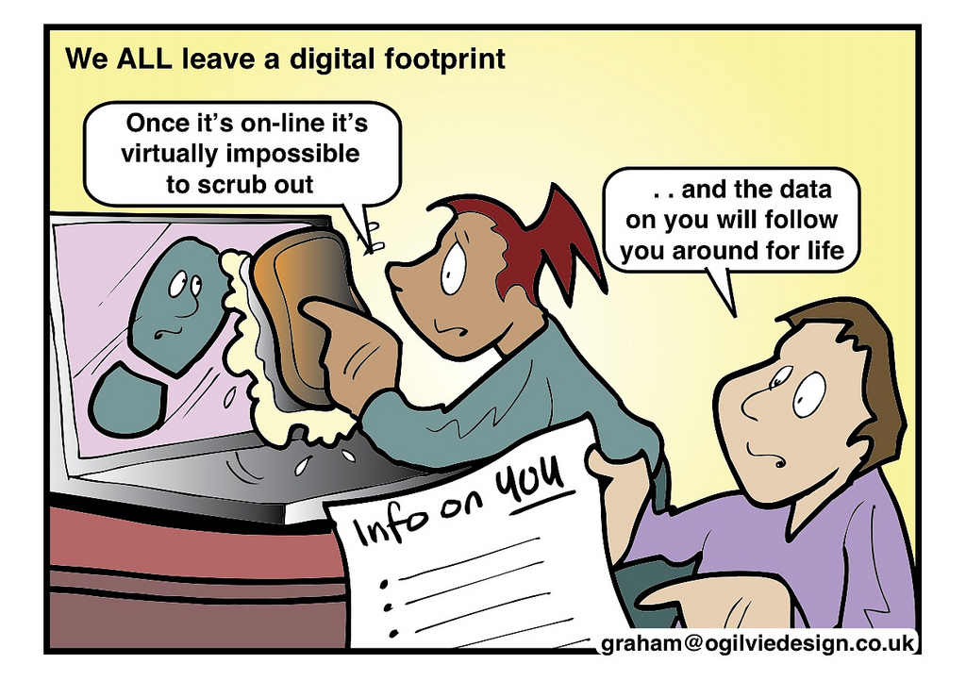
Find Your Digital Footprint Activity
Did you see anything that surprised you?
Notes:
Finding Your Digital Footprint Activity- Handout
Presenter notes: Give this as homework for them to do prior to the training. Then take time to go over the questions on the handout.
Fill out the handout and provide time to review over the questions.
Pew Research Center says that “more than half of all adult internet users have used a search engine to follow others’ footprints.” This means that people could be looking for information on you. Which is why it is important to be aware of your digital footprint.
The Purdue Global Article “Protecting Your Profile: Tips for Online Reputation Management” recommends “three simple tips to keep your digital profile under control.”
Perform a Social Audit Regularly.
Go through your posts first.
Next, take a look of posts where you're tagged.
Don't ignore the comments, these are just as important.
Search Yourself on the Web.
Try to correct erroneous information.
Update any outdated images and information.
Take Control of the Posts.
Limit friends and followers.
Limit who can view posts.
Control the tagging.
For more information on this article go to the Purdue link attached in the references and helpful links section.

Slide 21
Final Reminder: THINK Before You React!
T- Is it true?
H-Is it hurtful?
I- Is it illegal?
N- Is it necessary?
K- Is it kind?
If you can’t say it to someone's face then you shouldn’t say it online!
Notes:
Conclusion
Always THINK before you react.
Never reply or post when you are upset.
Be careful what you share online, over the phone, and in an email.
Be aware of your digital footprint.
Lastly, if you can’t say it to someone's face then you probably shouldn’t say it online.
If you follow the etiquette rules and tips that we have given you in the lesson you will be ready to go out a live in the digital world properly.

Slide 22
Helpful links
https://www.wikihow.com/Category:Computers-and-Electronic
https://www.commonsensemedia.org
https://www.facebook.com/help/
https://help.twitter.com/en
https://www.consumer.ftc.gov/topics/limiting-unwanted-calls-emails
Notes:
Wiki how and common sense media are a great tools to look up ways to do things related to your devices and social media.
You can always ask questions on social media site help centers.
To limit unwanted calls you can go to the consumer.ftc.gov site.

Slide 23
Questions?

Slide 24
References
https://www.bonappetit.com/story/phone-etiquette-rules
https://www.rd.com/advice/relationships/cell-phone-etiquette-tips/
http://www.pewinternet.org/fact-sheet/social-media/
https://owl.english.purdue.edu/owl/resource/636/01/
https://www.linkedin.com/pulse/social-media-etiquette-ethics-guide-personal-brand-use-quesenberry
https://4-h.ca.uky.edu/files/3.0_netiquette-_combined_files_pdf_final_9-6-2016.pdf
https://4-h.ca.uky.edu/files/2.0_cell_savvy-_combined_files_pdf_final_9-6-2016.pdf
https://www.lynda.com/Classroom-Management-tutorials/What-digital-etiquette/440956/476077-4.html
http://msue.anr.msu.edu/news/five_texting_etiquette_tips_for_youth
https://www.commonsensemedia.org
https://www.purdueglobal.edu/news-resources/protecting-your-profile/
http://www.pewinternet.org/2007/12/16/digital-footprints/

