Slide 1
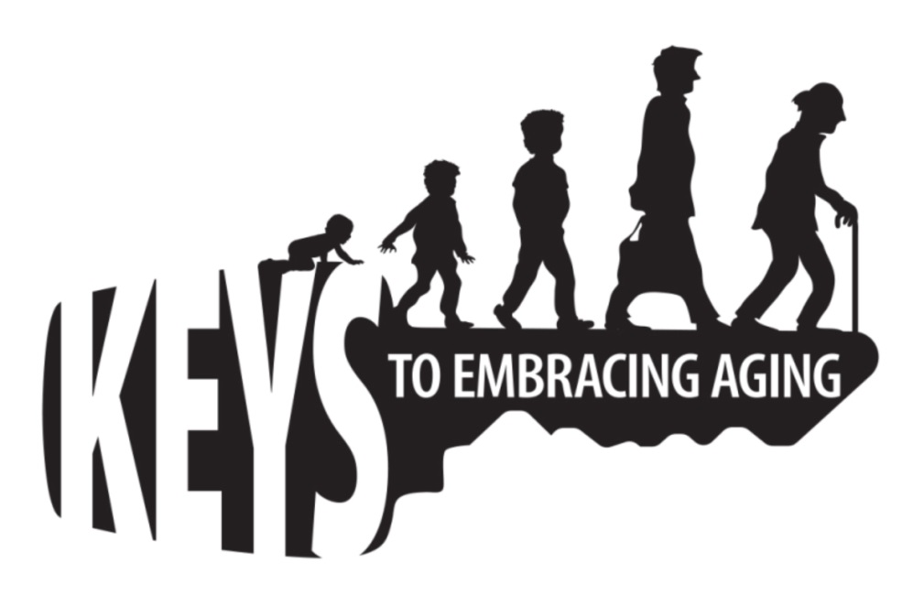


Keys to Embracing Aging
Notes:
Read the following poem by George Carlin:
George Carlin’s Take on Aging:
Do you realize that the only time in our lives when we like to get old is when we're kids? If you're less than 10 years old, you're so excited about aging that you think in fractions.
"How old are you?" "I'm four and a half!" You're never thirty-six and a half. You're four and a half, going on five! That's the key.
You get into your teens, now they can't hold you back. You jump to the next number, or even a few ahead.
"How old are you?" "I'm gonna be 16!" You could be 13, but hey, you're gonna be 16! And then the greatest day of your life...you become 21. Even the words sound like a ceremony. YOU BECOME 21. YESSSS!!!
But then you turn 30. Oooohh, what happened there? Makes you sound like bad milk! He TURNED; we had to throw him out. There's no fun now, you're just a sour-dumpling. What's wrong? What's changed?
You BECOME 21, you TURN 30, then you're PUSHING 40. Whoa! Put on the brakes, it's all slipping away. Before you know it, you REACH 50 and your dreams are gone.
But wait!!! You MAKE it to 60. You didn't think you would!
So you BECOME 21, TURN 30, PUSH 40, REACH 50 and MAKE it to 60.
You've built up so much speed that you HIT 70! After that it's a day-by-day thing; you HIT Wednesday!
You get into your 80s and every day is a complete cycle; you HIT lunch; you TURN 4:30; you REACH bedtime And it doesn't end there. Into the 90s, you start going backwards; "I Was JUST 92."
Then a strange thing happens. If you make it over 100, you become a little kid again. "I'm 100 and a half!"
May you all make it to a healthy 100 and a half!!
Group Activity:
As a group, what words come to mind when you hear the words AGE, AGING, and OLD? (make a list).
Count how many words are positive and how many words are negative.
Usually, there are more negative words than positive. Why is this? Discuss how aging is influenced by:
Society/Media (we live in a culture that values youth…we grow up knowing/thinking this. As a result, older adults are at higher risk for feeling like a burden, that they have no purpose, that aches/pains/frailty are “normal.”)
Ageism (negative stereotyping of older adults)
4. To help end on a positive note, click to the next slide and briefly discuss the positive words from the brainstorm and transition to the purpose of the “Keys to Embracing Aging “ program--healthy behavior practiced throughout the lifespan encourages optimal aging.

Slide 2

May You Make it to a Healthy 100!
Notes:
Wrap up Slide 2 Group Activity:
Briefly discuss the positive words from the brainstorm and transition to the purpose of the “Keys to Embracing Aging program”: healthy behavior practices throughout the lifespan encourage optimal aging.
Close this slide with the following statement:
As George Carlin points out in his poem, embracing aging is a life long journey; therefore it is important to establish healthy lifestyle behaviors throughout life to influence optimal aging.
Photo: Clipart Source: andrewudstraw from flickr

Slide 3

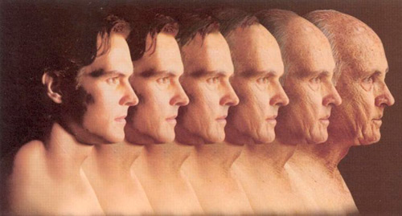
Establishing healthy lifestyle behaviors throughout your life influences optimal aging
Positive Attitude
Eating Smart and Healthy
Physical Activity
Brain Activity
Social Activity
Tuning-in to the Times
Safety
Know Your Health Numbers
Stress Management
Financial Affairs
Sleep
Taking Time for You
Notes:
The Keys to Embracing Aging that we are going to talk about today are:
Attitude is Everything
Eating Healthy
Get Fit
Brain Health
Be Social
Tune-in to the Times
Stay Safe
Know Your Numbers
Manage Your Stress
Financial Affairs
Sleep Tight
Take Time for You
Group Discussion (if you participated in the previous activity on meaning of old age):
Talk about how the 12 Keys to Embracing Aging can help combat the negative and reinforce the positive aspects and images of aging.
Photo: http://www.brinkzone.com/articles/successful-aging-its-your-choice/

Slide 4

Attitude is Everything
Accept change
Don’t let ageism in
Stay mentally healthy
Do things that make you happy
Notes:
The very first key to embracing aging, before you do anything else, is check your attitude. Attitude is everything. The power of the mind over body is amazing. You can sit around thinking about what does not work anymore, or dwell over the meaning of existence and how time is running out…but these scenarios are not going to allow you to age successfully. Maintaining a positive attitude is necessary for optimal aging. If you do need an attitude adjustment, or just a tune-up on your already positive outlook, here are four strategies to think about:
First, accept change. Most of us have heard the serenity prayer. “God, grant me the serenity to accept the things I cannot change, Courage to change the things I can, And wisdom to know the difference.” There is lots of wisdom in that prayer.
Next, get over negative stereotypes. Ageism is negative stereotyping of older adults. One key to being positive is to get over your own stereotypes of aging! Why harbor prejudice again older people…when you yourself either are old (at least to someone!) or will be old (by definition set by society—65+). After all, how many of you, at 65, feel “old” according to your stereotype??!!
Third, watch out for depression. The difficult changes that many older adults face—such as the death of a spouse, loss of independence, and health problems—can lead to depression, especially in those without a strong support system. But depression is NOT a normal or necessary part of aging. Depression symptoms such as aches and pains and fatigue are often overlooked in the elderly. This is dangerous, because depression increases the risk of illness, death, and suicide. It is important to learn how to spot and treat depression in older adults.
And fourth, do things that make you happy. So how do you “be happy”? Choose to be happy. Remember what I said about mind over body? Another tip, do something you love everyday, and I mean everyday. Other ways to be happy include taking charge of your own personal development—it is never too late to improve on yourself, ask for feedback, only make commitments you can keep, and last, but not least, to be happy—make friends.
Optional Group Activities:
Activity 1: Is the Glass Half Full or Empty? (Group Discussion).
Supplies Needed: Dry erase board or easel with paper, writing utensil
Ask the participants as a group to brainstorm several concerns that range from controversial issues such as abortion or fun issues such as ice-cream flavors. List the concerns/issues on a dry erase board or large piece of paper. After the list is written, ask the participants to state what they are FOR vs. AGAINST. When you are against something, you may sound and likely even feel negative. People can interpret your negativity as a personal attack and feel less likely to cooperate when they think you are against them. When you are “for” something, you are focusing your energy and thoughts more positively (See examples below). Positive attitudes not only contribute to well-being, but they also contribute to healthier, more meaningful collaborations with others.
Topic: Abortion. Instead of saying: “I am against abortion.” Say: “I am for pro-life.”
Topic: Chocolate ice cream. Instead of saying: “I don’t like chocolate.” Say: “I like vanilla.”
Activity 2: You Don’t Say (Group Activity).
Supplies Needed: None.
Another way to change your attitude to being more positive is by being more positive to others. Ask each participant to pay at least two sincere compliments to every person in the room. The key word is sincere. People care what you think about them. They appreciate your mentioning their good work or hard effort. Therefore, when the participants pay a the complement and recognize the individual, have them be specific in their compliments. For example, don’t just say, “You look nice today” but say “You look very nice in your blouse. It is a pretty color.”
In return, the participants must accept sincere compliments. Deflecting a compliment often draws unwanted attention and belittles both you and the person offering the compliment. During this activity, have the participants practice just saying, "Thank you." They may be pleased with how gracious they become after this activity
Photo: Flikr by WenchieLostElf

Slide 5
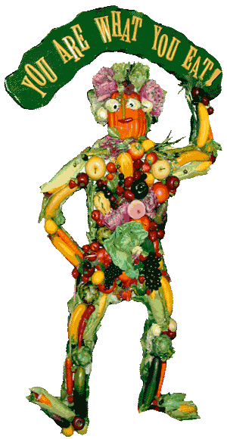
Eat Healthy and Smart
Examine your food relationship
My Plate
Eat breakfast
Control your portion control
Eat in moderation
Drink more water
Eat good fat vs. bad fat
Just say NO to sodium
Choose the right carbs
Eat less sugar
Eat smart while eating out
Count calories
Notes:
Eating is an activity that most of do at least three times a day. We eat because food appeals to our taste buds. We eat because it is a social activity. We also eat because it is good for us. Eating provides our body with energy so that we can breathe and function. It also has an impact on our overall health. Nutritious foods help us maintain a healthy body and protect us against various illnesses, disorders and chronic diseases (USDA, 2011), such as heart disease, stroke, dementia, type 2 diabetes, bone loss, cancer, and anemia (NIH, 2008). Diet and nutrition can also help reduce high blood pressure, lower cholesterol, handle arthritis, maintain healthy skin, hair and nails, and manage diabetes (NIH, 2008). The good news about nutrition is that it is never too late to start eating well. Smart, nutritious eating contributes to health and well-being at any age.
Note: With so many ideas and ways to eat smart and healthy. Identify 1 to 3 bullets and discuss those in greater detail. Use the publication for more detail regarding each topics.
Optional Activity: Eating Smart and Healthy (individual and/or group activity/discussion)
Supplies Needed: Eating Smart and Healthy MyPlate worksheet; pens/pencils
Ask participants to think about the last lunch or dinner they ate. Using the “Eating Smart and Healthy MyPlate” worksheet, ask participants to write down each food and drink item in the proper MyPlate quadrant. Then ask the group whether or not their plate represented all of the food groups? Ask if half their lunch or dinner was fruits and vegetables? Ask if at least half of their grains were whole grains? Ask if their protein was lean or low-fat and whether or not their dairy was fat-free or low-fat? Recommend participants to further track their foods and nutrition the USDA SuperTracker at https://www.supertracker.usda.gov/. The SuperTracker website also provides tips and support to help people make healthier choices, including physical activity.
Image: google images: http://vaintastic.blogspot.com/2012/02/you-are-what-you-eat.html

Slide 6
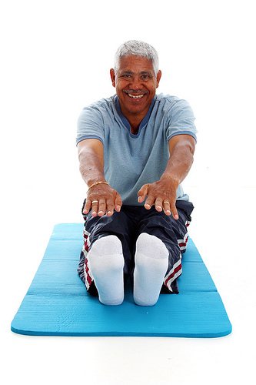
Get Fit: Physical Activity and Exercise
Four Types of Exercise
  Balance
  Endurance
  Strength Training
  Flexibility/Stretching
Amount of Exercise
  150 Minutes of exercise per week (minimum)
Notes:
Another key to embracing aging is to get fit. We all need physical activity and exercise. Why exercise besides just being healthy? To do the things you want to do! Did you know that there are 4 types of exercise? It is not just strength training/weight lifting and aerobics any more. There are official categories for balance exercises and flexibility/stretching exercises.
Balance exercises help prevent falls, a not uncommon problem in older adults. Falling is a major cause of broken hips and other injuries that often lead to disability and loss of independence. Some balance exercises build up your leg muscles while other exercises focus on your stability.
Examples of balance exercises include several strength exercises for the lower body such as front leg raises, side leg raises, and toe stands, as well as stability exercises such as forward toe-touch/arm reach and the stork pose.
Endurance exercises increase your breathing and heart rate. They improve the health of your heart, lungs and circulatory system. Increased endurance keeps you healthier and improves stamina for daily activities. Endurance exercises may also delay or even prevent many diseases associated with aging, such as heart disease and diabetes.
Examples of endurance exercises are walking, jogging, dancing, and playing tennis.
Strength training makes you stronger by building muscle. This increased strength allows you to perform daily activities on your own. Strength training also plays a key role in keeping obesity and diabetes at bay by increasing your metabolism, which helps you maintain a healthy weight and ideal blood sugar levels. Additionally, studies suggest strength training may help prevent the progression of osteoporosis.
Examples of strength training exercises include lifting or pushing free weights, pulling resistance bands, and using strength-training equipment at a fitness center or gym.
Stretching Exercises keep your body flexible by stretching the muscles and tissues that hold your bone’s together. These exercises help give you more freedom of movement to do everyday activities such as reaching and looking over your shoulder. Specific stretches are recommended to prevent injuries but others are recommended to recover from injuries. Flexibility may also play a part in the prevention of falls.
Examples of stretching exercises include shoulder, back, and upper arm stretch, calf stretch, and hamstring stretch.
How Much Exercise Do You Need?
Infants and babies (aged 0-2)
There are no specific requirements for infants; however, infants/ babies/very young children should not be inactive for prolonged periods of time — no more than 1 hour unless they are asleep.
Small children (aged 2-5)
Toddlers and preschoolers need 90 to 120 minutes of physical activity every day. This activity should be roughly halved between planned exercise and free play physical activity. Small children should not be inactive for more than 2 hour unless they are asleep.
Children and Adolescents (aged 6–17)
Children and teenagers need a minimum of 60 minutes of moderate intensity aerobic physical activity in 15-minute segments or longer every day. Children and adolescents should perform vigorous-intensity aerobic activity and strength training 3 days per week. However, it is important to note that children and adolescents should participate in physical activities that are appropriate for their age. For example, a muscle and bone strengthening activity for a 7 year old may include jumping rope and climbing on monkey bars whereas for a 17 year old it may include going to a gym and lifting weights. Children and adolescents also need to stretch.
Adults and Senior Adults (aged 18 and older)
In general, adults and senior adults should get 150 minutes of exercise a week and this needs to be in bouts of at least 10 minutes in length. When you break this down, 150 minutes is only (approximately) 20 minutes a day 7 days a week, 30 minutes a day for 5 days a week, or 50 minutes a day for 3 days a week. And when you break that down into 10 minute segments, it seems much easier to accomplish.
Optional Activity : Group Exercise
Supplies Needed: Chair with a sturdy back
Of the 4 types of exercise, balance, endurance, strength training and flexibility/stretching, balance exercises are the least well known, but still important. Therefore, let’s practice a balancing exercise today. Ask participants who are able to stand up and:
*Balance on one leg.
*Balance on one leg with their eyes closed. (It will be more difficult with their eyes closed as they will not have visual clues to help
them balance.)
*Encourage people to stand behind their chair and use the back to help steady themselves and to prevent falling.
While still standing, ask participants to try a balance exercise that also incorporates stability, the Forward Toe Touch/Arm Reach:
Place your feet shoulder-width apart. Raise your hands to your shoulders with your palms facing forward.
Extend your right arm and place your left foot forward, pointing down with your toes and touching the floor.
Return to the starting position.
Extend your left arm and place your right foot forward, pointing down with your toes and touching the floor
Return to the starting position.
Do 2 to 3 sets of 10 repetitions.
Photo: flikr by Yinisport

Slide 7

Get Fit: Physical Activity and Exercise
Include Physical Activity in your Life:
Make it a priority
Make it easy
Make it social
Make it interesting
Make it fun
Make it an active decision—Exercise doesn’t just happen, you have to make it happen
Notes:
The hardest part of exercising for many is getting started, but when you think about fitness goals in 10 minute segments, it doesn’t seem as daunting. It is helpful to some to make it part of their routine. For example, after you put the coffee on to brew, do 10 minutes of exercise, then have breakfast; or if you work in an office that has breaks, get with some colleagues and make an “appointment” for a 10 minute walk during your afternoon breaks. By accumulating several 10 minute segments throughout the week, you can reach your fitness goal. To help you get started and keep going, try to include physical activity in your everyday life, try all four types of exercise, and plan for breaks in routine—life happens—but you need to get back in action as soon as possible.
Photo: Flikr by neurotrials

Slide 8
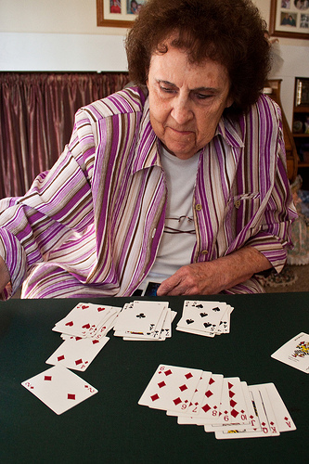
Brain Health
Socialization
Mental Stimulation
Physical Activity
Nutrition
Sleep
Notes:
The brain allows you to interact with the world, understand, analyze, and respond to various surroundings. Therefore, a healthy brain is crucial to survival, growth, and everyday successes (Center for Excellence in Community Mental Health, 2011).
Similar to the rest of the body, the brain needs exercise and maintenance in order to optimize and protect its current and future health. In particular, the brain needs: socialization, mental stimulation, physical activity, nutrition, and sleep (Yu, 2006; Alzheimer’s Association, 2011).
Socialize
Socializing with others provides opportunities for communication, critical thought, creativity and emotional expression. It can also play a role in boosting personal meaning and identity. People who isolate or segregate themselves are at greater risk of developing depression and dementia. Ways to socialize include: Keeping in touch with friends and family; staying engaged/become involved in clubs, groups, classes, or organizations; get to know your neighbors—those who live next door, down the street or those who work at nearby stores; plug-in to the internet to email, join a chat room, or online date.
2. Mental Stimulation
Just as going to the gym is important for your physical health, exercising your brain through mental stimulation is equally important throughout the lifespan. Through mental exercise, you can stimulate and enhance brain cell connections and even delay the onset of Alzheimer’s disease (Mitchell, 2010; Yu, 2006) Some common forms of mental stimulation include: games and puzzles, reading and writing, education and lifelong learning, recreation and leisure, and emotional/spiritual/psychological engagement.
3. Physical Activity
Engaging in physical activity is one of the biggest boosts you can give your brain, especially exercise that gets your heart pumping. There are many ways throughout the day to increase physical activity—try walking 10,000 steps a day, play with your children or grandchildren outside, take the stairs, ride a bike, go dancing, or move around during television commercial breaks. It is also important to strength train. Physical activity is associated with better decision-making, focus, and conflict resolution skills. Exercise can also trigger other health benefits such as a decreased risk of obesity, heart disease, stroke, and diabetes as well as improved mood, improved sleep, an increase in energy, and reduced anxiety and stress.
4. Nutrition
Nutrition plays a large role in brain development and function throughout life. A brain healthy diet can help reduce the risk of chronic-age related brain diseases, including Alzheimer’s disease (Alzheimer’s Association, 2011). A brain healthy diet is one that protects your heart, encourages good blood flow to the brain, and fights against diabetes (Alzheimer’s Association, 2011). For a healthy brain diet: Seek foods high in antioxidants, such as fruits, vegetables, whole grains and nuts.
5. Sleep
Sleeping well is essential to good health and brain functioning (AARP, 2008). A lack of sleep or poor sleep quality can impair alertness, concentration, memory, the ability to learn, solve problems, and remember important information (AARP, 2008). A lack of sleep can also contribute to obesity, the ability to safely drive a car, and it can hamper the ability to maintain overall healthy functioning (National Sleep Foundation, 2011).
Optional Activity: Neurobics (group activity)
Supplies Needed: paper, pens/pencils, radio or music
Background information: Neurobics are aerobic exercises for the brain. Neurobics are fascinating—and challenging—because you can use all of the senses to exercise your brain, which helps your brain get stronger by growing new cells. Neurobics force you out of our habitual routines that do not demand as much brain power. For example, you don’t think about the way in which you brush your teeth every night—you just do it. But if you were to brush with you non-dominant hand, you will have to work harder to properly brush. This same concept can be applied to getting dressed, eating, or doing other familiar activities, including driving a new route home from the store or cleaning the kitchen last if you usually clean it first.
Today, let’s try a neurobic activity (choose 1 or all):
Draw a picture of your family while listening to music.
Use your non-dominant hand to write a sentence about today’s lesson.
Engage in conversation with a partner, but instead of talking, use body language.
Photo: Flikr by fresh.capture

Slide 9
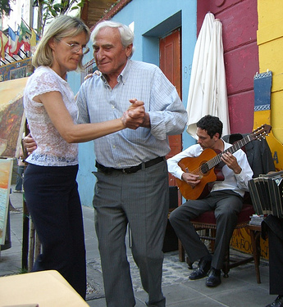
Be Social
Meaningful relationships, social experiences, and activities contribute to:
  Overall physical and mental health and well-being
  Happiness
  Decreased Depression
Notes:
Maintaining social activities and relationships throughout the lifespan is important to health and well-being. Engaged people are often healthier, happier, less depressed, and demonstrate enhanced brain vitality (NIH, 2009; Alzheimer’s Association, 2011; Park, 2009).
Meaningful activity produces the best benefits.
Social activity is good for a person regardless of who you are, how old you are, where you live, or what you do. Being socially engaged with friends, family, and various activities throughout the lifespan has many positive benefits:
Improved social skills
Improved academic performance
Positive attitude
Enhanced self-esteem
A sense of connection to peers, groups and the community
Reduced risk of cardiovascular disease
Reduced risk of osteoporosis and rheumatoid arthritis
Reduced risk for some cancers
Reduced risk for Alzheimer’s disease and other dementias
Reduced risk for mental health disorders, such as depression
Better brain vitality
Overall happier and healthier lifestyle
Not being social can lead to depression and social isolation which can negatively affect health and well-being.
Optional Activity: (Group discussion):
Supplies Needed: None
Ask participants to brainstorm and share with the group ways that they seek meaningful social interactions.
Photo: Flikr LordBigFire

Slide 10
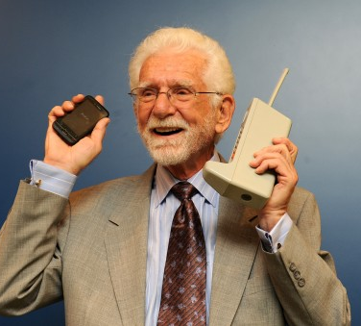
Tune-in to the Time
Promotes life-long learning
Increases knowledge
Enhances problem-solving & decision making
Exercises the brain
Broadens social opportunities
Notes:
When asked why they had lived so long, participants of a centenarian study (people who are 100+ years old) shared that they spent a life time staying in tune with the times (Reuters, 2007).
Staying in tune to the times throughout life:
Promotes life-long learning
Increases knowledge
Enhances problem-solving & decision making
Exercises the brain
Broadens social opportunities
Photo: Flikr: Techsavvydaughter

Slide 11
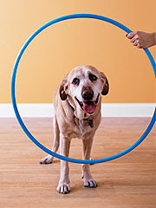
Tune-in to the Times
Cell Phones and Smart Phones
Computers and the Internet
Video Games
Music
Current Events
Old dogs CAN
learn new tricks!
Notes:
Old dogs CAN learn new tricks!!
Tuning in to today’s world will likely include:
Cell phones and Smart phones
A cell or mobile phone is a hand-held, cordless device that can make and receive calls.
A smartphone is a high-end mobile phone that incorporates computing abilities. Smartphones have an “app” or application for almost everything. An application is a computer program that can be downloaded to a smartphone allowing it to take photos, play music and videos, and access internet sites.
Charged on batteries, a mobile phone fits in your pocket and can be ready in hand to call a friend or call for help.
Computers and the Internet
Computers are used to type and print documents, calculate, sort, search and store data. They are also used for entertainment as they play and store games, music, movies and photos.
The majority of today’s computers are linked to the internet. The Internet is a worldwide collection of computer networks that connect users through satellite and telephone. Many people consider the internet to be the world’s largest encyclopedia.
The internet allows you to:
Surf the Net. Surfing the net means spending time on the internet to see what you find.
Social net-work. Social networking services, such as Facebook, allow you to register and create a personal profile, exchange messages, and join common-interest groups.
Email. Electronic mail, known as email, is a method of sending digital messages to or exchanging digital messages with one or more persons with accounts on the Internet. There is not post office or paper needed for this instant, modern-day letter writing.
Video Call. Through the use of webcams and microphones, various computer and social media programs allow you to communicate while both seeing and hearing the person you called.
Share, post and update information for others to see
Request and provide assistance with problems and questions
Market and publicize products and services
Read newspapers and other current events
Research your family tree
Plan and book a vacation
On-line date
3. Video games
The benefits of playing today’s video games include improved (Reuters Health, 2008; Thompson, 2009):
Reflexes
Processing speed
Memory
Attention skills
Spatial abilities
Reasoning and cognition
Physical activity
Video games may even contribute to slowing the progression of Alzheimer’s disease and other dementias
Music
Music releases dopamine, the feel-good chemical in the brain involved in motivation and addiction. As a result, music that moves you provides a sense of emotional arousal and pleasure.
Today it is simple to take music with you wherever you go. Portable music players such as an MP3 player or iPodTM, are electronic devices that allow you to download and save digital music and audio books.
Current events
Staying connected with the world influences longevity.
Whether it is the television, newspaper, internet, or radio, current events have a positive effect on long life because they encourage social interactions. For example, it is easier and more fun to engage in conversation when there are interesting topics to discuss or debate.
Staying in tune to your community and the world also exercises the brain and can keep you more mentally active as you read or listen and process the news.
Optional Group Discussion:
Supplies Needed: None
Ask the participants to brainstorm and share with the group ways that they tune-in or feel discouraged/overwhelmed when it comes to technology.
Photo from: http://teachingolddog.blogspot.com/

Slide 12

Stay Safe
Home Safety
Motor Vehicle Safety
Health Safety
Recreational Safety
Emergency Preparedness
Internet Safety
Scams and Cons
Notes:
Practicing safety is important because it helps keep you out of harm’s way. Over the course of our life we learn and practice safety, such as looking both ways before crossing the street, wearing a seatbelt or locking our doors when away or at night. Simple lifestyle changes and recognizing where most hazards are and how danger or injuries can occur when participating in different activities are key to safe living.
Safety across the lifespan includes a multitude of realms. The following safety tips are just a few that reflect various life domains: home, transportation, health, recreation, and emergency preparedness.
For a full list of safety tips, refer participants to the Keys to Embracing Aging Safety publication.
Home Security
Home is often a place that represents security and comfort. There is no place more important to keep safe than your home. Some home safety tips include: visible house numbers, locked doors and windows, childproofing, knowing your escape route, working fire extinguishers, avoid overloading plugs and extension cords.
Motor Vehicle Safety
Vehicle crashes are the leading cause of unintentional injuries and death for people between the ages of 1 and 33. The National Safety Council (2012) recommends several ways to reduce your likelihood of getting into an accident: wear seatbelts, avoid distractions, keep infants and children, be aware of your surroundings, be a defensive driver, don’t drive impaired.
Health Safety
Good health leads to happiness, independence, satisfaction and fulfillment in life. The following are just a few tips that promote health safety according to the National Council on Safety (2012): Get trained in CPR (cardiopulmonary resuscitation) and AED (automated external defibrillator), visit the dentist and doctor regularly, properly use and dispose of medications—prescription, over-the-counter and herbal, prevent falls, and practice safe sex.
Recreational Safety
The National Council on Safety (2012) reports that recreation-related injuries affect people of all ages and account for many injury-related emergency department visits. To have good recreational experiences: avoid injury while exercising (stretch, drink water), learn how to swim, travel smartly and safely, be smart and safe in hotels, and be street smart.
Emergency Preparedness
Natural disasters, fires, and other catastrophic events can disrupt your home, work and community with little to no warning. It is important to identify and learn about potential hazards common to your area. It is also important to make and share a plan to help prevent confusion and worry in the face of an emergency. Depending on the disaster, help may not always be there or be able to get to you due to multiple calls, blocked roads or other barriers. According to the National Safety Council (2012): Have a safety plan, stay informed, practice what to do in case of an emergency, and make a plan on how to keep in touch after an emergency.
Internet Safety
Adults and kids alike face several risks when they go online. Crimes and scams such as sexual predation and identify theft are everywhere. To stay safe on the internet, the National Council on Safety (2012) recommends: protect your kids (help your children understand internet safety , set limits on the computer, keep computers in common areas, share email and social media accounts, and look for signs of predators or cyber-bullying), and protect yourself (use passwords wisely, protect your identity and computer’s safety, be smart with social media and on-line dating sites).
Scams and Cons
Fraudulent activity can happen to anyone, regardless of age or means. Scams and cons are common occur via telephone, mail, in person, or, increasingly the Internet. Never give personal information, such as your social security number or bank information to anyone who shows up at your door or calls on the phone, be cautious of “free” deals, and don’t get pressured into “limited time offers.”
Optional Activity (Emergency Preparedness group activity/discussion):
Supplies Needed: Pen/pencil and handouts: 1) “What are you doing to prepare?” 2) “Ready on a budget” and 3) “FEMA Family Emergency Plan”
According to the Red Cross, a basic action plan includes: (1) an emergency supply kit, (2) a plan for evacuation (including where to meet, and what to do if family is separated), and (3) being informed of potential disasters or emergencies that may occur in your area. Before an action plan can be take place, people need to discern what they know, what they think they know that is not accurate, and what they don’t know. Pass out the handout, “What are you doing to prepare?” and have the participants take a few minutes to check the boxes. Next discuss a few of the responses. (All counties are different so be sure to check with your local county government for some of the answers. For example, do you have an official local evacuation route or does your county have a Citizen Corps Council?) Finally, pass out the handouts “Ready on a budget” and “Family Emergency Plan” and encourage your participants to go home and follow the suggestions.
Photo: Google Images: http://davefarmersblog.wordpress.com/tag/bad-drivers/

Slide 13

Know your Numbers
Cholesterol: <200
Triglycerides: <150
Blood Pressure: 120/80
Blood Sugar: <100
Body Mass Index: 18-25
Waist Circumstance: <40 (men) & <35 (women)
Notes:
These days our daily lives are flooded with numbers: PIN numbers, phone numbers, and various account numbers. But there are also certain health numbers that can save and extend your life. These numbers are those associated with cholesterol, triglycerides, blood pressure, blood sugar, body mass index (BMI), and waist circumference. Regular visits to a health care provider, proper nutrition, physical activity, and an overall healthy lifestyle, promote healthy numbers in addition to healthy aging throughout the lifespan.
A Quick Guide to Keeping Up With Your Numbers
Cholesterol: <200
Optional Information about cholesterol: Cholesterol is a waxy substance found in the fats (lipids) in your blood. It is essential for the body to build and maintain healthy cells and essential hormones. About 25% of cholesterol comes from the food we eat such as meat, fish, and dairy. The rest is made by the human body. There are two forms of cholesterol: low-density lipoprotein cholesterol (LDL), also known as the “bad” cholesterol and high-density lipoprotein cholesterol (HDL)—the “good” cholesterol. Too much LDL cholesterol creates a plaque that can accumulate and clog the arteries causing heart disease and stroke (CDC, 2011). HDL cholesterol is good because it helps clean the artery walls and carry away the excess bad cholesterol.
To increase HDL cholesterol:
Increase unsaturated fats in the diet, including omega-3 fatty acids (sesame, flax, pumpkin, avocado oil, olive oil, fat in peanut butter, and fish)
Add soluble fiber to your diet (oats, fruits, vegetables, and legumes)
Maintain a healthy weight
Regularly exercise
Avoid smoking and secondhand smoke
Talk to a medical provider about medication and other treatment options
Fasting Triglycerides: <150
Optional Information about fasting triglycerides: Triglycerides, like cholesterol, are a form of fat that circulates in the bloodstream. Triglycerides are responsible for the energy that tissues need to function. Similar to cholesterol, when the blood levels of triglycerides become too high (e.g., over 200 mg/dl.), the risk for developing heart disease increases (AHA, 2010; Medicine Plus, 2010).
Dietary and lifestyle changes help lower triglyceride levels:
Maintain an ideal and healthy body weight
Avoid fatty foods and foods high in cholesterol such as hamburgers and fried food
Eat fruits, vegetables, nonfat or low-fat dairy products most often
Eat foods high in good, unsaturated fats
Do not drink alcohol in excess
Exercise moderately for at least 30 minutes, 5 times per week
Blood Pressure: 120/80
Optional Information about blood pressure: Blood pressure is recorded as two numbers, and written as a ratio. The top number, referred to as the systolic blood pressure, measures the pressure in the arteries when the heart beats. The diastolic, or bottom number, refers to the amount of pressure in the arteries between heartbeats. This is when the heart muscle is at rest and is refilling with blood (AHA, 2011). Hypertension or high blood pressure is a condition that causes the pressure in the heart to change.
Maintaining a healthy blood pressure can be simple and easy:
Eat a diet rich in fruits, vegetables, whole grains, and low-fat or nonfat dairy products.
Avoid excess salt
Engage in regular physical activity
Maintain a healthy weight
Manage stress
Avoid tobacco
Limit alcohol
Fasting Blood Sugar: <100
Optional Information about fasting blood sugar: Blood sugar or glucose is a type of sugar that travels through the blood stream. It acts as a basic fuel for the body and is needed for energy and proper cell functioning, particularly brain cells and muscles. Diabetes is the most common disease related to blood sugar regulation failure. Diabetes is a disease that affects over 25.8 million children and adults (American Diabetes Association, 2011). If left untreated, diabetes can cause many medical complications including cardiovascular disease, kidney disease, unhealthy cholesterol levels, clogged arteries, metabolic syndrome, blindness, nerve disease, and limb amputations (AHA, 2010).
To maintain healthy blood sugar levels and prevent diabetes (American Diabetes Association and Mayo Clinic, 2010):
Exercise regularly
Eat plenty of fiber and whole grains
Maintain a healthy weight
Skip fad diets and make healthy choices
BMI: 18 to 25
Optional Information about Body Mass Index (BMI): BMI is a ratio between height and weight and is used as a tool to help judge body fat and weight. According to BMI calculations, there are five weight categories: underweight, normal, overweight, obese and extreme obese. These weight categories help indicate the risk of severe health problems, including heart disease, stroke, high blood pressure, high cholesterol, cancer, diabetes, sleep apnea, osteoarthritis, female infertility, urinary stress incontinence, and gastroesophageal reflux (CDC, 2011). There are certain people who should not use BMI as the basis for determining relative disease risk. Competitive athletes and body builders, whose BMI is high due to muscle, and women who are pregnant or lactating should not be disturbed if their BMI is not within the normal range.
To take control of your BMI (CDC, 2011):
Burn more calories than you consume by exercising and maintaining a healthy lifestyle
Eat a well-balanced diet
Exercise at least 30 minutes a day
Lose or gain weight in a healthy manner
Consult with a medical provider
Waist Circumference: <40 (men) & <35 (women)
Optional Information about waist circumference: Body fat that accumulates around the waist and stomach area poses a greater risk than fat stored in the lower half of the body. Therefore, the measurement of your waist size (circumference), like BMI, can predict future health problems, including Type 2 Diabetes, dyslipidemia, hypertension and cardiovascular disease, especially when BMI is between 25 and 35 (AHA, 2011; CDC, 2010).
Photo from: Flikr 6900686486_c1def467d5 copyright Emily from CERA

Slide 14
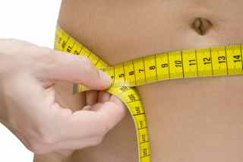
What are Your Numbers?
BMI =
Weight in Pounds / (Height in inches x Height in inches ) x 703
Waist Circumference:
Place a tape measure around your bare abdomen just above your hip bone. Be sure that the tape is snug, but does not compress your skin, and is parallel to the floor. Relax, exhale, then measure.
Notes:
Optional Slide/Activity:
Supplies needed: Pen/pencil, paper, tape measures and calculators
Keeping our body Mass Index (BMI) and waist circumference within healthy ranges affect our long term health. Therefore, today we will practice calculating BMI and/or measuring our waist circumference.
Pass out a paper, pencils, calculators and tape measures.
BMI: Ask participants to calculate their BMI with the following formula: weight (lb) / [height (in)]² x 703. Interpretation: A healthy BMI should be between 18-25
Waist Circumference: Instruct participants to measure their waist size: Place a tape measure around your bare abdomen just above your hip bone. Be sure that the tape is snug, but does not compress your skin, and is parallel to the floor. Relax, exhale, then measure. Interpretation: Males: < 40; Females: < 35
Discussion: While respecting people’s privacy, discuss ways in which healthy numbers can be obtained: (Examples include: healthy/smart nutrition, exercise, stress management & sleep.)
Photo: Flikr from www.healthchocolate.net

Slide 15
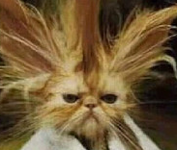
Manage Your Stress
Change the situation
Avoid the stressor
Alter the stressor
Change your reaction
Accept the stressor
Adapt to the stressor
Notes:
When thinking about being stressed, most people think about the emotional symptoms of stress, such as anxiety,
irritability (angry at small things), increased forgetfulness, and difficulty making decisions. But there are also physical signs of stress that can include headaches, upset stomach, increased arthritis pain, tightness in the chest, and oversleeping or sleeplessness.
The #1 and #2 cause of stress for senior adults is the loss of their spouse either through death or divorce. The third top cause of stress is having to move to a nursing home or retirement home. #11 in stress causing events is the inability to drive anymore.
While we cannot rid ourselves of stress, we can learn to manage it. The ultimate goal in stress management is to achieve a balanced life, with time for work, relationships, relaxation, and fun – plus the resilience to hold up under pressure and meet life’s stressors head on.
Two common strategies for managing stress include changing the situation and changing your response to the situation. If there is a situation that you can identify that causes stress, avoid it. For example, if the crowds and chaos of the State Fair make you feel anxious to the point that you do not like to go, stay home instead. In unavoidable situations, such as a holiday dinner with in-laws, you may have to change your reaction. Accept it for what it is, focus on what is really important, adapt to the environment, and move on.
Having realistic expectations of yourself, shifting your focus to looking at what is really important and taking care of yourself emotionally and physically will also increase your confidence to deal with stressors. Sometimes, taking a deep breath, meditating, relaxing or taking time to smell the roses allows you to appreciate the little things so that you don’t overreact over the big things.
Optional Activity:
Supplies needed: Pen/pencil, Stress Management worksheet
To manage your stress, it is helpful to know what resources you do have. Many resources fall into broad categories such as supportive social networks, personal skills and interests, as well as your life experiences. Ask participants to:
Write a list of specific resources that you currently have in Column 1 (Examples may include: helpful friends, strong family, savings, coping ability, hobbies, caring minister, great family traditions, creativity, experiences with challenges, religious faith, pay and leisure activities, local library, personal journal realistic expectations, healthy lifestyle, family pet, mentors, advisors, or counselors.)
Make a new list that includes all of the stresses and challenges you are currently facing in Column 2 (Examples may include: balancing caregiving and work, health problems, job loss, divorce, or decision-making).
Take your list of challenges (Column 2) and compare/pair it with your list of existing resources (Column 1). Can you identify any resources that can help you deal with your challenge? Do you have stressors that cannot be addressed with existing resources? Circle these stressors in Column 2.
For any stressors that do not have a resource, create a list of resources that would help and think about ways in which you can seek such help in Column 3.
Finally, discuss the strength of identifying existing and needed resources. Brainstorm resources for particular stressors as a group.
Photo: Flikr by HyperApril 1822499590_e0d16dee53_m

Slide 16
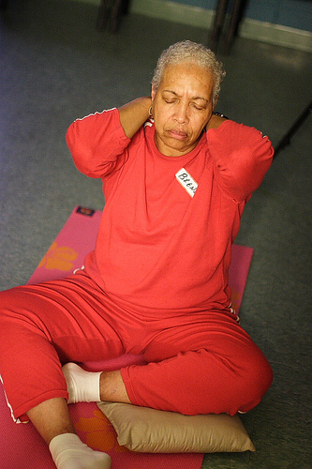
Manage Your Stress
Identify Stress in your life
  Good Stress vs. Bad Stress
Healthy Ways to Manage Stress
  Avoid unnecessary stress
  Alter the situation
  Adapt to the stressor
  Accept the things you cannot change
  Make time for you
  Adopt a healthy lifestyle
Notes:
Beyond a take-charge approach and a positive attitude, you can reduce stress in your life by making healthy lifestyle choices and taking care of yourself. If you regularly make time for rest and relaxation, you’ll be in a better place to handle life’s stressors when they inevitably come.
Don’t get so caught up in the hustle and bustle of life that you forget to take care of your own needs. Nurturing yourself is a necessity, not a luxury.
Set aside relaxation time. Include rest and relaxation in your daily schedule. Don’t allow other obligations to encroach. This is your time to take a break from all responsibilities and recharge your batteries.
Connect with others. Spend time with positive people who enhance your life. A strong support system will buffer you from the negative effects of stress.
Do something you enjoy every day. Make time for leisure activities that bring you joy, whether it be stargazing, playing the piano, or working on your bike.
Keep your sense of humor. This includes the ability to laugh at yourself. The act of laughing helps your body fight stress in a number of ways.
Optional Activity:
Supplies needed: Pen/pencil, paper
To manage your stress, it is helpful to know what resources you do have. Many resources fall into broad categories such as supportive social networks, personal skills and interests, as well as your life experiences. Ask participants to:
Write a list of specific resources that you currently have (Examples may include: helpful friends, strong family, savings, coping ability, hobbies, caring minister, great family traditions, creativity, experiences with challenges, religious faith, pay and leisure activities, local library, personal journal realistic expectations, healthy lifestyle, family pet, mentors, advisors, or counselors.)
Make a new list that includes all of the challenges you are currently facing (Examples may include: balancing caregiving and work, health problems, job loss, divorce, or decision-making).
Finally, take your list of challenges and compare/pair it with your list of resources. Can you identify any resources that can help you deal with your challenge?
Discuss the strength of resources and asking for help as a group.
Photo: Flikr: White Rabbit Resources

Slide 17
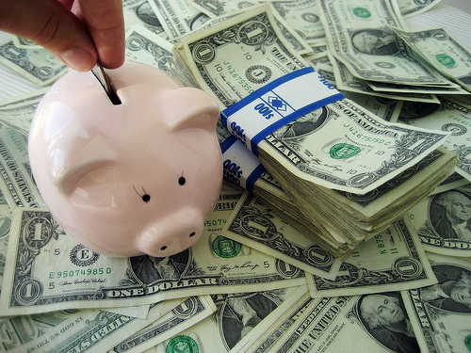
Basic Financial Affairs
Budget Development
Money Management
Wise Use of Credit
Consumer Protection
Saving Goals
Notes:
There is a lot to talk about when it comes to money, funny thing is, nobody likes to talk about it in public. Not going into major financial issues such as stocks, trusts, and inheritance laws, but just looking at the basics, we can still spend a long time on the topic of money. To keep it short and simple, the very first thing everyone should do is develop a budget. What is your income? What are your expenses? Balance your expenses so that they do not exceed your income and develop a spending plan. That is a budget.
It is easier to say than to do, but learning money management skills will help is keeping with your budget. For example, it is best not to buy on credit, but if you need to, budget your credit spending carefully. Shop around for the lowest finance charges and establish a person debt limit and stick to it.
There are some fairly new consumer protections available now. For example, the Federal Truth in Lending Act requires most businesses who extend credit to tell consumers what the credit will cost in the long run, including the finance charge and annual percentage rate of interest.
But it is not all about spending money, we should also be aware of saving money. Think about your short, medium, and long-term savings goals. Put that into the budget.
Optional Activities:
Choose one or both of the following activities:
Activity 1: Rags to Riches.
Supplies needed: Pen/pencil, paper, dry erase board or easel with paper
Often we don’t realize how rich we are in comparison to the rest of the world. Ask the participants to: Think about how blessed they are.
Ask them to consider everything on their body (clothes, shoes, jewelry, glasses/contact, tattoos, hearing aids, etc.) and the cost associated with each item. Ask participants to add these costs and to write the total on a piece of paper. Tell participants not to write their name on this paper and ask them to pass papers to the front. On a dry erase board or tablet, list the various totals that were handed forward. Discuss with the participants whether or not they are surprised at how high or how low the figures are.
Activity two: Build Your Savings.
Supplies needed: Pen/pencil, University of Arkansas Fact Sheet FSFCS43 “Build your Savings”
(http://www.uaex.edu/Other_Areas/publications/PDF/FSFCS43.pdf)
Ask the participants to take a few minutes to complete the University of Arkansas fact sheet, “Our Family’s Goals Wish List.” If more than one family member is present for the program, encourage families to compare/contrast/discuss their lists and/or discuss the goals and wish lists as a group in addition to the importance of having such goals and discussion.
Photo: Flikr: 401K 2012

Slide 18

Sleep Tight
Sleep is Important:
Learning and Memory
Metabolism and Weight
Safety
Mood
Heart Health
Disease Prevention
Notes:
1.Sleep, learning, and memory are complex phenomena that are not entirely understood. Research suggests that sleep helps learning and memory in two distinct ways. First, a sleep-deprived person cannot focus attention optimally and therefore cannot learn efficiently. Second, sleep itself has a role in the consolidation of memory, which is essential for learning new information. Consolidation represents the processes by which a memory becomes stable. Memory consolidation takes place during sleep through the strengthening of the neural connections that form our memories.
2. Sleep loss can affect the basic metabolic functions of storing carbohydrates and regulating hormones. Sleep deprivation from eight hours to four hours produces change in glucose tolerance and endocrine function. Sleep plays a vital role in regulating metabolism and appetite. When sleep deprived, the metabolic system will be out of balance, which will ultimately affect the dietary choices people make. For example, teens who are sleep deprived crave more carbohydrates. Sleep deprivation is a risk factor for obesity among adults.
3. Scientific research is revealing how sleep loss, and even poor-quality sleep, can lead to an increase in errors at the workplace, decreased productivity, and accidents that cost both lives and resources. For example, A National Sleep Foundation survey has revealed that 60 percent of adult drivers—about 168 million people—say they have driven a vehicle while feeling drowsy in the past year, and that more than one-third (103 million people) have actually fallen asleep at the wheel. Unfortunately, many of these situations end in tragedy.
4. Sleep and mood are closely connected; poor or inadequate sleep can cause irritability and stress, while healthy sleep can enhance well-being. Chronic insomnia may increase the risk of developing a mood disorder, such as anxiety or depression.
5. Sleep and the heart health go together. Poor sleep can lead to heart disease and heart disease can keep you awake. Poor sleep has been linked with high blood pressure, atherosclerosis, heart failure, heart attack and stroke, diabetes, and obesity. The thread that ties these together may be inflammation, the body’s response to injury, infection, irritation, or disease. Poor sleep increases levels of C-reactive protein and other substances that reflect active inflammation. It also revs up the body’s sympathetic nervous system, which is activated by fright or stress. In contrast, sometimes heart disease is a cause of poor sleep. People with heart failure may wake up with trouble breathing, which stems from fluid buildup in the lungs. There’s also some evidence that heart failure leads to sleep apnea, a breathing problem that can awaken a person repeatedly throughout the night. Some people have nighttime angina (chest pain), bouts of atrial fibrillation, or palpitations (the sensation of a racing or pounding heart) that disturb sleep.
6. Research has revealed that people who consistently fail to get enough sleep are at an increased risk of chronic disease. Treating sleep as a priority, rather than a luxury, may be an important step in preventing a number of chronic medical conditions.
Photo: Google Images: http://50up.com.au/article/2011/05/sleep-myth-busted/

Slide 19
Sleep Tight
Sleep Recommendations:
Use your bed for sleep and sex only
Restrict time in bed if time spent in bed is lying awake
Exercise in the afternoon… or early evening…not within a few hours of bedtime
Avoid caffeine, nicotine, and alcohol at least 3-4 hours before going to bed
Try to go to bed at the same time every night…and wake up at the same time every morning
Keep in mind that daytime naps affect nighttime sleep.
Notes:
Sometimes as we get older, it becomes harder to sleep through the night. The promotion of regular sleep is known as sleep hygiene. Here are some simple sleep hygiene tips:
• Go to bed at the same time each night, and rise at the same time each morning.
• Sleep in a quiet, dark, and relaxing environment, which is neither too hot nor too cold.
• Make your bed comfortable and use it only for sleeping and not for other activities, such as reading, watching TV, or listening to music.
• Remove all TVs, computers, and other "gadgets" from the bedroom.
• Avoid physical activity within a few hours of bedtime.
• Avoid large meals before bedtime.
Optional Activity: (Group Relaxation)
Supplies needed: None
Often when people cannot fall asleep they get impatient, which can result in not being able to sleep. To help yourself fall asleep, try to first relax. This starts with staying in the bed with the lights off, as moving around can make you more awake. Let’s try some relaxation techniques now. It’s okay if you snooze off, we will wake you up!
The first things I want you to do is to focus on your breathing. Consciously slow your breathing to a particular count (3 to 5 seconds in and out is good but it will vary by person). Counting focuses your mind and deep breathing relaxes you. Being relaxed and slowing your heart rate will make it easier to fall asleep.
Now that your breathing is slow and deep, picture a scene, a familiar place where you are happy—the beach, the mountains, your backyard. Visualize yourself moving around your place until you find a comfortable place to sit or lie down. In your imagination, sit or lie down and be comfortable there. When you are restless in bed trying to fall asleep, moving around in your favorite place in your mind can help relieve that restlessness. Once you are calm in your mind, you can become calm in your body.
Recheck your breathing. Slowly breathe in and out. Take a deep breaths. Are you still picturing your familiar place? Are you lying down in your mind? While you picture yourself in your favorite place in your mind, we are going to relax your muscles. Start by tensing up your toes for a few seconds while you breathe, then relax. Do it again. Tense the arches of your feet, hold, relax. Now your calves muscles…. (Walk the participants through tensing and relaxing their muscles up their body and end at the face.) By having this body awareness, it can help remove body tension and make you more comfortable enabling sleep to come easier.
Are you relaxed? Do you feel sleepy? Open your eyes and stretch. You can try these and other techniques at home to help you fall asleep at night.

Slide 20

Take Time for You
Get to know you
Take care of yourself
Take a Break
Make a “to do list”
Be physically active
Eat smart and drink water
Relax
Laugh
Learn to say “NO”
Create a bucket list
Notes:
Take at least 10 minutes a day for you:
Get to know you
The things you believe in, the values that guide your life, and the passions that motivate you are what make you you. It is healthy to identify what is important to you/what you want to get out of life, including short and long-term goals, and seek opportunities that fulfill you.
Optional Activity 1: Recipe of You (individual activity/group discussion).
Supplies needed: Pens/pencils and Recipe worksheet. You may want to ask participants to bring a photo of themselves for the recipe card.
This activity encourages participants to think carefully about the unique individual characteristics that make them who they are (a unique, one-of-a-kind individual who is a blend of “ingredients”). For example, you may be a mix of strength, 8 hours of sleep, and determination combined with short legs, blue eyes, brown hair and laughter and passion, to make a complete recipe of you.
Pass out Recipe Card worksheet
Read directions to the group
Think carefully about your personality, values, what makes you happy, what makes you special, favorite foods, hobbies, or any other characteristics that make up you. Use strong adjectives to describe you. Brainstorm first and then write down your ideas on the front of this card.
On the front of your card, list the ingredients and measurements that make you, YOU (1/2 cup love; 1 tsp. orneriness).
Provide directions on how to mix your ingredients together.
Name your recipe.
If you have a photo of yourself, include it with the recipe.
Allow 3-5 minutes for individual brainstorming/writing
Allow 5-8 minutes for group sharing (optional)
2. Take care of yourself
Life is busy. As a result, you may neglect your own well-being which can lead to stress, irritability, moodiness and even depression. Proper self care, such as sleep, nutrition, physical activity, and low stress can help improve mood and daily productivity. By taking care of yourself, you will be more relaxed and content. You will also feel stronger and more confident. A person who places an emphasis on self care is more efficient, better able to concentrate and help others, and will be more likely to accomplish and enjoy more within a 24 hour period (Thurman, 2011).
Optional Activity 2: take Care of Yourself (group discussion):
Supplies needed: None
Brainstorm about the many ways to take care of yourself. Some answers may include: Sleep, Exercise, Eat healthy, Laugh more, De-clutter or organize your house and/or office, Read a book, Walk your pet, Play with your kids/grandkids, Join a club, Go to your doctor for checkups…
3. Take a break from your daily routine without feeling guilty
It is mentally healthy to take a break from your daily routine. But such breaks often come with guilt. You feel guilty for while at work or running errand because you are not with you family, yet spending time with family can create pressure because you are not concentrating on work or household tasks. On top of it, people feel the most guilty when they time for themselves. Slipping away from your daily routine doesn’t have to occur for extended periods of time, it can mean going to your bedroom with your door closed to sit, take a bath, or read a book uninterrupted. Help your family and friends around you understand that this is a time you do not want any interruptions. If it's difficult for people to leave you alone, leave the house and go for a walk, meet a friend for coffee, see a movie, or go shopping.
4. Make a “to do list”
A “to do list” is a motivating and organizational tool that helps you plan your day and manage your time effectively. Prioritizing your list into due dates, short- and long-term goals and/or rank of importance can help you feel more control and balance. It also helps you recognize that everything does not all need to be done in one day. Crossing items off a list is a mental reminder that you’re making progress. It can be both gratifying and empowering. But, always leave enough room for day-to-day tasks and other unplanned events that naturally appear during the day.
5. Be physically active
Physical activity and exercise, including strength training, is a healthy way to spend “me time.” Exercise affects overall physical and mental well being. It increases strength, cardiovascular conditioning, flexibility, balance, and body composition (DSHS, 2011). It also boosts self-esteem and confidence and helps lower stress and anxiety.
6. Eat smart and drink water
Eating well, especially heart-healthy foods, is a key to taking care of yourself. Wholesome, nutritious foods can give you more energy, combat depression by keeping your brain functioning at its best, and prevent numerous other health problems such as obesity, diabetes, heart disease, and cancers. Drinking plenty of water will help hydrate your skin and your body. It also flushes toxins out of your body and helps you concentrate.
Optional information to share: the USDA’s My Plate (2011) recommendations:
Enjoy your food, but eat less
Avoid oversized portions
Make half of your plate fruits and vegetables
Make at least half of your grains whole-grains
Switch to fat-free or low-fat (1%) milk
Drink water instead of sugary drinks
Choose food that is low in sodium
7. Relax
Relaxation, the body’s natural unwinding technique, has been referred to as the single-most important key to health and well-being. As a result of relaxation, you may experience more energy, better sleep, enhanced immunity, increased concentration and problem-solving abilities, greater efficiency, smoother emotions, and fewer physical reactions to stress. Relaxation has also been known to decrease muscle tension and blood pressure, and increase blood flow, which is good for the heart (HOH, 2008; Mayo Clinic, 2011). Relaxation can occur through taking a hot bath, reading a book, getting a massage, or taking a few deep breaths (Mayo Clinic , 2011; Kovacs, 2010). Professional methods of relaxation include visual imagery, body awareness, and progressive muscle relaxation. Meditation is a form a
relaxation. Meditation is a state of peace that occurs when the mind is calm. Meditation helps to reduce stress, depression, and anxiety (Allen, 2003). In addition to contributing to a calmer, more peaceful and happier life, meditation can increase creativity and productivity in the workplace or classroom (TMP, 2011).
8. Laugh
It’s no joke. Laughter really is the best medicine. Laughter has the ability to increase the “feel good” hormones in the body, called endorphins. Laughter boosts the immune system, which contributes to overall healthiness. Finding humor in daily situations can even reduce stress, lower depression, and help your mind and body heal (AHA, 2011).
9. Learn to say “NO”
Do you find yourself saying “yes” to everything that is asked of you, even if it is something you really do not want to do? Always saying yes is not healthy. It often over-commits you, which can cause stress and fatigue. Saying no allows you to honor existing obligations and dedicate quality time to those commitments. Saying no to things that you have always done but are tired of doing, allows you to try new things. You should not feel guilty saying no, as saying no helps you to focus on what’s important.
10. Create A Bucket List
A bucket list can act as a road map for “me time” today and into the future. A bucket list is a list of goals, dreams, and life-experiences that are important for you to experience before you die. Bucket lists aim to help you maximize every moment of your existence and live your life to the fullest. Bucket lists can be grounding because we too often get caught up in the madness of daily activities and fail to live by personal plans and goals. A bucket list helps you identify purpose and meaning because it provides reminders about what is important in life, what you have done, and where you want to go. While bucket lists are often associated with dreams of travelling the world or skydiving, your list should fit your personal goals and dreams no matter how big or small (Grossman & Bly, 2008).
Optional Activity 3: Bucket List (individual activity and group discussion)
Supplies needed: Pen/pencil and Bucket Sheet worksheet
A bucket list is a list of things you want to do before you die. Keep in mind that not everyone wants to jump out of planes or climb mountains. A bucket list can also include dreams, aspirations, plans and decisions for the future.
Pass out Bucket List worksheet
Read the directions:
In column 1, write down your dreams, aspirations, plans and/or decisions you want to make or anticipate making in the future.
Include your age/date that you think these events might take place in Column 2.
Allow 2-3 minutes for participants to brainstorm and write
Allow 5-8 minutes for group sharing/discussion
Pass out Bucket List Worksheet
Read the directions
Allow 2-3 minutes for participants to brainstorm and write
Allow 5-8 minutes for group sharing/discussion
Photo: Free Stock Photos 11402189-an-old-lady-sitting-on-the-couch-reading-a-book

Slide 21


Aging is an inevitable process…
By embracing a healthy lifestyle throughout life you will have a greater ability to engineer a positive approach to the aging process.
Notes:
Aging in an inevitable and unavoidable process. It is a process that brings on many changes as a person progresses from childhood to adulthood. The way in which you take care of yourself through the years both physically and mentally will impact the ways in which you enter your later years. Life does not diminish with aging. In fact, the acceptance of aging can be something that is positive, joyful, and exciting. With aging comes new experiences, knowledge, wisdom and a greater ability to engineer a positive approach to the aging process. I hope today that the Keys to Embracing Aging program highlighted 12 keys to aging that will help you to grow old gracefully, successfully, and with increased longevity.
Optional Quotes to read as a conclusion to the lesson:
And in the end, it's not the years in your life that count. It's the life in your years.
~Abraham Lincoln
Aging seems to be the only available way to live a long life.
-Daniel Francois Esprit Auber-
If I'd known how old I was going to be I'd have taken better care of myself.
-Adolph Zukor-
Photo from Flickr: Terra Nova Foundation

