Slide 1
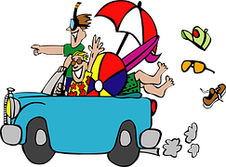

Happy Trails
Tips for Fun and Safe Travel with Kids
By: Dr. Brittney Schrick
Assistant Professor—Family Life Specialist

Slide 2
Overview
In this session we will discuss:
  Safe car travel with children including: car seats, seatbelts, and hot car safety
  Safe car snacks
  Tips for long car rides with kids
  Legal issues for traveling with kids
Notes:
Travel with kids can be fun, stressful, and, at times, very difficult. But, it is also necessary to get from point A to point B safely. Whether you’re taking children down the street or across the country, there are several things to remember to make traveling with children safer and easier.

Slide 3
Car Seat Safety
What kind of seat does my child need?
How should they be buckled in?
How do I install it?
  Who can check the installation for me?

Slide 4
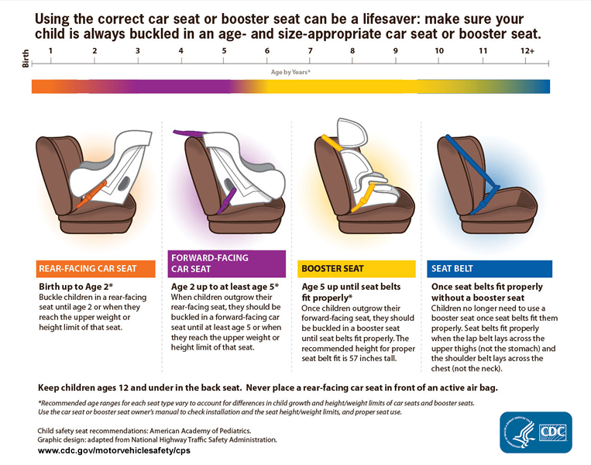
Notes:
This chart from the CDC gives basic information on which car seat is right for your child based on their age and height.
Older recommendations stated that a child could move from a rear-facing to a forward-facing car seat at age 1 and 20 pounds. Current recommendations say at least age two, but children are safer rear-facing for as long as their seat is safe to do so (until the child reaches the upper weight and height limit for their seat).
We will discuss each of these seats in turn. If you are unsure how to install your car seat correctly, please contact a certified car seat technician. This will be discussed later in this presentation.

Slide 5

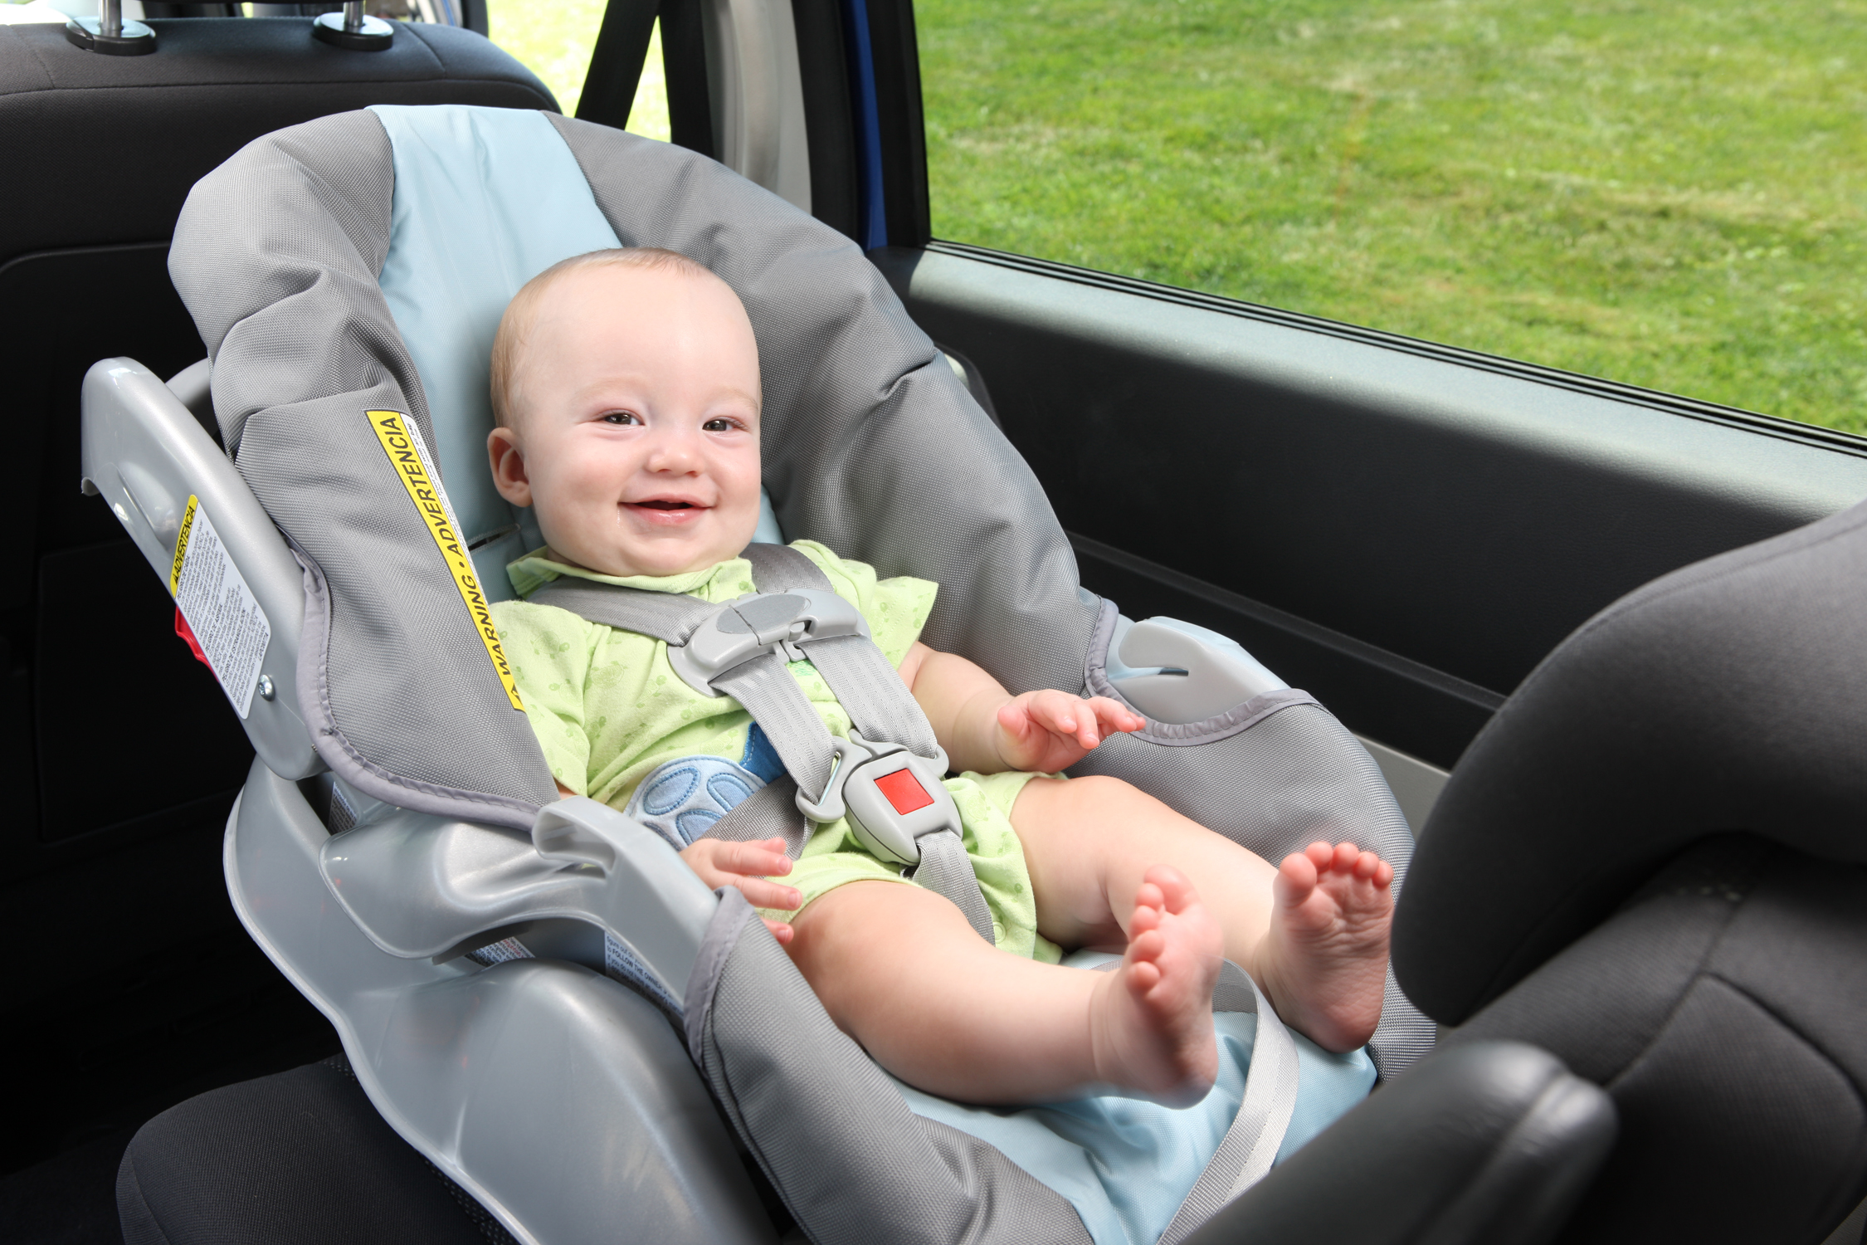
CDC recommendations:
  Newborn to age 2: Rear-facing, bucket or convertible car seat.
  Consult car seat manual for height and weight limits
Straps tight and positioned just at shoulder height.
Chest clip at armpit level.
Tighten straps.
Photo Credit: NHTSA.gov
Notes:
Infants under age 2 should be in a rear-facing seat. These seats may be carrier/bucket seats that have a base that stays installed in the car, or they may be convertible car seats that stay installed in the car and may be turned to face forward when the child meets age, height, and weight requirements.
When buckling a child into a rear-facing seat, check the tightness of the straps and the position of the chest clip.
(Click 1) In this photo, the strap is tight. It will pass the “pinch test” meaning that I could not grab the strap and pinch the slack.
(Click 2) The chest clip is at armpit level. It should not be so high as to hit the child in the neck, and it should not be at stomach or sternum. Right at armpit level is the safest to avoid internal injury.
(Click 3) The bottom strap allows for tightening and release of the shoulder straps. Be sure to use this feature. All seats with a 5-point harness, like this one, will have a way to adjust the tightness of the straps.
(Click 4). Familiarize yourself with the seat before you use it. If you are traveling with a grandchild, niece or nephew, or other child using an unfamiliar seat, be sure to ask questions to make sure you are comfortable enough to use the seat properly.
Bucket infant seats are slightly different in installation, but the features described above are the same. With very small infants, you may have difficulty tightening the straps and keeping the chest clip at armpit level, but get as close as you can and as tight as you can. Many newer seats come with an insert that helps boost a newborn high enough to allow for proper belt position.

Slide 6
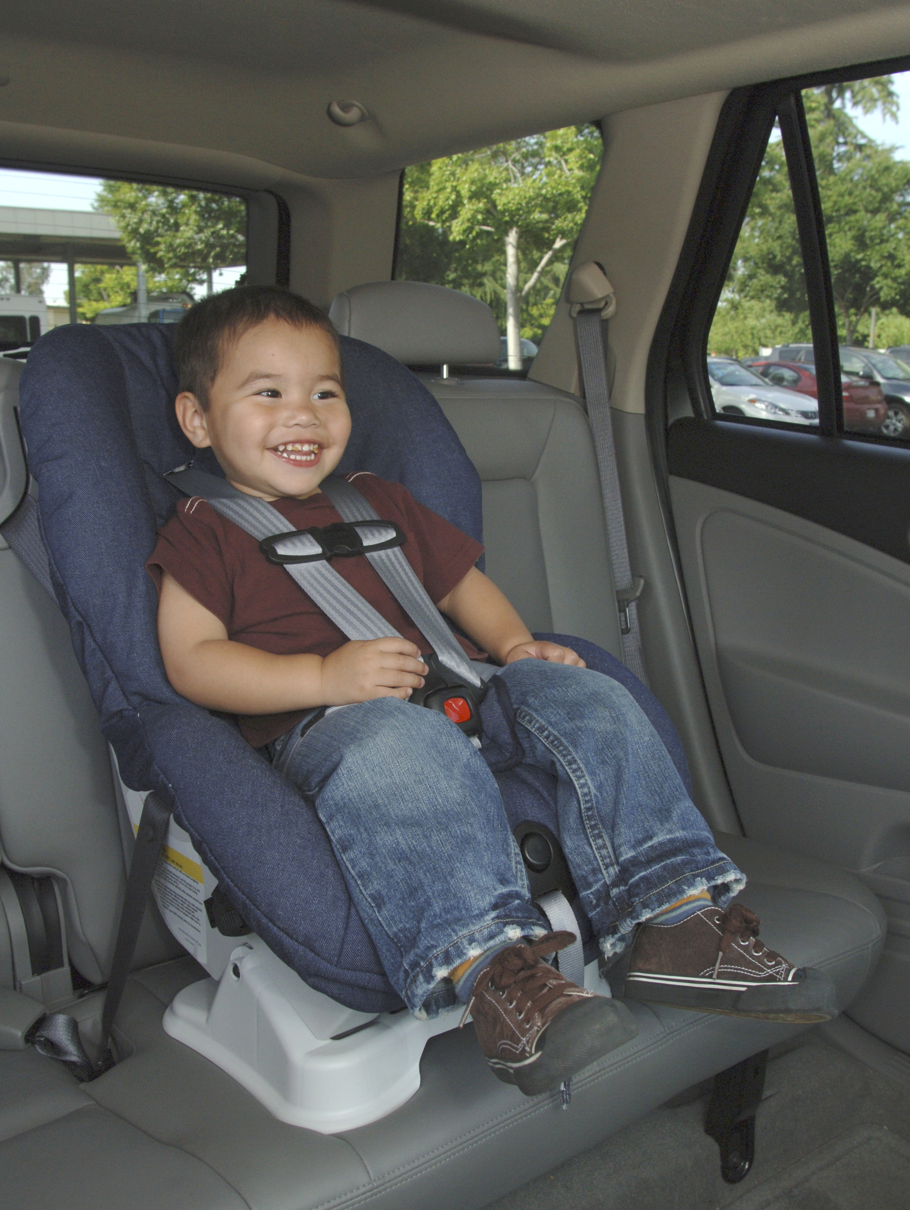
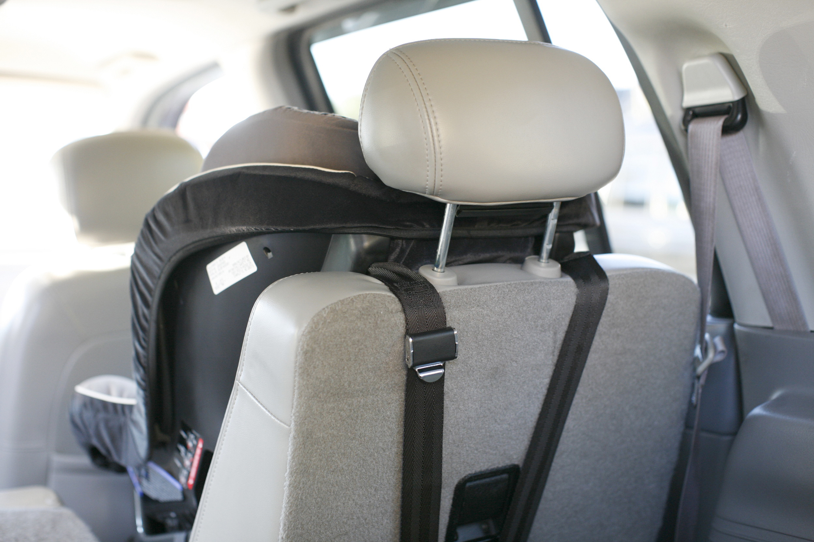
CDC recommendations:
  Age 2 – 5: Forward-facing car seats should have a 5-point harness and be tethered to the back of the seat with attached clips.
Tether seat back to car.
Tighten straps at shoulder level.
Chest clip at armpit level.
Photo credit: NHTSA.gov
Notes:
Updated recommendations for forward-facing car seats say that children should stay rear-facing until at least age 2, but for as long as possible based on the weight and height limits of the seat they are in. Following these recommendations with an appropriate seat increases the likelihood that a child will make it safely through most car accidents with only minor injuries. Many parents worry about their older child rear-facing with their legs being uncomfortable. Most children will cross their legs or find a comfortable position while rear-facing. Staying rear-facing longer protects against spinal injuries.
A change in installation occurs at the transition to forward-facing. (Click 1) The car seat will need to be tethered in the back.
Most convertible seats have a rear-facing limit of at least 45 pounds, and some go as high as 65 pounds. (Click 2) If the child is taller than the seat (their head comes above the top of the seat), it is time to upgrade to a different seat.
When you decide to turn a child forward-facing, the (Click 3) pinch test and (Click 4) chest clip rules still apply. The straps should be tight enough that the child cannot move around or wiggle out of them, and the chest clip should be at armpit level.

Slide 7
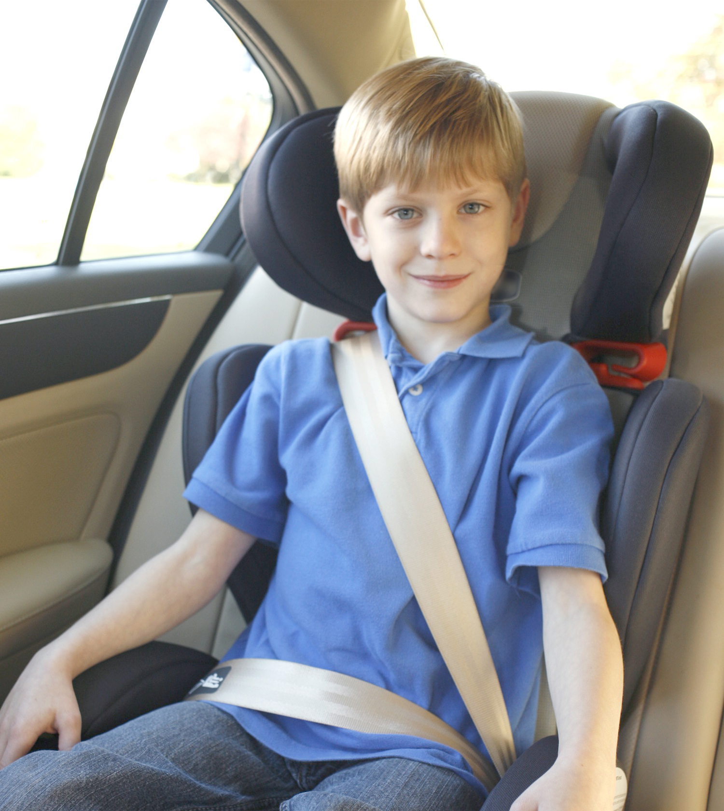
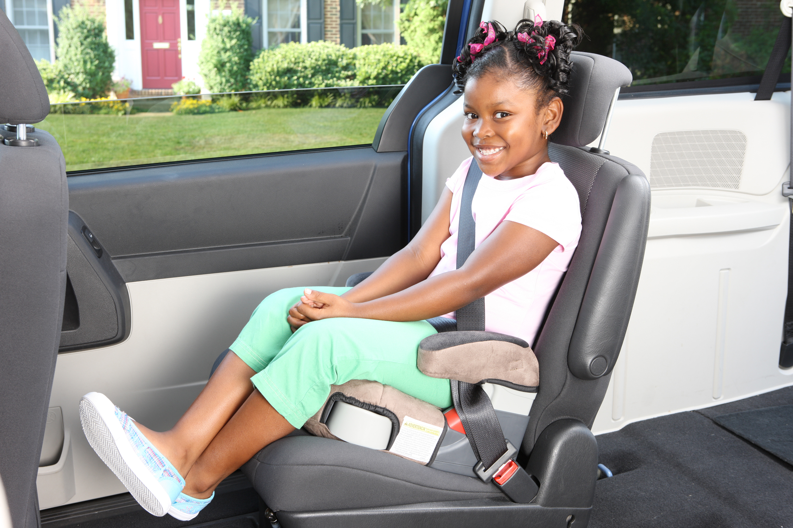
CDC recommendations:
  Age 5 until seatbelt fits properly: Children should ride in a booster seat until they are old enough to ride in the seat with a correctly positioned seatbelt; approximately 57 inches.
Belt positioner keeps belt from rubbing child’s neck.
Booster brings them to correct position in seat and with seatbelt.
Option 2: High-back booster
  Often have 5-point harness for children not ready for seatbelt.
  Positions seatbelt more effectively.
Photo Credit: NHTSA.gov
Notes:
Moving to a booster seat is appropriate when a child is 5 or older and will sit properly in a seatbelt (i.e., they won’t put it behind their back or under their arms, and they will sit up in the car).
(Click 1) Some booster seats have a belt positioner that keeps the seatbelt off of the child’s neck. This will increase the likelihood that they will keep the belt in the correct position.
(Click 2) The booster raises the child to the correct height for the seatbelt to fit them by laying flat across their chest and hips.
Another option for this age group or as a transition between a forward facing and booster seat is a high-backed booster seat. They typically still have a 5-point harness, but they sit flatter and often have an adjustable head rest to fit the height of the child.

Slide 8
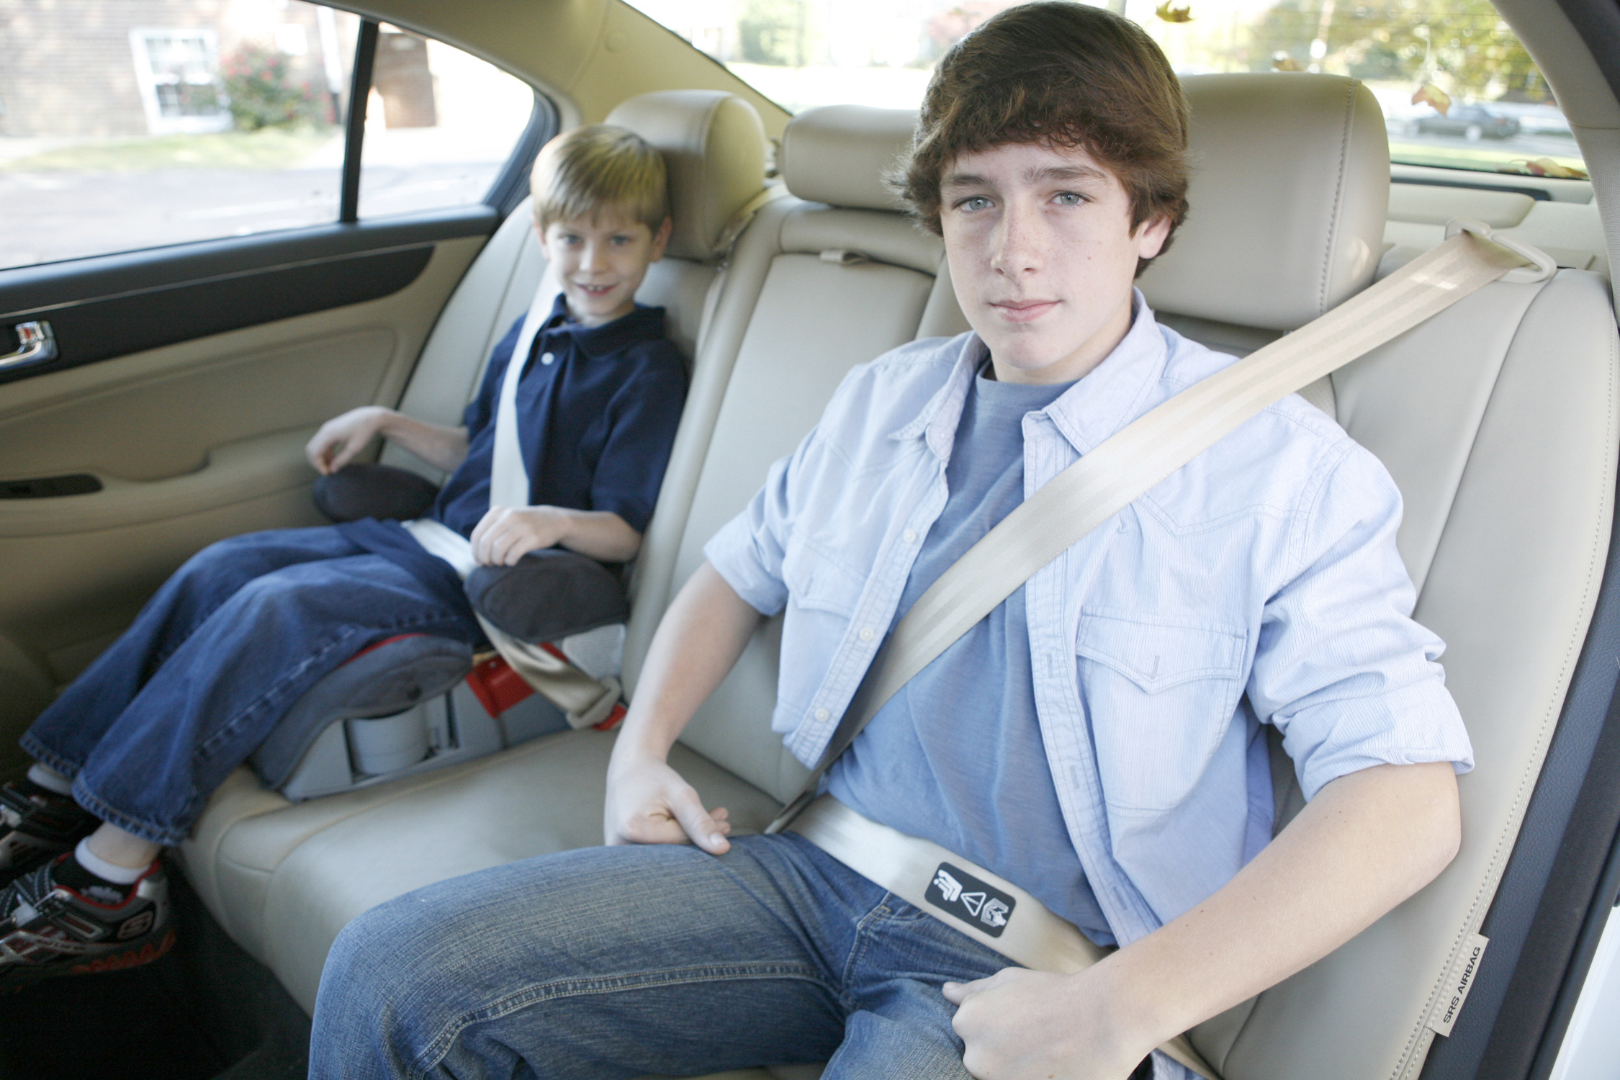
CDC recommendations:
  When a seatbelt fits properly without a booster seat: Child should be in correctly positioned seatbelt in the back seat.
  The belt should lay across upper thighs/hips and flat across the chest and shoulder without cutting into the child’s neck.
Photo Credit: NHTSA.gov
Notes:
When a child is 8 years or older and ready to sit in the seat alone, be sure to check for seatbelt position:
(Click 1) The belt should lay flat across the child’s chest and not dig into their neck,
(Click 2) and it should lay across their hips or upper thighs NOT their stomach.
(Click 3) They should be able to sit with their knees bent over the edge of the seat without slouching down. If they are not yet able to do this, they should continue using a booster seat until they are tall enough for the seatbelt to fit them properly.
Children should still ride without putting the seatbelt behind them or under their arms.

Slide 9

Car Seat Safety
Avoid “after market” add-ons for car seats such as pads for the straps, head positioners, toys, and boutique covers not made by the manufacturer.
Car seats that have been in an accident should be replaced.
Observe all warnings and expiration dates on car seats.
All children under age 12 should sit in the back seat.
When children are old enough to move to the front seat, they must still wear their seatbelts correctly.
Notes:
(Click 1) When choosing or installing a car seat, it is important to use only the parts that come with the seat itself. After-market items like pads, head positioners, toys, and boutique seat covers are cute, and some are helpful, but they often interfere with the proper function of the car seat (many keep the straps from tightening effectively), and some may invalidate the manufacturer warranty.
(Click 2) Any car seat that was installed in a car that experienced an accident should be replaced. Even if it looks fine, the frame or other materials may have been stressed or cracked during impact.
(Click 3) Be sure to observe all warnings posted on car seats and to properly dispose of them by when they expire. Car seat materials are rated to be safe for a specific period of time. After that time, the manufacturer does not guarantee safety, even if it is installed correctly. For this reason, avoid buying car seats at yard sales or consignment shops (even if they will be “spares”). Most car insurance agents and some hospitals offer sources for affordable or free car seats if you cannot afford one.
(Click 4) All children under age 12 should sit buckled in the back seat.
(Click 5) When children are old enough, heavy and tall enough, to move to the front seat, they must still wear seatbelts correctly.
It is important to model safe behaviors. Be sure to wear your own seatbelt while driving or riding in a car! Kids will do what they see.

Slide 10
Car Seat Technicians
If you are unsure whether your child’s car seat is installed properly, find a car seat technician in your area.
  Hospitals, fire & police stations are the most likely places to find a technician.
  Visit http://cert.safekids.org/ for a searchable database.
Notes:
Agents: If you are interested in becoming a certified car seat technician, this website offers information on that process.

Slide 11

Sun Safety in the Car
Especially for young babies and preverbal toddlers, be sure to check their sun exposure throughout the day. If you don’t have tinted windows, putting a screen, a hat, long sleeves, and/or sunscreen is important to avoid sunburn
Older children will likely do their best to avoid sunny spots, but be sure to have options for them to cover windows or themselves if windows are not tinted.
Notes:
Another car safety issue to be aware of is the sun.
(Click 1) Especially if you are traveling a long distance, check sun exposure throughout the day. Babies and young children are especially sensitive to sun exposure, so it may be a good idea to put sunscreen on, even if you will be in the car, if you do not have tinted windows. For very young babies, long sleeves, long pants, socks, and a hat and/or a sun shade that attaches to the window are all good ways to protect them from sunburn in the car.
(Click 2) Older children will likely do their best to avoid the sun, but if they nap in the sun, it is best to cover the window or cover the child with sunscreen, clothes, or a blanket, if windows are not tinted.

Slide 12


Hot Car Safety
Never leave a child unattended in a car, even if the windows are down.
It only takes a few minutes for a car to get to a dangerous temperature in the sun.
  Outside temperature does not have to be hot for it to get dangerously hot inside a car.
Look Before You Lock: Be sure to check your car before leaving.
Tips:
  Put a shoe or your phone next to any rear-facing car seat to ensure that you will check it before you leave the car.
  Ask daycare provider or babysitter to check in with you if your child does not attend when expected.
  Lock cars when they are sitting at home to keep children from climbing inside to play or hide.
Notes:
Another car safety issue when traveling with children is knowing how to prevent injury or death from a hot car. We have all driven somewhere on autopilot and realize we missed our turn, went the wrong direction, or just don’t quite remember driving so far. Especially in cases where we are out of our routine, such as taking a child to school that we are normally not responsible for or going somewhere with our child who is usually at school or daycare, it is not uncommon to forget where we are going or why. When we are alone, this is, at worst, inconvenient. If we have a child with us, it could be dangerous. Forgetting about a child in the car is an all too common occurrence. The majority of these cases are not of bad parents who intended their child harm, they are of good parents who were out of their routine.
(Click 1 & 2) Children, especially very young children, are in danger of heat stroke or death when left in a hot car for even a brief period of time (as little as 10 to 15 minutes in direct sunlight). The danger of this happening increases with rear-facing car seats because the driver cannot see the child when looking in the rearview mirror. Another danger for young babies is that they may fall asleep or be very quiet so the driver does not remember they are in the car.
The main stories we hear in the news of hot car deaths and injuries involve parents who forgot their child in a hot car or left them in their car seat unattended while they ran an errand; however, many children who die or are injured in hot cars climb in the car or trunk themselves while the car is parked. They may be playing in the car or using it as a hiding place. Most older children will get out on their own, but a younger child may become trapped because they are unable to open the door, they accidentally lock themselves in, or they close the trunk and cannot open it from the inside. It is a good habit to lock cars while they are parked and to teach children not to play in or around cars to avoid these dangers and other potential hazards.
(Click 3) To protect against these hazards, the NHTSA recommends Look Before You Lock. Check the car before locking it and walking away.
(Click 4) Especially if you have a rear-facing car seat, it might be helpful to put a shoe or your phone next to the car seat to ensure that you will check it before you leave the car. Ask your daycare provider to call if your child does not arrive at daycare when expected. Keep parked cars locked.

Slide 13
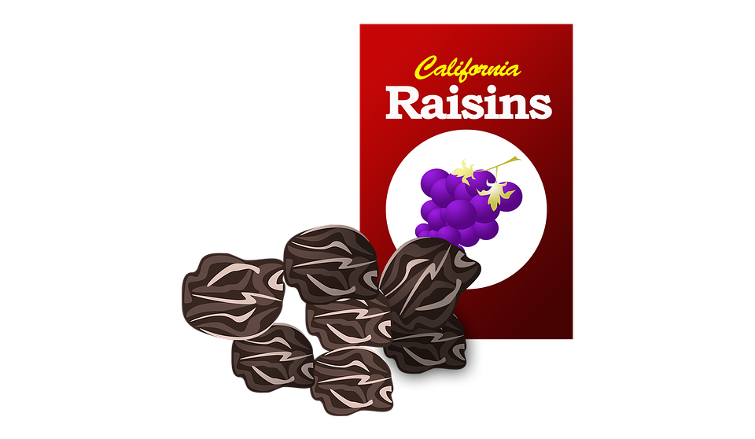
Are we there yet??
Pack snacks and drinks for each child that are within their reach
  Exceptions for children under 2 or 3 that will need help.
Younger children should avoid anything that may cause choking
  No suckers or other snacks on sticks, no hard candy or nuts or other choking hazards
You may want to avoid messy things like chocolate, ice cream/popsicles, yogurt, or pudding as these may cause more stress than help.
Pack extra water either in refillable bottles or with extra bottles of water in case of emergency. Pack extra snacks in the trunk or back of the vehicle that are out of reach.
Notes:
Especially on long trips, kids get bored in the car. They will ask to go to the bathroom. Are we there yet? I’m hungry! My tummy hurts. She hit me! He’s looking at me!
It is inevitable on a long trip that kids will get bored and unruly. Some cars are equipped with entertainment systems to allow kids to watch movies. Some kids will have tablets or phones to play on. But, those aren’t necessary to keep kids entertained and happy-er on the road.
(Click 1) Healthy, safe snacks are a great way to keep a child content. Things like granola bars, raisins, Goldfish crackers, peanut butter crackers, applesauce pouches, or fruit.
(Click 2) Be careful when giving snacks to kids under two. Anything with a stick (like a sucker or corndog) or that is a choking hazard (like nuts, hot dogs, or carrots) should be avoided. If a small child started choking, you may not be able to get to them quickly in the car.
(Click 3) You may want to avoid messy snacks with chocolate or anything sticky, ice cream, pudding, etc. for younger children. These may cause more stress than they are worth.
A quick way to organize and control car snacks is by using a snack box or bag for each child. Pre-pack snacks for long trips by giving each child the amount they can have of each snack in a box or bag that is within their reach. It will save you from having to reach around to get things for them all day. Let them know that once the box is empty, their snacks are gone.
(Click 4) It is also a good idea to pack water in either refillable bottles that can be filled during rest stops or in disposable plastic bottles. Packing extra water and snacks is helpful if you get stuck in traffic or stranded with car trouble.

Slide 14
Other Tips and Tricks
Are you traveling with a child who is potty training? Bring their potty along!
Are you traveling with a child who gets car sick? Be sure to give medication at least 30 minutes before leaving.
  Sea Bands and similar products are available to help with symptoms.
  Pack Ziploc bags in the car in case of a sick child.
  Learn their “tells”
    Do they complain of thirst? Say their throat hurts? Look pale?
Look for picnic areas or playgrounds along the way. Pack a meal and let the kids play! Or, stop at a fast food restaurant with a playground.
Get out a few toys or books that your child has not played with in a while. It will be like getting new toys for the trip!
Notes:
Here are a few other tips and tricks for traveling with kids:
(Click 1) Are you traveling with a child who is potty training? Bring their potty with you! Put it in the trunk or the back of the vehicle, and if they need to go…pull over! You will not have to put them back in diapers just for the trip, and it will help cut down on accidents while they try to hold it until the next stop.
(Click 2) Do you have a child who gets car sick? Giving medication at least 30 minutes ahead of departure will help make sure it is working by the time you leave. There are other products available to help with nausea such as Sea Bands. Pack bags or cups in case of a sick emergency. Also, remind yourself of your child’s “tells” when they are going to be sick. Most children do something that lets you know they will be sick. If you are traveling with a niece or nephew or a grandchild who gets carsick, be sure to ask their parent what they do!
(Click 3) Do some research ahead of your trip to find parks or picnic areas that allow you to stop and stretch your legs. Pack your meal and have a picnic! Let the kids play at the playground or run around in a safe area. They get the wiggles out, and you save some money on eating out. If this isn’t a preference or option, look for a restaurant with a play ground. Asking kids to sit still at a sit down restaurant when they have been in the car on a long trip may cause frustration for all involved.
(Click 4) To give your kids something “new” to do in the car, pull out some toys or games they haven’t played with in a while or swap some toys or games with a friend. It will be like getting new toys without spending a dime!

Slide 15

Legal Issues When Traveling with Kids
Arkansas state law prohibits smoking in the car with a child under 14.
  This is a primary offense that allows an officer to pull over and cite an adult smoking while a child is in the vehicle.
Primary seatbelt law requires that the driver and passenger be buckled up regardless of age.
All children under age 6 and under 60 pounds must be in a proper child safety seat.
All children under age 15 must be buckled into a seatbelt regardless of where they are in the car.
Arkansas state law prohibits a driver under age 18 from transporting more than one non-related person under age 21 in the car with them.
Notes:
If you are not used to traveling with children, there are some legal issues that you need to be aware of before taking them along.
(Click 1) Arkansas law prohibits smoking in the car with children under 14. If you smoke, you can be pulled over for doing so with children in your car. If you must smoke along the trip, do so at rest stops.
(Click 2) Primary seatbelt law requires that the driver and passenger be buckled regardless of age. Even adults must be buckled in the front seat.
(Click 3) Legally, all children under age 6 and under 60 pounds must be restrained in a child safety seat that is appropriate for their age, weight, and height.
(Click 4) Children under age 15 must be buckled in the car at all times regardless of where they are seated. So, even if they are in the back seat, if they are unbuckled, you could get a ticket.
(Click 5) Drivers under the age of 18 are legally prohibited from transporting more than one non-related person under 21 in the car with them. This includes children they are babysitting as well as friends they may be driving. In other words, if the driver is transporting her/his siblings, cousins, etc., they are allowed; however, if they are babysitting someone else’s children, they must be over 18 to drive more than one child at a time.

Slide 16
Links and References
Car Seat and Other Car Safety Resources:
http://www.archildrens.org/Services/Community-Outreach-Department/Child-Passenger-Safety.aspx
http://www.safercar.gov/parents/InandAroundtheCar/heatstroke.htm
http://www.safercar.gov/parents/CarSeats/Car-Seat-Safety.htm
http://www.cdc.gov/motorvehiclesafety/child_passenger_safety/cps-factsheet.html
Other Extension Resources for Families:
www.arfamilies.org
www.uaex.edu/familylifefriday
www.uaex.edu/childcare

