Slide 1



Grace Under Pressure: Dealing with difficult People
By: Dr. Brittney Schrick
Assistant Professor – Family Life Specialist
University of Arkansas Cooperative Extension Service

Slide 2
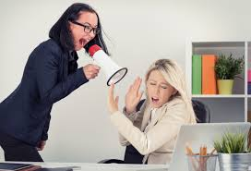
Objectives
At the conclusion of this session, participants will:
be able to identify different types of difficult or unreasonable people.
learn positive responses to difficult or unreasonable people.
be able to identify sexual harassment behaviors.
learn how to identify your own difficult behaviors.
learn ways to engage in self-care that will make dealing with difficult people easier.

Slide 3
Ice-Breaker
Getting to know you BINGO!
Find someone who fits each category and have them sign your BINGO card.
The person with the most different people who sign their card will get a prize!

Slide 4
https://www.uaex.edu/health-living/extension-homemakers/docs/AEHC%20Code%20of%20Ethics.pdf

Slide 5
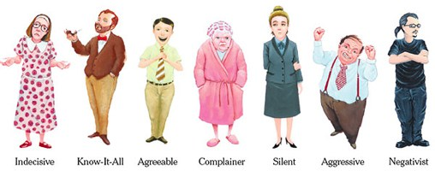
Types of Difficult People
Floor Hogs
Constant Commenters
Yellers
Nitpickers
Negative Nancies
Controllers

Slide 6

Floor Hogs
Take over the meeting but don’t let anyone else talk.
What to do with a Floor Hog:
  Read the room. Are people engaged or shut down?
  Politely invite someone else to speak.
  Make eye-contact with them and thank them for their contribution.
Are YOU a Floor Hog?
  Read the room.
  Watch people’s facial expressions and for other non-verbal cues that you may be taking over the conversation.
  Acknowledge that you may be hogging the floor.

Slide 7
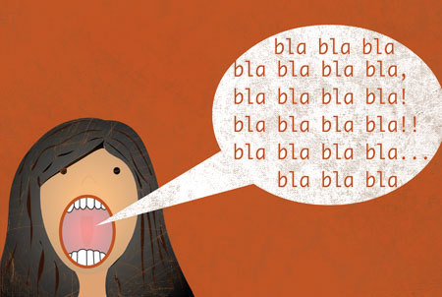
Constant Commenters
They have an answer for every question. A comment for every answer. Like to have the last word. May often extend meetings because they ask questions or need to respond to something.
What to do about Constant Commenters:
  Thank them for their comments and ask if anyone else would like to contribute.
  Suggest that they talk to the presenter or whomever one-on-one.
  Politely talk to them alone.
Are YOU a Constant Commenter?
  Do you like to have the last word even when it doesn’t matter?
  Do people sigh or start to squirm when you start talking toward the end of a meeting?
  Consider whether what you feel the need to say is necessary or could be addressed better in a one-on-one conversation.

Slide 8

Yellers
Use their tone of voice to control a discussion or other situation; seek to intimidate others.
What to do with a Yeller:
  Don’t show that you are intimidated.
  Don’t meet their anger with anger.
  Assertively (not aggressively) respond if what they are saying needs a response.
  If it doesn’t need a response, don’t respond.
  If you have a consistent yeller in your club, politely confront them about it one-on-one.
Are YOU a Yeller?
  Breathe.
  Apologize if you have hurt someone’s feelings or treated them badly.
  Do a body scan to see how you feel in the moment. Tense? Breathless? Shaky?
  Reflect on how you could have responded differently.

Slide 9
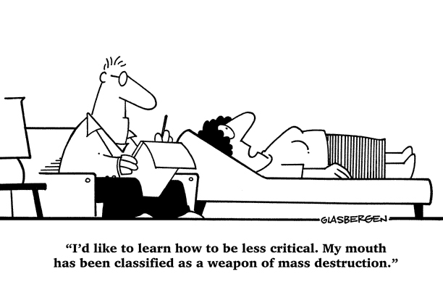
Nitpickers
They always have a better idea, a way something could be done differently, or find a flaw.
What to do about Nitpickers:
  Thank them for their comments but don’t dwell on them.
  Allow them to complete the task they are picking on.
  Offer to talk to them one-on-one.
Are YOU a Nitpicker?
  Do you often comment on minor details?
  Do you focus on the flaws in a presentation or project and feel the need to call them out?
  If you see a flaw or something that needs to be brought to attention, talk to the person one-on-one.
  Consider whether what you are saying is necessary to the conversation.

Slide 10
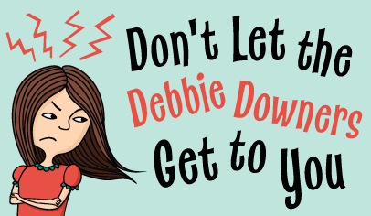
Negative Nancies
Focus on the negative and shut down positivity.
What to do with a Negative Nancy:
  Don’t let them bring you down or shut down ideas.
  Meet their comments with positivity when possible.
Are YOU a Negative Nancy?
  Count to 3 before responding to allow yourself a chance to assess:
    Are you focusing on the negative?
    Is your contribution helpful or necessary?
    Can you frame your comment in a positive way?
  Consider staying out of the conversation if you can’t contribute positively.

Slide 11

Controllers/Competitors
Have to be right. There is always an excuse for the behavior, and always a reason to blame others. Everything is a competition.
They are perfectionists and micro-managers, and often criticize others. Will not let up until they win…even if no one else is competing.
What to do with a Controller:
  Act unintimidated. Show that you are good enough and they can’t make you feel insecure.
  Take credit for a job well done and resist calls for constant changes.
  Avoid engaging in a contest of who is right and wrong.
Are you a Controller/Competitor?
  Do you try to take over situations or prove you are right at any cost?
  Do people see you as unreasonable?
  Think before you speak. Competing may not be worth the cost.

Slide 12
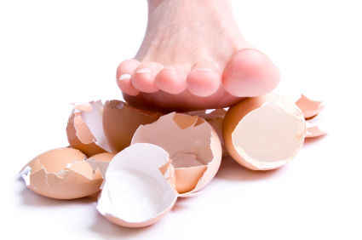
How to Deal:
Breathe
Take a moment before responding
Avoid power-struggles
Confront damaging behaviors one-on-one
Meet negativity with positivity
Set limits and boundaries
Look for specific solutions to the situation
Engage in self-care

Slide 13

Self Care
Deep breathing, mindfulness
Exercise
Journaling
Avoid inflammatory situations when possible
Be proactive instead of reactive
Ask for help if needed

Slide 14
Notes:
We’re going to switch gears just a bit, but this next topic is still related to dealing with difficult people and making sure your club is place that is comfortable for all involved.

Slide 15
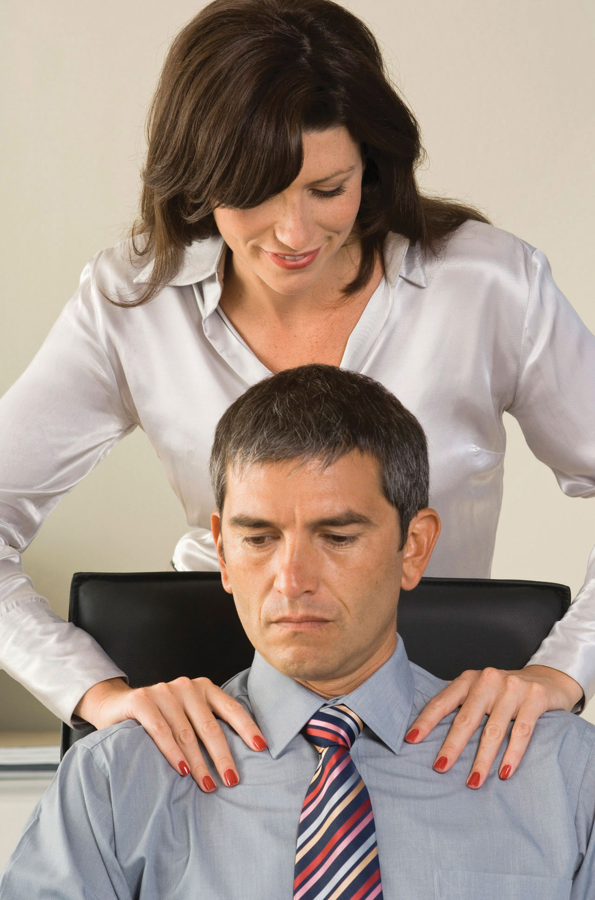

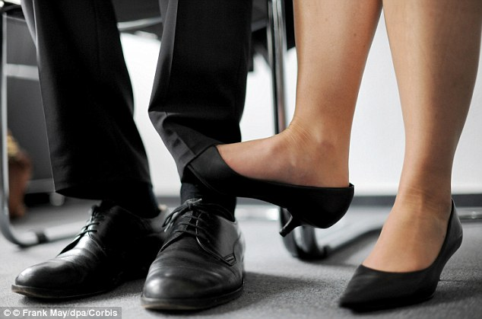
Sexual harassment
Harassment: Unwanted sexual advances, requests for sexual favors (even in jest), and other verbal or physical conduct of a sexual nature when:
  Submission to such conduct is made either explicitly or implicitly a term or condition of employment.
  Submission to or rejection of such conduct by an individual is used as a basis for employment decisions affecting the individual.
  Such conduct has the purpose or effect of unreasonably interfering with an individual’s work performance or creating an intimidating, hostile, or offensive working environment.
Generally, must be severe OR pervasive to meet legal definition. (Doesn’t need to be both.)

Slide 16
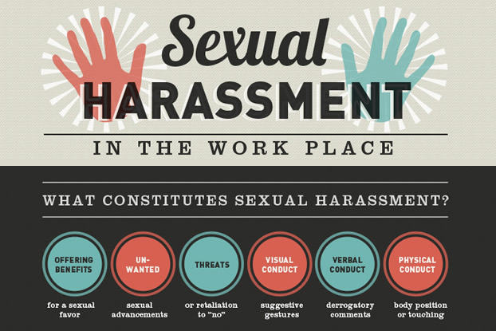

Slide 17

What to Do:
Clearly, tell the person to stop.
Report the person to club leadership and/or agent
In cases of illegal activity such as stalking or assault, report (or encourage the victim to report) to the police.
Keep a record of incidences. Start a paper trail.
Stand your ground.

Slide 18
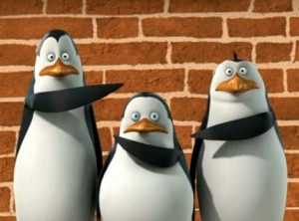
Not me!

Slide 19

Notes:
Working together in your clubs, you can insure that all are heard and comfortable and can contribute to their highest potential.

