Slide 1


Telling Your Story
& Building Bridges
Effective Communication with the Public and Media
Kristin Higgins, Program Associate
University of Arkansas Division of Agriculture
Public Policy Center

Slide 2
Today’s Discussion
Telling Your Story
Communication Planning
Building Bridges
Trust Behaviors
The Media
A Limited Role

Slide 3
Ask Yourself
Define Your Audience
  Who do you want to reach?
Determine Your Purpose
  Why do you want to reach them?
Identify Your Information
  What do you want to tell them?
Plan Your Steps
  How will you tell them?

Slide 4
Good Communication = Planning
Develop Communication Plans
  Determine goals
  Identify message
  Develop a timeframe for implementation
  Establish how often you communicate
  Reduce confusion

Slide 5
1. Assess
What is the situation?
What is your current communication style?
Who are you reaching now?
What has been your audience feedback?
What assets does your community have?
  i.e. media, interested residents, etc.
What assets does your group have?
  i.e. partners, committees, budget, building, etc.

Slide 6
2. Establish Goals
What do you want to accomplish or change?

Slide 7
3. Determine Your Audience
Who will be affected by your goals?
Who else do you want to reach?
How does your audience seek and receive information?

Slide 8
4. Identify your Message
What is your mission?
What about your organization will resonate with the audience?
What do you want the public to know
  Short-term: upcoming event
  Long-term: your impact on the community

Slide 9
5. Create Your Strategy
Identify realistic short-term goals
Identify realistic long-term goals
How often will you communicate?
Recognize how strategy might differ depending on the audience
Identify spokesperson

Slide 10
Multiple Audiences
  Create multiple plans:
  Community
  Sponsors
  Media
  Social Media

Slide 11
6. Develop a Timetable
Identify action steps and assign deadlines
  Example:
    June: Established communication committee
    July: E-mailed press release on August event
    August: Recruited 5 new volunteers
Predetermine evaluation dates

Slide 12
7. Evaluate
Did you meet deadlines?
Did you accomplish goals?
What does your audience say?
What did you find easy? Difficult?
What would you do different next time?
What do you want to add?

Slide 13
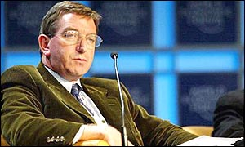
Building Bridges = Trust
“You can have all the facts and figures, all the supporting evidence, all the endorsement that you want, but if you don’t command trust, you won’t get anywhere.”
Niall Fitzgerald,
former chairman of Unilever

Slide 14
Trust Behaviors
Talk Straight
Demonstrate Respect
Create Transparency
Right Wrongs
Give Credit to Others
Source: The Speed of Trust, Stephen M. R. Covey

Slide 15
Trust Behaviors
6. Deliver Results
7. Get Better
8. Confront Reality
9. Clarify Expectations
10. Practice Accountability
Source: The Speed of Trust, Stephen M. R. Covey

Slide 16
Trust Behaviors
11. Listen First
12. Keep Commitments
13. Extend Trust
Source: The Speed of Trust, Stephen M. R. Covey

Slide 17
Trust Behaviors
Apply these principles to each other
Apply these principles toward the public

Slide 18
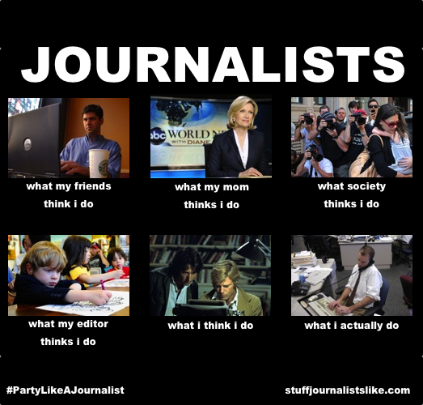
Working with the Media

Slide 19
The World of Journalism
39,806 – Newspaper jobs eliminated between 2007 and 2011. (source: newspaperlayoffs.com)
$32,000 – Average reporter salary (indeed.com)
244,864 – Arkansas Democrat-Gazette’s Sunday circulation

Slide 20
The Bad News
NEWS TRIAGE
With less space for publishing community news and fewer reporters on hand, media outlets have to prioritize their coverage.
Your event or organization might not be deemed important enough for coverage.

Slide 21
The Good News
HYPER LOCAL NEWS
Community blogs and Facebook pages have popped up to keep residents informed of local news – school sports highlights, lost and found pets, public meetings and events.
Smaller organizations can now share information with a wider group of people through new online venues.

Slide 22
How to Connect
New reporter? Seek them out at meetings, make a phone call to introduce yourself, give them your card
Ignored issue? Invite reporter or editor out to coffee to talk more about important issue, even if there’s not an immediate story
Reporters want to develop community relationships because it leads to better understanding, better stories and better access.

Slide 23
Effective press releases:
Explain why the public should care, therefore why the newspaper should care about printing
Delivered via email, fax, mail, etc. several weeks ahead of time, with reminders the day before and DAY OF event
If possible, have a press packet ready with important information, fact sheets, etc. at event

Slide 24
Good press releases include:
What’s new
Contact information for interviews
Cost estimates or donation amounts
Names, titles
Background on issue – dates, people, etc.
Put everything in the body of the email. Not everyone has the time or right programs to open attachments.

Slide 25
Do
Return phone calls/emails as quickly as possible
Provide accurate information
Provide access for interviews
Talk in complete sentences when possible
Give reporters advance notice

Slide 26
Don’t
Lie
Guess on dollar figures
Repeatedly call to ask if your event is being covered
Wait until after an interview to invoke “Off the record”
Offer reporters food, gifts, or anything else that may create a conflict of interest

Slide 27
Prepare yourself
Unless it’s an emergency, don’t go into an interview cold
  Review your information prior to the interview
  Keep your notes in front of you to refer back to
  Know what the reporter is writing about
  Think about what you’re saying

Slide 28
Expect
Reporters to talk to multiple people, not just you
All conversations to be on the record – unless you say “This is off the record” before the statement is made
Accuracy – CALL the reporter/editor about any mistake otherwise it will be repeated as truth in future stories

Slide 29
Know that
Most reporters don’t write the headlines
Not everything you say will be printed
You may be talking to an inexperienced reporter
Reporters do not do allow prior review

Slide 30

QUESTIONS?
Kristin Higgins
khiggins@uaex.edu
501-671-2160
www.ppc.uaex.edu
Facebook.com/uappc

