Slide 1


Keep it Safe:
Fun and Healthy Picnic Foods
Notes:
30-50 minute presentation + optional 10 minute activity with handout
Welcome. My name is __________, and I am a Family and Consumer Science Agent with the University of Arkansas Cooperative Extension Services for _____________County. With the weather heating-up it is the perfect time to head outside with family and friends for some fresh air, physical activity and of course a picnic. Today, I will be talking about how easy it is to keep your picnic foods safe as well as help you identify some healthy, delicious foods to try at your picnics. So let’s celebrate and have an active and foodborne illness free summer!

Slide 2
Objectives
Identify common picnic food safety challenges and high-risk picnic foods.
Identify the four plus one key principles of picnic food safety.
Name at least three good tasting and good for you foods to serve safely at picnics.
Notes:
By the end of this presentation, you will be able to…
Identify common picnic food safety challenges and high-risk picnic foods.
Identify the five key principles of picnic food safety.
Name at least three good tasting and good for you foods to serve safely at picnics.

Slide 3
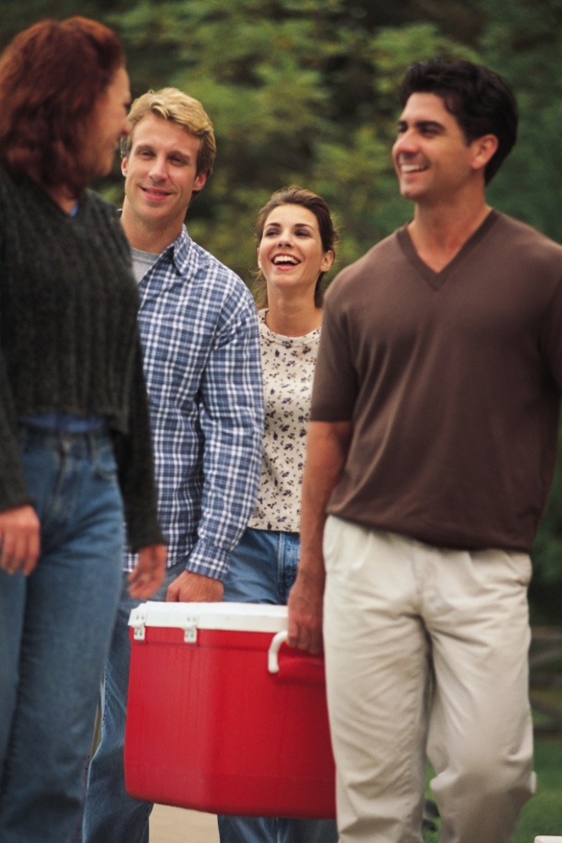
It’s Perfect Picnic Weather But…
CDC estimates that 1 in 6 individuals fall ill due to foodborne illness every year - that’s 48 million people! (FoodNet: Trends in Foodborne Illness in the United States, 2012)
Incidence of foodborne illnesses increase during summer months. (CDC Foodborne Outbreak Online Database, 1998-2011)
Notes:
We can all admit that getting sick from the food we eat isn’t any fun but the reality is many of us will experience a foodborne illness over a lifetime. In fact based on data from the Centers for Disease Control and Prevention (CDC) we can expect foodborne illness to impact 48 million of us a year. That is an estimate based on surveillance of about 15% of the entire US population.
While food poisoning can happen at any time foodborne illness peaks during warmer summer months.
Why is this? The answer is twofold.
One the bacteria that are present throughout the environment grow faster in warm months. Most foodborne illness causing bacteria grow fastest between the temperatures of 90 to 110 °F. Bacteria also need moisture to flourish and summer weather is often hot and humid. So given these ‘right’ circumstances harmful bacteria can quickly multiply on food to large numbers.
Two we go outside during the summer and that means more people are cooking at picnics, barbecues and on camping trips without the safety controls that our kitchens provide.
Luckily we seldom get sick from contaminated food because most of us have healthy immune systems. But we all can minimize our risk if we take some simple steps to ensure safe food is served at our outdoor events.
What are these steps? We will be reviewing them on the next series of slides.

Slide 4

Four (+1) Steps to Safe Picnic Food
CLEAN
SEPARATE
COOK
HOLD (the + 1)
CHILL
image credit Foodsafety.gov and part of the Food Safe Families campaign
Notes:
Today we are going to review the FOUR basic principles of the Food Safe Families campaign plus ONE extra principle and apply these concepts to summer-time picnics.
The first principle is CLEAN (as in reduce overall pathogen load)
1) Wash your hands before and after handing foods. Wash hands for 20 seconds (you can sing the happy birthday song twice) with soap and running water and dry with a clean towel or paper towel.
2) Wash surfaces and utensils that come into contact with food after each use. Use soap and water, then rinse clean, and allow to air dry. Wash dishes and utensils in a dishwasher and dish towels in a washing machine if available.
3) Wash fruits and vegetables (even if you plan to peel them) under cold running water and use a fruit and vegetable scrubber to ensure maximum cleanliness. Do not wash meat, poultry or eggs just pat dry. If you wash meat, poultry and eggs you will simply spread the germs rather than contain the germs!
The second principle is SEPARATE (as in avoid cross-contamination)
1) Long before you ever prepare foods start separating them. This is to avoid cross-contamination. Cross-contamination occurs when pathogens on one type of food get onto another type of food that didn’t previously contain those pathogens.
2) Separate meat, poultry, seafood, and eggs from all other foods at all times.
3) Store foods separately and place raw meat, poultry, and seafood in containers or sealed in plastic bags and place them below ready-to-eat foods.
4) When preparing foods use separate utensils and cutting boards for produce and ready-to-eat items and meats, poultry and seafood or wash thoroughly before using again.
The third principle is COOK (as in reduce pathogen load or toxin load)
Cook foods to their appropriate internal temperatures.
2) The only way to know if the correct internal temperature has been reached is to use a food thermometer.
3) Avoid partial cooking.
The fourth principle is HOLD (as in keep bacteria out of the temperature danger zone)
1) Keep hot foods hot and cold foods cold. The key is to never let your foods remain in the temperature danger zone of 40 °F and 140 °F. That means cold foods should be kept below 40 °F and hot foods kept above 140 °F. These temperatures are when bacteria multiply the fastest.
2) If your food does enter the temperature danger zone watch your time! You can keep food safely out for 2 hours between 40 °F and 90 °F and for 1 hour if over 90 °F. If these times are not met you should discard your leftovers.
The fifth principle is CHILL (as in slow bacteria’s ability to replicate)
1) Make sure your fridge and freezer are cooled to the right temperature. Your fridge should be between 32 ˚F and 40 ˚F and your freezer should be 0 ˚F or below.
2) Always thaw and marinate meats in your refrigerator.
3) Cool hot leftovers in several, shallow containers before storing.
Ok now we are ready to apply these principles to picnics.

Slide 5
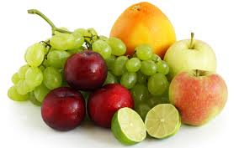
CLEAN – Picnic Challenges
Hand washing
Washing utensils and surfaces
Washing fruits and vegetables
High risk food: melons
Notes:
CLEAN Picnic Challenges
Wash your hands before and after handing foods.
But outdoors you may not have access to running water so what to do?
Wash surfaces and utensils that come into contact with food after each use.
With no dishwasher in site what are picnickers to do?
Wash fruits and vegetables.
We need to wash our produce but again no running water is available.
Why are melons are a CLEAN high risk picnic food? Because we often forget to wash and scrub the rinds. Then when we cut the melons we essentially drag bacteria onto the parts we do eat. These parts also happen to be prime growing grounds for bacteria!

Slide 6
CLEAN – Picnic Solutions
Hand washing
  Identify parks/recreation areas with running water
  Bring your own water and soap
  Use disposable towelettes in a pinch
Washing utensils and surfaces
  Use disposable plates, platters, towels
  Bring multiple utensils for meat vs. ready-to-eat foods
Washing fruits and vegetables
  Wash before you leave
  Melon rinds should be cleaned too!
Notes:
So what are the solutions for your picnic CLEAN challenges?
With a little planning it is simple to follow the CLEAN principle of food safety.
If you don’t have access to running water you can bring your own. Simply use a water jug, some soap and paper towels OR consider using moist disposable towelettes for cleaning your
hands.
When it comes to picnicking multiple utensils and plates/platters are your friend. Keep uncooked meats on one platter and use a new platter once they are cooked. Or use disposable items to ensure surfaces that come into contact with foods stay clean.
Think ahead and wash fresh fruits and vegetables under running water before packing them in coolers or picnic baskets. It is also good idea to scrub firm-skinned fruits and vegetables under running tap water and especially melons which have been linked to foodborne illness outbreaks. Even if you don’t eat the rinds it is important to keep them clean!
You may ask the audience if they have any ideas for solutions.

Slide 7
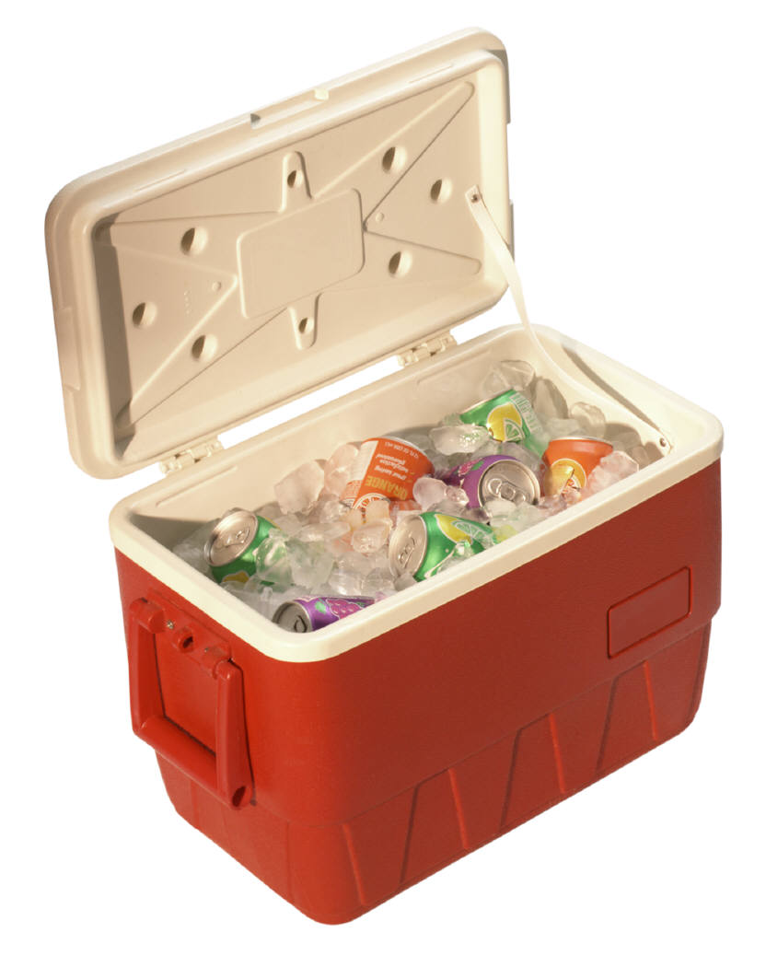
SEPARATE – Picnic Challenges
Cross-contamination
High risk food: coleslaw
Notes:
SEPARATE Picnic Challenges
Avoid cross-contamination.
But outdoors when we don’t have access to kitchen space and the variety of dishware and utensils we can find in our kitchens it can be an added challenge!
Why would coleslaw be a SEPARATE high risk food? Because it is a ready-to-eat COLD food that requires refrigeration. In fact any ready-to-eat COLD food that may be stored in a cooler next to uncooked meat, poultry, seafood, egg dishes, or other mixed dishes is a high risk picnic food.

Slide 8
SEPARATE – Picnic Solutions
Avoid cross-contamination
  Use disposable plates, platters, towels
  Bring multiple utensils for meat vs. ready-to-eat foods
  Wrap foods securely
  Avoid leakages
  Bring multiple coolers – use one for ready-to-eat items and one for uncooked items OR organize cooler contents
  Purchase pre-cooked hot items to serve
Notes:
So what are the solutions for your picnic SEPARATE challenges?
You can avoid cross-contamination by following a CLEAN principle. Bring multiple utensils and plates/platters and keep uncooked meats on one platter and use a new platter after they are cooked. Or you can always use disposable items to avoid cross-contamination. Another solution is to be sure to keep raw meat, poultry and seafood securely wrapped. Check for leaks! This keeps raw meat juices from contaminating your ready-to-eat foods.
Another way to avoid cross-contamination is the use of multiple coolers. Use one for your ready-to-eat items (that means items that won’t be cooked or heated) and one for your picnic items that require cooking. OR if you don’t want to bring multiple coolers organize your cooler contents keeping your ready-to-eat items on top and separated from the items that require cooking and of course be sure that everything is wrapped securely to prevent leaking!
OR you could always purchase pre-cooked hot food items like vegetarian pizza on whole grain or wheat crust, herb seasoned grilled chicken or marinated grilled salmon to avoid uncooked meat leakages.
You may ask the audience if they have any other ideas for solutions.

Slide 9
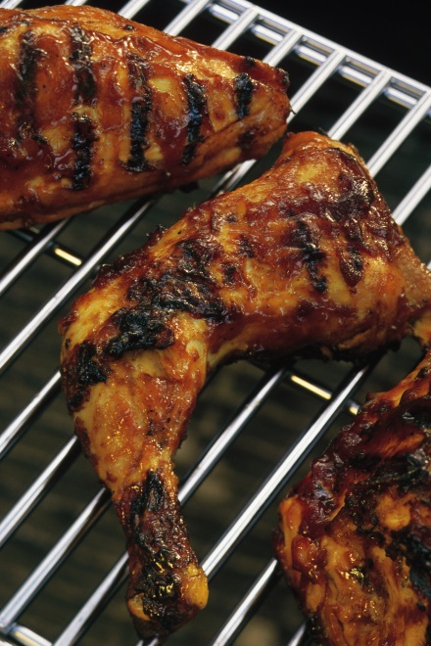
COOK – Picnic Challenges
Cooking variety of foods
Thermometer
Marinating
Partial cooking
High risk food: marinated chicken breast
Notes:
Cook Picnic Challenges
Cooking foods to their appropriate internal temperatures.
Grilling and picnics go hand-in-hand but often we cook more than one type of food. That means we need to know a variety of safe internal cooking temperatures? So what to do?
The only way to know if the correct internal temperature is reached is to use a food thermometer.
But we aren’t in our kitchen? So where is our thermometer?
Marinating is a great way to impart healthy flavor to grilled meats.
But we are outdoors? Where to marinate?
Avoid partial cooking.
But we have lots of people to feed and we need to feed them quickly so how do we get the hot food to them quickly?
Why would marinated chicken breast be a COOK high risk food? Because it is marinated and requires the highest internal temperature (165 °F) to ensure safety.

Slide 10
COOK – Picnic Solutions
Cooking variety of foods
  Remember 140, 145, 160, and 165 °F
  Refer to Keep it Safe – Fun and Healthy Picnic Foods Handout
Thermometer
  Have a plan and bring from home
Marinating
  Have a plan and marinate before your picnic
  If using as sauce set some aside just for that reason
Partial cooking
  Avoid this OR immediately do so before you finish cooking on grill
Notes:
So what are the solutions for your picnic COOK challenges?
You can avoid COOK picnic blunders by referring to the Keep it Safe – Fun and Healthy Picnic Foods Handout. But all you need to remember is four safe temperatures, 140, 145, 160, and 165 °F.
140 °F for re-heating precooked ham
145 °F for whole cuts/roasts of beef, lamb and pork with a 3 minute rest period
160 °F for ground beef, pork and lamb and egg dishes
165 °F for all types of poultry including ground, leftovers and casseroles including casseroles with eggs
Make a plan and bring a food thermometer from home so you can check your temperatures. The only true way to know if you food has reached safe internal temperatures is to measure it with a thermometer. Better yet bring multiple thermometers for your different dishes OR be sure to clean your thermometer between uses.
Marinating is a delicious and healthy way to impart great flavor. Just be sure to marinate at home or in a cooler that is below 40 °F. Also if you want to use some of the marinade as a sauce be sure to hold some separately.
Partial cooking should be avoided if possible. If you partially cook food to reduce grilling time, do so immediately before the food goes on the hot grill. If time is of the essence a great solution is to offer a variety of foods including ready-to-eat foods, like fresh fruit and veggies, baked chips, yogurt based dips, and trail mix, so hungry crowds don’t stand around the grill waiting for the cook to finish.
You may ask the audience if they have any other ideas for solutions.

Slide 11
HOLD (the + 1) – Picnic Challenges
Keeping hot foods hot
Keeping cold foods cold
Timing
High risk food: coconut cream pie
Notes:
HOLD Picnic Challenges
Keeping hot foods hot.
No stoves or ovens…
Keeping cold foods cold.
No refrigeration….
Time.
We serve our picnics buffet style and we have lots of people to feed plus we are playing games and participating in other outdoor activities so we need lots of time for our food to be out.
Why would a coconut cream pie be a high risk HOLD food? Because it is a cold food that requires temperatures of less than 40 °F to prevent bacteria from multiplying to unsafe levels. Pies often aren’t considered a ‘cold food’ and will be held out for many hours in the temperature danger zone. Plus cream pies with their whipped toppings can get ‘smooshed’ when placed in coolers with ice so often they are left out on tables for beauty reasons as well.

Slide 12
HOLD (the + 1) – Picnic Solutions
Keeping hot foods hot
  Keep in insulated containers
  Grilled foods can be kept hot until served by moving to the side of the grill rack
Keeping cold foods cold
  Use separate coolers
  Keep in shade
  Place serving dishes in containers filled with ice
  Don’t transport in the trunk of your car
Timing
  Eat within 2 hours when 40-90 °F
  Eat within 1 hour when >90 °F
Notes:
So what are the solutions for your picnic HOLD challenges?
The key to avoiding HOLD picnic errors is to never let your foods remain in the temperature danger zone of 40 °F and 140 °F for too long. Or it means cold foods should be kept below 40 °F and hot foods kept above 140 °F.
You can keep your hot foods hot by placing them in insulated containers until serving or you can keep grilled foods hot until served by moving them to the side of the grill rack where there are no flames. Or if you are purchasing ready-to-eat hot items be sure to directly transport them to your picnic and use insulated containers when possible.
Then keep your cold picnic foods cold by having a separate cooler, one for foods and one for beverages, as an example, and be sure to keep them in the shade. You want to minimize the number of times you open and close your cold food coolers! Also when transporting food from your home keep coolers in the temperature controlled part of the vehicle. Not in the trunk where temperatures can become very hot very quickly.
And always watch your time. You can keep food safely out for 2 hours between 40 °F and 90 °F and for 1 hour if over 90 °F. If these times are not met you should discard your leftover food.
You may ask the audience if they have any other ideas for solutions.

Slide 13
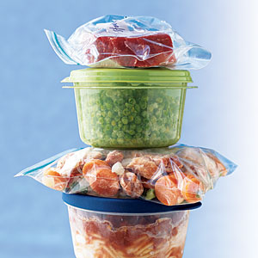
CHILL – Picnic Challenges
No refrigerator or freezer
Lots of leftovers
High risk food: baked beans
Notes:
CHILL Picnic Challenges
No refrigerator or freezer.
Again we are not in our kitchen…darn.
Lots of leftovers.
We don’t want anyone to go hungry so we always bring lots of food to our picnics.
Why would baked beans be a high risk CHILL food? Because it is a hot food that is often made in large quantities. Plus we don’t often think of beans as a high risk food because they aren’t meat or eggs. But baked beans meet all the requirements for bacteria to grow. So be sure to keep baked beans hot above 140 °F OR watch your time, left out for 2 hours between 40 – 90 °F and 1 hour if hotter than 90 °F, and prior to storing, place into several, shallow containers to allow for rapid cooling.

Slide 14
CHILL – Picnic Solutions
No refrigerator
  Multiple coolers packed with ice or ice packs or frozen water jugs plus cooler thermometer
  Keep at 40 °F or less
  Keep foods under a layer of ice not sitting directly on top
  Keep draining water and adding ice to keep cool
Lots of leftovers
  Avoid if possible
  Pack extra foods that are safe at all temperatures
  Pack extra plastic, sealable bags or other food storage containers for safe storage
Notes:
So what are the solutions for your picnic CHILL challenges?
No refrigerator? A cooler with a cooler thermometer is a great solution.
Find a shady spot, separate your beverages in one cooler from your foods in another cooler to minimize opening and closing, add ice as necessary, and keep foods under a layer of ice not sitting directly on top.
Have a plan to limit the amount of leftovers that need to be kept out of the temperature danger zone. If you are concerned about running out of food pack extra foods that are safe at all temperatures and pack plastic, sealable bags or other food storage containers to put small amounts of leftovers in so you can chill them easily.
You may ask the audience if they have any other ideas for solutions.

Slide 15
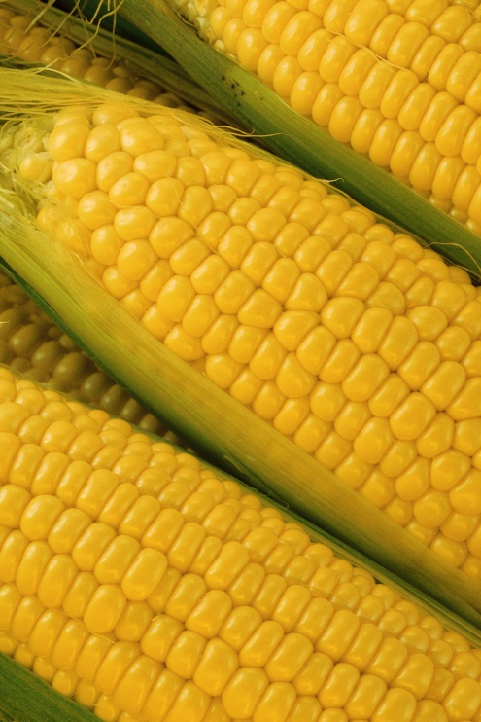
Focus on Food
Now that we know the Four plus One principles of safe food practices….
All we have to do for our picnics is make a plan…
Think about the tools we need…
Select a variety of foods….
and get ready for fun!
Notes:
Review the slide.
We will be reviewing a variety of healthy, safe food options on the next series of slides.

Slide 16
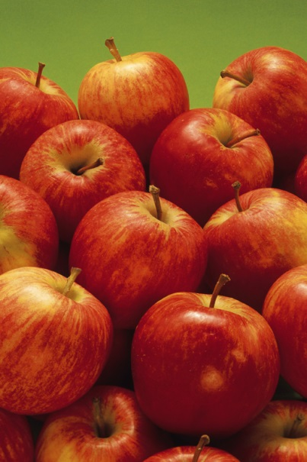
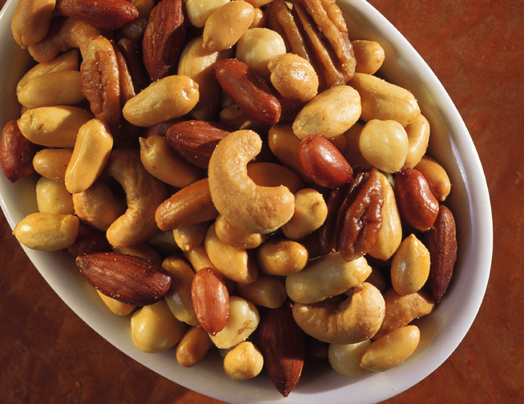
Temperature Stable Food: Ideas
Fresh whole fruit
  Apples, pears, grapes, tangerines, berries, bananas, pears, oranges
Dried fruit
Mixed nuts and trail mix
  Roasted, raw, lightly salted
Healthy baked items
  Oatmeal cookies
  Applesauce sweetened brownies
Notes:
Review the slide.
Temperature stable food refers to foods that can be kept in the temperature danger zone of 40 °F – 140 °F for more than 2 hours without added risk of foodborne illness. But it is still advisable to keep out of direct sunlight as quality will diminish with hot temperatures and high-humidity.
The CLEAN principle still applies, though, so be sure to wash your produce items either before you leave home or once you get to your picnic site!

Slide 17
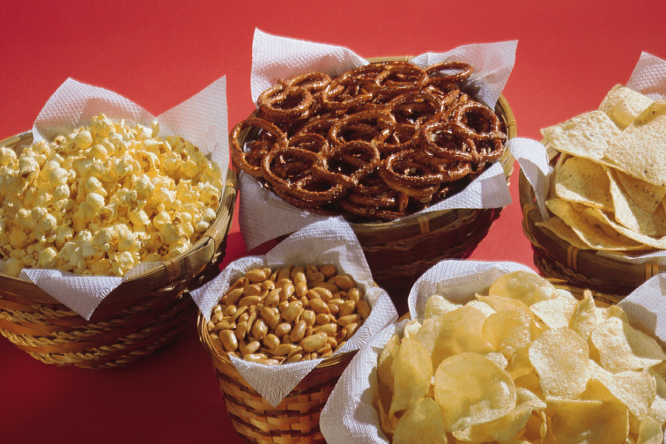
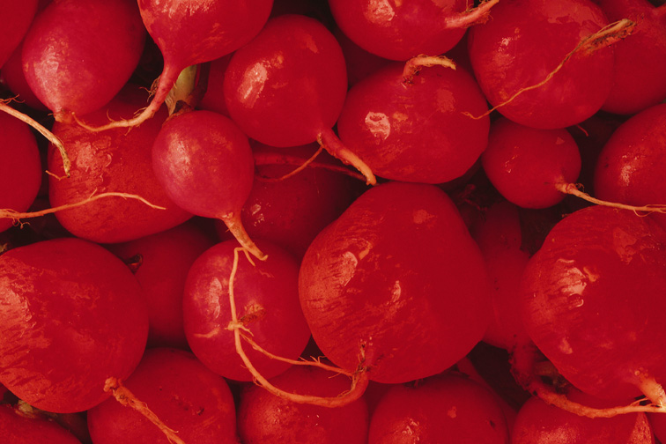
Temperature Stable Food: Ideas
100% whole grain or multi-grain pretzels
Air popped popcorn
Baked chips
  Corn, potato
Hard cheeses
  Cheddar, Gouda, Gruyere
Uncut veggies
  Baby carrots, sugar snap peas, cherry tomatoes, snow peas, radishes
Notes:
Review the slide.
More ideas and remember…
Temperature stable foods refers to foods that can be kept in the temperature danger zone of 40 °F – 140 °F for more than 2 hours without added risk of foodborne illness. But it is still advisable to keep out of direct sunlight as quality will diminish with hot temperatures and high-humidity. This is especially true for your hard cheeses!
The CLEAN principle still applies, though, so be sure to wash your produce items either before you leave home or once you get to your picnic site!

Slide 18
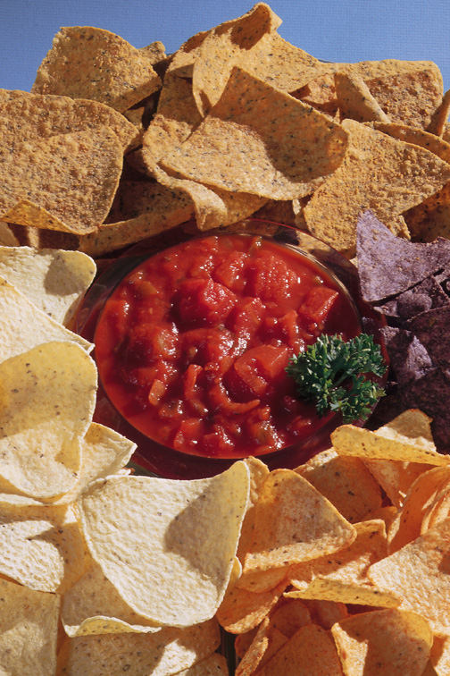
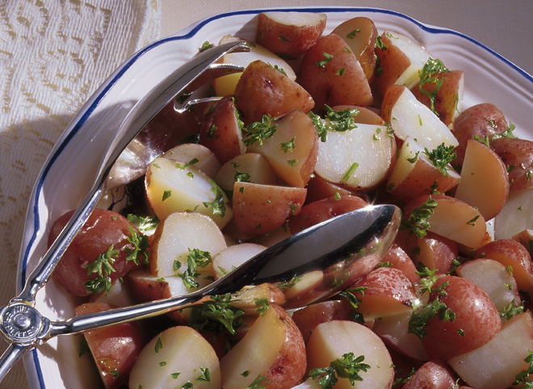
Ready-to-Eat COLD: Ideas
Yogurt based dips
Bean based dips
Salsas
Marinated vegetable salads
German-style potato salad (vinegar based)
Grain based side dishes
  Wild rice, couscous, quinoa, whole wheat pasta salads
Notes:
Review the slide.
Ready-to-eat COLD refers to foods that CAN NOT be kept in the temperature danger zone of 40 °F – 90 °F for more than 2 hours without added risk of foodborne illness or 1 hour if >90 °F . They are also foods that need to be transported and held cold at a temperature of 40 °F or less. So keep that ice coming! Remember you can also nestle the serving dishes in larger containers full of ice to keep the temperatures down. Also make a plan and prepare or purchase these dishes the morning of your picnic.

Slide 19
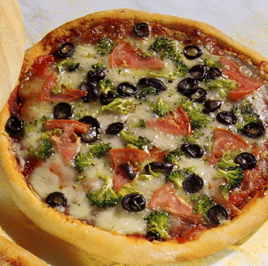
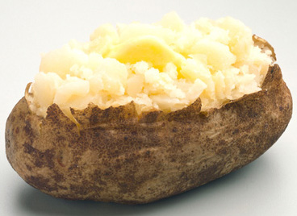
Ready-to-Eat HOT: Ideas
Roasted chicken
Vegetarian pizza on whole grain crust
Baked potatoes*
Turkey chili
Notes:
Review the slide.
Ready-to-eat HOT refers to foods that CAN NOT be kept in the temperature danger zone of 40 °F – 90 °F for more than 2 hours without added risk of foodborne illness or 1 hour if >90 °F . They are also foods that need to be transported and held hot at a temperature of 140 °F or more. So think insulated containers and consume quickly! As always make a plan and prepare or purchase these dishes immediately before driving to your outdoor activity.
*don’t wrap your baked potatoes in foil because that can produce an anaerobic environment that is perfect for botulism - store baked potatoes in insulated containers instead where air can circulate.

Slide 20
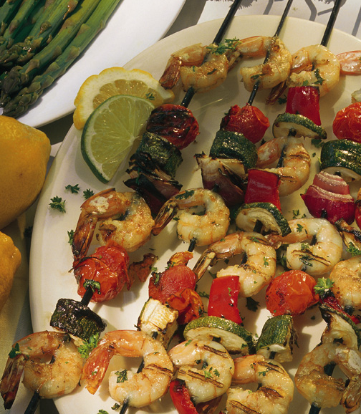
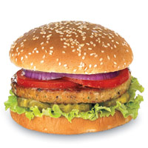
Cook on Site: Ideas
Vegetable kabobs
Grilled shrimp, chicken and fish
Veggie and turkey burgers on 100% whole wheat buns
Iron skillet fruit cobblers
Notes:
Review the slide.
Cook on site foods need special attention.
Make a plan and prep ahead of time that means wash your produce, think about the utensils you will need, bring soap and water, etc.
Wrap and store seafood, poultry and meats securely and separately to ensure no leakage and to avoid cross-contamination.
Transport and hold until ready to cook at 40 °F or less.
Cook to safe internal temperatures.
Eat within 2 hours if >90 °F and 1 hour <90 °F or hold hot at >140 °F.
Chill leftovers that have not been in the temperature danger zone for more than 2 hours or 1 hour depending on temperature in several, small shallow containers and on ice to ensure quick cooling.

Slide 21
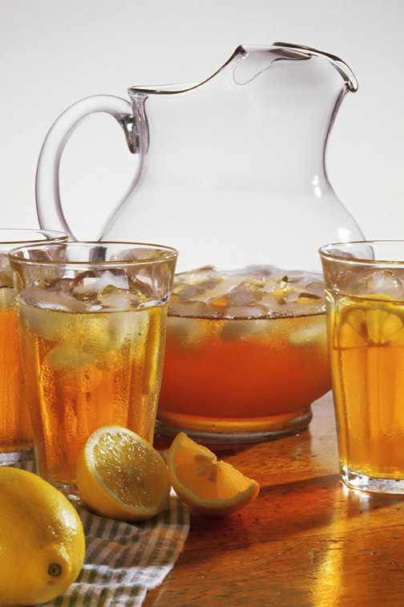
Beverages
Sparkling water
Sparkling water with splash of fruit juice
Unsweetened iced tea
Spa water (water with citrus or cucumber slices)
Frozen bottled water
Notes:
Review the slide.
Don’t forget beverages! Here are some great healthy beverages for your outdoor activities. It is important to stay hydrated during the hot summer months. Frozen bottled water serves two purposes it can keep you cool plus help you stay hydrated.
The CLEAN principle still applies, though, so be sure to wash your produce items either before you leave home or once you get to your picnic site if using for your beverages.

Slide 22
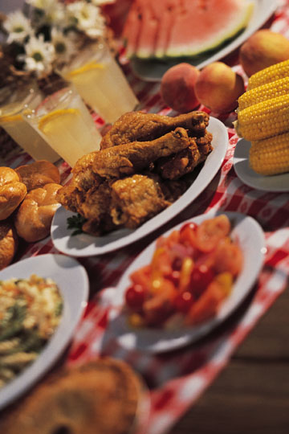
Activity
Now it’s your turn to practice planning a safe and healthy picnic.
Notes:
SUGGESTED ACTIVITY (10 minutes)
Note: If you are not doing an optional activity, please delete this slide and move to the summary slide. Refer to Keep it Safe – Fun and Healthy Picnic Foods Handout for activity.
ACTIVITY INSTRUCTIONS:
Ask individuals to get into groups. Aim for 3-4 individuals per group. Have groups plan a safe and healthy picnic.
Remind them to include:
Tools they would bring including coolers, utensils, ice, water and soap, containers for leftovers, etc.
How they would pack and transport the items
Include a variety of temperature stable items plus ready-to-eat cold and hot items and items that require on-site cooking plus beverages
Strategy for leftovers
Near the end of the activity, ask each group to share their safe and healthy picnic plans.
Other suggested activity ideas:
Bring two coolers and two picnic baskets plus multiply empty containers labeled with foods items like raw chicken, fresh cut veggies, chocolate chip cookies, apples, etc. Have individuals form two teams and see which team can pack the cooler plus picnic basket the fastest while correctly applying the principles of SEPARATE.
Bring ingredients for a yogurt based dip plus cherry tomatoes and baby carrots for dipping. Also bring an appropriate container for transporting and storing the dip, tomatoes and carrots at picnics. Demonstrate making the dip and washing the produce and then packing it safely for a picnic trip. Then taste!
Obtain local grocery store deli menus and have participants identify safe and healthy ready-to-eat options to bring to their picnics. Build meals containing at least one ready-to-eat cold food, ready-to-eat hot food, plus 2 temperature stable foods. Discuss how you would transport and serve these items.

Slide 23
Summary
You can avoid foodborne illness at picnics and all your outdoor summer dining activities.
Just remember the FOUR plus ONE steps to prevent foodborne illnesses.
There a lots of great options for safe, delicious and healthy picnic foods all you need is a plan.
Notes:
You can avoid foodborne illness at picnics and all your outdoor summer dining activities.
Make a plan
Remember your tools (ice, coolers, insulated containers, storage for leftovers, water, soap, hand-wipes, paper towels, multiple utensils, thermometers etc)
Choose a variety of ready-to-eat, hot and cold foods plus self-stable foods
Just remember the FOUR plus ONE steps to prevent foodborne illnesses.
CLEAN
SEPARATE
COOK
HOLD
CHILL
There a lots of great options for safe, delicious and healthy picnic foods all you need is a plan.
Remember our great ideas?
Fresh whole fruit
Dried fruit
Mixed nuts
Baked chips
Whole grain pretzels
Yogurt based dips
Bean based dips
Cherry tomatoes and baby carrots
Grilled veggies
Ready-to-eat grilled salmon and chicken
Veggie burgers
Hard cheeses
Oatmeal and cranberry cookies
Applesauce sweetened brownies

Slide 24
Resources
University of Arkansas Cooperative Extension Service
  www.uaex.edu
Your Gateway to Federal Food Safety Information
  www.foodsafety.gov
Partnership for Food Safety Education
  www.fightbac.org
Centers for Disease Control and Prevention – Food Safety
  www.cdc.gov/foodsafety
Notes:
Here are some helpful places to go for more information on keeping your foods safe. This is also in your Keep it Safe – Fun and Healthy Picnic Foods Handout.

Slide 25
Questions?
Thank you!
Content Expertise Provided by:
Serena M. Fuller
Associate Professor – Nutrition and Food Safety
Department of Family and Consumer Sciences
University of Arkansas Research and Extension
Notes:
Thank you for your attention today. I hope this presentation gave you some good ideas about how to keep your summer picnics safe, healthy and fun!
Handouts:
Keep it Safe – Fun and Healthy Picnic Foods Handout

