Slide 1
10 Tips to Improve Mental Health During Covid-19 Crisis
Jean A. Ince-County Extension Agent-Staff Chair/ Family Consumer Science – Howard County
Notes:
Life has become challenging during the Covid-19 pandemic. Not being able to see your family, visit with friends and co-workers on a daily basis is stressful. You may be feeling overwhelmed or out of sorts. Guess what? This is a perfectly normal reaction. We all feel stressed from time to time. Hello, I’m Jean Ince, County Extension Agent-Staff Chair with the University of Arkansas Division of Agriculture. You may not have given a lot of thought to taking care of yourself while you are trying to meet the needs of others. However, it is so important, especially now as we are having to deal with many new challenges. Let’s look at some ways you can help improve your mental health.

Slide 2
Activity!
Notes:
To begin I would like for you to think about some things you do when you feel out of sorts or overwhelmed. I invite you to get a piece of paper and jot down your thoughts. You might want to pause the program here and write down just one thing you do to make yourself feel better. (PAUSE) Welcome back. Did you write down at least one thing? Good. Keep your list handy as we go through this program.

Slide 3
1. Socialize
Notes:
The first tip we will look at is socialization. Research shows that loneliness is a bigger predictor of health problems in later life. More so than poor diet, smoking, or lack of exercise. Look for ways to interact with others. While this may be challenging in today’s world, it can be a huge boost to your mental health. Visiting face-to-face or in social settings may not be possible. However, Facetime, Zoom and just plain old picking up the phone and calling a friend can help keep you connected. Call on those people who you enjoy being around and those that bring you up. These are those people who make us feel better. If possible, avoid those “Debby Downers”. Socialization boosts your endorphins and help you to feel good.

Slide 4
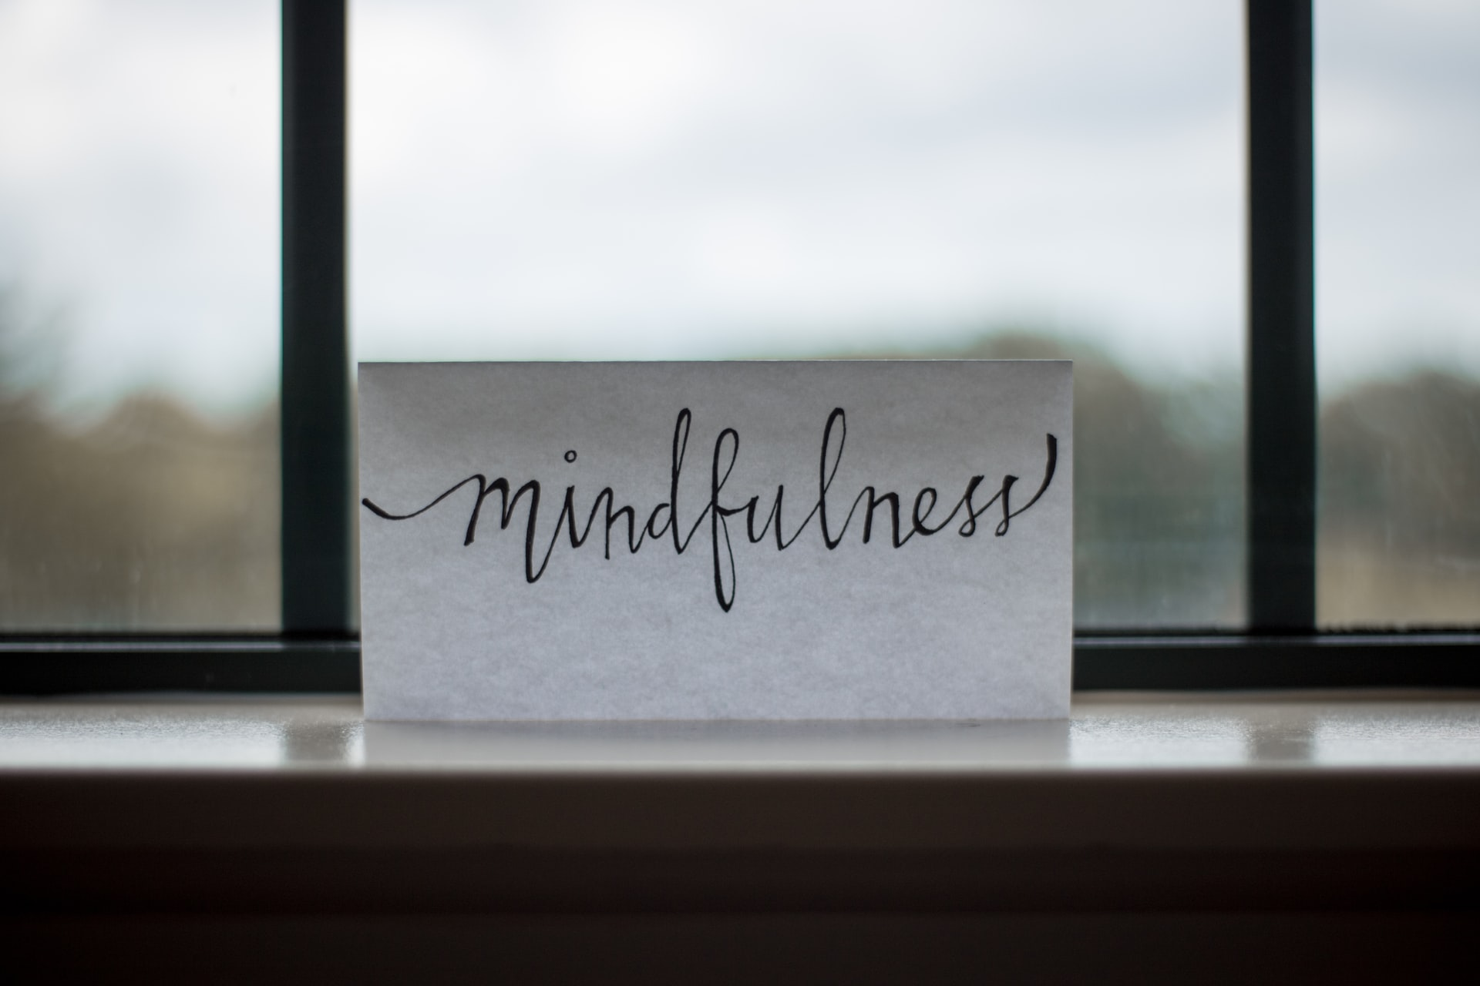
2. Mindfulness/Meditation
Breethe
Ibreathe
Calm
Notes:
2. Mindfulness or meditation. We practice mindfulness through meditation, deep breathing, or other practices that allow you to focus on and appreciate “the moment”. There are many free apps that help with meditation. Breethe, ibreathe, or calm are a few free ones you might want to check out. Start with short periods of mindfulness to train yourself and then increase the time as needed. Now is a good time to reflect back on the list you made during the opening activity. Have you thought of something else that helps you deal with stress? Add them to your list.

Slide 5
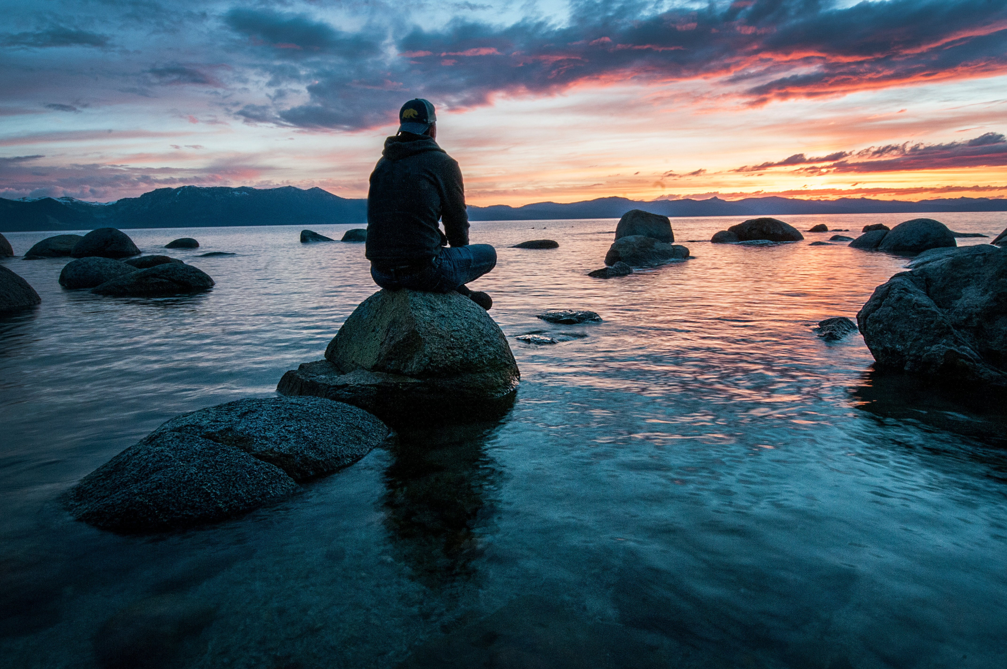
Activity!
Notes:
At this point you might consider pausing the video, downloading one of the apps mentioned and trying it out. (Pause) How do you feel? Calmer. Relaxed. That’s the goal.

Slide 6
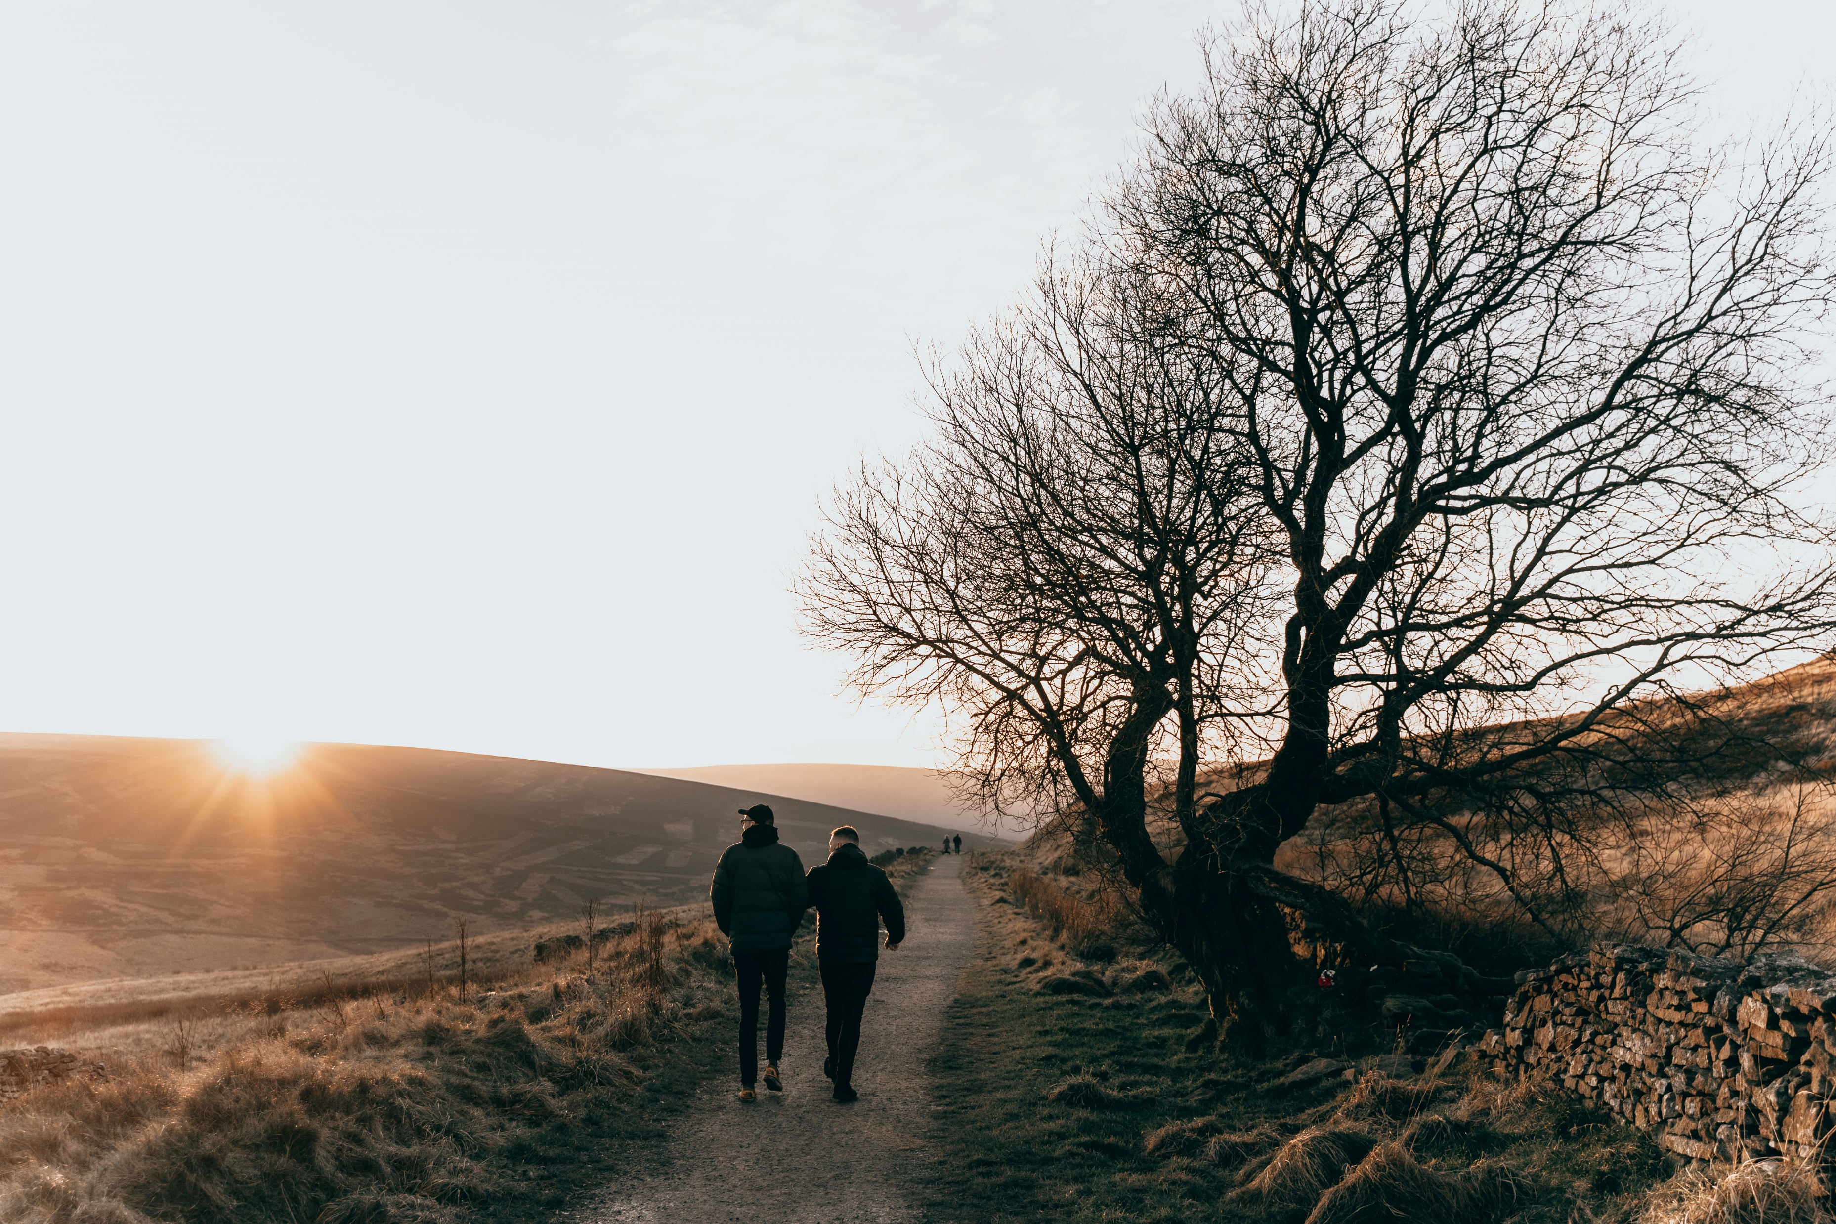
3. Exercise
uaex.edu/life-skills-wellness/health/physical-activity-resources/exercise-routines
Go4life.nia.nih.gov
Notes:
Daily exercise boosts endorphins that help improve your mood and overall wellness. Any exercise can work. Join Extension Get Fit, Walk Across Arkansas, or even gardening will work. You might check out one of these websites for exercises that you can do at home. Take time each day to plan some type of exercise into your day and then make a point to do it!

Slide 7
4. Healthy Diet
www.choosemyPlate.gov
Notes:
You’ve heard it before but eating right is a major key to overall health, including mental health. If you sometimes have difficulty with mood swings, it may be worthwhile to pay attention to diet triggers like sugar, alcohol, or caffeine. Sometimes nutrients may be missing from your diet that affect your mood and energy level such as not enough protein or carbohydrates. Keep a log of the foods you eat over a period of three to four days. This can help you see what improvements you need to make. You may notice a pattern. If you are confused about what foods to eat to be healthy, check out the website www.choosemyplate.gov.

Slide 8
5. Practice gratitude
Notes:
5. Practice gratitude. Studies show that taking time each day to intentionally think about the people, things, places and experiences in our lives can have real mental health benefits. Keep a journal or get up every morning and mentally list your blessings. Being thankful for what we have improves relationships, sleep and our overall well-being.

Slide 9
6. Laugh
Notes:
6. Laugh. How often do you laugh? During stressful times, it may be hard to find humor. But there really is truth in the phrase, “laughter is the best medicine”. Laughter releases dopamine which is our brain’s feel good chemical. So, let me encourage you to find ways to laugh every day!

Slide 10
7. Enjoy Music
Notes:
7. Enjoy music. Listening to upbeat music can boost your mood. However, not all music can be effective in reducing stress. Some may even cause stress. Think about the music that is played at the doctor’s office. What would happen if they were tuned in to the “heavy metal” channel? Chances are it wouldn’t calm you. Everyone enjoys different types of music. Find music that works for you.

Slide 11
8. Set Boundaries
Notes:
8. Set boundaries. Boundaries are important tools for healthy relationships. They allow you to connect with those in your life in ways that are comfortable and safe. You may need boundaries with your children, your spouse, your parents or those you work with. Boundaries should be flexible and may need to change over time to accommodate changing relationships. You might want to check out the worksheet “Setting Boundaries” on the link I’ll provide at the end of the program.

Slide 12
9. Think Positive
Notes:
9. Engage in positive self-talk. Often, we focus on the negatives in ourselves. What does this do for our mental health? It brings us down. When we have negative thoughts, push back against them. Many times we put too much pressure on ourselves to be perfect. When this happens, Stop and ask yourself, “Is this line of thinking fair or logical?” Chances are no it isn’t! We are not always in control of our circumstances. Covid-19 proves that point. It does take practice to be positive. But, you can do it!

Slide 13
10. Seek Professional Help
Notes:
Finally, even if some of these tips work for a short period of time, you may need to seek the counsel of a mental health professional. Therapists listen and can offer coping strategies from a neutral perspective. Where you may struggle to identify spots in your life that are causing stress, they may be able to reframe a relationship or experience and help you understand its impact. This is especially true if you are dealing with trauma, grief, or life changes. A therapist can be a wonderful resource.

Slide 14
The End!
Contact https://www.uaex.edu/life-skills-wellness/personal-family-well-being
https://www.uaex.edu/counties/howard/
Notes:
I hope these tips I have shared with you today, have provided you with some ways to boost your mood and overall mental health. Thank you for joining me. Be sure to check out these websites or contact your local extension office.

