Slide 1

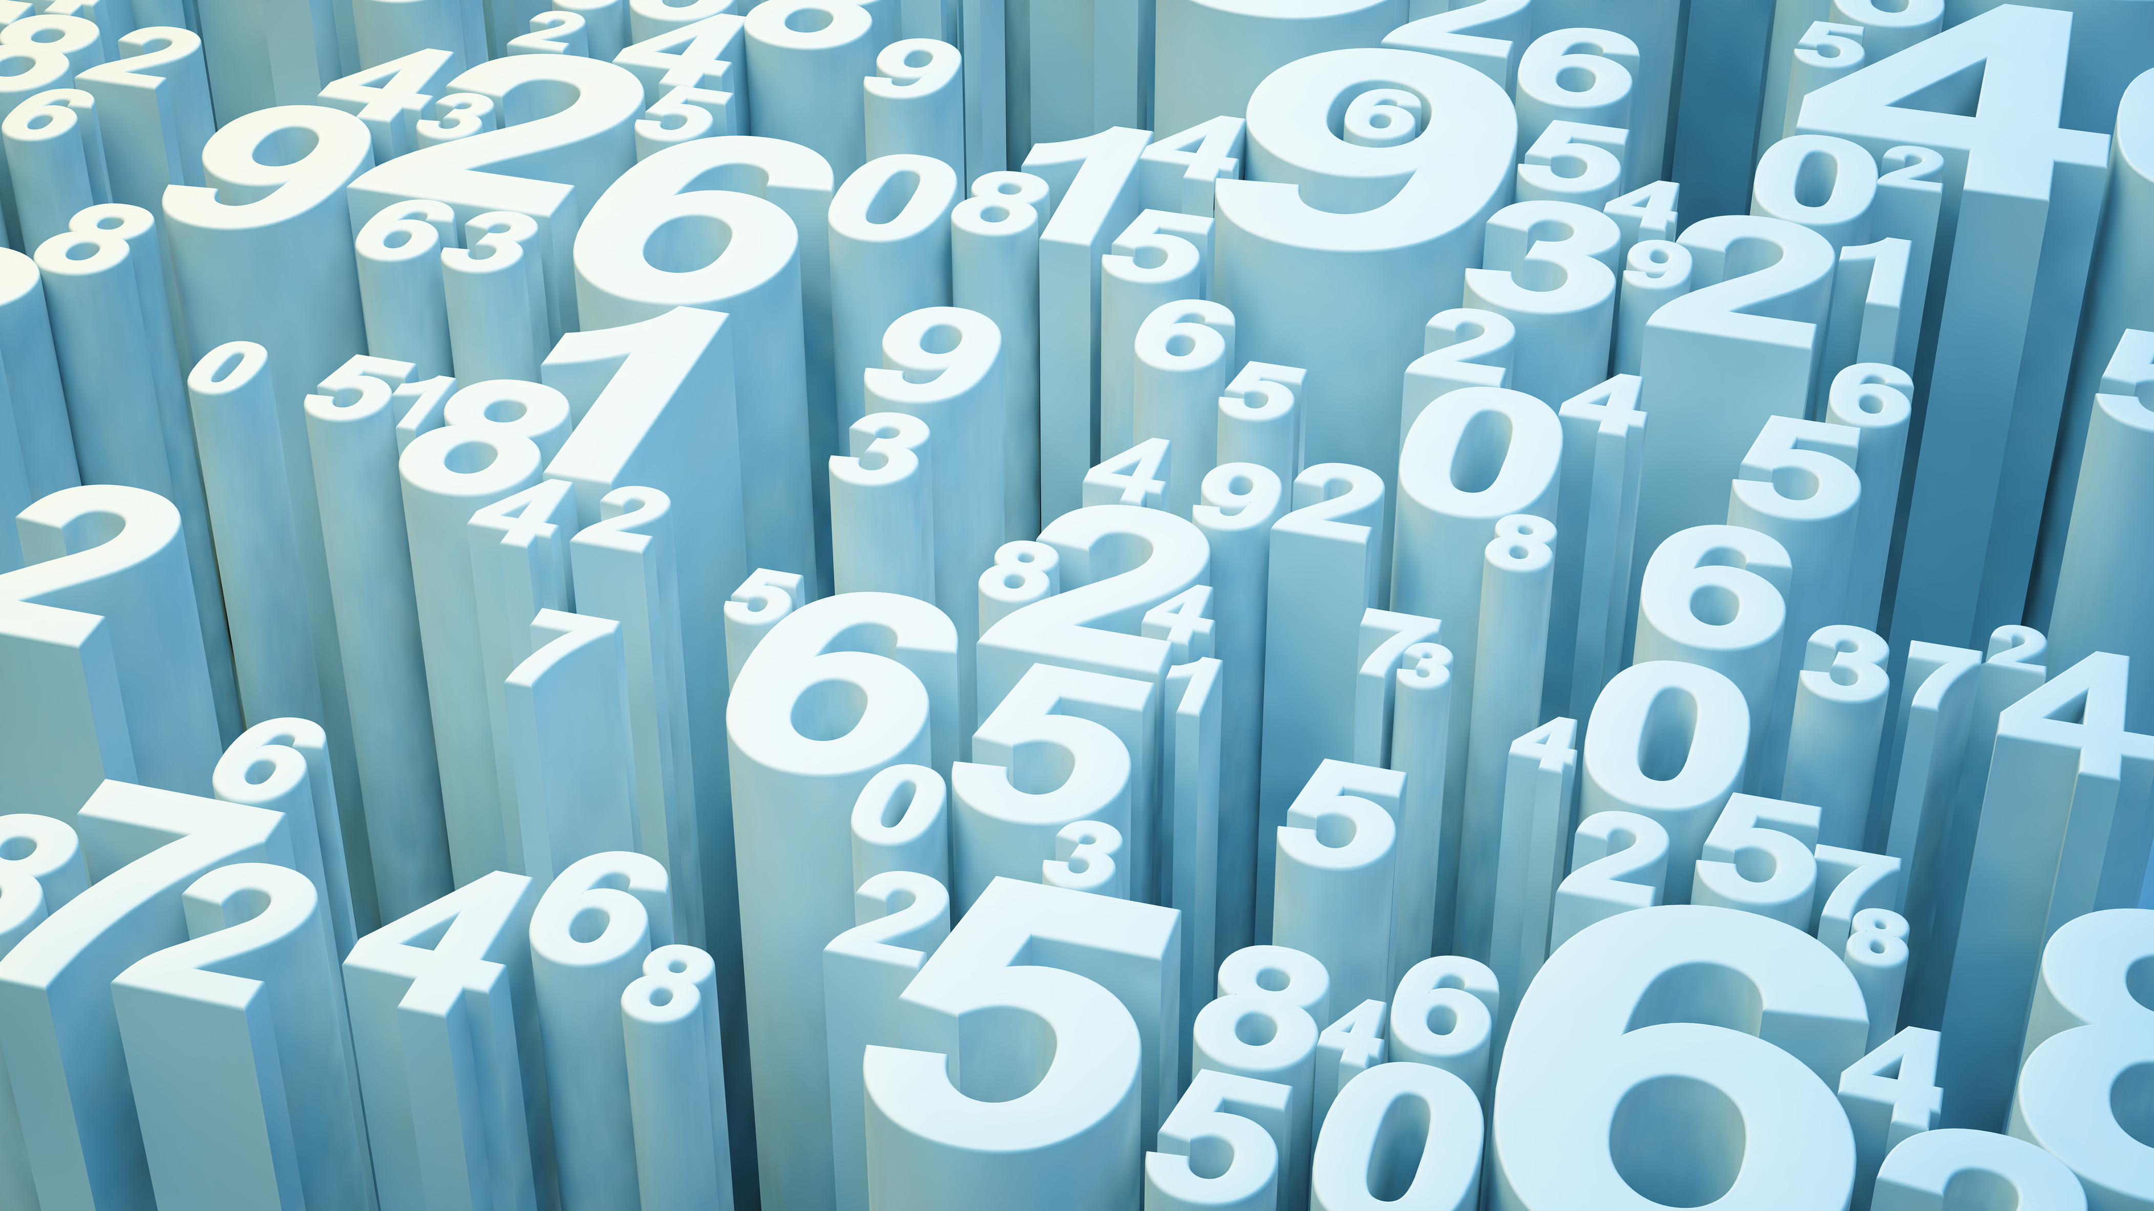

Physics: Work and Energy, Heat and Thermodynamics
Diedre Young MAT
Soybean Science Challenge Coordinator
Daniel Young PhD
Teaching Assistant Professor, UNC-Chapel Hill

Slide 2

NGSS STANDARDS
TOPIC 2: Work and Energy
P-PS2-2AR
*Dr. Daniel Young at UNC Chapel Hill helped with this presentation. You may contact him at:
dyoung4@email.unc.edu for help
TOPIC 3: Heat and Thermodynamics
P-PS3-3AR

Slide 3

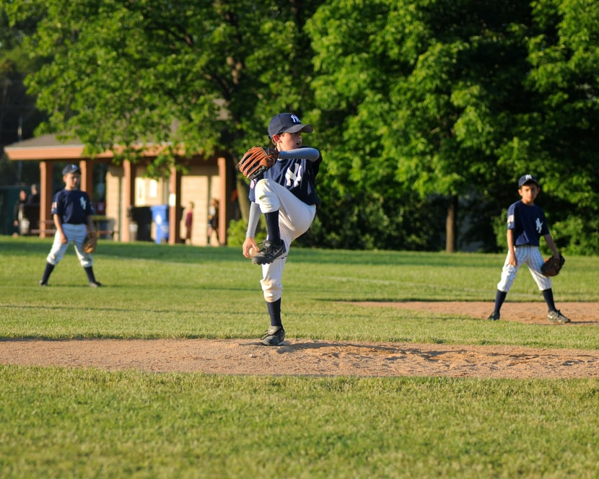

KINETIC ENERGY
Anything that is in motion has kinetic energy. Energy is measured in units of Joules.
The more mass you have, the more kinetic energy you have.
The faster you are going, the more kinetic energy you have.
$$KE= \frac{1}{2}\left(mass\right)∗{(velocity)}^{2}$$
0.1 kg baseball thrown at 45 m/sec = 203 Joules of KE
1000 kg truck moving at 10 m/sec = 100,000 Joules of KE

Slide 4
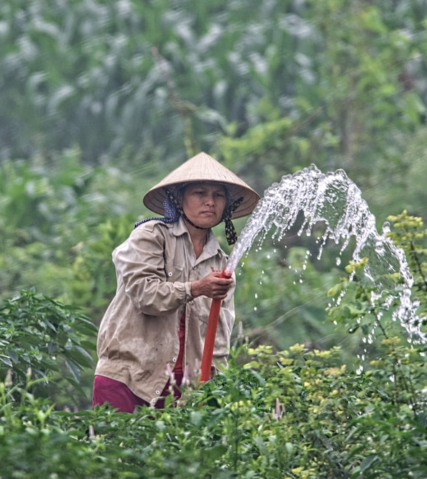


Potential Energy
Potential Energy is an interaction between two things such as a nerf ball compressing a spring or a human walking in Earth’s gravity (also measured in Joules).
Gravitational Potential Energy depends on the mass of the object, height, and the strength of Earth’s gravitational field.
  $GPE=\left(mass\right)∗\left(g\right)∗(height)$
  $g=gravitational constant=9.8 \frac{m}{\sec^{2}}$
Energy can be converted from one form to another: at the top of the water’s arc, the fluid has lots of GPE and little KE, at the bottom of the arc, there is little GPE and lots of KE.

Slide 5
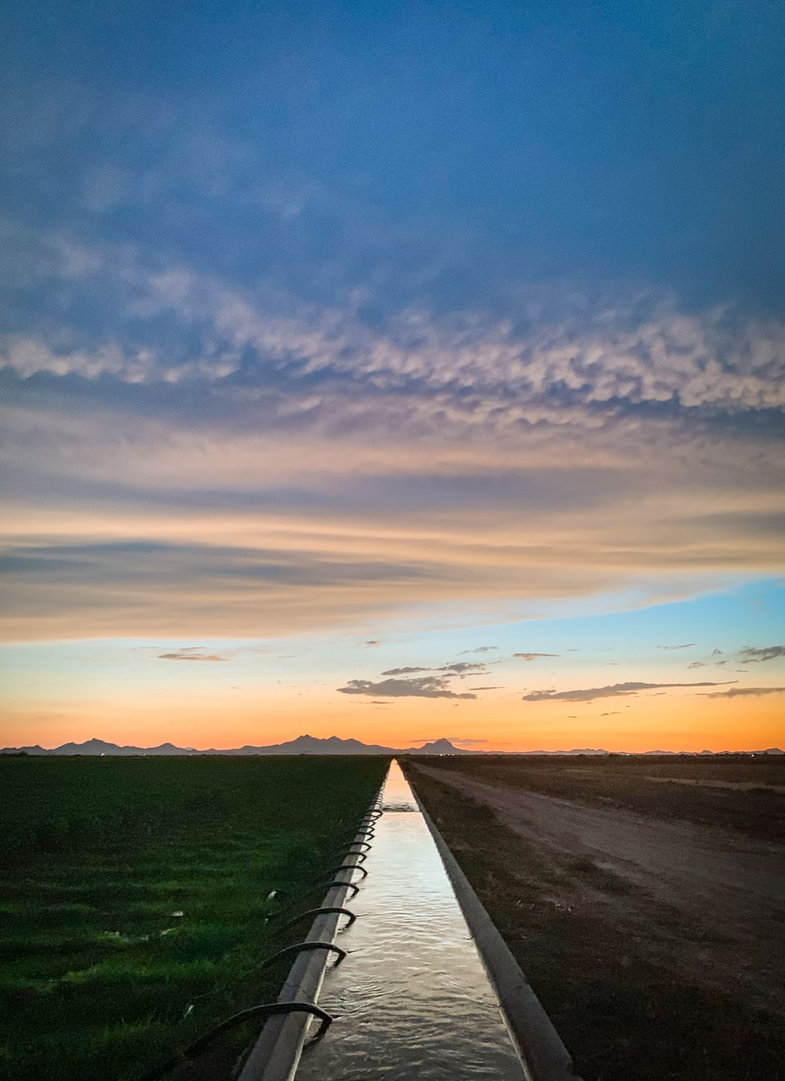
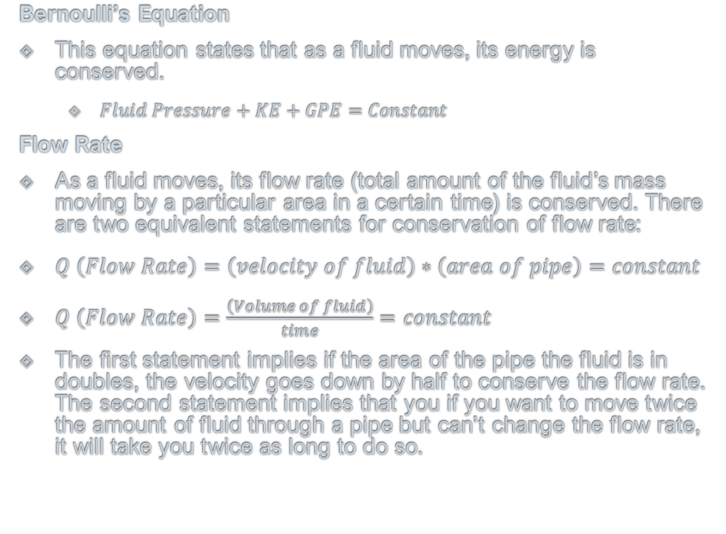
Fluid Dynamics
Bernoulli’s Equation
This equation states that as a fluid moves, its energy is conserved.
  $Fluid Pressure+KE+GPE=Constant$
Flow Rate
As a fluid moves, its flow rate (total amount of the fluid’s mass moving by a particular area in a certain time) is conserved. There are two equivalent statements for conservation of flow rate:
$Q \left(Flow Rate\right)=\left(velocity of fluid\right)∗\left(area of pipe\right)=constant$
$Q \left(Flow Rate\right)=\frac{\left(Volume of fluid\right)}{time}=constant$
The first statement implies if the area of the pipe the fluid is in doubles, the velocity goes down by half to conserve the flow rate. The second statement implies that you if you want to move twice the amount of fluid through a pipe but can’t change the flow rate, it will take you twice as long to do so.

Slide 6
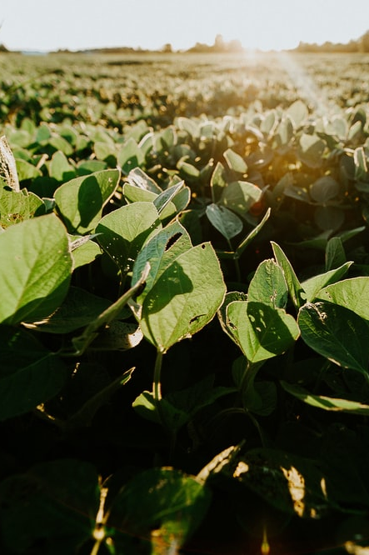
Irrigation using Physics
You have two 100 square-acre fields. One is growing cotton (which needs to be filled to a depth of 0.64 meters) and soybeans (which needs to be filled to a depth of 0.28 meters).
Question #1: What is the total volume of water needed to irrigate both crops?
You want to fill both fields simultaneously by using one pipe that splits into two, watering both fields at the same time.
Question #2: If the velocity of the fluid in one of the two split pipes is 10 meters/sec and the cross-section of the pipe is 0.30 meters², how long would it take to fill the cotton field and the soybean field?

Slide 7
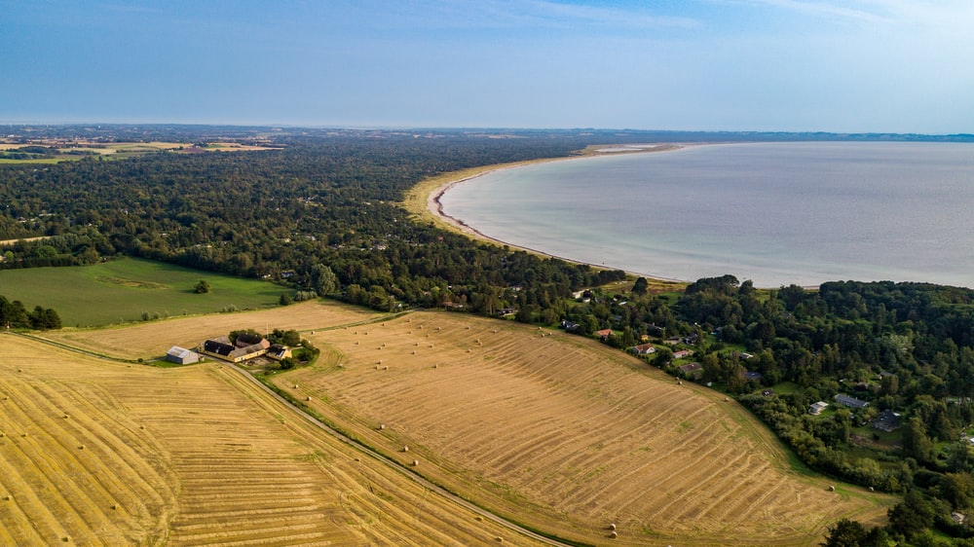
Irrigation using Physics Solutions
Solution to Question 1:
Procedure: The total volume we need to water is the area of the fields times the depth of the water required. To aid with the fluid equations (which are SI equations), convert everything to meters.
  100 acres = 404,868 m²
  Cotton Field Volume = (404,868 m²)*(0.64 m) = 259,116 m³
  Soybean Field Volume = (404,868 m²)*(0.28 m) = 113,363 m³
Analysis: As expected, the soybean field requires significantly less water as it only needs to be filled to about 1/3 of the depth of the cotton. This likely implies that it will take less time to fill the soybean field as well.

Slide 8
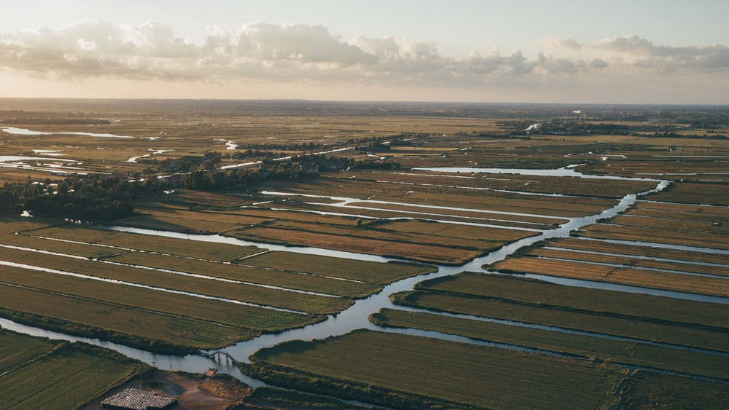
Irrigation using Physics Solutions
Solution to Question #2
Procedure: The second equation for flow rate contains the time that we need to find. Calculate the flow rate with information about the velocity and area, then use the flow rate and volume needed to fill to calculate the time.
  Flow Rate = (velocity)*(area) = (10 m/s)*(0.30 m²) = 3 m³/s
  Flow Rate = (Volume)/time, therefore: Time = (Volume)/(Flow Rate)
  Cotton Field: Time = (259,116 m³)/(3 m³/s) = 86,372 sec = 1 day (!)
  Soybean Field: Time = (113,363 m³)/(3 m³/s) = 37,789 sec = 10.5 hours
Analysis: As expected, the soybean fill time is significantly less. You could fill nearly 2.5 soybean fields in the same time it takes you to fill one cotton field!

Slide 9
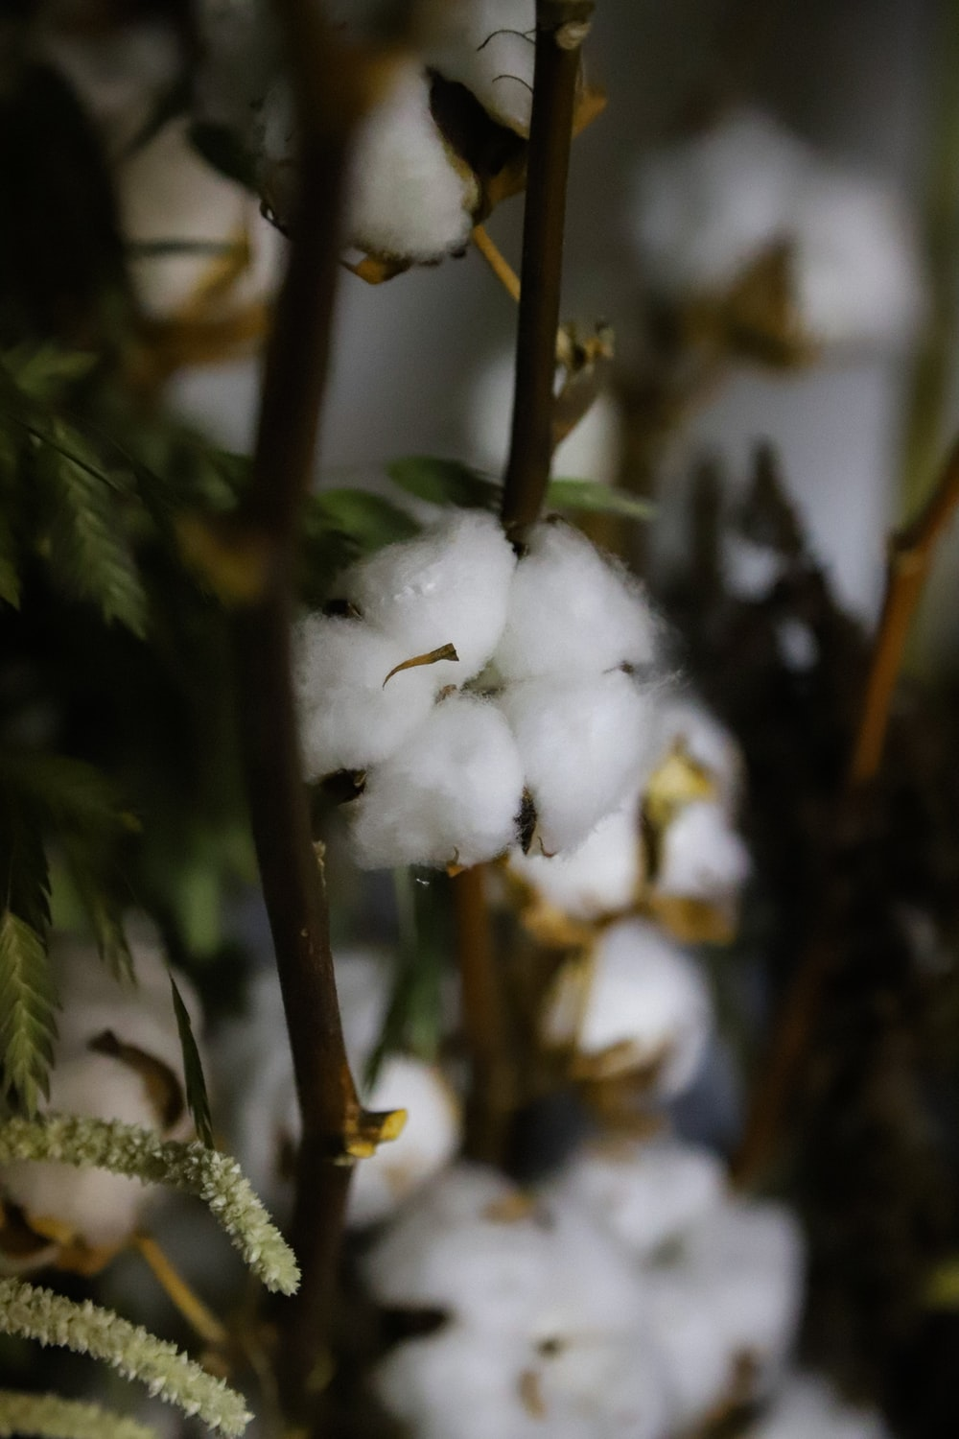
Extension Concept
Let’s think of a few ways that you could avoid the very long fill time of the two fields using multiple pipes or changing the flow velocity.
Option #1: Turn off the soybean pipe when the soybean water depth is reached. However, this will have a secondary effect of doubling the flow rate (and hence the flow velocity) to the cotton. Calculate the new time required to fill both fields.
Option #2: Use two different pipes with two different flow speeds (you can change the flow speed by changing the pressure in the pipe, this is one consequence of Bernoulli’s Equation). If you want to fill both fields in the same amount of time, how much bigger does the flow speed need to be to the cotton versus the soybeans?

Slide 10
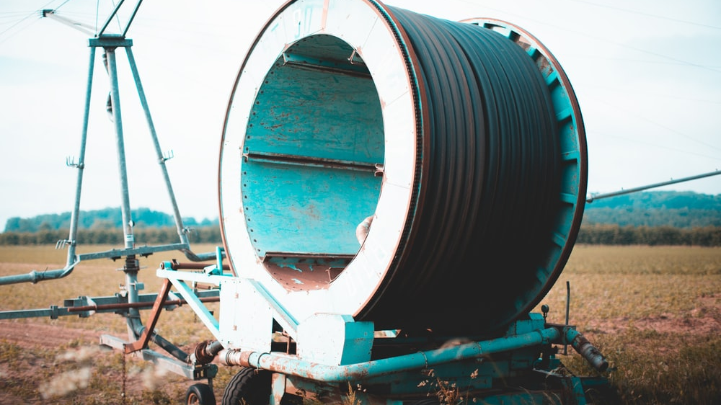
Extension Concept Solutions
Option 1 Solutions:
Procedure: We need to find how much time it will take to fill the cotton field when the soybean field is done. Doubling the flow velocity will give us a new time to finish filling the cotton, then add the two final times together.
  From an earlier slide, the soybean field will fill in 37,789 sec, this means that there are (86,372 sec – 37,798 sec) = 48, 574 sec left to fill the cotton field.
  From the flow rate equations, doubling the flow velocity will also double the flow rate [Flow Rate = (flow velocity)*(area)] and doubling the flow rate will half the time required to fill the same remaining volume [Flow Rate = (volume)/(time)]. Therefore, doubling the flow rate to the cotton will half the remaining time down to 24,287 sec.
  The total final time to fill both fields by turning off one pipe is 37,789 sec + 24,287 sec = 62,067 sec = 17.2 hours.
Analysis: This is significantly faster than the 1 day previously required to fill both fields using two separate pipes with no adjustment to the flow rate! Let’s see if we can do a bit better however…

Slide 11
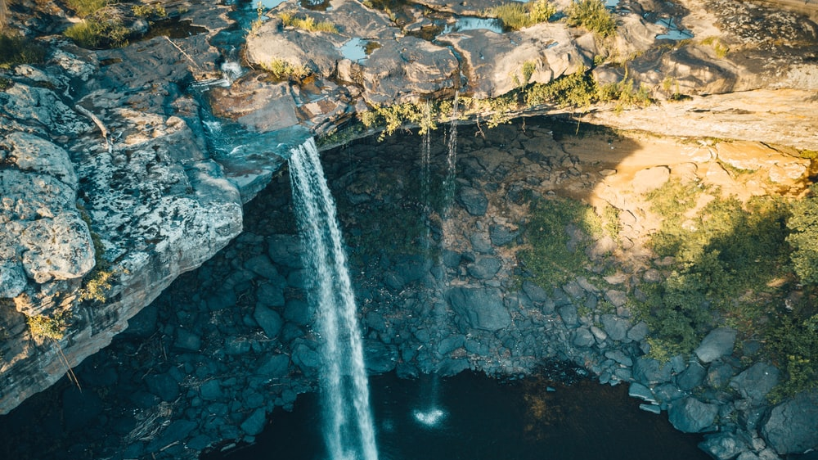
Extension Concept Solutions
Option 2 Solutions:
Procedure: Determine the flow velocity that will be needed to fill the cotton field in the same time as the soybean field by using the flow rate equations and the time solved on a previous slide.
  Time to fill Soybean field = 37,789 sec.
  Use this time to find the flow rate required to fill the entire cotton field (using the cotton field’s volume):
  New Flow Rate = (Volume)/(Time) = (259,116 m³)/(37,789 sec) = 6.86 m³/sec
  Now use the new flow rate for the cotton field along with the pipe’s area, to determine the new flow velocity that is needed:
  Flow Rate = (Velocity)*(Area) therefore: Velocity = (Flow Rate)/(Area) = (6.86 m³/sec)/(0.30 m²) = 22.9 m/sec
Analysis: This will fill both fields in the same time but will require a flow velocity of 23 m/s to the cotton as opposed to the previous value of 10 m/s. Via Bernoulli’s equation, this will require a pressure increase of nearly 5.3x larger than what it was before. If your pipes can handle the pressure increase, it would save a lot of time! (nearly 13.5 hours over filling both fields separately)

Slide 12
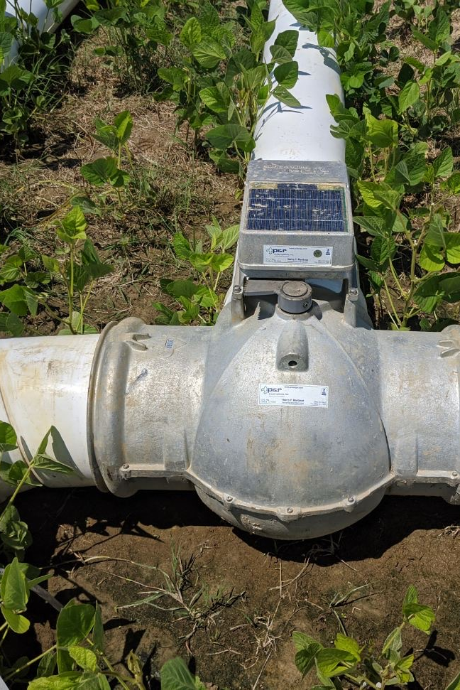
Farmers using physics to save water
Farmers are using physics to help conserve the water they use. By conserving water, both the environment and the farmer win!
Farmers use poly-pipe and surge irrigation to use as little water as possible. Poly-pipe only releases the right amount of water to fields. This amount is based on the diameter of the hole punched in the pipe and the flow rate of the water in the pipe.
Surge irrigation uses multi-variable pumps to ‘surge’ water over wet previously irrigated areas to guarantee the whole field is watered to the roots.

Slide 13

Online Pipe Planner App
Check out this application online at:
https://www.pipeplanner.com/
This application does all the physics for you!!

Slide 14
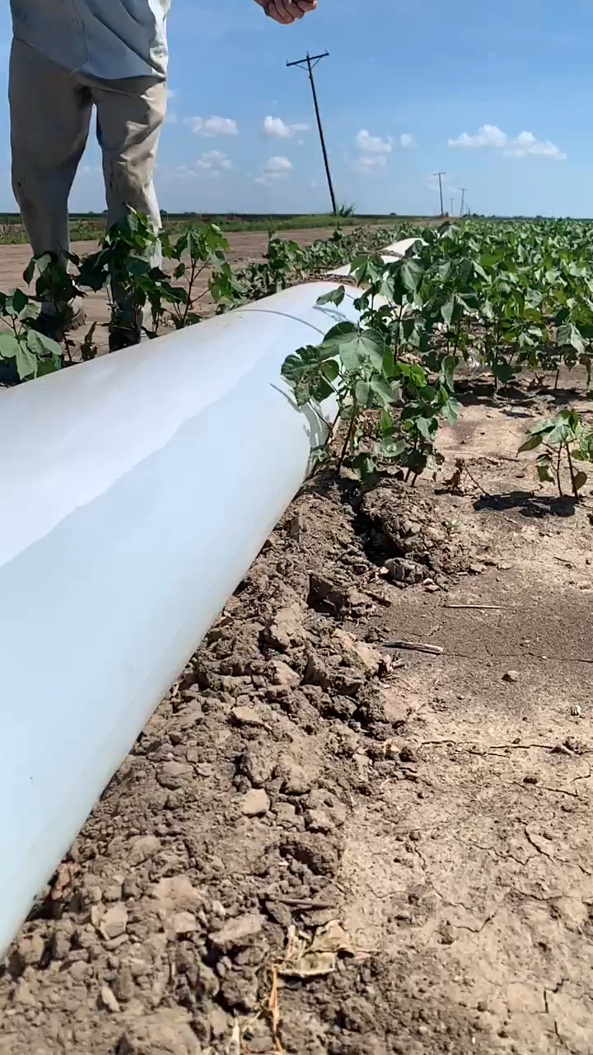
Check out this video!
This video shows how a poly-pipe is ‘holed’ for irrigation. The diameter of a pipe is dependent on the amount of water needed for that crop and particular soil type.

