Slide 1


Earth Science:
Earth Systems and Human Sustainability
Diedre Young MAT
Soybean Science Challenge Coordinator

Slide 2
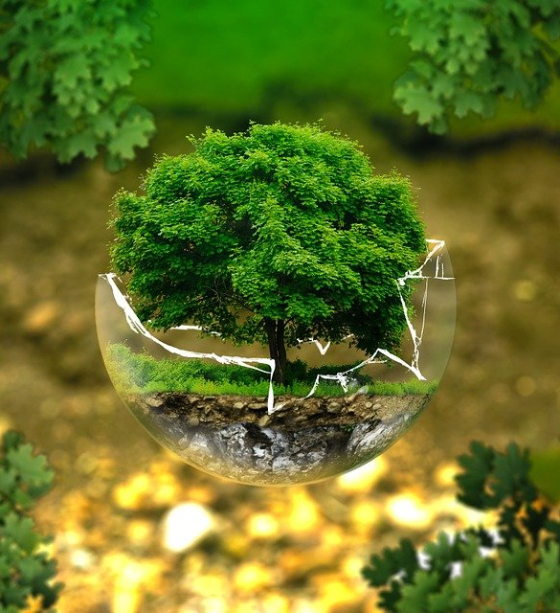

NGSS STANDARDS
TOPIC TWO: EARTH SYSTEMS
ES2-ETS1-1
TOPIC THREE: HUMAN SUSTAINABILITY
ES-ESS3-4
ES3-ETS1-1
ES3-ETS1-2

Slide 3
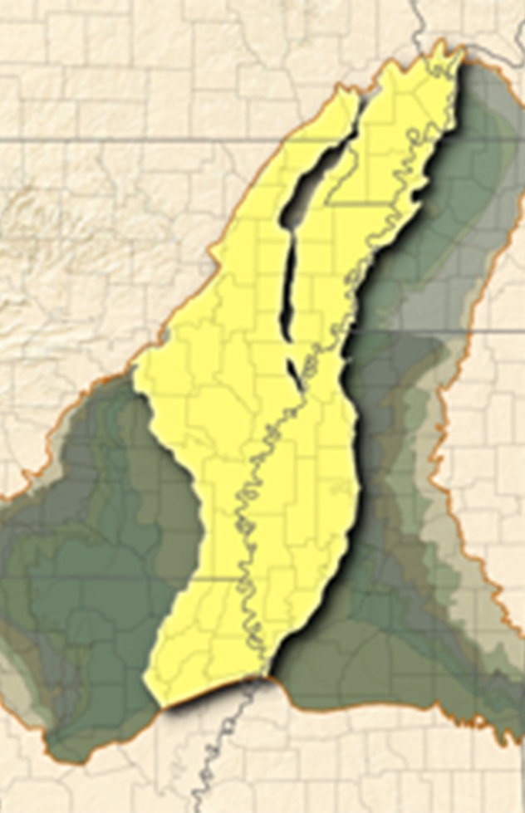
Current Alluvial Aquifer Issues (Earth Systems)
The Alluvial Aquifer is a gravel and sand shallow aquifer that covers multiple states (including Arkansas) and 32,000 square miles.
The confining beds on this aquifer determine water recharge, with a recharge rate of around two million gallons (2-5 inches) a year. Studies show the Alluvial will need to stay at a 50% level for sustainability.
The Alluvial is used by private and public wells, industry, powerplants and irrigation.
Currently, 11% of the Alluvial’s water is used for irrigation. Due to the slow recharge rate of the Alluvial, cones of depression have developed due to water loss (with some areas at 10% levels) and current predictions show an 80% difference in recharge rate and water usage.
What can be done by farmers to help improve the aquifer’s water levels to a sustainable level all while keeping their crops irrigated?

Slide 4
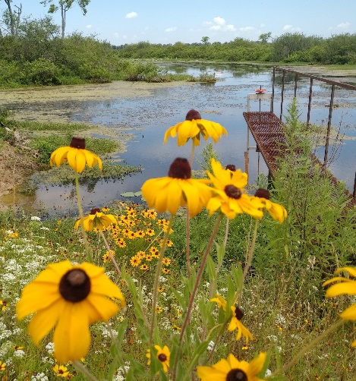
Farm Surface Water Retention Techniques: Creating Sustainable Irrigation Water
Reservoirs: Reservoirs are built to catch rain and to store excess water from winter transfer. Some water transfer is:
Tail Water Ditches: Tail water is directed to local reservoirs for reuse. This could be from irrigation or rainwater.
River Overflow Usage: Water from rivers full of winter overflow is pumped to local streams and bayous for reservoir pumping. Studies show this DOES NOT affect water flow downstream to the Gulf.
Water overflow redirection: Winter water overflow from local bayous is directed into farm reservoirs. The bayous are not drained, only overflow is taken to keep bayous at a sustainable water level.

Slide 5
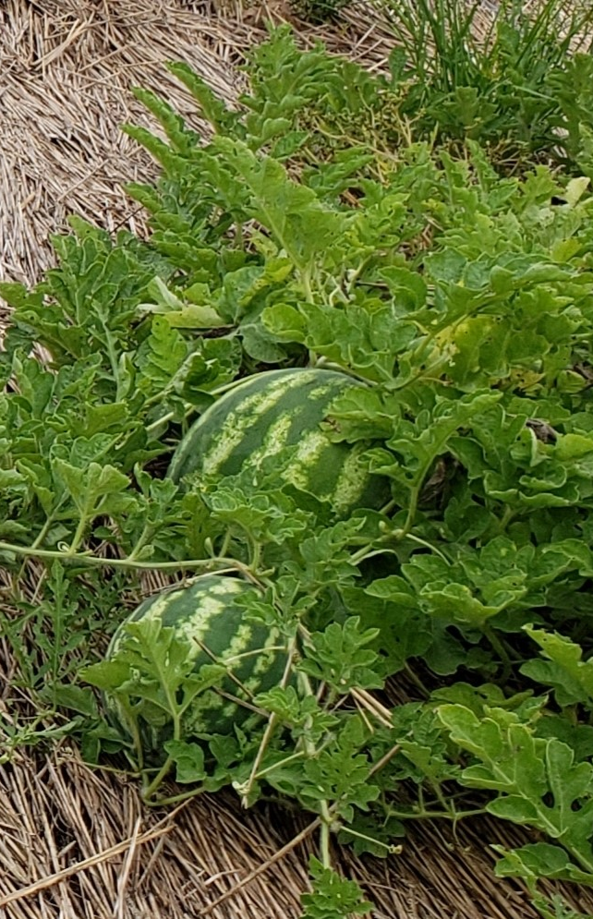
Sustainable Irrigation Farming
Leveling Fields: By leveling fields to a fraction of a percent grade, farmers can keep water on their crops longer and decrease tail water build up.
Underground Piping: By using underground piping from the reservoir to the field, water evaporation loss is minimized.
Alternating Wetting and Drying: By allowing field to dry to a mud and then re-watering, less water is wasted, and the greenhouse gas methane is decreased.
Poly-pipe: Poly pipe irrigation uses pipe with specific diameter holes to release only the amount of water needed for that crop and soil type. Less water is used, and evaporation/tail water stays at a minimum.
No-till and cover crops: By not tilling the soil, water loss is minimized from exposure and cover crops add to this by creating a root structure that holds the water in the soil.

Slide 6

Sustainability Augmented by Technology:
Farmers use a series of technologies to help keep their farms irrigated while being sustainably responsible.
Moisture Sensors: Farmers use moisture sensors at a series of soil depths to determine if water (in the unsaturated zone) is getting to the plant roots. This allows the minimal amount of water to be added for root uptake.
Variable Speed Electric Pumps: Using electric rather than diesel decreases greenhouse gas emissions. Speed levels are adjusted via cell phones to optimize real-time water output per field.
Pipe Planner Computer Application: This allows farmers to plug in their acreage, crop and soil type to get the most accurate amount of water that should be used on that field.
Drones: Drones are used to determine water usage ‘at a glance’.
Water Chemistry Testing: Surface water run-off is constantly tested by the local university for phosphorous, nitrogen and sediments. Studies show very little is ending up in local waterways.

Slide 7

Why Conservation? Studies show both the farmer and the ecosystem benefit from these sustainability practices!
Cost: After initial building outlay, farmers see a decrease in cost of labor, chemicals and underground water usage.
Sustainability: Famers are seeing a large increase in water sustainability by using surface water.
Production Yields: Farmers are seeing an increase in production yields as nutrients from the surface water are being redirected back onto fields and plants are not being exposed to ‘cold water shock’ from aquifers.
Recreation: Reservoirs open the doors for locals to use the area for recreation.
Wildlife: Reservoirs allow for local wildlife to have a consistent water and food source.
Aquatic: With reservoirs comes the aquatic benefits. This can be food, filtration, and habitat.
Water Filtration: The reservoirs act as filters for surface water, protecting wildlife and local ecology.

Slide 8
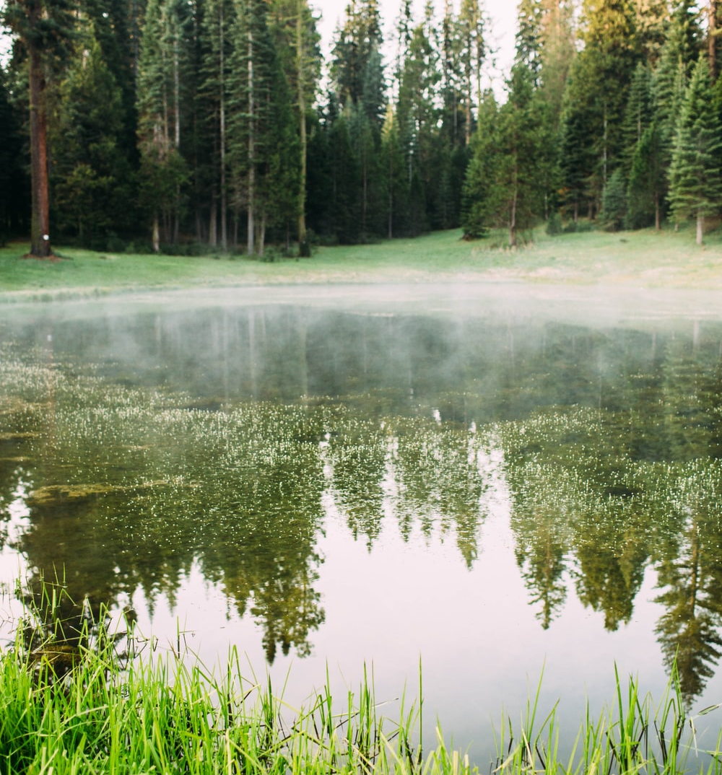
Earth Systems and Human Sustainability
Farmers using sustainable practices help the Alluvial Aquifer to recharge. This allows consumers like us to be able to use the water for our personal use for generations to come and it protects the water for the local ecology.
Farmers benefit as it allows their farms to flourish and be useful for generations.

Slide 9
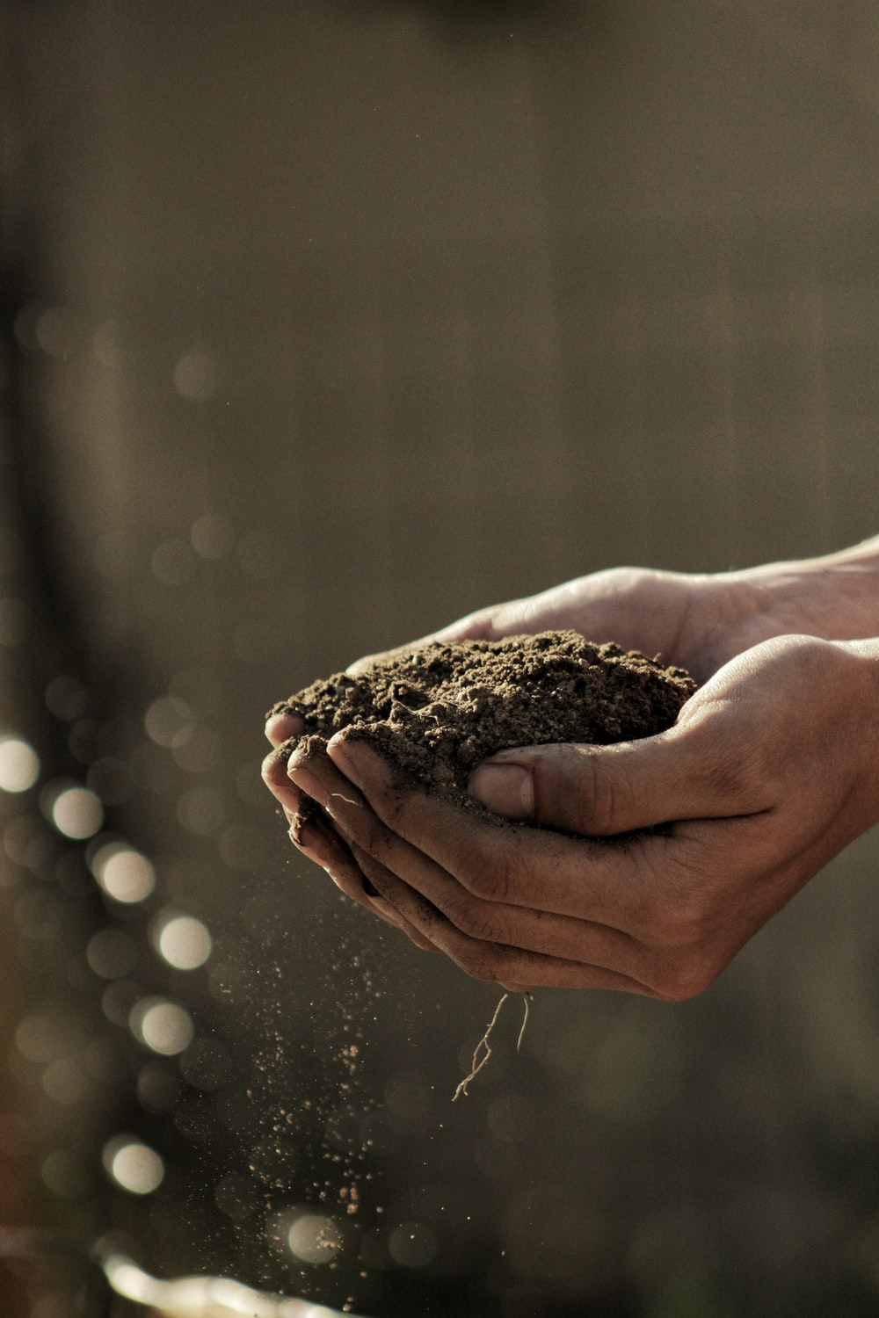
Check out these videos!
See what it takes to be a soil scientist!
https://www.youtube.com/watch?v=QV4dxHrvxp8&list=PL7B61381EE0438243&index=38
Watch how soil and climate are tied together:
https://www.youtube.com/watch?v=T4A_rMlHcyE

