Slide 1



Earth Science:
Human Sustainability, Weather and Climate
Diedre Young, MAT
Soybean Science Challenge Coordinator

Slide 2
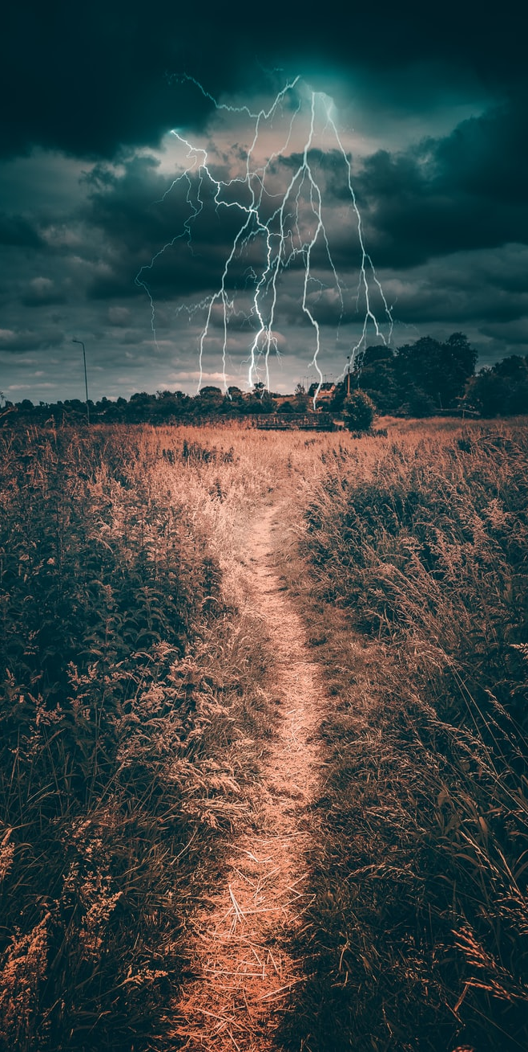
NGSS STANDARDS
Topic 3: Human Sustainability
ES-ESS3-1
ES-ESS3-4
ES-ESS3-6
ES3-ETS1-1
ES3-ETS1-2
Topic 4: Weather and Climate
ES-ESS2-4
ES4-ETS1-3

Slide 3
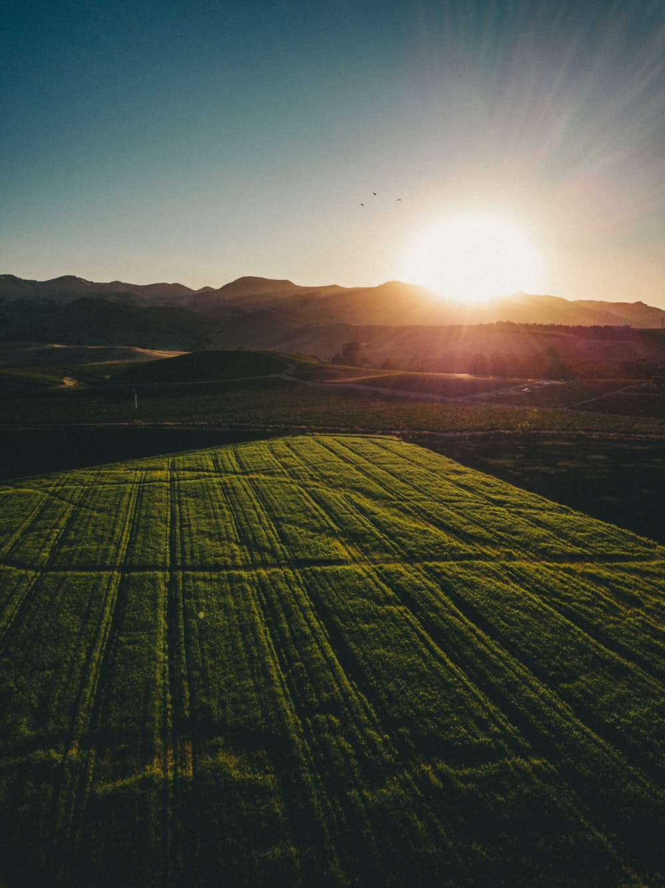
Changes in climate and agricultural activity
Farmers need water for irrigation and livestock. Farmers used to rely on rain for most of their water needs; however, recent climate changes have caused unreliable rain patterns. Rain now comes in the winter and not during growing seasons with flash floods becoming an issue.
Famers then turned to irrigating from the Alluvial and Sparta Aquifers. Recent studies have shown both aquifers are below sustainable levels, so this is no longer a viable option.
Agriculture has an impact on climate through water usage, loss of trees and plants, and soil erosion. How can farmers help our climate and still be productive?

Slide 4
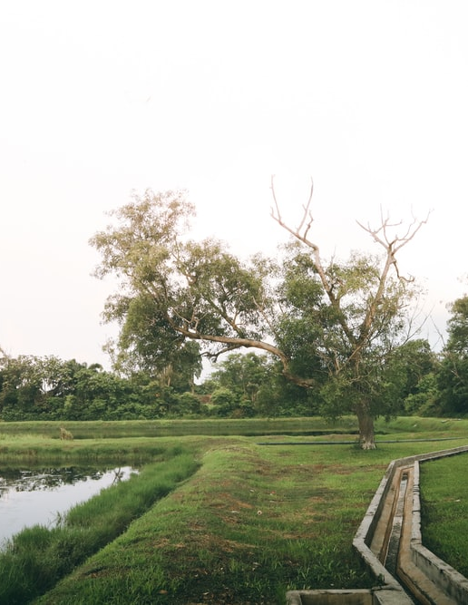
Protecting the climate while farming:
Using less water.
Water is a major greenhouse gas. Increased water in the atmosphere means warmer temperatures. This translates into increased humidity, rain and unstable weather patterns.
Irrigation releases a lot of water into the atmosphere through evaporation. This is bad for the climate (changes in weather) and bad for the farmer (increase in water costs due to water waste).
Farmers want to decrease water usage. It is a win-win for climate and agriculture. Farmers decrease water usage in several ways, such as surface water retention, poly pipe and surge irrigation, recharge from river overflows and variable speed pumps for optimum water usage.

Slide 5
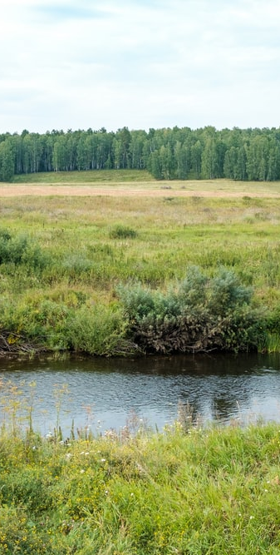
Surface Irrigation: Evaluating a solution to a complex real-world problem.
Surface irrigation involves a number of methods that allow for using water that’s readily available on the surface, thus avoiding well or aquifer water. They are:
Reservoirs: Reservoirs are built to catch rain and to store excess water from winter transfer.
Tail Water Ditches: Tail water is directed to local reservoirs for reuse. This could be from irrigation or rainwater. Standing water produces methane, by rerouting standing water, less greenhouse gases are produced and released.
River Overflow Usage: Water from rivers full of winter overflow is pumped to local streams and bayous for reservoir pumping. Studies show this DOES NOT affect water flow downstream to the Gulf.
Water Overflow Redirection: Winter water overflow from local bayous and streams is directed into farm reservoirs. The waterways are not drained; only overflow is taken to keep them at a sustainable water level.

Slide 6
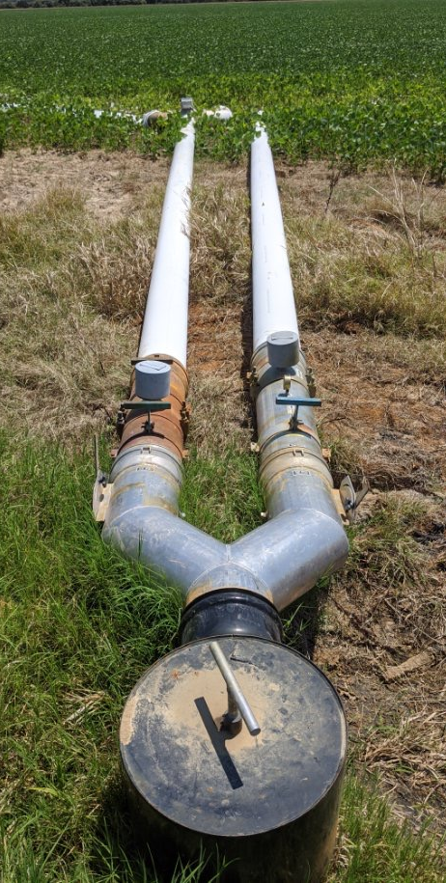
Poly Pipe and Surge Irrigation: Designing solutions through engineering
Poly pipe: Poly pipe irrigation uses pipe with specific diameter holes to release only the amount of water needed for that crop and soil type. Less water is used, and evaporation/tail water stays at a minimum.
Surge Irrigation: This involves surging water down a furrow at sequential times. This allows the water to absorb at its deepest depth so new surges of water ‘skim’ over the wet mud to dry areas in need of irrigation. Variable speed pumps are used to surge the water and back off when needed.
Underground Water Transfer: By using buried pipes to transport surface water, all water is retained and not lost to evaporation.

Slide 7
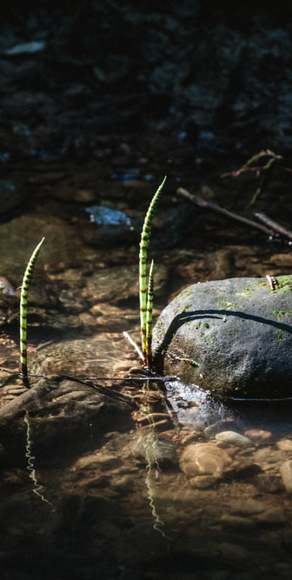
Reducing impacts of human activities on natural systems; filtering agricultural pollutants
Water is an excellent solvent which means it will dissolve animal waste. Therefore, waste will be incorporated into any standing water or water runoff on an animal farm.
Manure filled standing water produces methane, adding to greenhouse gases.
As water evaporates, it leaves high levels of waste behind.
Rain will move this waste either to local waterways or into the ground to form areas of high levels of waste.
This translates into damage to plants and soils which means less filtration and more erosion.

Slide 8
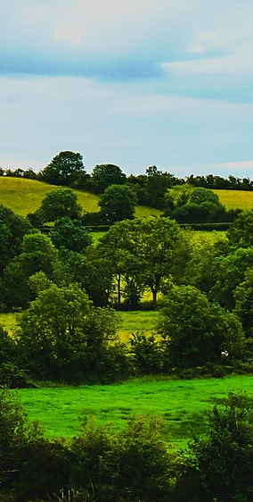
Designing a solution to the agricultural pollution problem using engineering
Fertilizing Evenly: By spreading excess nutrients throughout the farm area, buildup is eliminated, and nutrient retention is accelerated.
Grassed Waterways: Grassed waterways reduce nutrient load as water is filtered by both the surrounding grass (before it reaches the pond) and by the water itself.
Nutrient Ponds: Nutrient ponds break down excess nutrients. This water is in turn recycled back onto the farm as irrigation or as watering for local livestock.
Aerating Soils: By adding aerator holes to the soil, water runoff is quickly absorbed, and nutrients are spread more evenly through the soil

Slide 9

Evaluating solutions to help reduce human impact
On site real-time chemical monitoring of soil and water quality to determine changes needed.
Education by local researchers on the latest conservation methods.
Stream bank restoration on farmlands.
Controlled burns to reduce organic loads and increase water infiltration.
Funding to protect local waterways.
Farmers teaching farmers best conservation practices.
Involving producers in the solution.
Educating policy makers.
Engaging the non-farming sector.

Slide 10
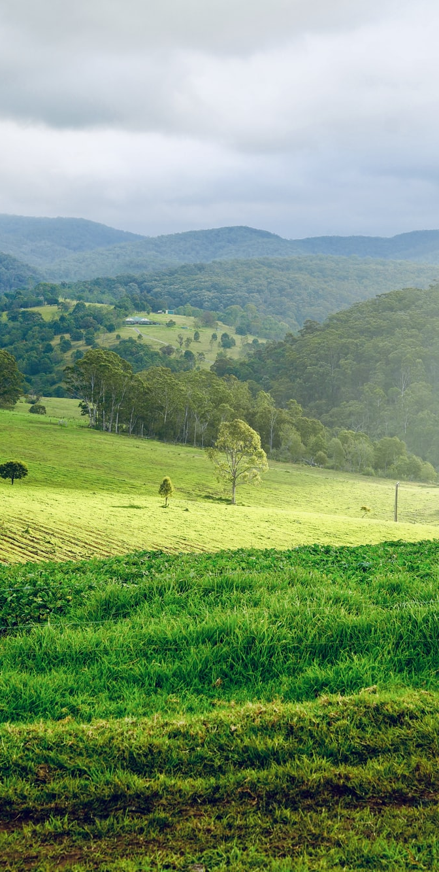
Designing solutions that protect our natural resources
Using surface water irrigation means water stays in aquifers and local wells.
Using Poly Pipe and Surge irrigation ensures the least amount of water is used with the best results, thus protecting our natural resource, water.
Grassways, ponds and aerators are needed to keep nutrients on the farm and not in the water.
Local watersheds meet the needs of our drinking water supply. By keeping nutrients on the farm, nearby watersheds are kept free of algal blooms, sediments and organics, thus protecting the local waterways.
Working together, we can protect our water resources and adequately irrigate crops. A win-win for all.

Slide 11
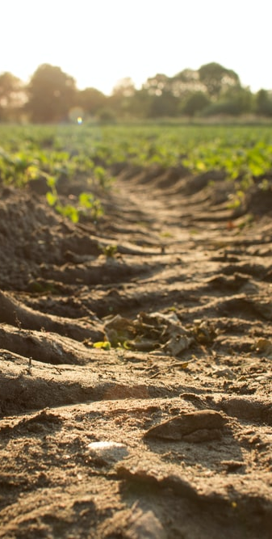
Check out these You Tube Videos!
This video talks about how soils support agriculture:
https://www.youtube.com/watch?v=GGV2jlg_P4M&feature=youtu.be
This video talks about how soils protect the natural environment:
https://www.youtube.com/watch?v=hpMG43oFin4&feature=youtu.be
This video talks about how soils affect climate:
https://www.youtube.com/watch?v=T4A_rMlHcyE&feature=youtu.be

