Slide 1
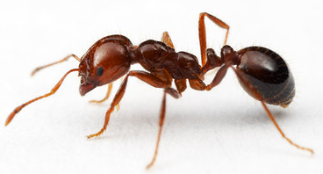

Imported Fire Ant Management in the Home Vegetable Garden
Master Gardener Meeting
Wednesday, May 10, 2017 - Faulkner Co.
Photo by Alex Wild
Dr. John D. Hopkins
Extension Urban Entomologist

Slide 2
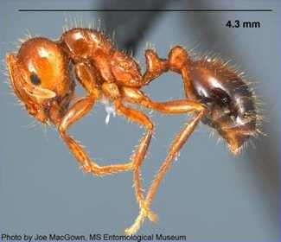
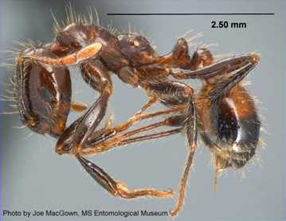
Imported Fire Ants
Red Imported Fire Ant found in ~ 58 counties - Solenopsis invicta Buren
Black Imported Fire Ant found in 4 counties - Solenopsis richteri Forel

Slide 3
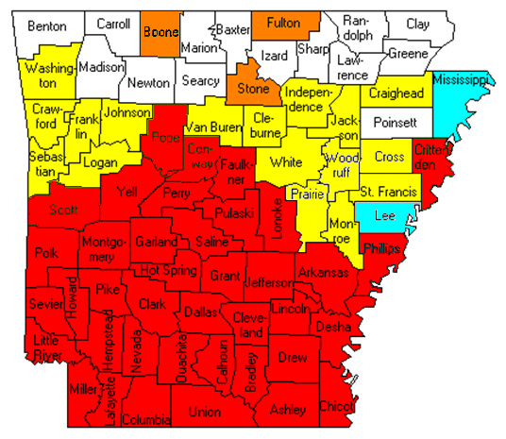
IFA Distribution in AR
Union Co. - first county listed as infested (1958)
39 entire counties are quarantined for RIFA
19 counties have isolated populations
  RIFA
  BIFA
3 counties have had previous RIFA infestations
Notes:
Union Co. in south Arkansas was the first county to be recognized as being infested with fire ants. Currently there are 39 counties infested to the point of quarantine, with 19 other counties having isolated populations of this pest.
It is unknown where the eventual range of this pest will reach. Every ‘line in the sand’ that has been drawn has been passed by the red imported fire ant. Currently, in White Co. there are several locations where fire ants have survived for several years. In Sebastian County over 1000 acres are now infested. In addition, isolated imported fire ants have been found in Washington, Crawford, Sebastian, Franklin, Logan, Johnson, Van Buren, Cleburne, Independence, White, Jackson, Woodruff, Prairie, Monroe, St. Francis, Cross, Craighead, Lee, and Mississippi. Dry weather and cold temperatures are the limiting factors -- the dry Texas west may not have much of a fire ant problem. Sustained cold temperatures (2 weeks or more) of less than 10 degrees F are needed for it to have an impact on the ant population.

Slide 4
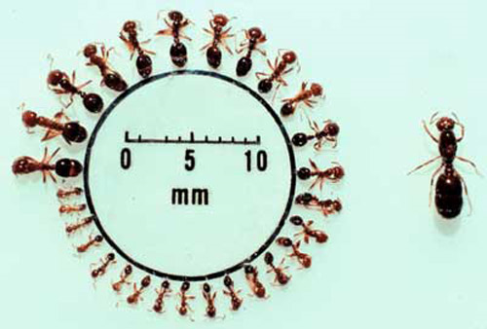
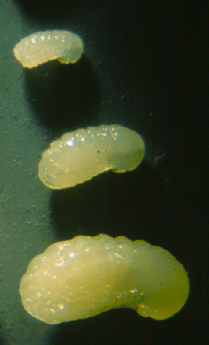
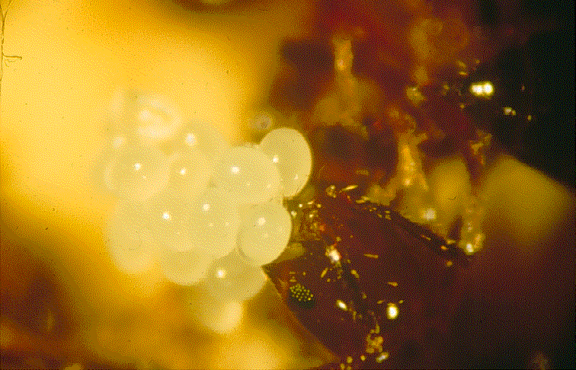
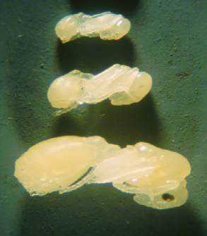
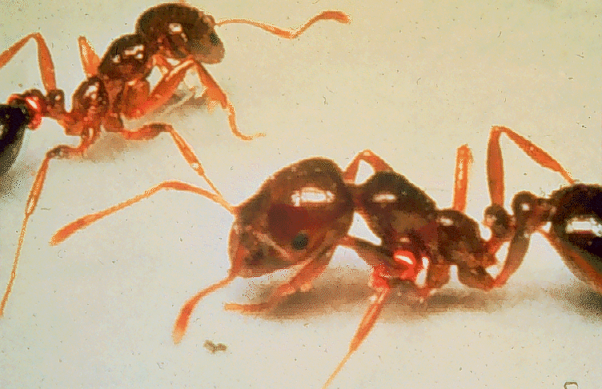
IFA Biology
Queens produce 500 eggs/day (up to 3,000 eggs/day)
Queen lives 3-4 years
Workers 30-90 days
Single & multiple queen colonies
Workers, queen & immatures share food through trophallaxis
Accidentally introduced from South America, few natural enemies
US IFA population much denser than in South America
Various size workers (left)
Queen (right)
Eggs
Larvae
Pupae
Adults
Notes:
Union Co. in south Arkansas was the first county to be recognized as being infested with fire ants. Currently there are 39 counties infested to the point of quarantine, with 19 other counties having isolated populations of this pest.
It is unknown where the eventual range of this pest will reach. Every ‘line in the sand’ that has been drawn has been passed by the red imported fire ant. Currently, in White Co. there are several locations where fire ants have survived for several years. In Sebastian County over 1000 acres are now infested. In addition, isolated imported fire ants have been found in Washington, Crawford, Sebastian, Franklin, Logan, Johnson, Van Buren, Cleburne, Independence, White, Jackson, Woodruff, Prairie, Monroe, St. Francis, Cross, Craighead, Lee, and Mississippi. Dry weather and cold temperatures are the limiting factors -- the dry Texas west may not have much of a fire ant problem. Sustained cold temperatures (2 weeks or more) of less than 10 degrees F are needed for it to have an impact on the ant population.

Slide 5
The TWO-STEP Method
Recommended Control:
1. Broadcast Application of a BAIT product
  *when greater than 20 mounds per acre
2. Treatment of Individual Mounds on an “as needed” basis (or rebroadcast)
Do Not Treat (BAIT) for Fire Ants Unless They Are Present
Notes:
A method of treatment has been developed and has been found to be quite effective in minimizing the impact of fire ants. It is a method called the two-step method. A spring and fall application of the products involved in the two step has been found to be quite effective. The first step of the two step is a broadcast application of a bait product, example of brand names of bait products are AMDRO, AWARD, RAID Fire Ant Killer, COMBAT, EXTINGUISH, VARSITY, CLINCH or DISTANCE. The second step is the use of contact insecticides on individual mounds on a as-needed basis.

Slide 6
Management Options for IFAs
Insecticidal Baits (broadcast or individual mound treatment)
TOXIN + attractive material
ANTS must pick up the material & take it back to colony
TOXIN must kill the queen(s) or make her infertile

Slide 7
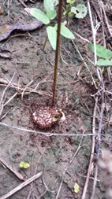
Management Options for IFAs
Tips for Using Insecticidal Baits
Do not apply if fire ants are not foraging
  Need ground temp above ~65○F
  Foraging reduced when temps greater than 95○F
  Check for foraging with (hot dog pieces, etc.)
Do not apply if rain expected (12 hours)
Turn off automatic sprinklers for 12-24 hrs
Don’t apply immediately after cutting grass or brush
  Wait at least 1 day after cutting
Store unused bait in a cool, dry environment

Slide 8
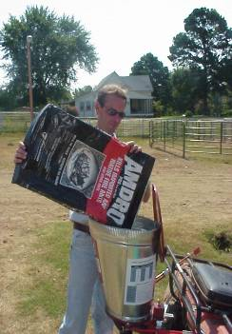
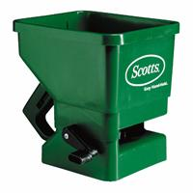
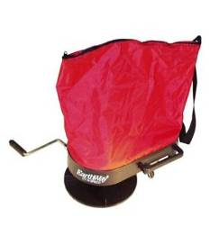
Broadcast Application of Bait
BENEFITS:
More effective
  Treat both seen & unseen mounds
  Less pesticide applied to environment (≈25 granules/ sq. ft.)
Saves time
  no time spent looking for mounds
Notes:
The broadcast application is much more effective than treating mound to mound -- you are treating the mounds seen and unseen. You also have less pesticide present in an local area. If applied correctly approximately 25 granules of bait will be spread on a 1 foot square.
It is definitely more time saving that identifying EVERY mound and treating it individually.

Slide 9
Management Options for IFAs
In Cropland & Food Crops
Fire Ant Baits

Slide 10
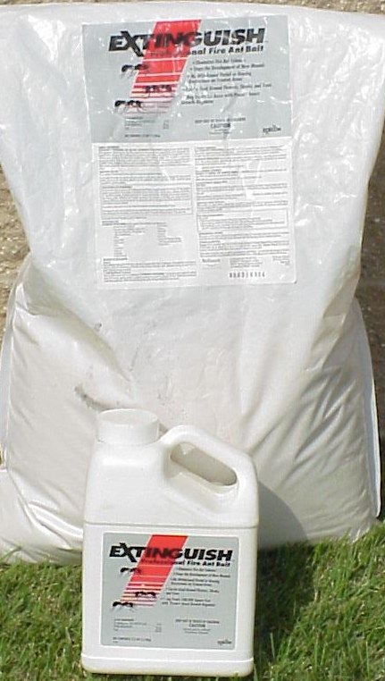

Management Options for IFAs
Insecticidal Bait
(S)-methoprene
Extinguish
IGR: Sterilizes the Queen
≈8 wks for optimal control
Rate: 1-1.5 lbs/A
Registered for use in Cropland
including Gardens
Also public areas, home lawns, & pastures

Slide 11
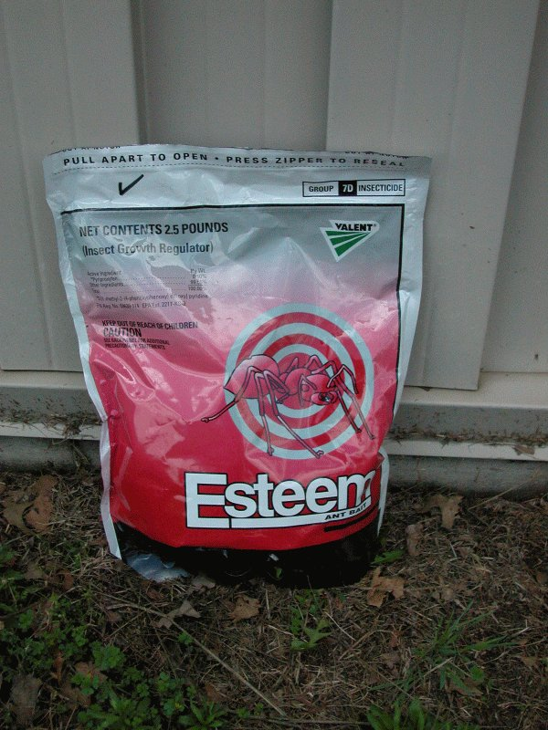
Management Options for IFAs
Insecticidal Bait
pyriproxyfen
Esteem
IGR: Sterilizes the Queen
≈8 wks for optimal control
Rate: 1.5-2.0 lbs/A
Ag use product registered for pastures & fruits, vegetables & small fruit, strawberries

Slide 12
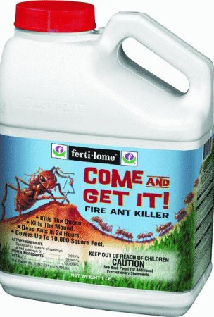
Management Options for IFAs
Insecticidal Bait
spinosad
Ferti-lome Come & Get It! Fire Ant Killer
Actual toxin: Kills the Queen
Controls in 2-4 wks
RATE: 2.5-5.0 lbs/A
Use in Lawns, Turfgrass, Recreational Areas ( including golf courses, parks, playgrounds, & playing fields), Ornamentals growing outdoors, Tree Nuts, Citrus, Stone Fruit, Tree Fruit, & Vegetables
Formerly OMRI certified

Slide 13
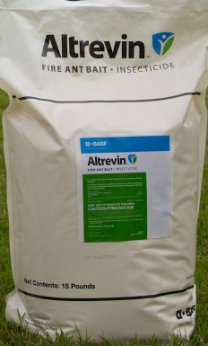
Management Options for IFAs
Insecticidal Bait
metaflumizone
Altrevin Fire Ant Bait
Actual toxin: Kills the Queen
One of quickest acting IFA baits
Controls within a few days
RATE: 1.5 lbs/A
Use in citrus orchards, tree nut orchards, grape vineyards, nonbearing stone & pome fruit orchards, & nurseries containing nonbearing container or field-grown stone & pome fruit tree stock

Slide 14
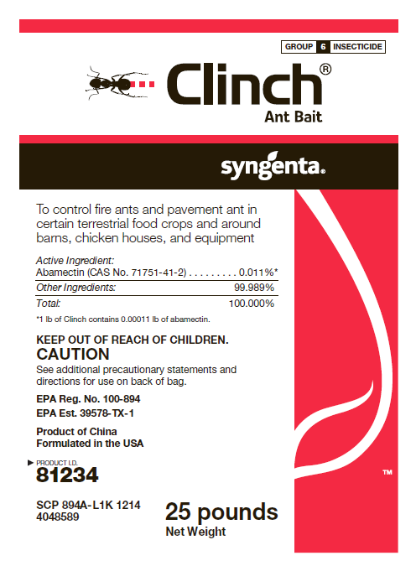
Management Options for IFAs
Insecticidal Bait
abamectin
Clinch Ant Bait
Toxin & Queen Sterilant
RATE: 1.0 lb/A
Use on many Tree Fruit & Nut Crops, Vegetables, Grapes, & Strawberry

Slide 15
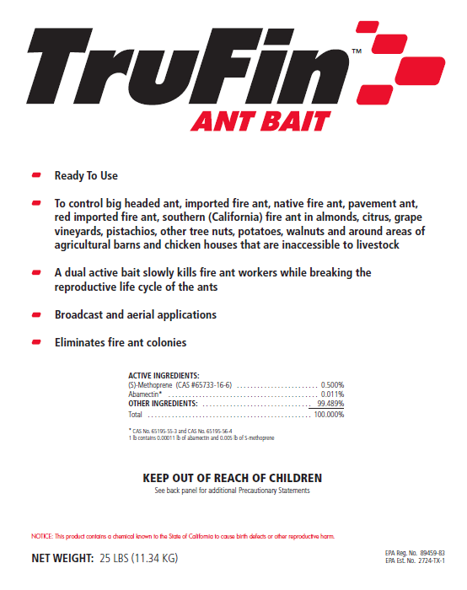
Management Options for IFAs
Insecticidal Bait
(S)-methoprene +
abamectin
Trufin Ant Bait
IGR + Toxin & Queen Sterilant
RATE: 1.0 lb/A
Use on almonds, citrus, grape vineyards, pistachios, other tree nuts, potatoes, walnuts & around areas of agricultural barns & chicken houses that are inaccessible to livestock

Slide 16
Management Options for IFAs
In Cropland & Food Crops
Fire Ant Drenches

Slide 17
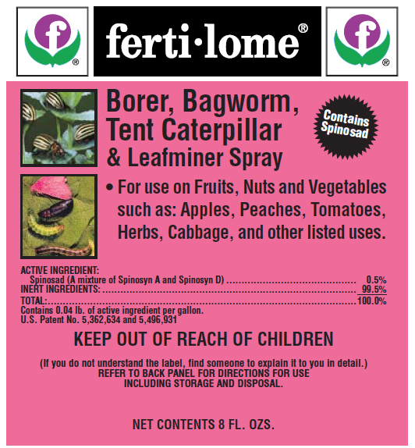
Management Options for IFAs
Liquid Drench
spinosad
Ferti-lome Borer Bagworm Tent Caterpillar & Leafminer Spray
Actual toxin: Kills the Queen
Controls in 2-4 wks
RATE: 2.0 floz/gal of drench
For residential use in home gardens, lawn & ornamentals, strawberry. Not for use on plants being grown for sale or other commercial use, or for commercial seed production

Slide 18
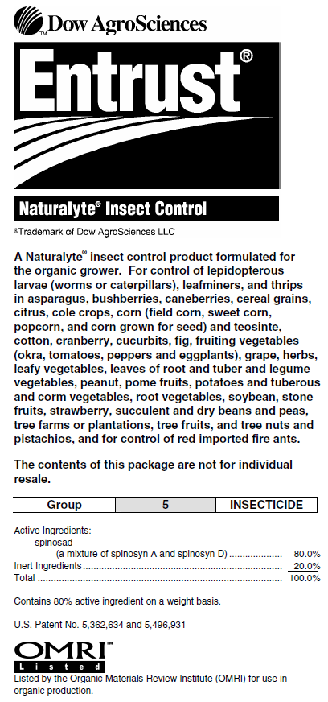
Management Options for IFAs
Liquid Drench
spinosad
Entrust Naturalyte Insect Control
Actual toxin: Kills the Queen
Controls in 2-4 wks
OMRI Listed
RATE: 0.45gm/gal of drench
For use in Organic fruits & vegetables & small fruit (strawberries)

Slide 19
Management Options for IFAs
In the Lawn & Landscape
Fire Ant Baits

Slide 20
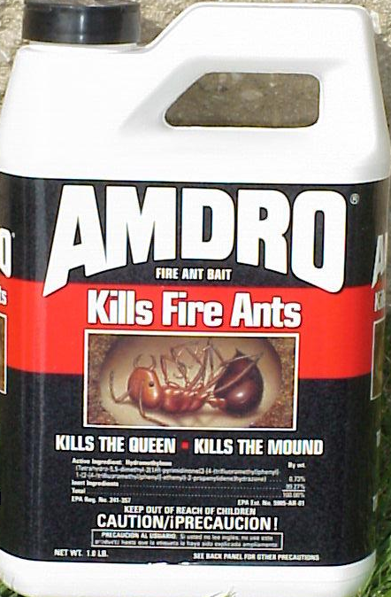
Management Options for IFAs
Lawn & Landscape IFA Bait NO FOOD CROPS
hydramethylanon
Amdro Fire Ant Bait 1.0-2.0 lbs/A
*Amdro Pro Fire Ant Bait 1.0-1.5 lbs/A
Amdro Fire Ant Bait Yard Trt 5.5 lbs/5500 to 11,000 sqft
Amdro Fire Strike 5.0 lbs/5000 to 10,000 sqft
MaxForce Complete Granular Insect Bait
1.0 oz/around each mound
Slow acting toxin: Kills the Queen
Controls within 2-3 weeks
*Use on lawns, landscaped areas, golf courses, & other non-cropland areas (airports, roadsides, etc). Also around container or field grown ornamental & nonbearing nursery stock, sod farms, commercial turf, nonbearing fruit or nut trees, grass forage (Pasture & Rangeland)

Slide 21
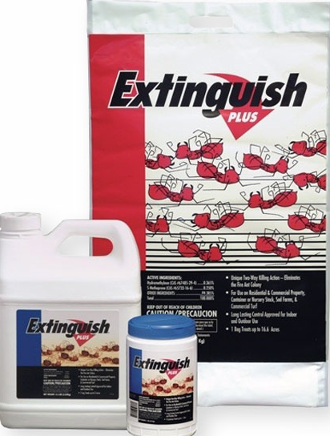
Management Options for IFAs
Lawn & Landscape IFA Bait NO FOOD CROPS
hydramethylnon + (S)-methoprene
Extinguish Plus
Contains a toxin & IGR
Kills or sterilizes queen
Controls within 2-3 wks
RATE: 1.5 lbs/A
Use on residential & commercial property, container or nursery stock, sod farms, commercial turf, pasture & rangeland

Slide 22
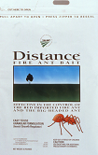
Management Options for IFAs
Lawn & Landscape IFA Bait NO FOOD CROPS
pyriproxyfen
Distance
IGR: Sterilizes the Queen
≈8 wks for optimal control
Rate: 1.0-1.5 lbs/A
Use in container or field grown ornamentals in commercial nurseries, ornamental tree farms, nonbearing nut, citrus, & other fruit trees grown in nurseries, non-grazed pasture & rangeland, conifers & conifer nurseries, sod farms, residential/domestic sites, uncultivated, non-agricultural areas & institutional sites

Slide 23
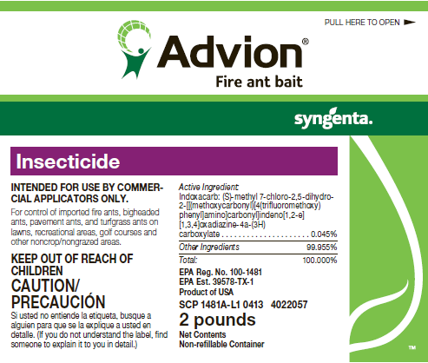
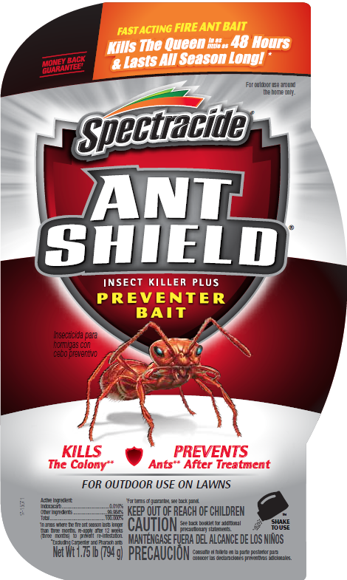
Management Options for IFAs
Lawn & Landscape IFA Bait NO FOOD CROPS
Indoxacarb
Syngenta Advion Fire Ant Bait
Spectracide Ant Shield Insect Killer Plus
Preventer Bait
Ortho Fire Ant Killer Mound Bait
Black Flag Extreme Fire Ant Killer
Actual toxin: Kills the Queen
One of the quickest acting fire ant baits
Controls within a few days
Advion on lawns, recreational areas, golf courses & other
noncrop/nongrazed areas. Rate 1.5 lbs product/A
Spectracide Ant Shield - Outdoor use on lawns
Rate 0.5 lb product/1000 sqft

Slide 24
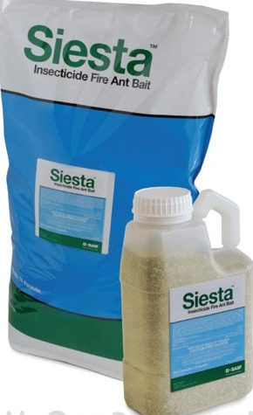
Management Options for IFAs
Lawn & Landscape IFA Bait NO FOOD CROPS
metaflumizone
Siesta Fire Ant Bait
Actual toxin: Kills the Queen
One of quickest acting IFA baits
Controls within a few days
RATE: 1.5 lbs/A
Use on lawns, landscaped areas, golf courses, sod farms, industrial & municipal sites, other non-crop/non-grazed areas, & in nurseries containing non-bearing fruit & nut tree stocks

Slide 25
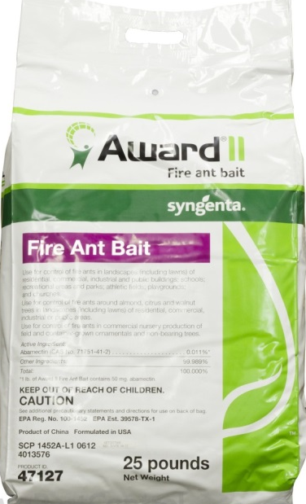
Management Options for IFAs
Lawn & Landscape IFA Bait NO FOOD CROPS
abamectin
Award™ II Fire Ant Bait
Toxin & Queen Sterilant
Similar to Amdro (speed & efficacy)
RATE: 1.0 lb/A
Use in lawns & landscapes of residential, commercial, industrial & public buildings/areas; schools; recreational areas & parks; athletic fields; playgrounds; & churches.
Use around almond, citrus & walnut trees in lawns & landscapes of residential, commercial, industrial or public areas.
Use in commercial nursery production of field & container-grown ornamentals & non-bearing trees

Slide 26
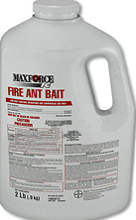
Management Options for IFAs
Lawn & Landscape IFA Bait NO FOOD CROPS
fipronil
Maxforce FC Fire Ant Bait
Slow acting toxin
Rate: 1.5-5.0 lbs/A
Use on home lawns, golf courses,
commercial & recreational turf, adjacent
landscape beds, & sod farms
Do not apply to bare soil

Slide 27
Management Options for IFAs
Contact Insecticides - Individual Mound Trt
Lawn & Landscape - NO FOOD CROPS
Granule
Dust
Drench
Dusts, liquid drench, & granular formulations
ONLY kills those ants that are directly contacted

Slide 28
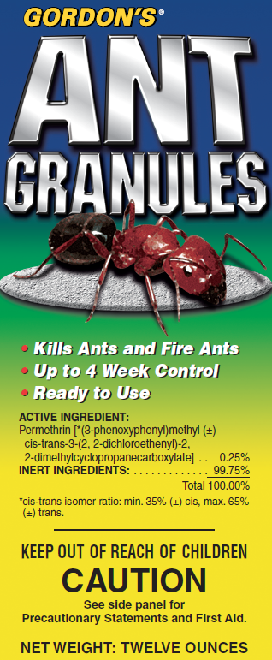
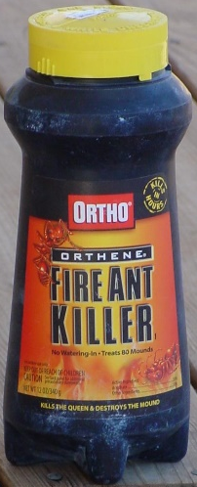
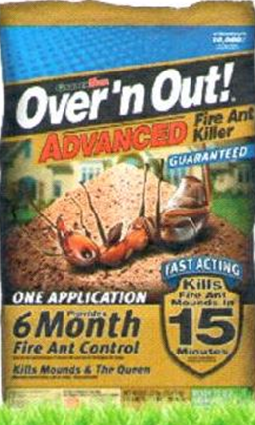
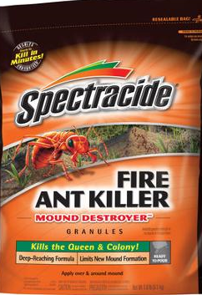
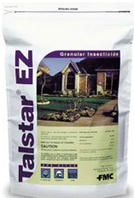
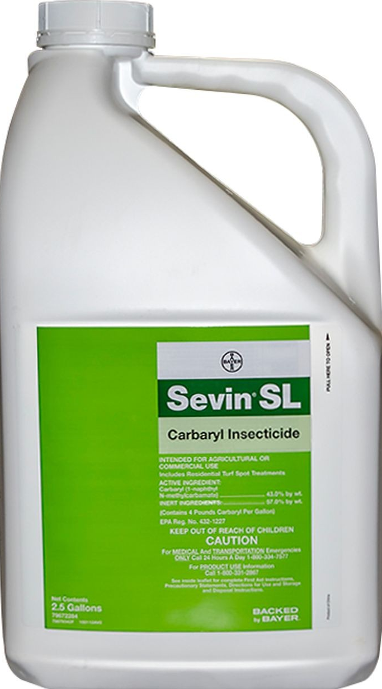
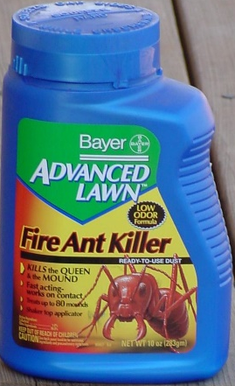

Management Options for IFAs
Contact Insecticides
acephate
lambda-cyhalothrin
bifenthrin +
zeta-cypermethrin
permethrin
bifenthrin
fipronil - RUP
87 lbs/A
cyfluthrin
carbaryl

Slide 29
Misapplication of baits:
Common Mistakes
Use of product when ants NOT active
Use of product prior to a rain
Incorrect storage of product
Applying too much --double the rate per mound
Watering-in baits
Disturbing the mound prior to use
Notes:
Misapplication of baits is probably the biggest problem with them. People don’t read and follow the label instructions.
More does not mean better.

Slide 30
NOT “Home Remedies”
Gasoline
Diesel Fuel
Laundry detergent
Ammonia
Bleach
Vinegar
Used motor oil
Grits / Instant Grits
HOT WATER (can be effective, but is it worth the risk)
Generally only causes ants to move to a new
location, many are detrimental to environment
Notes:
A lot of people have heard about a lot of home remedies and have tried at least one or two of them. Although they may kill a few ants, the odds are that the queen is not impacted and the colony lives, but the environment is impacted.

Slide 31
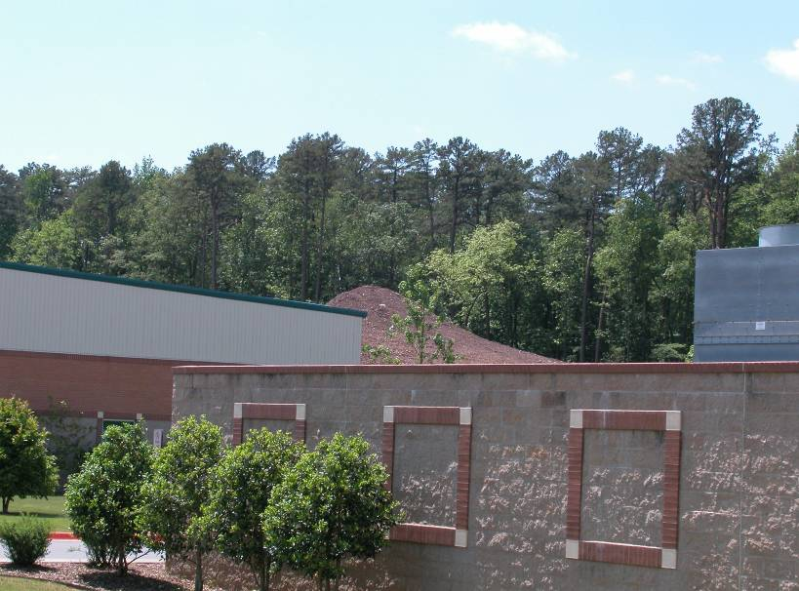
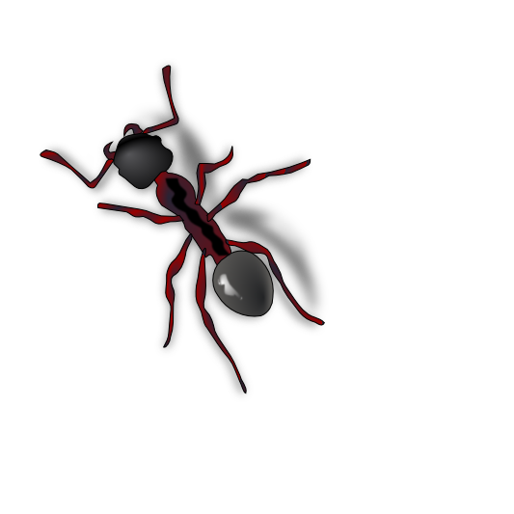
Questions?

