Slide 1
Session 7
Cover crops in vegetable systems, Part II

Slide 2
Outline
  Examples of how cover crops can impact vegetable crop production: yields, weed control and pests.
    Research from Arkansas
    Research from the Southeastern U.S.

Slide 3
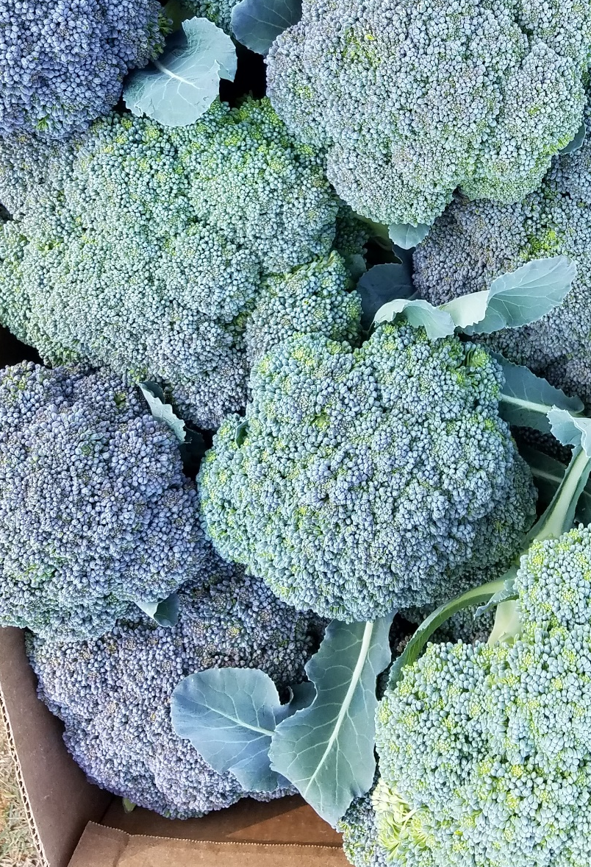
Effects of Summer Cover Crops on Yield
Summer Cover Crops for Fall Broccoli Production
Fall plasticulture ‘Arcadia’ Broccoli head size and yields were increased in plots planted in a summer cover crop of cowpea ‘Iron Clay’ over control plots at two site locations during the fall of 2016.
(McWhirt and Lee, 2017)
Notes:
This trial evaluated legume and grass legume combinations. The legume by itself was found to increase yield relative to a non-cover cropped control at bot locations in Arkansas. Both trials were plasticulture with all of the biomass turned into the soil. And black plastic.

Slide 4
Cover Crops Effect on Reducing Soil Nitrogen Leaching in Winter
Problem: want to retain soil nitrate and prevent it from leaching during winter, but too much cover crop biomass that needs to be incorporated may delay planting
Solution: Kill cover crops with herbicide at an early growth stage (8-9 weeks post germination) to reduce biomass
Outcome: the early killed cover crop can sometimes retain nitrate better than bare ground plots, but not always equal to an un-killed cover crop
  (Heinrich, Smith and Cahn, 2014)
Notes:
Important to realize that a living cover crop can have more impact than a dead cover crop.

Slide 5
Cover Crop Effect on Cash Crop Nitrogen Fertility

Slide 6
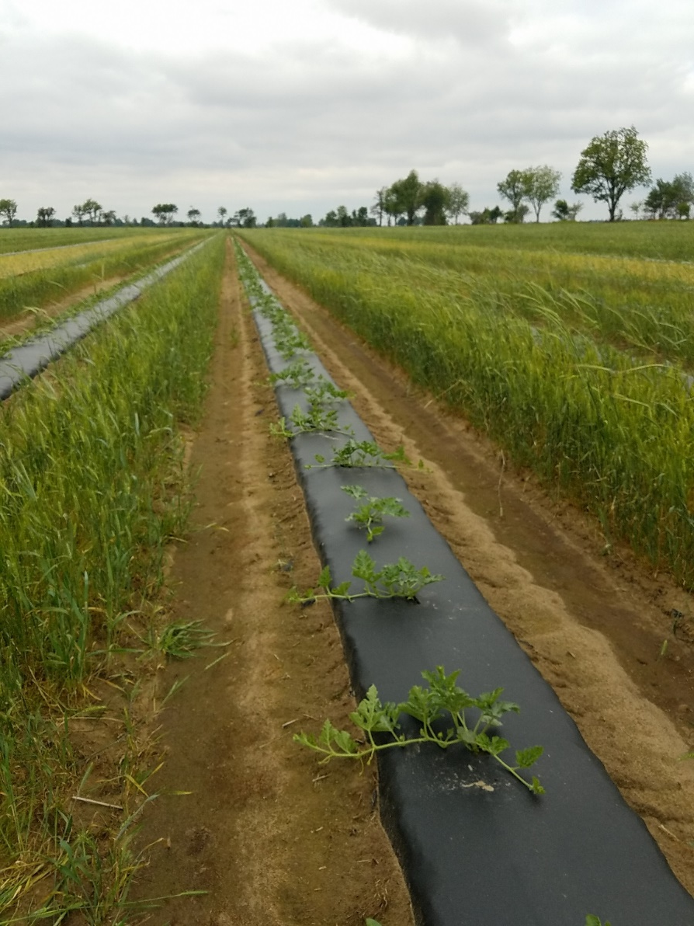
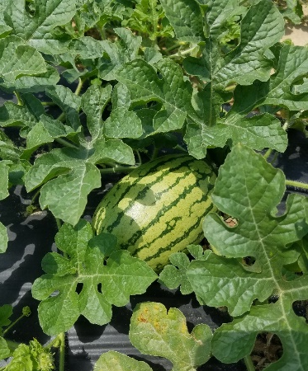
Strip-Till Plasticulture
Watermelons
Currently used practices in NE Arkansas:
Winter cover crops planted to precede spring planted melons
  Wind-break
  Weed control in the alleyways
Seedless watermelon, No-till:
Crimson clover + rye or Hairy vetch
  Higher fruit number and yields compared to bare ground (where there was 100 lbs. N supplied)
Rangappa, Hamama and Bhardwaj. 2002.

Slide 7
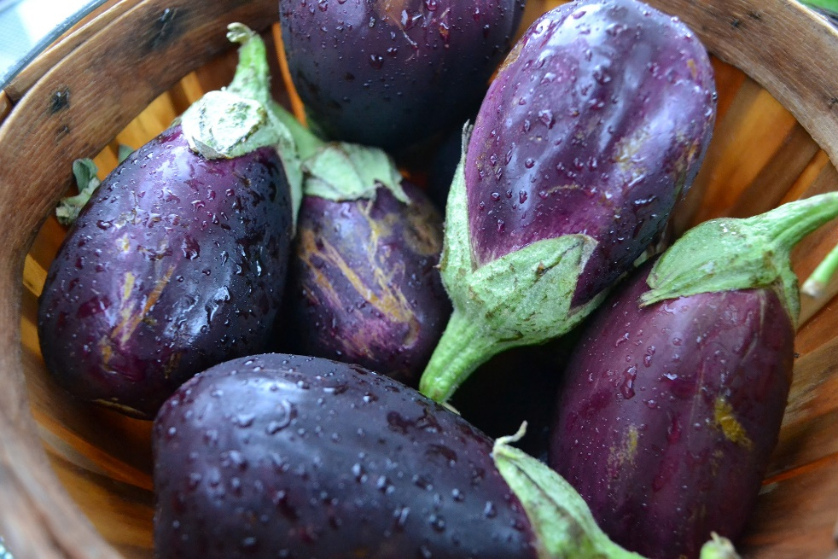
Examples of Cover Crops Delaying Harvest and Reducing Yield
Eggplant
Lower soil temperatures in a no-till eggplant system resulted in delayed harvests and reduced the yields when compared to a bare ground plot or a black plastic mulch plot.
(Chen et. al 2017)

Slide 8
Cover Crops Impacts on Soil Health
After 2 years of using reduced-till and cover cropping in organic vegetable production, increases in soil organic matter and soil nitrogen were observed relative to tilled systems were that was also using cover crops.
The reduced till system had higher weed pressure.
(Butler, Bates and Inwood, 2016)
Notes:
Cover crops can increase measures of soil health, but there may be trade-offs. Organic systems struggle with weed control, particularly in reduced till systems.

Slide 9
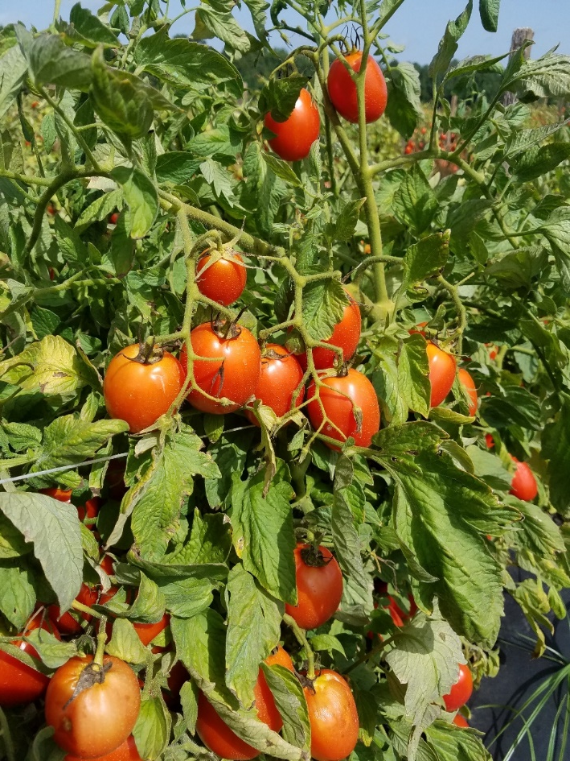
No-Till Cover Crops Conserve Soil Moisture
No-till tomato
In drought years rye cover crop mulch had higher marketable tomato yields compared to plastic mulch.
Likely due to better soil moisture conservation.
(Kornecki, and Arriaga. 2011)
Rye cover crop residues plus glyphosate suppressed annual grasses, jimsonweed and common lambsquarters but did not suppress smooth pigweed and ivyleaf morning glory in a single year trial in New Jersey.
(Jack Rabin, 2013)

Slide 10
Bio-fumigant Cover crop Effects on Soil Borne Disease
The cover crop material must be incorporated into the soil.

Slide 11
Take Home Message
Cover crops can have diverse impacts on vegetable cropping systems
  Well thought out cover crop selection, crop management and timing can increase the chances of success and the benefits to the cash crop and soil health.

Slide 12

Authors and Acknowledgements
This presentation was prepared by
Drs. Amanda McWhirt and Jackie Lee with support from a Southern SARE
Professional Development Program Grant (RD309-137 / S001419 – ES17-135) and are provided by the USDA-SARE program to educators and producers for outreach and educational purposes. These presentations were further reviewed by Dr. Trent Roberts and
Dr. Bill Robertson.
Notes:
These training was developed by Drs. Amanda McWhirt and Jackie Lee with support from a Southern SARE Professional Development Program Grant.

Slide 13
Resources and Sources
Heinrich, Smith and Cahn. 2014. Winter-killed Cereal Rye Cover Crop Influence on Nitrate Leaching in Intensive Vegetable Production Systems. Hort Technology. 24 (5): 205-2011 https://journals.ashs.org/horttech/view/journals/horttech/24/5/article-p502.xml
Butler, Bates and Inwood. 2016. Tillage System and Cover Crop Management Impacts on Soil Quality and Vegetable Crop Performance in Organically Managed Production in Tennessee. https://journals.ashs.org/hortsci/abstract/journals/hortsci/51/8/article-p1038.xml

