Slide 1
Session 6
Cover crops in vegetable systems, Part I

Slide 2
Outline
Plasticulture vs. No-till vs. Strip-till
High tunnels
Pollinators improtance
Cover crops are required for organic production systems
Notes:
Horticultural crops tend to be very high value, that can sometimes mean that farmers hesitate to take land out of production, but can also mean more importance in maintaining ground for good quality crops.
Vegetable crops are grown in many seasons, which means the “off” season or season for cover crops can be in the summer or winter
Intensive rotations may mean there are only short windows for incorporating a cover crop
There are many different scales of horticultural production, and small and large scale growers will have different needs
There are 3 main types of soil management that necessitate different ways of managing cover crops
Plasticutlure (tilled)
No till
Strip till or strip till+plasticulture
High tunnels offer a unique opportunity for cover crop use
Cover crops for pollinator habitat may be particularly important to horticultural crops that rely on pollinaotrs
And in organic systems cover crops are a requirement for the farm plan

Slide 3
Cover Crops for Vegetable Production
High values crop production
Returns of >$4,000-20,000/acre
Can afford the cost of cover crops
Little year round production so can fit cover crops into system of production
Summer vs. winter cash crops
Small to large scale of horticultural production
Ability to rotate crops on small plots
What equipment do growers have on hand

Slide 4
Planning for Cover Crops in Horticultural Production
Choose cover crops that fit in the existing cropping system
Members of the Brassicas and Legumes are also horticultural cash crops.
Use drive rows for cover crops
Use marginal land for beneficial habitat
Use cover crops that fit the crop timing
EX. The market demands that watermelons be ready before July 4th
Example
Plan to use cover crops in a no-till watermelon system. Need a grass to head out early enough in the spring to easily roller terminate and be able to plant on time in late-March to early April. Will the soil be warm enough at that time?
Notes:
Choose crops that fit the existing system: This means land will not have to sit out of production for cover crop use when a cash crop would otherwise be grown.
Cover crops and crop rotation should be a part of a good vegetable production system.
Thinking about the timing needs of the cash crop and the maturation timeline of the cover crop is key. The two timelines should closely align.

Slide 5
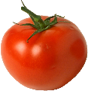
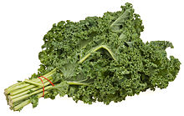
Crop Rotation Examples
Clover + Cereal Rye cover crop (Winter) -> Tomato
(Summer) -> Mustard cover crop (Late summer)-> Fall Kale Crop
Clover + Cereal Rye cover crop (Winter) -> Tomato (Summer) -> Japanese millet (45 days)(Late summer)-> Fall Kale Crop
Avoid the same plant families one after the other.
Notes:
Think about your long term crop roations
Japanese millet is highly responsive to growing degree days (GDD) i.e. it grows faster the hotter it is.
In 30 days will produce seed, kill before then otherwise big problem.

Slide 6
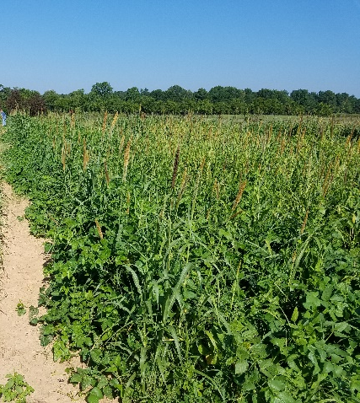
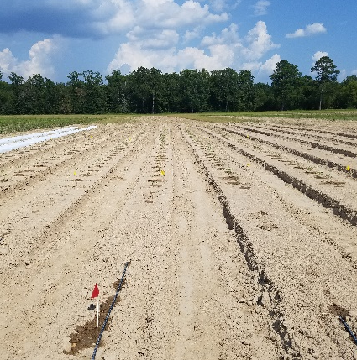
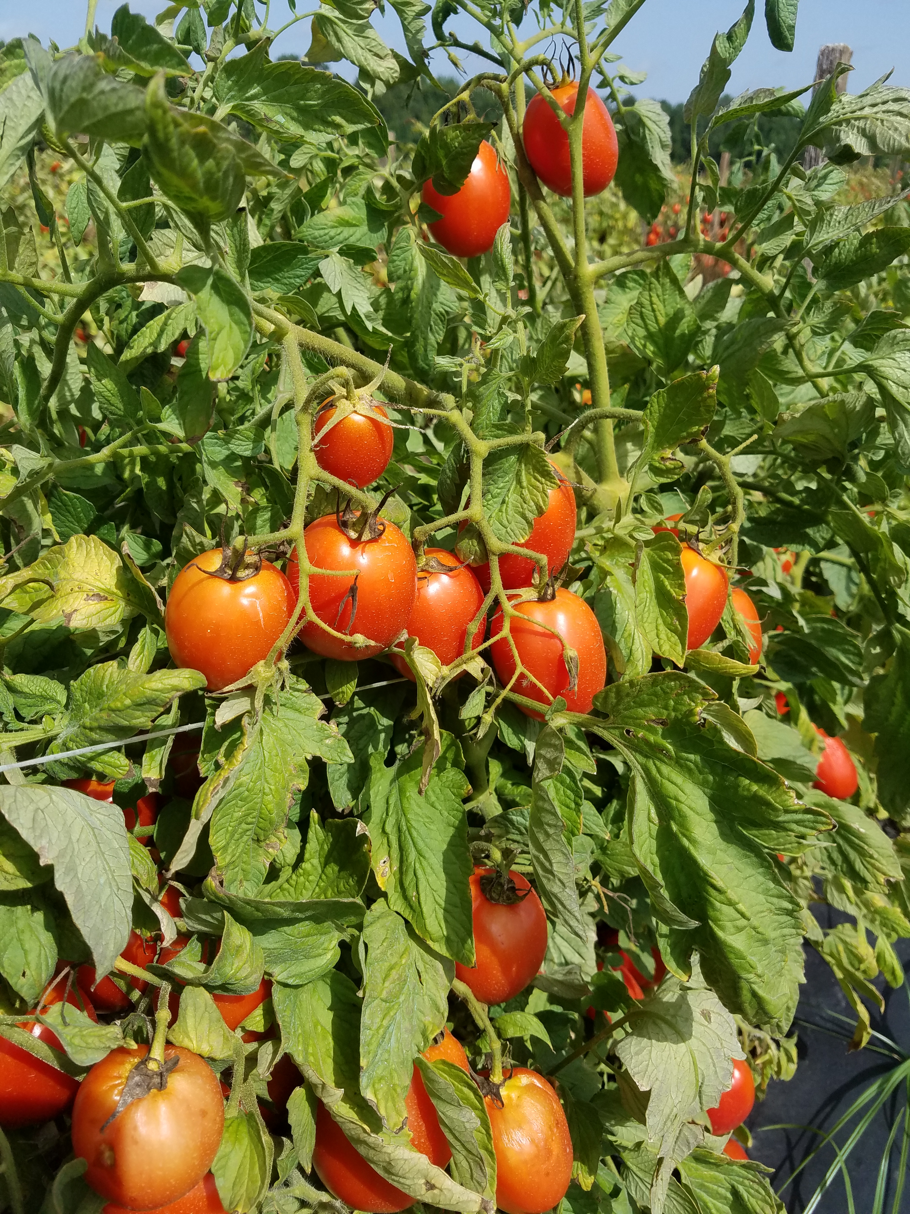
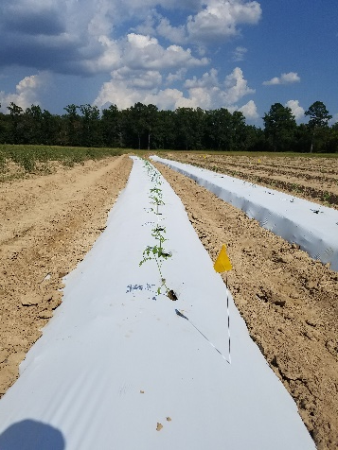
Cover Crops in Plasticulture Vegetable Systems
Cover crops will be used for Nitrogen and soil organic matter contributions under the plastic and/or weed control in the row middles.
Time: Cover crops can be integrated into crop rotations between cash crops
Soil Management: cover crops should be incorporated into the soil prior to laying plastic.
Tillage or Strip-tillage
Generally 2-4 weeks is enough time for the biomass to break down

Slide 7
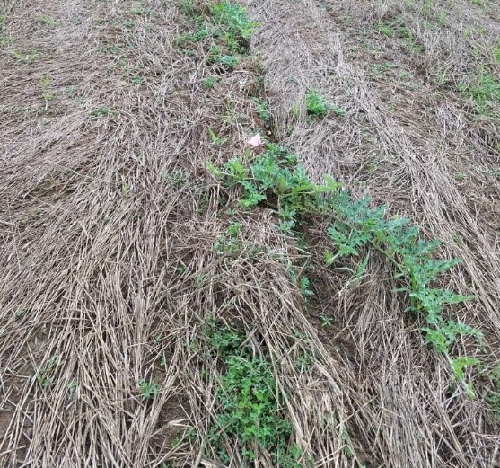
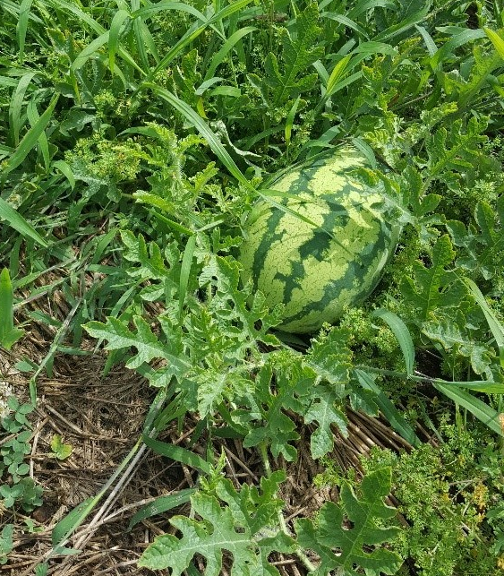
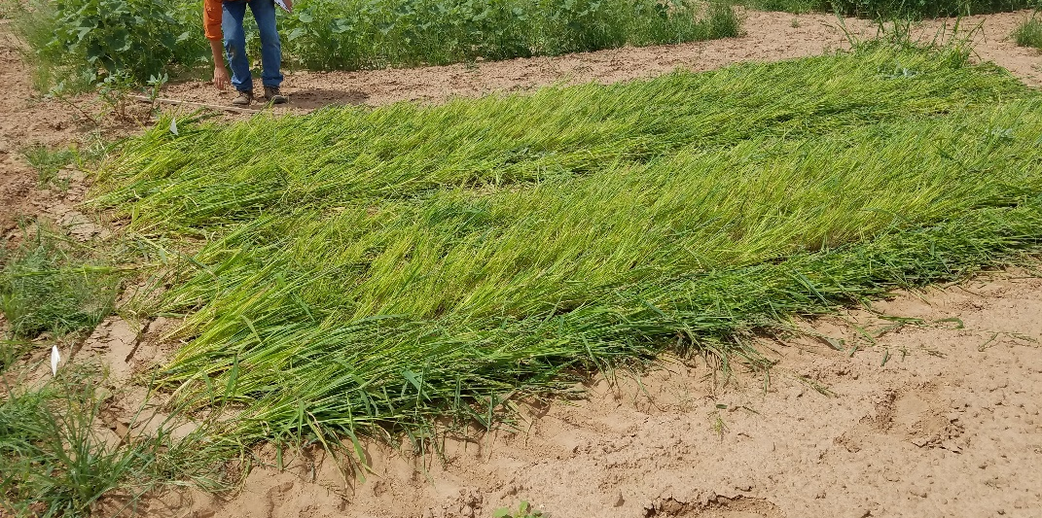
Cover Crops in No-Till Vegetable Systems
Why? Reduce reliance on plastic and soil disruption via tillage and cut input costs associated with laying and removing plastic
Time: Success is dependent on the biomass produced if the cover crops is to be used as a weed mat/ green mulch before cash crops
Soil Management: cover crops should be terminated and allowed to die down before the cash crop is transplanted, Preference for rye as wheat has been shown to break down more quickly ²

Slide 8
Cover Crops in No-Till Vegetable Systems
No-till mulches rarely result in season long weed control -> Challenge for organic producers
Cool soil temperatures under the biomass ->Use transplants to help with delays and achieve more rapid canopy closure (not feasible with all crops)
Must wait for appropriate crop timing to terminate, which may delay planting
Use drip irrigation to combat possible moisture competition between the cover crop and cash crop
May need to supplement Nitrogen to compensate for high C:N cover crop residues
May need to reduce between row spacing so the crop canopy can close and help shade out weeds

Slide 9
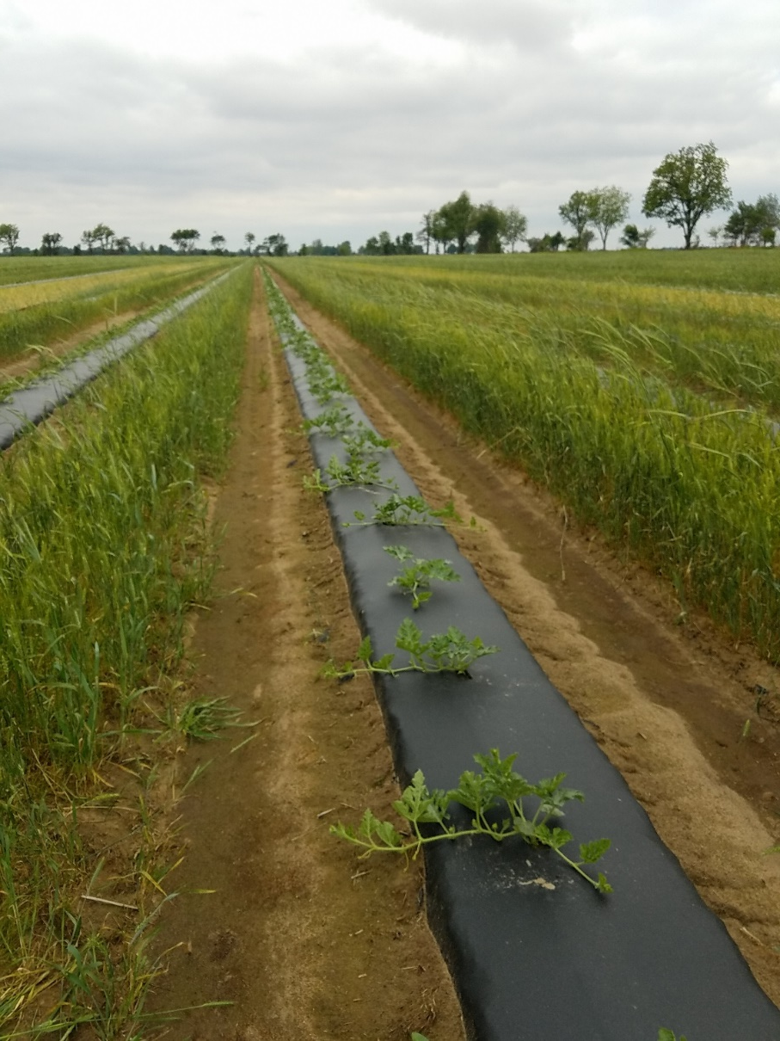
Strip-Tillage
Combines no-till and plasticulture production
Cover crop is left standing in the row middles
Cover crop is mowed and tilled into the soil where the beds will be laid
(+) Weed coverage in row middles, warm soil to transplant into
(+) Reduced tillage across the field.
(-) Will need to supplement weed control next to the beds where soil is disrupted.
Example: Watermelons
Winter cover crops planted to precede spring planted melons
Cover crop in row middles provides a wind-break and weed control. The grass will die down naturally or can be rolled after plants establish

Slide 10
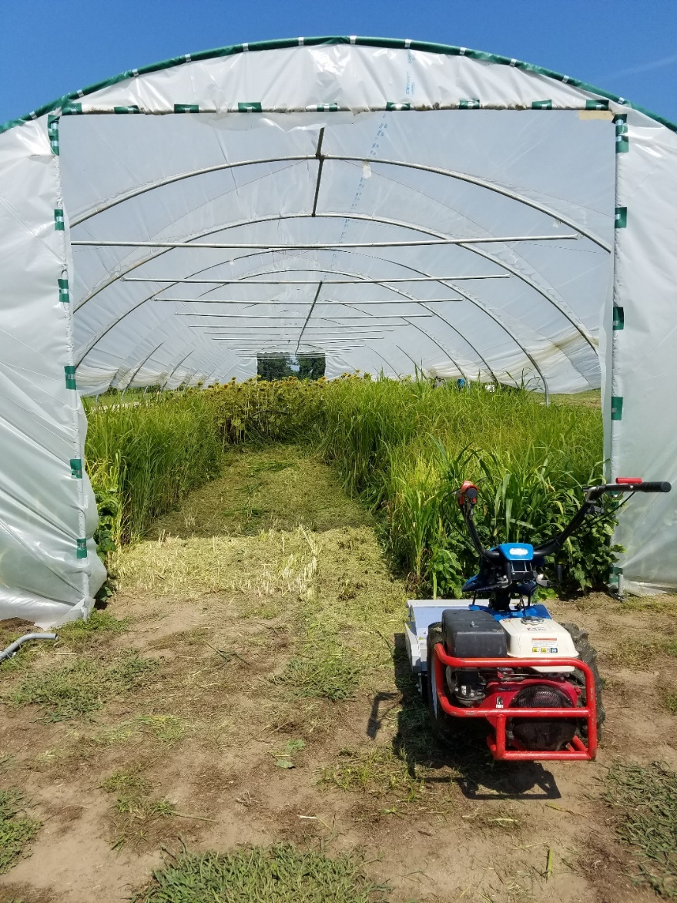
High Tunnels
High Tunnels extend the growing season
Accumulation of salts in the soil
Very hot temperatures in mid-summer
Too cold or short days in mid-winter
Cover crops grown in high-tunnels
Can accumulate salts
Crop can be removed
Can withstand hot temperatures
Opportunity for crop rotation
May require specialized equipment
Will require irrigation

Slide 11
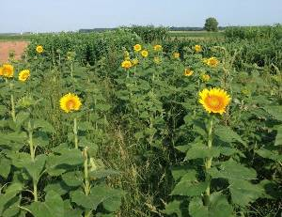
Pollinator Strips
Cucurbits in particular require pollinators for good fruit set
Native pollinators have been demonstrated to be as or more effective pollinators than honeybees for certain crops.
Pollinator strip flowering should be synchronized with cash crop flowering
Mixes preferable due to differences in pollinator preferences
Opportunity for Agritourism operations
Some cut flower production
Sunflowers are good at smothering weeds and salt accumulators

Slide 12
Organic Requirements for Cover Crops
The National Organic Program Rule: Soil fertility and crop nutrient management practice (§205.203)
The organic regulations state that a producer must select and implement tillage and cultivation practices that maintain or improve the physical, chemical, and biologic al condition of the soil and minimize soil erosion.
Required crop nutrient and soil fertility management practices:
Crop rotations (perennials as an exception)
Cover crops
Application of plant and animal materials
Organically grown seeds must be used, unless the producer can demonstrate lack of commercial availability or prohibitive cost (CFR 205.204).
If a grower can demonstrate a lack of availability, they may use conventionally-grown, untreated seed.
Should consult their certifier prior to proceeding
Must have support documentation
GMO seed is never allowed
Notes:
For organic production the main considerations are that no herbicides can be used. This means that no-till systems must be very precise in choosing the correct timing for terminating the cover crop to get an effective kill. Otherwise the cover crop will not die down and can become a weed for the next cash crop.

Slide 13
Take Home Message
Cover crops can benefit horticultural crop production
There are specific considerations unique to vegetable production systems that require careful planning to successfully integrate cover crops

Slide 14
Authors and Acknowledgements
This presentation was prepared by
Drs. Amanda McWhirt and Jackie Lee with support from a Southern SARE
Professional Development Program Grant (RD309-137 / S001419 – ES17-135) and are provided by the USDA-SARE program to educators and producers for outreach and educational purposes. These presentations were further reviewed by Dr. Trent Roberts and Dr. Bill Robertson.
Notes:
These training was developed by Drs. Amanda McWhirt and Jackie Lee with support from a Southern SARE Professional Development Program Grant.

Slide 15
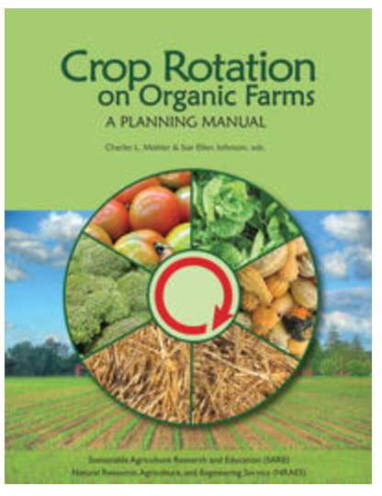
Resources and Sources
Free SARE guide for organic farms on planning rotations
¹ Clark, A., editor. 2012. Managing Cover Crops Profitably, 3rd Edition. Sustainable Agriculture Research and Education. Handbook Series Book 9. https://www.sare.org/Learning-Center/Books/Managing-Cover-Crops-Profitably-3rd-Edition/Text-Version/Printable-Version
USDA.The Cover Crop Chart (v. 3.0). https://www.ars.usda.gov/plains-area/mandan-nd/ngprl/docs/cover-crop-chart/
FSA2156. Understanding Cover Crops. https://www.uaex.edu/publications/pdf/FSA-2156.pdf
Making the Most of Mixtures: Considerations for Winter Cover Crops in Temperate Climates https://articles.extension.org/pages/72973/making-the-most-of-mixtures:-considerations-for-winter-cover-crops-in-temperate-climates
Farming With Bees: The Synchronization of Pollinator Plantings to Increase Production of Cucurbit Crops https://www.ctahr.hawaii.edu/oc/freepubs/pdf/SA-6.pdf
https://sustainable-farming.rutgers.edu/wp-content/uploads/2014/02/Six-Things-Mother-Never-Warned-You-About-Using-Roller-Crimpers-Rabin-2013.pdf

