Slide 1
Session 5
Cover crops for pest managment

Slide 2
Outline
Cover Crops for Effective Crop Rotation and Pest Management
Crop rotation
Nematode suppression
Weed control
Disease suppression
Effects on pests and beneficials

Slide 3
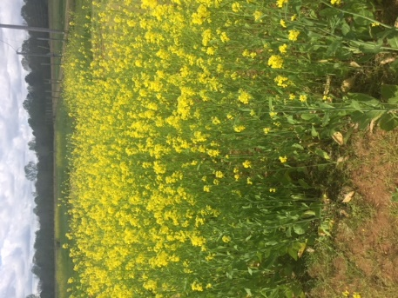
Crop Rotation
Important to avoid cover crop plantings which could be alternate hosts for the same diseases/insects you are trying to control
Clockwise from upper left: black oats, winter wheat, Austrian pea, mustard, crimson clover, cereal rye. Photos: Jackie Lee
Notes:
Crop rotation is important with cover crops as well as cash crops. You want to make sure that you plant a cover crop that is a different species than the cash crop you plan on planting. This is important because many plants that are the same species have the same dieseases and insect pests. When you rotate it can help to decrease disease and insect pressure over time. Ex.

Slide 4
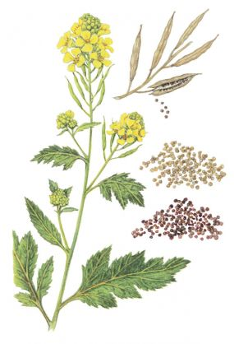
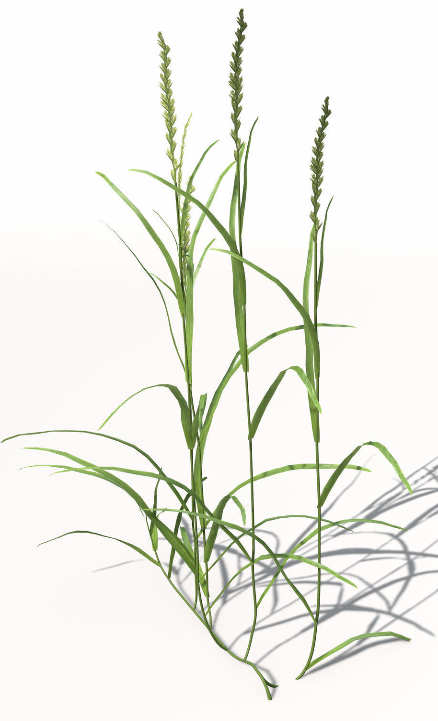
Crop Rotation
X
Mustard
Rye grass
Notes:
Poorly selected cover crops can attract, stimulate or harbor pests that can negatively impact the following cash crop. Planting several different species of cover crops in the same field will reduce the risk of hosting a particular pathogen. Cereal rye is NOT in the same family as common vegetable crops and is a great choice for a cover crop or to add to a cover crop mixture. Example. Mustard is a brassica and you would not want to follow with other brassicas due to the increase potential for pest transfer. Cereal rye or other grasses would be a better option in this situation.

Slide 5
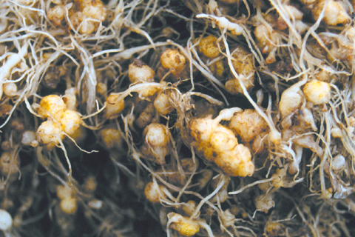
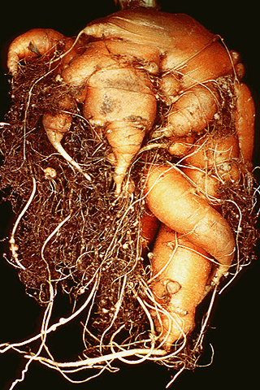
Nematode Suppression
Cover crop plantings can be affective for nematode suppression, but do your research!!
Non-Host = Starving out nematodes:
Root knot nematodes (RKN) can only survive for 1-2 years absent a suitable host
Cyst nematodes have long-term survival stages and are more difficult to control with the starving out method
In the case of RKN, utilize a non-host such as sorghum (Sudan grass) and avoid mustards/brassicas
Make sure to have the correct cultivar – not all are equally effective
Environmental factors can influence the effectiveness of RKN control, so year-to-year results may vary.
If RKN levels are high, or the subsequent crop is highly susceptible, a multi-year rotation with non-hosts may be required
Root-knot nematode on lettuce. Source: apsnet.org
Severe forking in carrot caused by RKN. Source: apsnet.org
Notes:
No cover crop will suppress all species of nematodes. Some are better than others. Data is conflicting as to efficacy. Do your research!
When planted following a RKN-susceptible crop, Sudan grass used as green manure was just as effective as a nematicide for reducing RKN populations in the subsequent crop (source: SARE.org)
Using this strategy each year is necessary for continued RKN control
Best control observed when Sudan grass is cut and incorporated into the soil

Slide 6
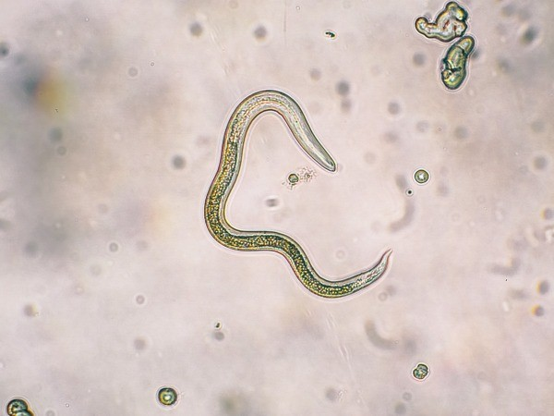
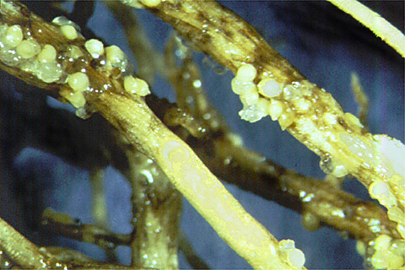
Nematode suppression
Bio fumigating nematodes
Brassicas/mustards release glucosinolates (bio fumigant) as they break down when cut and incorporated into the soil
Glucosinolate levels peak at different times for different species, so incorporation should be done as close to this peak time as possible
More useful for cyst nematodes
Most brassicas/mustards are excellent hosts for RKN, so avoid if RKN is your primary issue
Avoid hairy vetch if soybean cyst nematode is present
Other less-common nematodes can also cause issues (E.g. lesion/dagger/etc.)
Research compatibility of cover crop species if your soil test shows you have issues with these nematodes
Close-up view of RNK. Source: apsnet.org
Soybean cyst nematode. Source: apsnet.org
Notes:
Will need to avoid certain cover crops that could be alternate hosts for nematodes if present. Ex. Hairy vetch and soybean cyst nematode. Few cover crops will suppress lesion or dagger nematodes.

Slide 7
Cover Crops as Hosts to Nematodes
 |  |  | Host (+) or Poor/ Non-host (-) ²
Season | Cover Crop Type | Cover Crop | Root Lesion | Root knot nematode | Dagger | Needle | Sting | Foliar Nematode
Warm | Legume | Sun hemp ¹ |  | _ |  |  | _
 | Legume | Soybean |  | +
 | Legume | Cowpea ¹ ‘Iron clay’ |  | _ |  |  | +
 | Legume | Velvet Bean |  | _ |  |  | _
 |  | Sesame |  | _
 |  | Marigold | _ | _ | _
 | Grass | Pearl, Millets ¹ | _ | _ | + |  | +
 | Grass | Sorghum, Sudan ¹ | _ | _ | + |  | +
Inter | Brassicas | Canola/ Rapeseed |  | _ | _
Cool | Legume | Clovers |  | +
 | Legume | Vetches |  | +
 | Broadleaf | Buckwheat |  | +
 | Brassicas | Mustards ¹ |  | _ | _
 | Grass | Cereal Rye | _ | _ | _
 | Grass | Wheat | + | _
 | Grass | Black Oats ¹ | _ | _
¹ Be sure to select varieties that have resistance
2 Host and Non-host is a spectrum and the chart is based on best recommendations and likelihood for nematode population rebound following planting of the cover crop
Notes:
Cover crops however, particularly grasses and brassicas are either poor hosts or do not host many of our common nematode species that are pests of strawberry. Again knowing what nematodes you have is important. In florida the sting nematode is a major issue and for that reason sun hemp is often planted b.c it is not a host to that nematode where as millets and sorghum sudan are hosts, It is also a warm season legume so it fits in well to their production system. In other parts of the country where root knot nematodes are more likely to be the major issues there are many warm and cool season options. But notice for the most part it is grasses and brassicas that are non-hosts. I don’t have every line of this chart filled out, these are just some general guidelines, and it is important to point out that for a given cover crop different varieties may vary in their ability to suppress nematodes. For iron clay cow pea is a specific variety of cow pea that does not host root knot nematodes. Sun hemp verities vary in their ability to suppress Sting nematodes.
Always consult local university and extension for local expertise on what works in your region.
So what has research shown as far as planting cover crops to suppress nematodes in the off-season for strawberry crops?

Slide 8
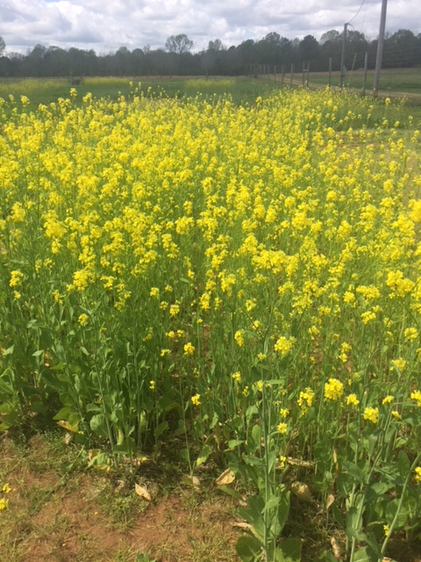
Weed Control
Cover crops can help suppress weeds through both physical and chemical means
Physical control:
Outcompete weeds for nutrients, sunlight, and other resources
After termination, cover crop residues can prevent weed seed germination when left on the soil surface by blocking sunlight and affecting soil temperature/moisture.
These effects are highly species specific and favored by a high cover crop density
Grasses tend to produce the most biomass and result in the best weed suppression
Grasses alone, or mixed with legume/brassicas provides better weed control compared to legume/brassica monocultures
Mature plot of mustard relatively free of weeds (left) compared to heavy weed growth in a control plot. Photos: Jackie Lee

Slide 9
Weed control
Bio-chemical control:
Brassica species and cereal rye produce allelopathic chemicals (nature’s herbicides!) which inhibit growth or germination of nearby plants
These benefits in addition to physical control
Most effective on germinating seeds, seedlings, and young plants
Significantly slows weed growth and sometimes kills them outright
Allelopathic interactions are often species specific
Winter wheat/rye are quite active against pigweed, lambs quarter, purslane, crabgrass, and less so against ragweed, and morning glory (articles.extension.org)
Sunflower and some clover species suppress morning glory, and sorghum can inhibit purple nutsedge
Herbicide resistant palmer amaranth, a type of pigweed, is a major problem
Cereal rye/winter wheat provides good control (Wiggins et al., 2016)
Cover crops may not always provide sufficient weed control by themselves, necessitating herbicide use for more persistent weeds

Slide 10
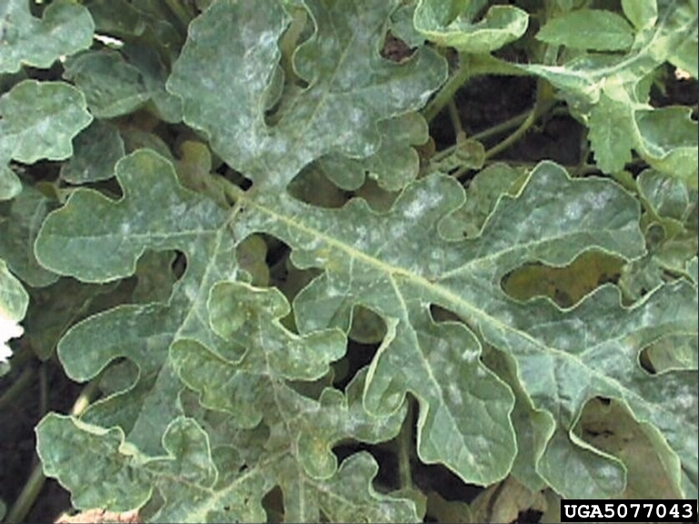
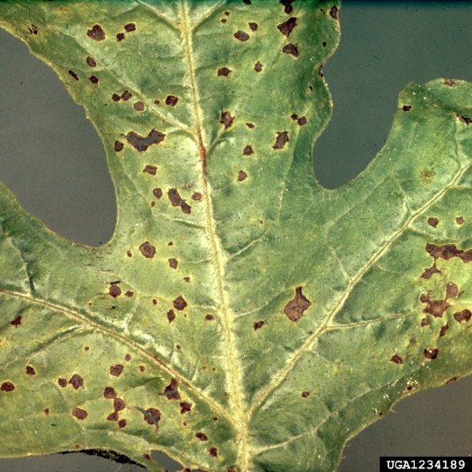
Disease suppression
Cover crops can help suppress disease, but the system is complex and not fully understood.
Suppressive effects can vary greatly due to location, climate, environmental conditions, and differences in pathogens present. Each of these factors can affect disease susceptibility in crop plants.
Powdery mildew on watermelon
Anthracnose on watermelon

Slide 11
Disease suppression
Possible modes of disease suppression:
Cover crops produce a physical barrier that reduces rain splashing, thereby decreasing pathogen dispersal
Increased soil microbial activity; can increase plant health, thereby reducing disease susceptibility
Arbuscular mycorrhizal fungi interactions – some cover crops promote these fungal species which lead to beneficial interactions with the roots of crop plants, causing the crop to be less susceptible to certain diseases
Many cover crop species (annual rye, red clover, hairy vetch, winter wheat, canola, etc.) can be colonized by the fungus Trichoderma harzianum
Suppresses Pythium and Fusarium spp. Cause important soil borne diseases in many vegetable crops including damping off
Allows carryover to subsequent crop (southernsare.org)
Brassica species are known for their disease suppressive effects:
The result of the breakdown of naturally-occurring sulfur-containing compounds in the brassica crop residues
The breakdown results in compounds with fungicidal activity
Good in theory, but evidence is lacking and effects are highly crop-specific
Notes:
It is important to incorporate cover crops at the proper time to allow enough time to break down
Cover crops also get diseases, so incorporating soon before planting the cash crop can have a negative affect on diseases
When pathogens are abundant, disease pressure is high and the suppressive effects of cover crops may be limited
Races of pathogens present (genetically distinct populations of the same species) likely play a large role in levels of disease suppression
Further research will hopefully increase our understanding of these interactions

Slide 12
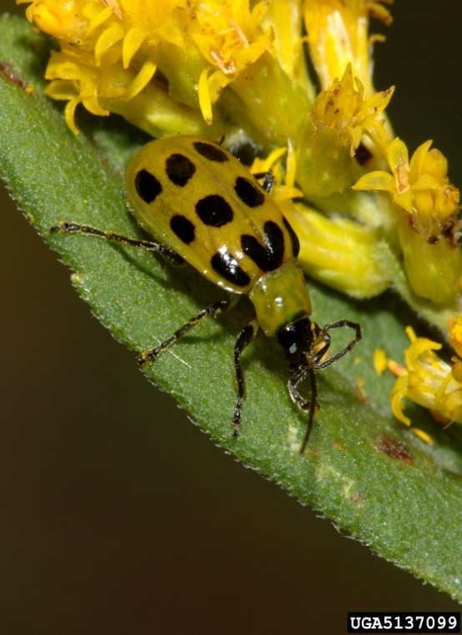
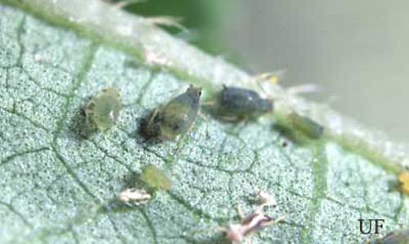
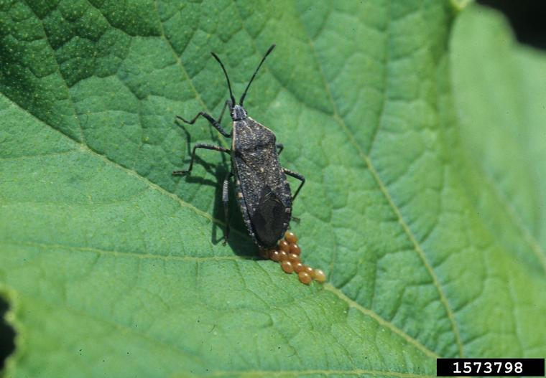
Cover crop effects on arthropod populations
Cover crops can have many effects on arthropod populations:
Reduce pest insect/arthropod populations
Promote natural enemies & beneficials
Promote pollinator populations & diversity
Possible pest bridging issues?
Photo cred: Paul M. Choate, University of Florida
Photo cred: Gerald Holmes, California Polytechnic State University at San Luis Obispo, Bugwood.org
Photo cred: Susan Ellis, Bugwood.org
Melon aphids
Squash bug
Cucumber beetle

Slide 13
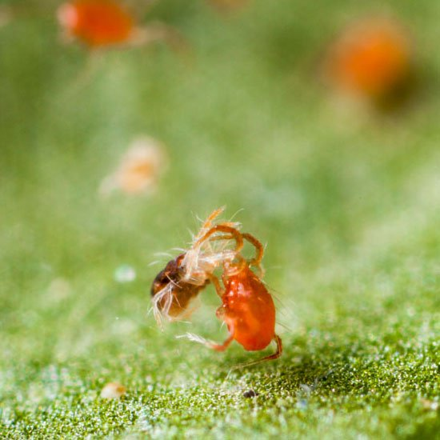
Cover crop effects on arthropod populations
Reduction in pest insect populations by disrupting their life cycles
These effects are varied, depending on the crop, its associated pests, and subsequent crops.
Impact on beneficial insect/arthropod populations
Increase natural predators
Provide refuge and overwintering sites
Springtime habitat
Positively impacted by plant diversity
Predatory mite; Source: www.planetnatural.com

Slide 14
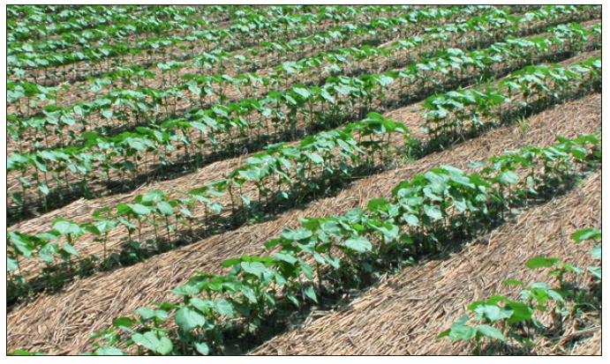
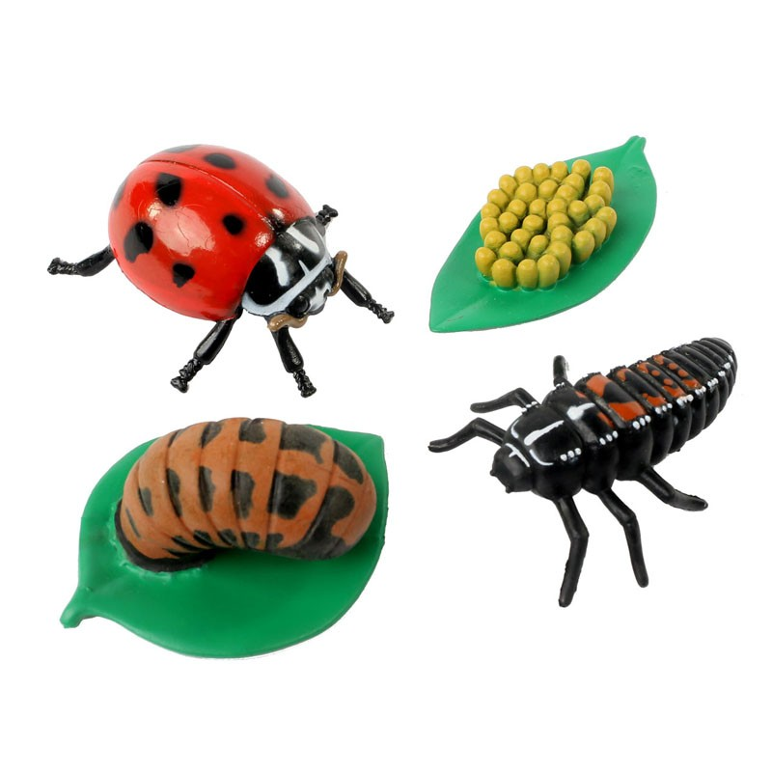
Cover crop effects on arthropod populations
Examples of promoting beneficials/predators
Strip tilled cover crops help maintain predator insect populations, and lady beetles preferred legume cover crops (Tillman et al., 2004)
Cereal rye can support populations of lady beetles which are a major predator of aphids (Bugg et al., 1990).
Crimson clover can reduce Colorado potato beetle populations in eggplant (Hooks et al., 2013)
Many cover crops can support predatory mites which can help keep spider mites in check

Slide 15
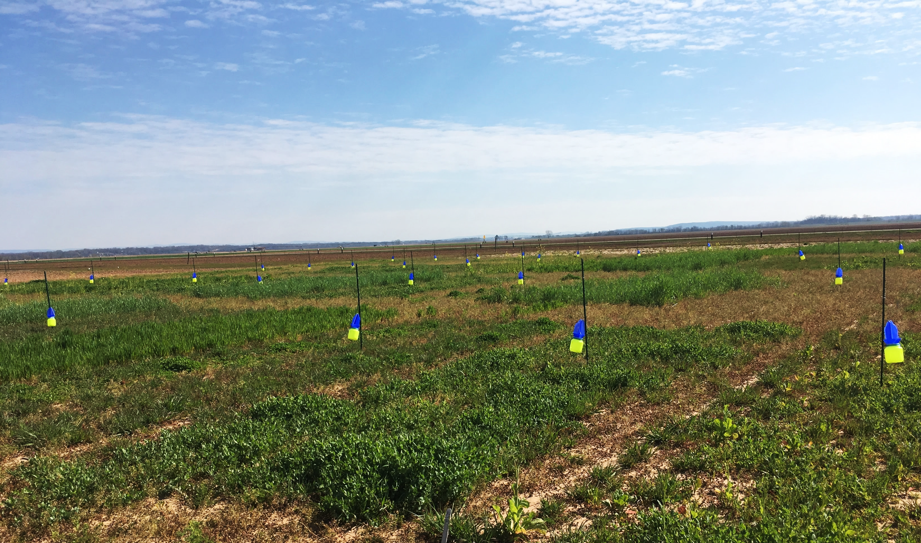
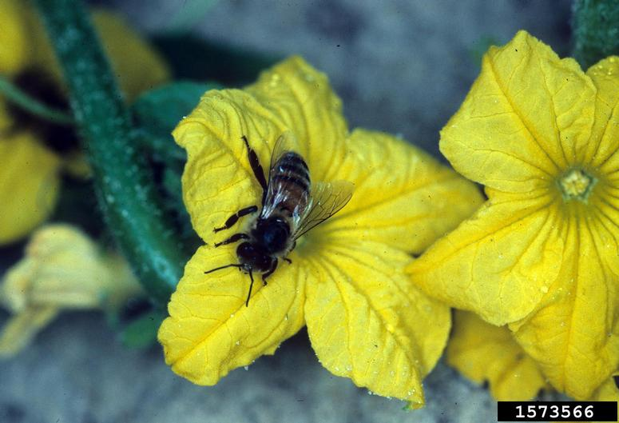
Pollinator effects
Pollinator conservation is important due to global decline:
Habitat destruction
Pesticide use
Disease
Climate effects
35% of food crops are reliant on pollinator services, so having abundant pollinators present is desirable
Source: Paige Hickman
Source: bugwood.org

Slide 16
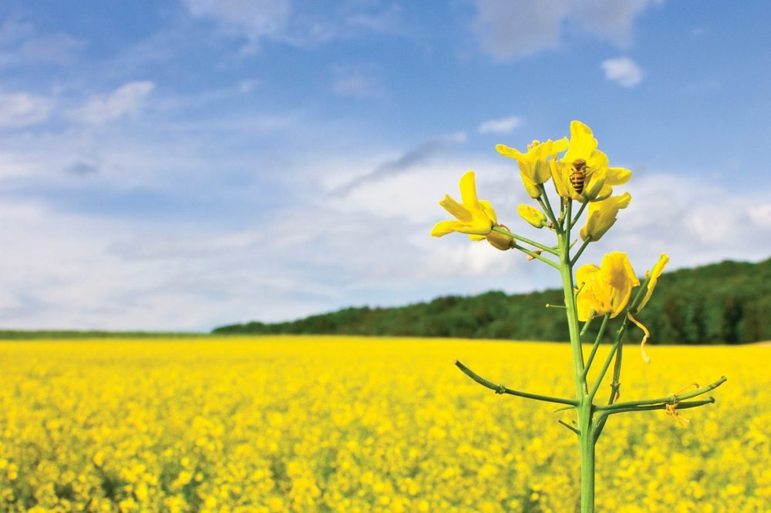
Pollinator effects
Winter planted flowering cover crops can provide an early-season food source for emerging pollinators
Can increase pollinator abundance for subsequent crops
Floral density is the primary factor affecting bee populations
Canola has the highest floral density compared to Austrian pea and crimson clover
Canola also supported the greatest bee diversity, likely due to flowering earlier than Austrian pea and crimson clover (Ellis and Barbercheck, 2015)
Source:www.albertafarmexpress.ca

Slide 17
Pest Bridging
Cover crop effects on pest populations is not always positive
Cover crops can possibly serve as alternate hosts for pest insects
Overwintering sites for pests vs. beneficials
May increase pest populations and damage in subsequent crop
(Dunbar et al., 2016) found increased early-season lepidopteran pests and increased damage in cornfields previously planted with a cereal rye cover crop
Important to consider subsequent crops and insect-host plant interactions when choosing cover crop plantings
Can also serve as alternate hosts for plant pathogens if not managed properly

Slide 18
Take Home Message
Important to avoid cover crop plantings which could be alternate hosts for the same diseases/insects you are trying to control
Cover crops can provide habitat for beneficial insects and pollinators
Cover crops can suppress diseases
Cover crops can suppress nematodes but highly variety dependent

Slide 19
Authors and Acknowledgements
Southern SARE Grant
Professional Development Program
RD309-137 / S001419 – ES17-135
Authors:
Dr. Jackie Lee
Dr. Amanda McWhirt
Reviewers:
Dr. Trent Roberts
Dr. Bill Robertson

Slide 20
Authors and Acknowledgements
This presentation was prepared by
Dr. Jackie Lee, Mike Brown and Dr. Amanda McWhirt with support from a Southern SARE
Professional Development Program Grant (RD309-137 / S001419 – ES17-135) and are provided by the USDA-SARE program to educators and producers for outreach and educational purposes. These presentations were further reviewed by Dr. Trent Roberts and
Dr. Bill Robertson.
Notes:
These training was developed by Drs. Amanda McWhirt and Jackie Lee with support from a Southern SARE Professional Development Program Grant.

Slide 21
Resources and Sources
Managing cover crops profitabily (3rd Ed.): https://www.sare.org/Learning-Center/Books/Managing-Cover-Crops-Profitably-3rd-Edition
Baraibar, B., Hunter, M. C., Schipanski, M. E., Hamilton, A., & Mortensen, D. A. (2017). Weed suppression in cover crop monocultures and mixes. Weed Science, 1-13.
Bugg, R. L., Phatak, S. C., & Dutcher, J. D. (1990). Insects associated with cool-season cover crops in southern Georgia: Implications for pest control in truck-farm and pecan agroecosystems. Biological Agriculture & Horticulture, 7, 17-45.
Dunbar, M. W., O’Neal, M. E., & Gassmann, A. J. (2016). Increased risk of insect injury to corn following rye cover crop. Journal of Economic Entomology, 109, 1691-1697.
Ellis, K. E., & Barbercheck, M. E. (2015). Management of overwintering cover crops influences floral resources and visitation by native bees. Environmental Entomology, 44, 999-1010.
Hooks, C. R. R., Hinds, J., Zobel, E., & Patton, T. (2013). Impact of crimson clover dying mulch on two eggplant insect herbivores. Journal of Applied Entomology, 137, 170-180.
Tillman, G., Schomberg, H., Phatak, S., Mullinix, B., Lachnicht, S., Timper, P., & Olson, D. (2004). Influence of cover crops on insect pests and predators in conservation tillage cotton. Journal of Economic Entomology, 97, 1217-1232.
Wiggins, M. S., Hayes, R. M., and Steckel, L. E. (2016). Evaluating cover crops and herbicides for glyphosate-resistant Palmer Amaranth (Amaranthus palmeri) control in cotton. Weed Technology, 30, 415-422.

