Slide 1
Session 4
Estimating Nitrogen Credits

Slide 2
Outline
Factors effecting nitrogen content of cover crop
Factors effecting cover crop nitrogen availability to cash crop
Major steps to estimating nitrogen credits
    Biomass sampling of area of known sq. ft.
    Assessment of biomass nitrogen content
    Estimate of nitrogen release and availability to cash crop
Notes:
Legume cover crops can supply large amounts of nitrogen to subsequent cash crops.
Estimating the amount of nitrogen that will be plant available, or available to the next crop can be tricky.
Here we will discuss how to estimate nitrogen credits from cover crops.

Slide 3
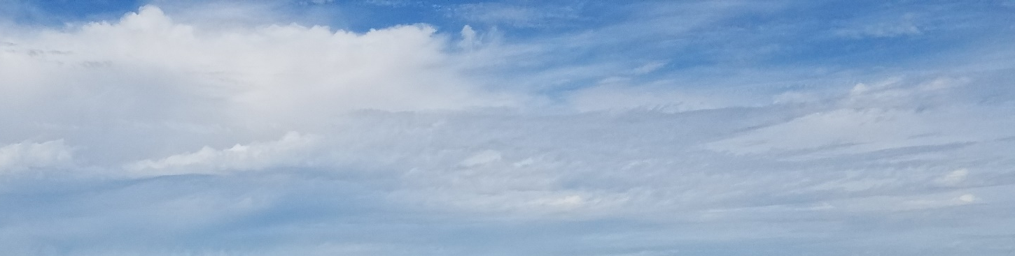

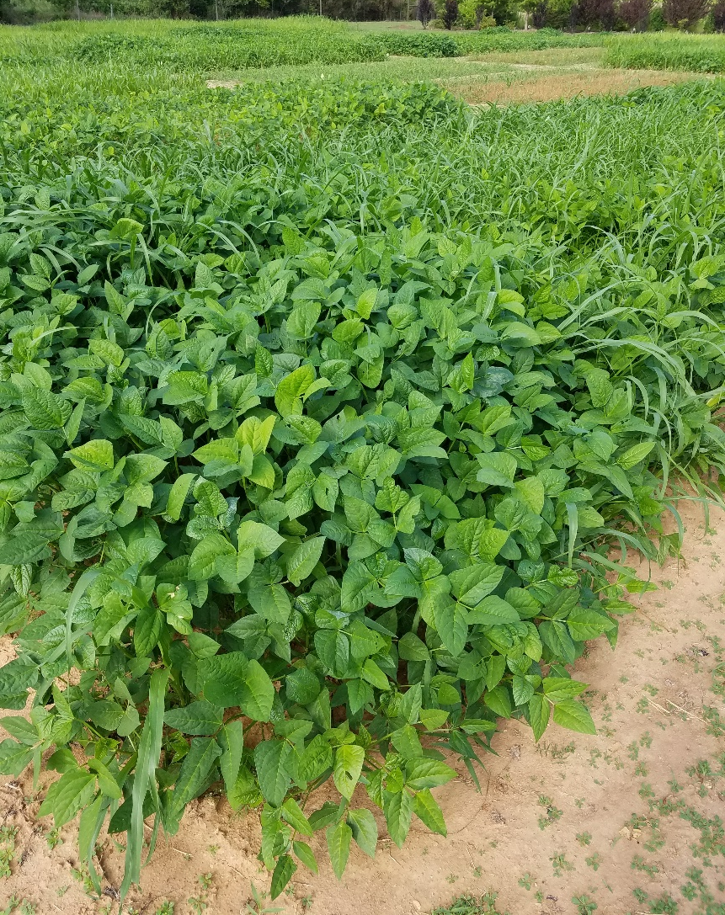
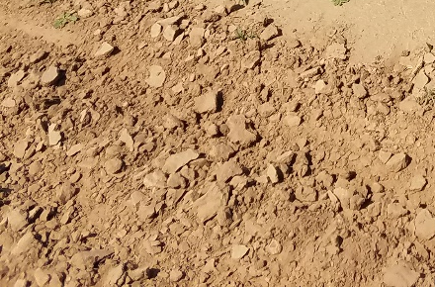
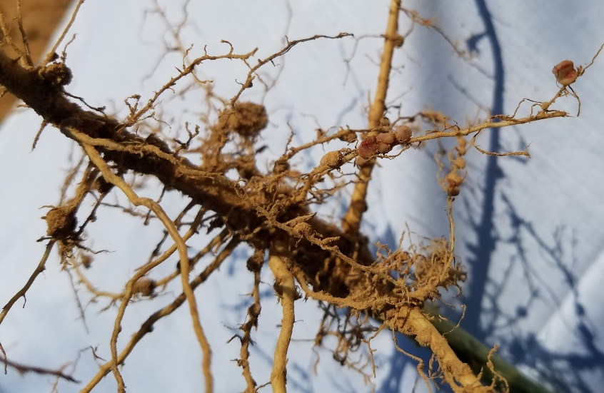
N 2
How Legume Cover Crops Supply Nitrogen to Cash Crops
Fall broccoli cash crop
Summer cowpea cover crop
Nitrogen Uptake
Biological Nitrogen Fixation
Plant matter added to the soil
Mineralization
Soil microbes mineralize organic nitrogen held in plant matter into plant available forms
Image: Amanda McWhirt
Notes:
Legumes host rhizobia bacteria that live inside their roots.
The rhizobia can convert or “fix” nitrogen gas (N2) into nitrogen (NH3, ammonia) that is used by the plant to grow.
Once the legume plant is killed or dies its plant tissues (biomass) is broken down by soil microbes and nitrogen is released in forms other plants can take up ( ammonium NH4+ or nitrate NO3+)

Slide 4
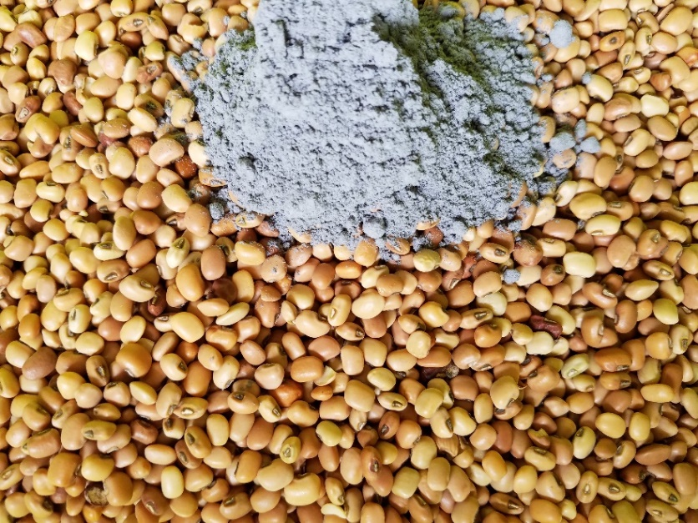
Legume Cover Crop Require Inoculants
Ensure good seed coverage
Can be added to the seed dry, some recommend a sticking agent
Contain live organisms so avoid temperature extremes
Legume | Recommended Inoculant Group(s) ³
Cowpeas, Lespedeza | Cowpeas or Lespedeza
Crimson clover, Berseem clover | Crimson or Berseem
Field peas, Hairy vetch , Lentil | Pea or Vetch
Red clover White clover | Red clover or White clover
Subterranean clover | Subterranean clover or Clover or Rose clover
Sunn hemp | Cowpea EL (based on Abdul-Baki et al., 2001)⁴
Velvetbean | Cowpea EL (based on Piper and Morse, 1928)⁵
Notes:
Be sure to inoculate, see the examples of specificity.
Don’t rely what’s in the soil.
Inoculants are relatively in-expensive

Slide 5
How much nitrogen can cover crops fix?
Legume | Total Nitrogen Content of the Cover Crop Biomass¹ (Total lbs. /acre)
Austrian pea | 90-150
Crimson Clover | 70-130
Vetch | 90-200
Cowpea | 50-150
Soybean | 50-150
For reference:
Tomato nitrogen requirements range from 90-200 lbs. of Nitrogen.
(Total season)¹⁰
Notes:
Legume cover crops can supply some but rarely all of the nitrogen required for vegetable production.
Timing of the release of the nitrogen may not sync with crop needs.
There is typically a large release early after the cover crop is terminated; while the cash crop demand is usually higher later in the season. (SEE THE NEXT SLIDE)
The values reported in the table are TOTAL nitrogen, not plant available.

Slide 6
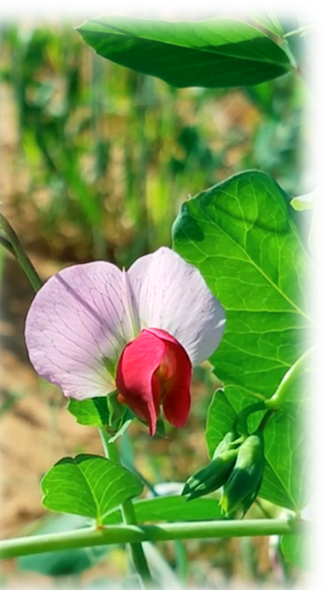
Factors Affecting Nitrogen Content of Cover Crop
Cover crop mixes
  Mixes with higher proportions of legumes will have higher N content
Inoculation
  Legumes must have active rhizobia and root nodules to fix Nitrogen.
  May require an inoculant
Different legumes species fix different amounts of N and have different biomass potentials.
  Consider seed costs and potential lbs. N/ acre fixed.
Cover crop stand
  Amount of N is dependent on the amount of biomass produced
Available soil N
  High soil N will inhibit legume reliance on biological nitrogen fixation
Cover crop age
  Established legumes fix more N than young seedlings.
  Peak nitrogen content in green aboveground tissue generally occurs at or just before bloom.
Notes:
Here are some factors that contribute to how much nitrogen may be fixed by a legume cover crop

Slide 7
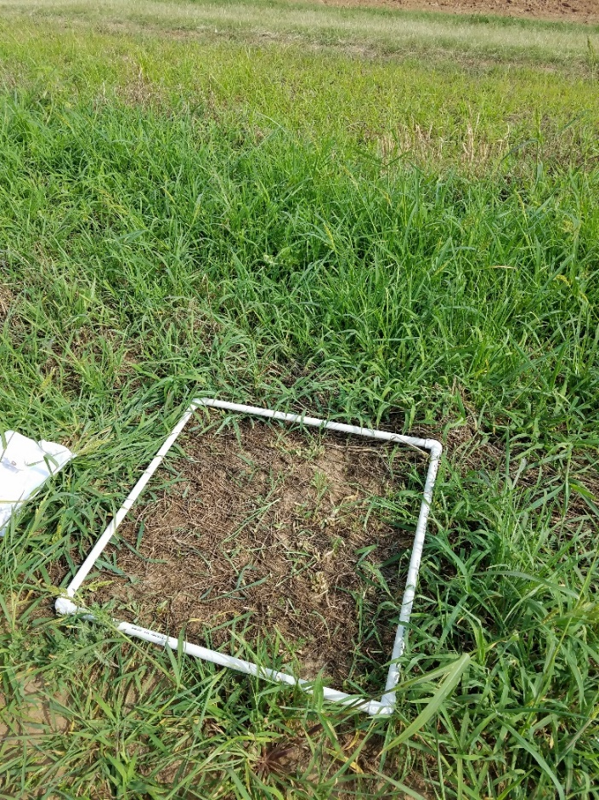
Estimating Nitrogen Credits from Cover Crops
Assess biomass
  Known dry weight per known area
Estimate Total Nitrogen
  From established ranges
  Send material to be tested at lab
Estimate Available Nitrogen
  Estimate how much of the total nitrogen will be available to the cash crop
    50 % is a good rule of thumb¹³
This method does not include nitrogen in the plant roots in the estimation, the amount of below ground N is variable but release tends to be very quick after termination ^{6, 7}
Notes:
Biomass sampling the cover crop to assess the lbs of biomass produced and then assessing the % nitrogen of the cover crop is the most accurate way to measure the TOTAL nitrogen in the cover crop.
LBS OF BIOMASS X % NITROGEN IN THE COVER CROP= LBS OF TOTAL NITROGEN IN THE COVER CROP
This is not the same as PLANT available nitrogen which will be impacted by soil temperatures and moisture, timing of cover crop termination and cash crop planting and method of cover crop incorporation

Slide 8
Example Estimating Nitrogen Credits from Cover Crops
Example:
Biomass (lb.)/Acre = (Total weight of dried samples (lb.)/ # square feet sampled) X (43,560 sq. ft./Acre)
Then multiply by percent nitrogen in the plant tissue
  General Estimates: Annual legumes 3.5-4.0% N in their aboveground parts prior to FLOWERING and 3.0-3.5% percent at flowering. ¹
Example: 37 grams= 37/454 g per lb.= 0.081 lb
(0.081 lbs./ 2.25 sq. ft. sampling square= 0.036) x (43,560/1)= 1,577 lbs. of biomass per acre x 3% N = 47.33 lbs. of Total Nitrogen
Notes:
Here is an example of how to estimate total nitrogen from a biomass sample

Slide 9
Factors Affecting Nitrogen Return to Cash Crop
Crop biomass incorporated or on soil surface
  Some sources estimate up to 25% less Nitrogen from the cover crop will be returned to the cash crop if the residue is left on the soil surface rather than incorporated; other estimates suggest no difference between surface application and soil incorporation for the Southeast. ¹
  Nitrogen can be lost from cover crop residues due to microbial activity. ¹
Soil temperature ⁸
  Influences soil biological activity
Soil moisture ⁸
  Influences soil biological activity
C:N ratio of biomass²
  Immobilization (tie up) >30:1
  Mobilization (release) <15:1
Time
  General rule of thumb has suggested much of the plant available Nitrogen (50-75%) supplied by the cover crop is released 4-6 weeks after incorporation or termination
    So if the nitrogen credit was estimated to be 60lbs; 30-45 lbs. of that will have become available in the first 4-6 weeks after termination
Affect rates of mineralization
Notes:
Nitrogen can be lost via multiple means depending on the weather, temperature and soil moisture. ¹
See pages 21-23 of Managing Cover Crops Profitably for an in depth discussion of how nitrogen may be lost from cover crop residues.
Here are some factors that may affect how much nitrogen and how quickly nitrogen is released from the cover crop biomass.
All of these factors may it difficult to predict exact nitrogen credits from different legumes from field to field and year to year.
Mineralization is the process by which microbes break down organic nitrogen and return it to plant available forms.

Slide 10
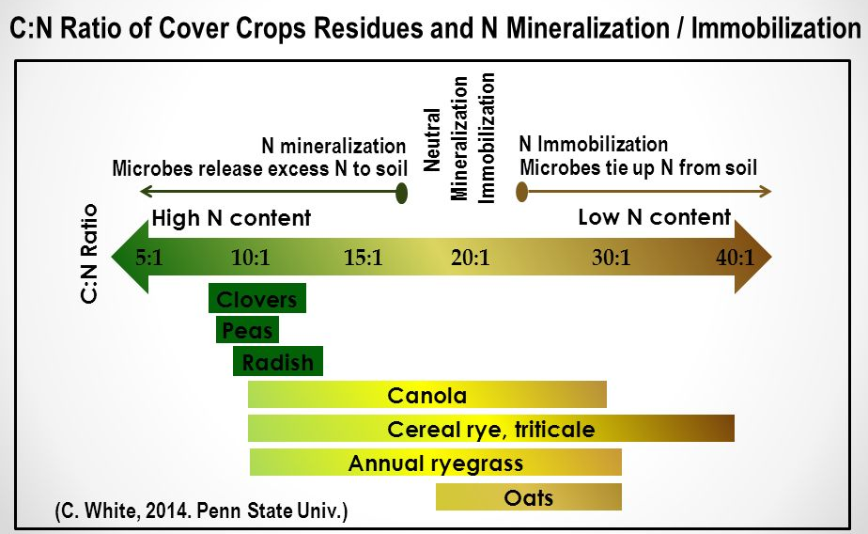

Slide 11
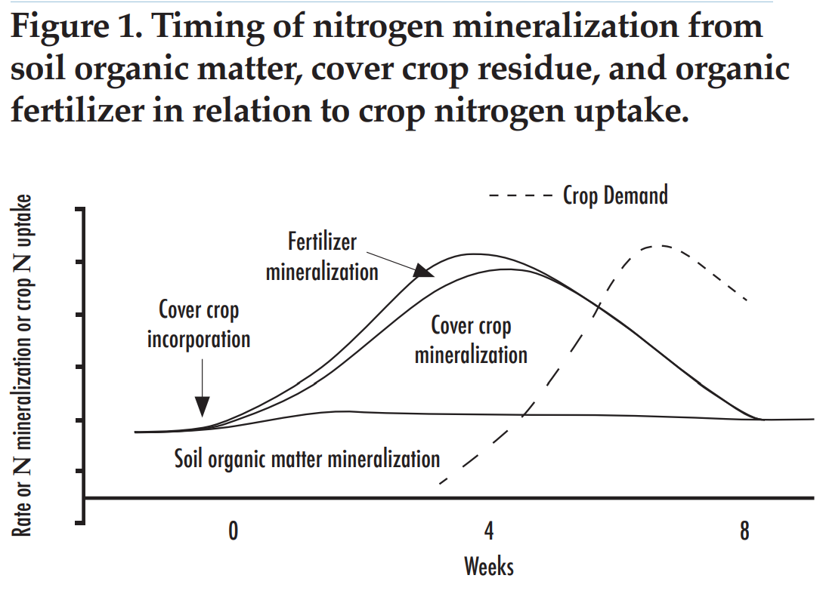
Timing of Cover Crop Nitrogen Release and Cash Crop Demand
Source:
Gaskell and Smith, 2007
Notes:
Nitrogen Mineralization= is the conversion of nitrogen from an organic form ( i.e. plant material, manure) to a plant available form (i.e. Ammonium (NH4))
Generally large amounts of nitrogen are released from the cover crop biomass in the first 4 weeks after termination.
Often times the cash crop may not be established or large enough to take up all of the released nitrogen and some of it will be lost.
Patterns of nitrogen release and crop need vary by plant species, and this graph is only meant to demonstrate how there can be a lack of overlap between nitrogen release and plant demand.
An average of 50% of total Nitrogen becoming PLANT available is conservative.

Slide 12
Nutrient Inputs from Legume Cover Crops and Cover Crop Mixes
Estimates of Lbs./ Acre of Plant Available¹ N, Total P₂O₅, K₂O and C:N Ratios of Summer Cover Crop Mixes
¹Based off an estimate that 50% of the total Nitrogen would be available to the cash crop
58.1
*Based off results from of two site locations in Arkansas in 2016
Notes:
Observe the differences in nutrient levels of different cover crop mixes and the C:N ratios.
The C:N ratio will determine how quickly available these nutrients are/ how quickly the material breaks down. Notice how the grass mixtures have much higher C:N ratios.
Important to note that the cover crop biomass is also taking up and supplying phosphorus and potassium once they break down.
This is not newly fixed potassium or phosphorus as it is with nitrogen. But may represent nutrients saved from loss if the field otherwise sat fallow.

Slide 13
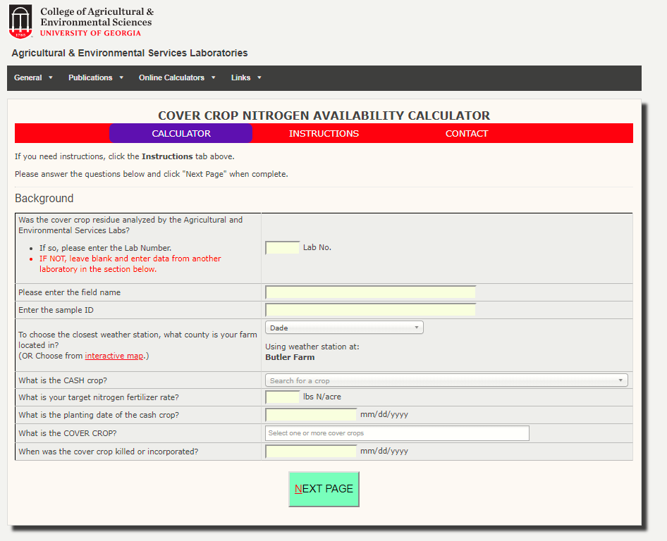
Calculators: Cover Crop Nitrogen Credits
Combine estimated nitrogen contents of the cover crop with temperature or weather data to estimate nitrogen release patterns.
  Georgia:
  http://aesl.ces.uga.edu/mineralization/
***Relies on local weather stations in Georgia

Slide 14
Costs of Cover Crop Nitrogen
Estimates of Cover Crop Seeding Costs per Acre
Estimated Cost Range
per Total unit of nitrogen
$0.44-0.27 per lb. of N
$0.20-0.11 per lb. of N
$0.48-0.22 per lb. of N
$1.28-0.42 per lb. of N
$1.44-0.48 per lb. of N
*These are only rough estimates. Seeding rates and local conditions will influence the potential nitrogen credit obtained by various legumes and seed prices vary by region and year. Estimates obtained based off of two years of data,
Notes:
A grower must consider the other benefits cover crops provide outside of nitrogen inputs and the possible associated economic benefits (increased water holding capacity of the soil on cover cropped ground may have a very high value on non irrigated ground). Chemical fertilizer sources will not be providing these additional benefits.
These are only rough estimates and based on high broadcast seeding rates.
Lower seeding rates may result in similar stands and similar estimates of biomass; which could reduce costs.
The estimates of cost per unit of Nitrogen are based off the previously reported ranges of TOTAL nitrogen production on slide 5.
By contrast potassium nitrate may cost $10 per unit nitrogen while urea may only cost <$0.60 per unit nitrogen.

Slide 15
Take Home Message
Legume cover crops can supply large quantities of nitrogen to subsequent cash crops
We can make estimates of how much of that nitrogen will become plant available
  These are generally only well educated estimates due to the reliance on biological processes to release the nitrogen into plant available forms that are impacted by temperature and moisture

Slide 16

Authors and Acknowledgements
This presentation was prepared by
Dr. Amanda McWhirt, Matt Fryer and Dr. Jackie Lee with support from a Southern SARE Professional Development Program Grant (RD309-137 / S001419 – ES17-135) and are provided by the USDA-SARE program to educators and producers for outreach and educational purposes. These presentations were further reviewed by Dr. Trent Roberts and Dr. Bill Robertson.
Notes:
These training was developed by Drs. Amanda McWhirt and Jackie Lee with support from a Southern SARE Professional Development Program Grant.

Slide 17
Resources and Sources
¹ Clark, A., editor. 2012. Managing Cover Crops Profitably, 3rd Edition. Sustainable Agriculture Research and Education. Handbook Series Book 9. https://www.sare.org/Learning-Center/Books/Managing-Cover-Crops-Profitably-3rd-Edition/Text-Version/Printable-Version
² Virginia NRCS Cover Crop Planning Manual 1.0
³ Buying and Sourcing Cover Crop Seed for Organic Farming Systems
https://articles.extension.org/pages/18654/buying-and-sourcing-cover-crop-seed-for-organic-farming-systems
⁴ Abdul-Baki, A. A., H. H. Bryan, G. M. Zinati, W. Klassen, M. Codallo, and N. Heckert. 2001. Biomass yield and flower production in sunn hemp: Effect of cutting the main stem. Journal of Vegetable Crop Production 71:83–104.
⁵ Piper, C. V., and W. J. Morse. 1928. The velvet bean. Farmers’ bulletin No. 1276. U. S. Department of Agriculture, Washington, DC.
⁶ Sievers and Cook. 2018. Aboveground and Root Decomposition of Cereal Rye and Hairy Vetch Cover Crops. Soil Fertility and Plant Nutrition. 82 (1):147-155. https://dl.sciencesocieties.org/publications/sssaj/abstracts/82/1/147?access=0&view=pdf
⁷ Jani, A., Grossman, J., Smyth, T., and S. Hu. 2015. Winter legume cover-crop root decomposition and N release dynamics under disking and roller-crimping termination approaches. Renewable Agriculture and Food Systems. 31(3): 214-229 https://www.cambridge.org/core/journals/renewable-agriculture-and-food-systems/article/winter-legume-covercrop-root-decomposition-and-n-release-dynamics-under-disking-and-rollercrimping-termination-approaches/65E7DFBA13888A5BF32DCA1A1840EBF4
⁸ Soil fertility management for organic crops https://anrcatalog.ucanr.edu/pdf/7249.pdf
⁹ Gaskell, M., and R. Smith. 2007. Nitrogen Sources for Organic Vegetable Crops. HortTechnology 17(4): 431-441
¹⁰ Southeastern vegetable crop handbook https://content.ces.ncsu.edu/southeastern-us-vegetable-crop-handbook
¹¹ FSA2156. Understanding Cover Crops. https://www.uaex.edu/publications/pdf/FSA-2156.pdf
¹² https://cropwatch.unl.edu/2016/nitrogen-fixation-oversold-legume-cover-crops
¹³ https://www.southernsare.org/Regional-News/Bulletins/Cover-Crops-Research-Across-the-Southern-Region/Nitrogen-Release-from-Cover-Crops

