Slide 1
Session 2
Cover Crop Selection

Slide 2
Outline
Cover crop groups
Legume
Grass
Brassicas
Cover crop selection
Winter/summer
Seeding rate selection
Planting date selection
Notes:
This presentation will discuss how to select the appropriate cover crop species for the goals set.
Characteristics of major winter and summer cover crops will be discussed, as well as a discussion of seeding rates and cover crop mixes.

Slide 3
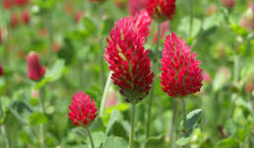
Cover Crops
Instead of harvesting as a cash crop, cover crops are grown for the benefits they have on the soil or on subsequent crops
Legumes
Provide N to the following crop when tilled into the soil
Grasses
Produce Biomass! Increase Soil Organic Matter
Brassicas
Disease Suppression
Notes:
The three major cover crop classes are:
Grasses
Legumes
Brassicas
Grasses are planted because the produce a lot of biomass which means higher organic matter input. They also are generally good at competing with weeds.
Legumes are planted to increase soil nitrogen and feed the next cash crop
Brassicas are planted to suppress diseases, due to their bio-fumigant properties.

Slide 4
Cover Crops
Instead of harvesting as a cash crop, cover crops are grown for the benefits they have on the soil or on subsequent crops
Legumes
Provide N to the following crop when tilled into the soil
Interplant Mixes
Grasses
Produce Biomass! Increase Soil Organic Matter
Brassicas
Disease Suppression
Notes:
Planting mixes of all three types can maximize the benefit of planting cover crops

Slide 5
Cover Crop Selection
5. Site Location or Available Equipment
4. Variety Selection
3. Compliment the next cash crop
1.What is the goal?
2. Season and Timing
Frost prone
Requires flail mower
Wet or dry soil
Avoid cover crops that may become weeds
Cold tolerance
Non-host to disease or nematode
Requires herbicide to terminate
Not in the same plant family
Different nutrient use patterns
Winter, spring, fall, or summer
Days to maturity
Notes:
Cover crops require thought and planning, you cannot just plant and then be done. Spend time on planning.
1.The primary consideration should be what What is the goal for the next cash crop? Weed suppression, nitrogen or disease suppression?
2. Next you need to consider the window of time available and Season: Winter/ summer
3. Next Cash Crop and Timing. Time to maturity, ease of termination. Should compliment the next cash crop
4. Variety Selection: Nematode or disease resistance
5. Site Location or Available Equipment
These are listed in order from 1-5, but really at each step you should be looking both ahead and behind to make sure your selections are still going to work for the cropping system, the goals and the next cash crop.

Slide 6
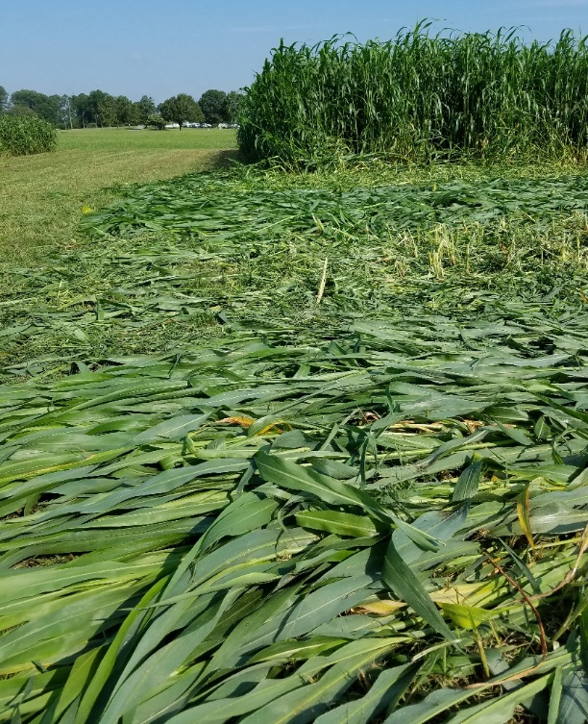
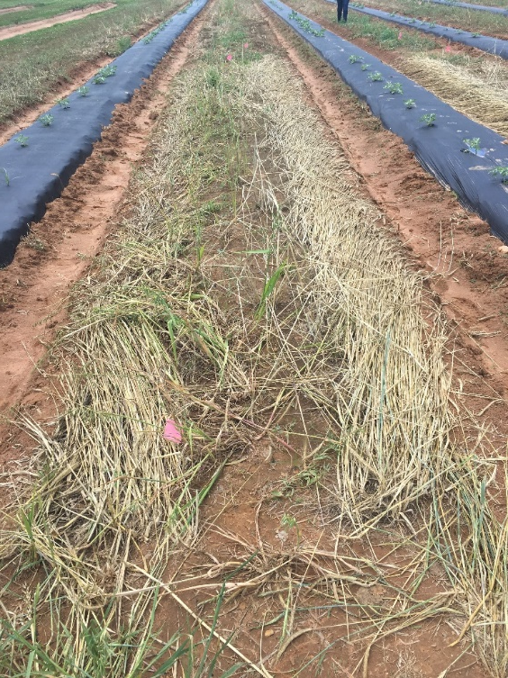
Cover Crop Goal: Weed control
Grasses produce the most biomass and create the most effective weed mat
Increase seeding rates and plant on-time to ensure a good cover crop stand
Long-vined legume varieties are preferred over short-vined for weed control
Notes:
If your primary goal is weed control- grasses will be the preferred choice.
Certain legumes can also be good weed competitors, but will break down rapidly on the soil surface and provide less weed control going into the next season.
The key to achieving good weed control into the next season is producing adequate cover crop BIOMASS.
Adequate biomass can be achieved by planting on time, ensuring adequate seed to soil contact and using the right rate for the seeding method. Seeding rates can be increased.
Higher biomass inputs may also ultimately lead to increases in soil organic matter.

Slide 7
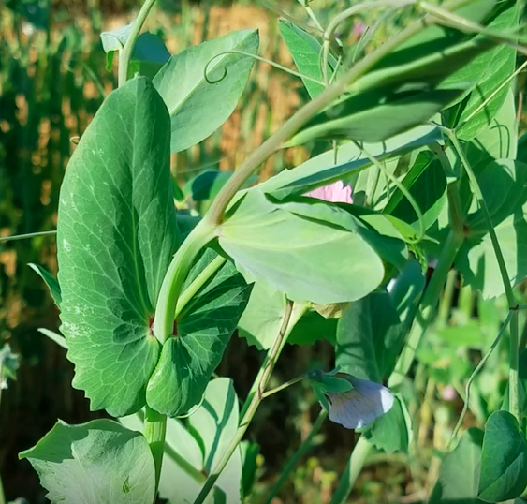
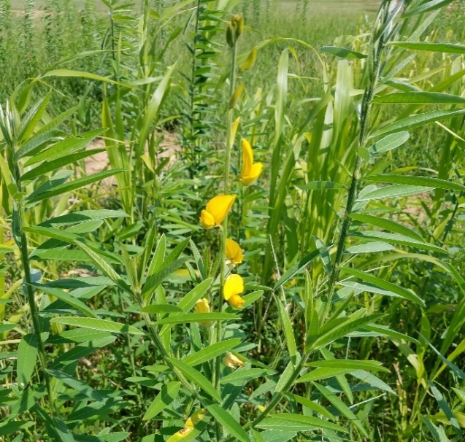
Cover Crop Goal: Nitrogen
Legumes fix nitrogen
Termination timing and crop stand influence nitrogen credits.
Consider seed costs and potential lbs. N/ acre fixed.
Legumes tend to be poor competitors against weeds
Notes:
If nitrogen is the primary goal, legumes should predominate the mix or a single species planting of legumes should be used.
It is important to realize that cover crop stand again will have a big impact on the amount of nitrogen that is returned to the next crop.
However timing of the termination and crop age also will influence the nitrogen content of the crop; nitrogen content is generally highest at or just before flowering.
Legumes vary in the amount N they can fix and their seed costs. Depending on the application, certain legumes are not good economic choices.
Legumes also tend to be poor competitors against weeds and so taking steps to ensure a strong stand at planting can help prevent weeds from overtaking the cover crop

Slide 8
Cover Crop Goal: Pest Control
Nematodes
Pearl Millet Poor or non-host to root knot and lesion nematodes
Cereal Rye Poor or Non-host to root knot, lesion and dagger nematodes
Cowpea ‘Iron Clay’ Poor or Non-host to root knot nematode
Diseases
Mustard and brassica cover crops have glucosinolate compounds in their leaves. After mowing and soil incorporation these compounds breakdown and release isothiocyanates (biological fumigant)
Notes:
If cover crops are planned to be used to combat pests, specific pests should be identified in order to target them specifically and achieve the best results.
Ensure appropriate cover crop species and cultivar selection. Sometimes only specific cultivars are nematode resistant or non-hosts
Brassicas are often called “bio-fumigant” crops, this is because they have glucosinolate compounds in their leaves that once mixed into the soil release isothiocyanates that act as biological fumigants.
Glucosinolates and the resulting isothiocyanates are responsible for the pungent mustard smell and taste experienced when mustards and other brassicas are chewed or torn up.
Pronunciation:
Glue-co-sin-o-late
I-so-thy-o-sy-an-ates
Brassica species vary in the level of glucosinolate compounds in their leaves, certain varieties with high concentrations have been released specifically for biofumigant purposes.
Generally mowing (chopping up) the leaves of the brassicas and immediate incorporation of the material into the soil results in the best biofumigant effect.

Slide 9
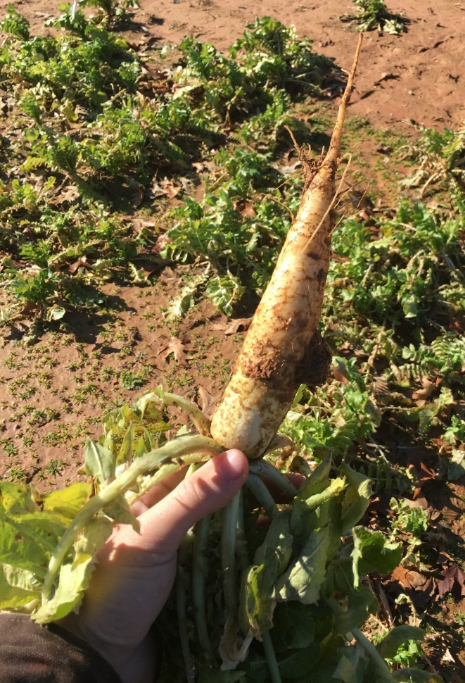
Cover Crop Goal: Easing Soil Compaction
Oilseed or daikon radish types
Ex. GroundHog radish™, Nitro radish, Sodbuster, and Bio-till radish
May winter kill
Soil texture will impact rooting depth
Good at taking up and rapidly releasing nutrients as biomass decomposes
Notes:
Tillage radishes are all types of oilseed or daikon radish.
There are several named types, but in general there is little difference between cultivated edible types and those used for cover crops.
They may winter kill, but generally will still produce a strong tap root prior to dying out if planted early enough in the fall.
They are a good crop for trapping soil nutrients and then releasing the nutrients quickly for plant up take as they decompose.

Slide 10
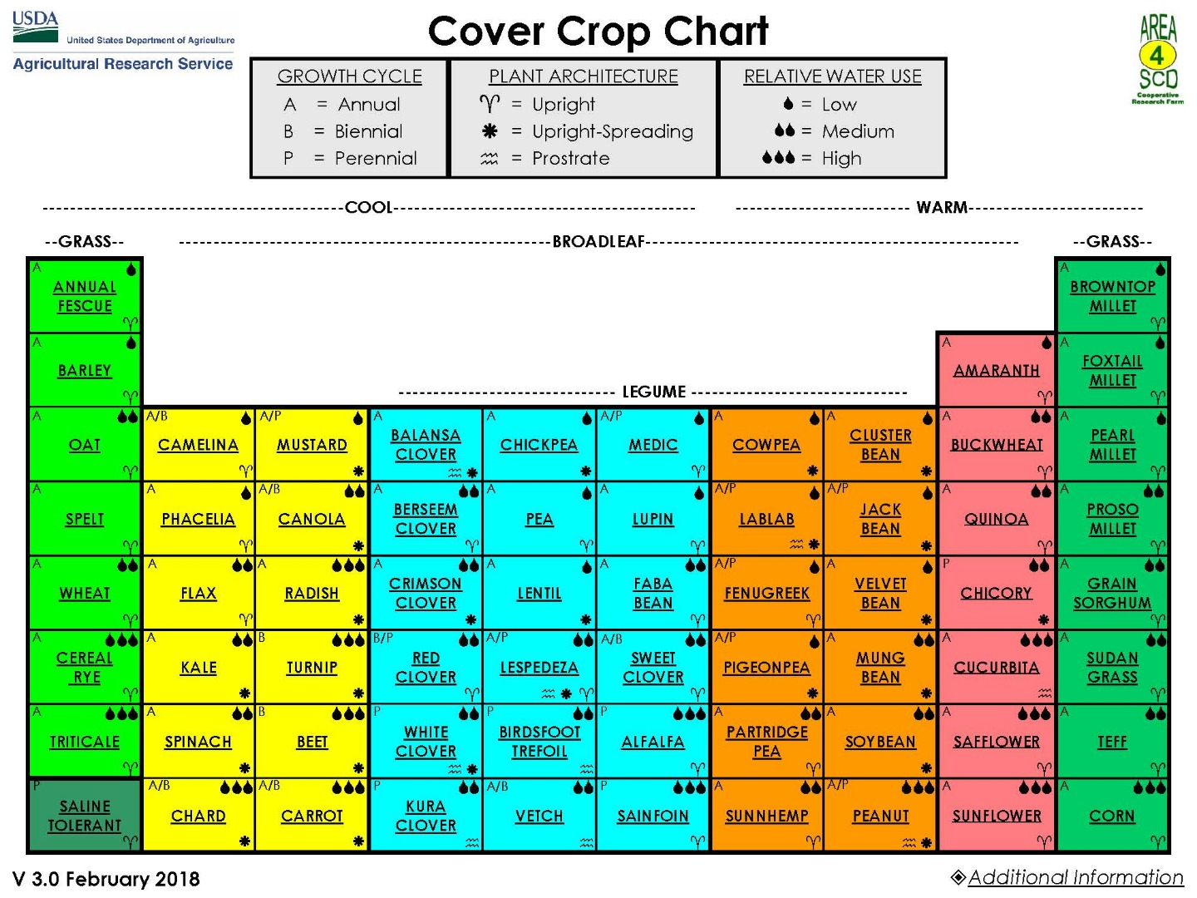
Source: https://www.ars.usda.gov/plains-area/mandan-nd/ngprl/docs/cover-crop-chart/
Notes:
There are many different crops used as cover crops for different purposes
Think about the goals and what season the cover crop will be planted in.
Then narrow in on the specific site location. (wet, dry, etc.)

Slide 11
Common Summer Cover Crops
Grows 4-6’ tall in 90-120 days.
Grows 10-12’ tall in 90-120 days. 4,000-5,000 lbs./acre
Consistent producer of 100lbs of N per acre, Drought tolerant.
Biomass, may suppress root-knot nematodes
Fast growth, pollinator habitat
Biomass
Nitrogen Fixer
Pearl Millet
Sorghum Sudangrass
Buckwheat
Cowpea
Notes:
Common summer cover crops
Grasses: pearl millet and sorghum sudan. Both are drought tolerant and reliable in the SE. both good competitors with weeds.
Broadleaf: buckwheat. Fast growth and good beneficial insect habitat. Poor heat tolerance.
Legume: Cowpea. Good competitor with weeds. Very drought tolerant. Has extra floral nectaries. “iron clay” is a preferred variety due to being nematode resistant.

Slide 12
Common Winter Cover Crops
Reliable establishment, good amount of N for seed costs
Fine root system, enhances nutrient cycling, good weed suppression
Can be planted late in fall, High Biomass, high C:N
Plant early to establish,
May winter kill
Winter wheat
Cereal Rye
Austrian Pea
Mustard
Notes:
Winter cover crops:
Grasses: wheat creates a tight canopy closure. Cereal rye is reliable, and can be planted late.
Legume: Austrian pea is a higher biomass producer than the clovers, may winter kill below 10F but also known to regrow from burnt back stems. Be aware of Sclerotinia crown rot of which field peas can be a host. Ensure good rotation away from other legume crops
Boradleaf, brassica: Mustard- must plant early, small seeded which can be difficult to establish evenly via broadcast.

Slide 13
Cover Crop Mixes
Cover crop mixes mimic plant diversity found in nature and can maximize the benefits of using cover crops
Individual species in a mix should compliment one another
Vines that can use grasses as a ladder
Avoid combining species with dense canopies with something low growing
Combine a slow growing grass species with a cover known to winter kill
Combine a high C:N grass with a legume
Chose covers that have similar maturation timelines
A good mixture has 3-5 species.
Be aware of differences in seeding depth requirements
Black oats, crimson clover and mustard cover crop
Notes:
Cover crop mixes mimic the diversity of plants seen in nature.
Mixes if chosen carefully can work together to be more effective. i.e choose a quick germinating crop to help nurse along a slower germinating crop that will over take the earlier crop later on.
Legumes can help reduce the C:N ratio of overall mix as compared to just straight grass mixes which may tie up nitrogen.
Use a tall grass to help a vining legume compete for sunlight.

Slide 14
Seeding Rates
Refer to local Extension publication and university research for the production system
Seeding rate will affect stand and characteristics of the crop
(i.e. High grass seeding rate results in thinner stems, lower rates result in thicker stems)
Examples:
Standard rate per acre x % of standard rate= Mix rate
Austrian pea & Cereal Rye
Aust. Peas: 50 lbs. x 0.85= 42.5 lbs. ;
Cereal Rye: 120 lbs. x 0.50= 60 lbs.
Triticale, Cereal Rye & Crimson Clover
Triticale and cereal rye are redundant ( divide by 2)
Triticale, 120 lbs. x 0.50 = 60 /2 = 30 lbs.
Cereal Rye 120 lbs. x 0.50 = 60 /2 = 30 lbs.
Crim. Clover 12lbs. x 0.90 = 10.8 lbs.
Seeding Rates for Mixes:
Change seeding rates based on species with competitive growth rates and desired crop mix.
Grasses reduce rate 75-50%
Legumes reduce rate 25%
Brassicas reduce rate 25%
Functional redundancy
divide each seeding rate by number of species that are redundant
Notes:
Seeding rates will vary based on the seeding method used, timing and intended use.
Consult local research or the “managing cover crops profitably” book for guidance
Be aware that when using mixes seeding rates of each of the individual species should be reduced based on the goals of the cover crop mix.
Functional redundancy: cover crops can be divided based on their function i.e. grasses, legumes and brassicas. Example: If planting a mix of Cereal rye and wheat, these “2” species are both grasses and thus have similar functions in the cover crop mix. Thus using both of them means they are “functionally redundant”. So each of their individual seeding rates should be cut by “2”.

Slide 15
Take home message
Cover crops selection is goal, cropping system and farm specific
Cover crop mixes are desirable because they mimic nature and combine the benefits of multiple types of cover crops
Mixes should be a goal, but not necessarily a starting point
Notes:
Spend time planning cover crop selection and researching varieties
Think about the growth habit of the cover crop, timing and machinery needed to manage the cover crop
Mixes are ideal but may be more difficult to establish successfully.

Slide 16
Authors and Acknowledgements
This presentation was prepared by
Drs. Amanda McWhirt and Jackie Lee with support from a Southern SARE
Professional Development Program Grant (RD309-137 / S001419 – ES17-135) and are provided by the USDA-SARE program to educators and producers for outreach and educational purposes. These presentations were further reviewed by Dr. Trent Roberts and
Dr. Bill Robertson.
Notes:
These training was developed by Drs. Amanda McWhirt and Jackie Lee with support from a Southern SARE Professional Development Program Grant.

Slide 17
Resources and Sources
USDA. The Cover Crop Chart (v. 3.0). https://www.ars.usda.gov/plains-area/mandan-nd/ngprl/docs/cover-crop-chart/
FSA2156. Understanding Cover Crops. https://www.uaex.edu/publications/pdf/FSA-2156.pdf
Making the Most of Mixtures: Considerations for Winter Cover Crops in Temperate Climates https://articles.extension.org/pages/72973/making-the-most-of-mixtures:-considerations-for-winter-cover-crops-in-temperate-climates
Clark, A., editor. 2012. Managing Cover Crops Profitably, 3rd Edition. Sustainable Agriculture Research and Education. Handbook Series Book 9. https://www.sare.org/Learning-Center/Books/Managing-Cover-Crops-Profitably-3rd-Edition/Text-Version/Printable-Version
Notes:
For more information see these resources and links.

