Slide 1
Why Plant Cover Crops?

Slide 2
Outline
What is a cover crop?
Why plant cover crops
Soil health
Beneficial insects/pollinators
Organic matter
Diversified cover crop systems mimic natural systems
Notes:
The topics covered in this presentation are a brief introduction to what defines a cover crop, why they are planted and the benefits we can expect to see on soil health and subsequent cash crops.

Slide 3
What is a cover crop?
A crop to cover the soil when it would otherwise sit fallow
Not planted to be harvested and sold
Are planted for the effects they have on:
The next cash crop
Improving soil health which results in healthier cash crops
Notes:
Cover crops are planted because of the effects they have on the soil or on subsequent cash crops
Often they are grasses, legume or brassicas.
They are generally not harvested or sold, but are tilled back into the soil or left on the soil surface.
Sometimes cover crop species are used that are also cash crops, but harvesting the crop results in lower nutrient and organic matter returns to the soil and competes with the goals of planting a cover crop.

Slide 4
Soil Health
A soil is not considered "healthy"
if it is managed for short term productivity
at the expense of future degradation
(Doran et al., 1994).
Notes:
A Soil Health fact-sheet will support this slide set, if you have questions about what soil health is, how it is measured and why it is important to crop production.
Cover crops are meant to help put nutrients and organic matter back into the soil to compensate for losses that result following cash crops.
Cover crops are a way to feed and protect the soil in the off season, and prevent losses to soil erosion and degradation.

Slide 5
Cover Crop Services
Above Ground
Habitat for beneficial insects
Suppress weeds
Protect soil from erosion
Soil Surface
Reduce nutrient leaching
Increase soil organic matter
Improved habitat for soil microorganisms and earthworms
Increase soil Nitrogen
Below Ground
Nematode suppression
Mine deep layers of the soil for nutrients
Notes:
Cover crops can have impacts above ground, at the soil surface and below ground.
Some of the benefits of cover crops on the soil are listed here.
These benefits can have direct impacts on improving the soil for subsequent cash crops.
i.e. nematode suppression and increases in soil nitrogen
Other benefits protect the long-term viability of the farm
Protect soil from erosion
Others may not be observed in the short term, but long-term use of cover crops can improve:
Soil organic matter content
Which will help improve many aspects of the soil and overall soil health

Slide 6
Cover crops provide soil cover
20-30 billion tons of soil is eroded due to water erosion and 2 billion or more tons due to wind erosion worldwide each year ¹
It takes 500-1,000 years to form 1 inch of topsoil
Soil is a non-renewable resource in our lifetimes
Soil cover helps reduce soil erosion caused by water¹
Notes:
Soil is a Non-Renewable Resource ( in our lifetimes).
The soil we have today is all the soil we and our children will have to farm with
Soil lost do to erosion also causes water quality impairment.
Turbidity= is the cloudiness or haziness of water
Water erosion is more of an issue in Arkansas, but in drier climates like Texas wind erosion results in major losses.
Soil covered with a living plant is less prone to loss due to erosion
Cover crops are preferable to bare-ground in the off-season for erosion control.

Slide 7
Cover Crops Can Suppress Weeds
Weed suppression can be accomplished:
in the season the cover crop is planted
in the following season if the cover crop residue is used as a weed mat or if the cover crop has allelopathic properties.
No cover crop/ bare ground
100 lbs. cowpea & 10 lbs. pearl millet cover crop
Notes:
Cover crops can suppress weeds in two different ways.
They can suppress weeds in the season they are grown due to plant-to-plant competition.
They can suppress weeds in the NEXT season when the biomass is left in place to create a weed barrier mat that shades the soil and inhibits weed seed germination.
The can also suppress weeds in the next season if the cover crop has allelopatic properties that inhibit germination or growth of other plants.
Definition of allelopathy: a biological phenomenon where a living organism produces chemical substances that influence the growth or development of other living things. Ex. Black walnuts produce juglone that inhibits the growth of other plants. Sorghum Sudangrass is believed to sometimes have an allelopathic effect on subsequent crops.
Regardless of the season of suppression fewer weeds means fewer seeds added to the weed seed bank over time.
Both of these methods can reduce contributions to the weed seed bank.

Slide 8
Cover crops can reduce pest pressure
Use cover crops to diversify crop rotations
Legume cash crop + grass cover crop
Rotating to cover crops that are non-hosts can reduce nematode populations
Brassica cover crops
biological fumigant crops
Sorghum Sudan
Wheat
Mustard
Notes:
Most horticultural crops benefit from regular crop rotation. Cover crops can be used to diversify cash crop rotations either between cash crops or in the off-season.
Break the disease cycle by not having a host crop in the soil for a period of time.
Many cover crop species are non- or poor hosts to nematode species that are problems in vegetable crops. Planting these species of cover crops can help suppress or reduce nematode populations for subsequent cash crops that may be susceptible to nematode damage
Brassica cover crops in particular can have properties that may them act like “biological fumigants” or “bio-fumigants”. The compounds they produce may suppress weeds, diseases and nematodes in some cases, much like a typical chemical fumigant.
Use brassica cover crops only when not planting brassica cash crops.

Slide 9
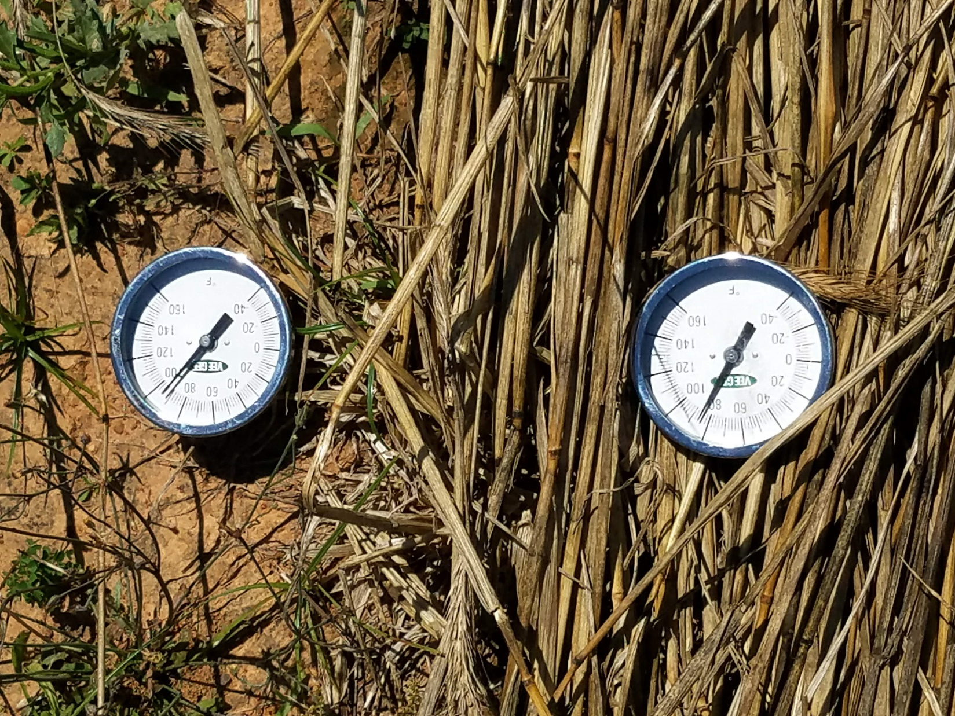
Cover crops can affect soil temperature
Cover crop residue on soil surface
Bare soil
85° F
92° F
Notes:
Cover crops can reduce the surface and near-surface temperature of the soil. This is ideal in the summer to help alleviate heat and water stress to crops. The lower temperatures mean water will evaporate more slowly and soil water will be conserved.
In the early spring it also means that ground covered by cover crops or cover crop residue may warm more slowly which may delay planting due to cold soil temperatures or slower soil drying times.

Slide 10
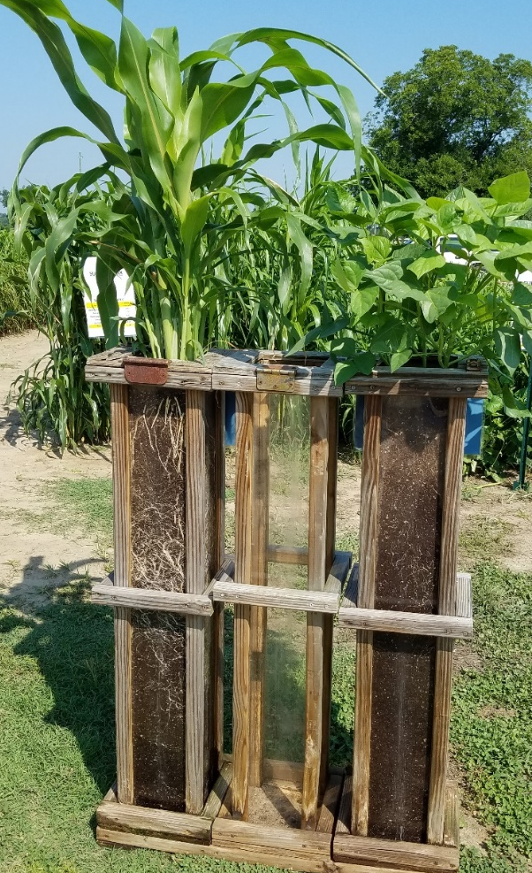
Cover crops can increase water infiltration and break up hard pans
Research has shown cover crops can increase water infiltration by 8 % to 528 % ²
3 feet
Notes:
However cover crops can also help increase how deeply water infiltrates the soil.
This can happen when deep rooted cover crops break up compaction layers in the soil.
The roots will create new channels for water to move in the soil.
This means more water will move deeper into the soil and less water will accumulate on the soil surface and run off.
The release of soil compaction will help subsequent cash crops to be able to root deeper and access the higher amount of stored soil water.

Slide 11
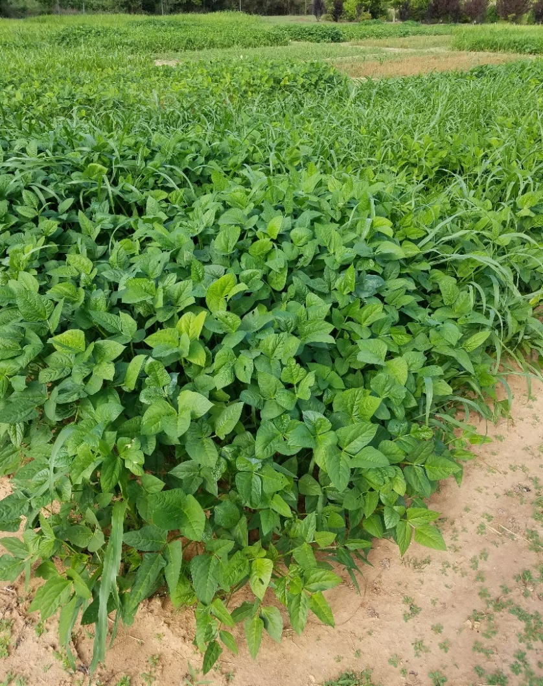
Cover crops can increase soil nitrogen
Biological Nitrogen Fixation
Rhizobia bacteria live inside the roots of legumes
Notes:
Legume cover crops use nitrogen from the atmosphere as source of nitrogen.
Most plants can’t access atmospheric nitrogen. But rhizobia bacteria in the roots of legumes can convert gaseous Nitrogen into plant available forms the plant can use to grow
(aka. Biological nitrogen fixation).
When the legumes are tilled into the soil or left of the soil surface to decompose that nitrogen is released to the subsequent cash crop.
All of these processes of nitrogen cycling are reliant on soil microorganisms
This is like planting tiny nitrogen fertilizer factories all across your field. The factories take nitrogen gas from the air and convert it into fertilizer for the next crop.

Slide 12
Cover crops can reduce nutrient losses
Research has shown 1% to 89% less Nitrogen and 15% to 92% less Phosphorus in runoff samples collected from cover cropped ground³
Notes:
Cover crops can help capture nutrients that are in the soil and prone to being washed away (leached).
Cover crops take up the nutrients as they grow and then return them to the soil when they decompose.
This is important because large amounts of N, P may be lost in the off-season if ground is left fallow.
These losses mean lost nutrients to the farmer and may cause issues in local and national waterways where they can cause contamination issues and environmental damage.
i.e. algae blooms and red tide

Slide 13
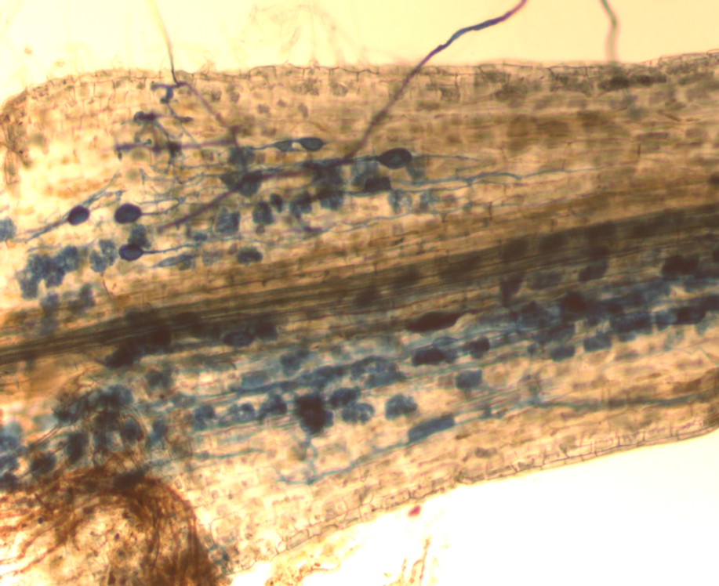
Cover crops can support beneficial soil microorganisms
Example:
Arbuscular mycorrhizal fungi (AMF) live inside the roots of >80% of plant species.
They help plants through increased nutrient uptake, and increase resistance to stresses (drought, root pathogens)
They require a plant host to survive.
Cover crops can help increase AMF populations in the soil ^{6,7}
Strawberry root colonized by arbuscular mycorrhizal fungi (AMF) (stained blue)
Notes:
Cover Crops also provide habitat for many beneficial (the good guys!) soil microorganisms.
Soil microbes perform many important functions:
Breaking down organic matter to release nutrients
Helping to improve gas and water exchange with the surface (earthworms- soil engineers)
Helping to balance and combat soil pests ( diseases, insects and nematodes)
One example is Arbuscular Mycorrhizal fungi (pronounced: are-bus-Q-u-lar my-co-ri-za). Also known as: “A.M.F.”
Over 80% of plants form associations with AMF! (Brassicas are an exception)
AMF live inside of plant’s roots and have their own ‘hyphal’ root network that extends into the soil.
This helps the plant take up nutrients, take up water in drought and can protect the root from disease in some cases.
They require a host plant to survive long-term
Long fallow periods and excessive tillage may reduce their populations
Cover crops can help them to survive from season to season.
“A green bridge- living plant bridge”--- in this case this is a good thing.

Slide 14
Cover crops can provide habitat for beneficial insects
Mid Fall
Early Spring
Notes:
Cover crops can also provide habitat ABOVE ground
Examples of Beneficial insects are pollinators, predatory insects that attack pest organisms like parasitoid wasps or some spiders.
Most beneficial insects rely on floral nectaries or pollen resources, so allowing the cover crop to flower can increase the attracting of pollinating beneficial insects.
Cover crops can be planted to help support healthy populations of native pollinators between crops that require pollinators.
Buckwheat (picture on the right) is a fast growing crop that is good for promoting beneficial insects.
Cowpeas also have extra floral nectaries.

Slide 15
Cover crops add organic matter to the soil
Soil Properties:
Biological
Physical
Chemical
All three must be in balance for soil health to be achieved.
Photo credit: Building Soils for Better Crops, SARE ⁴
Notes:
One of the most important things cover crops do is increase soil organic matter (SOM).
SOM is important for helping the soil function, b/c SOM is the base of the food pyramid for soil microbes.
Many soil microbes use SOM for food/ energy.
So adding SOM is feeding the soil!
Microbes help suppress diseases and cycle nutrients
SOM also acts as a glue holding the soil aggregates together
Soil health is achieved when the physical, chemical and biological components of the soil are functioning well.
When soil is healthy it will promote healthy plants!

Slide 16
Take home message
Cover crops can contribute to subsequent cash crops management, fertility and crop health.
Cover crop provide multiple benefits that promote healthy function soils
Organic matter additions from cover crops are key to improving the physical, biological and chemical properties of the soil.
Notes:
Cover crops can have many diverse impacts on soil health and plant health.
They are planted to promote the long-term viability and health of agricultural systems.
Organic matter is key to long-term soil health!

Slide 17
Authors and Acknowledgements
This presentation was prepared by
Drs. Amanda McWhirt and Jackie Lee with support from a Southern SARE
Professional Development Program Grant (RD309-137 / S001419 – ES17-135) and are provided by the USDA-SARE program to educators and producers for outreach and educational purposes. These presentations were further reviewed by Dr. Trent Roberts and
Dr. Bill Robertson.
Notes:
These training was developed by Drs. Amanda McWhirt and Jackie Lee with support from a Southern SARE Professional Development Program Grant.

Slide 18
Resources and Sources
¹ Status of the World’s Soil Resources http://www.fao.org/3/a-bc595e.pdf
² Cover Crops at Work: Increasing Infiltration. Cover Crop Resource Series, SARE.
https://www.sare.org/content/download/80109/1406598/Cover_Crops_at_Work_-_Increasing_Infiltration.pdf?inlinedownload=1
³ Cover Crops at Work: Keeping Nutrients Out of Waterways. Cover Crop Resource Series, SARE. https://www.sare.org/content/download/80110/1406605/Cover_Crops_at_Work_-_Keeping_Nutrients_Out_of_Waterways.pdf?inlinedownload=1
⁴ Ten Ways Cover Crops Enhance Soil Health. Soil Health and Cover Crop factsheets. SARE. https://www.sare.org/content/download/80998/1422252/10_ways_cover_crops_enhance_soil_health.pdf?inlinedownload=1
⁵ Clark, A., editor. 2012. Managing Cover Crops Profitably, 3rd Edition. Sustainable Agriculture Research and Education. Handbook Series Book 9. https://www.sare.org/Learning-Center/Books/Managing-Cover-Crops-Profitably-3rd-Edition/Text-Version/Printable-Version
⁶ First evidence for a major cover crop effect on arbuscular mycorrhizal fungi and organic maize growth
https://link.springer.com/article/10.1007/s13593-013-0197-y
⁷ Positive effects of organic farming on below‐ground mutualists: large‐scale comparison of mycorrhizal fungal communities in agricultural soils
https://nph.onlinelibrary.wiley.com/doi/full/10.1111/j.1469-8137.2010.03230.x
Notes:
For more information see these resources and links.

