Slide 1
Adoption Rates for Irrigation Practices in the Mid-south
C.G. Henry, L.J. Krutz, J. Henggeler, R. Levy
RISER

Slide 2
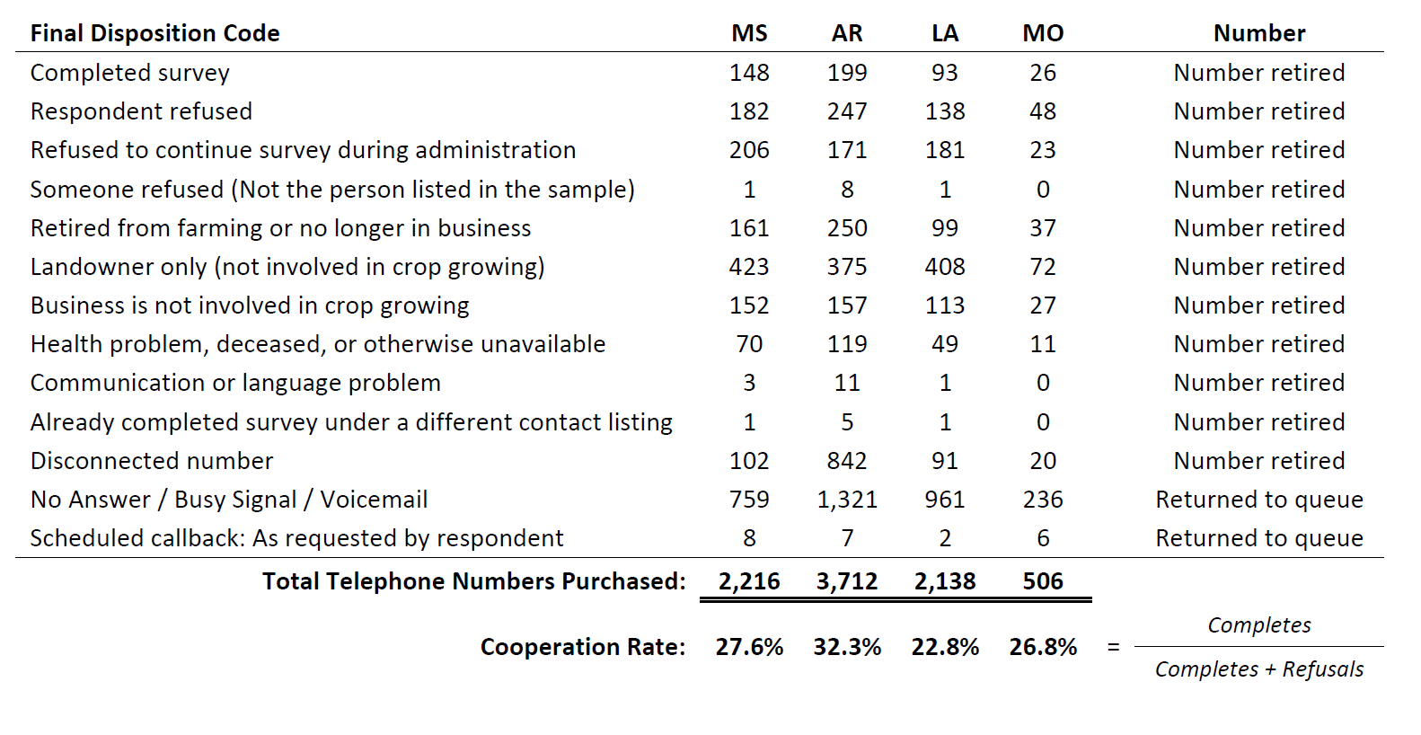
Margin of error, 4.6%, 95% CI, 50% Response Distribution
Survey represents 1.02 Million irrigated acres, there are 13.3 Million acres reported in the region by NASS (8% sample)

Slide 4
Survey Questions
2016 crop year
Perceptions about water shortage
IWM practices: CHS, Surge, Irrigation Scheduling methods
Pumps, energy sources, etc.
Crop types, irrigation systems, etc.
Demographics

Slide 6
On a scale of 1 to 5, with 1 meaning 'no problem' and 5 meaning 'severe problem,' how would you rate the groundwater shortage problem on your farm?
3.49

Slide 9
83.2% since 2012 when DeClerk, Henry, Krutz, Reba started

Slide 13
Other reasons why they don’t use CHS
The computer doesn't know if a phaucet uses more water than the others
Its a new system to the area
Knows the size of the holes he needs on his farms (3)
Knows the soil well enough to predict what size the holes needed
Wells surge and cannot get accurate reading to determine holes size
It's not accurate
It was not how it was set up when he got it

Slide 16
Other Methods
30% report using end blocking
10.5% report using cutback irrigation
54.8% report using deep tillage

Slide 17
Center Pivots
16% of acres under pivot
8.7 years between sprinkler package changes
62.3 percent of Center Pivots in Arkansas have drop nozzles
79.5% have end guns
Only 33.5% of pivots have rotators
6.5% have VRI
4.2% have corner units
14.2% are considering converting their CP to furrow, representing 3% of irrigated acres in the mid-south

Slide 18
15% of pumps have timers

Slide 20
USB (2016); NASS (2012)

Slide 22
This represents an adoption rate of 17%
for all irrigated acres (rice acres excluded)
But Houston, we have a problem,
55% don’t know what brand they are using

Slide 30
Take Home Message
Hey guys, the state has a serious water problem, but it’s not on my farm.
Major improvement in CHS practices showed up in survey, likely due to DP and Extension programs for Pipe Planner.
“Doesn’t work on my farm” or “Doesn’t need it” most reported excuse to CHS
“Doesn’t work on my farm” or “Don’t know how to use it” most reported excuse for not using MIRI
MIRI adoption is high, but questionable.
If they tried it and saw the benefit, they adopted it.
They also appear to adopt practices because of Extension meetings.
Perception is that water savings are small; reason for doing them is to reduce production costs

