Slide 1
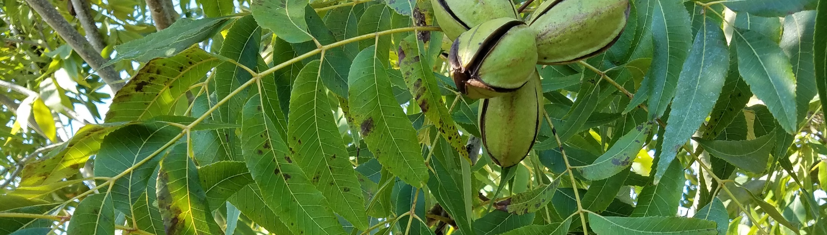

Arkansas 2019
Pecan Plant Tissue Nutrient Testing Program
Amanda McWhirt
Horticulture Production-Extension Specialist

Slide 2

Tool in your Toolbox
Soil testing= nutrients present in the soil, pH
Plant tissue nutrient testing= nutrients being taken up by the plant

Slide 3
Plant Tissue Nutrient Testing
Good measure of if fertility program is meeting nutrient needs for perennial crops.
  Can identify nutrient deficiencies before symptoms appear
  Can help determine fertility rates for the next season
  Many crops early growth in the spring pulls from nutrients applied the previous year and stored in the plant’s tissues; later summer growth pulls from fertility in applied to the soil.
    How you fertilize this year can impact next year’s crop more than fertilizer applied in the current season.
See blog post for timing for other perennial fruit crops
  Samples should be pulled at the right stage of growth and from the right part of the plant for comparison to recommended standards
For pecan the time to sample is July to early August, NOW!

Slide 4
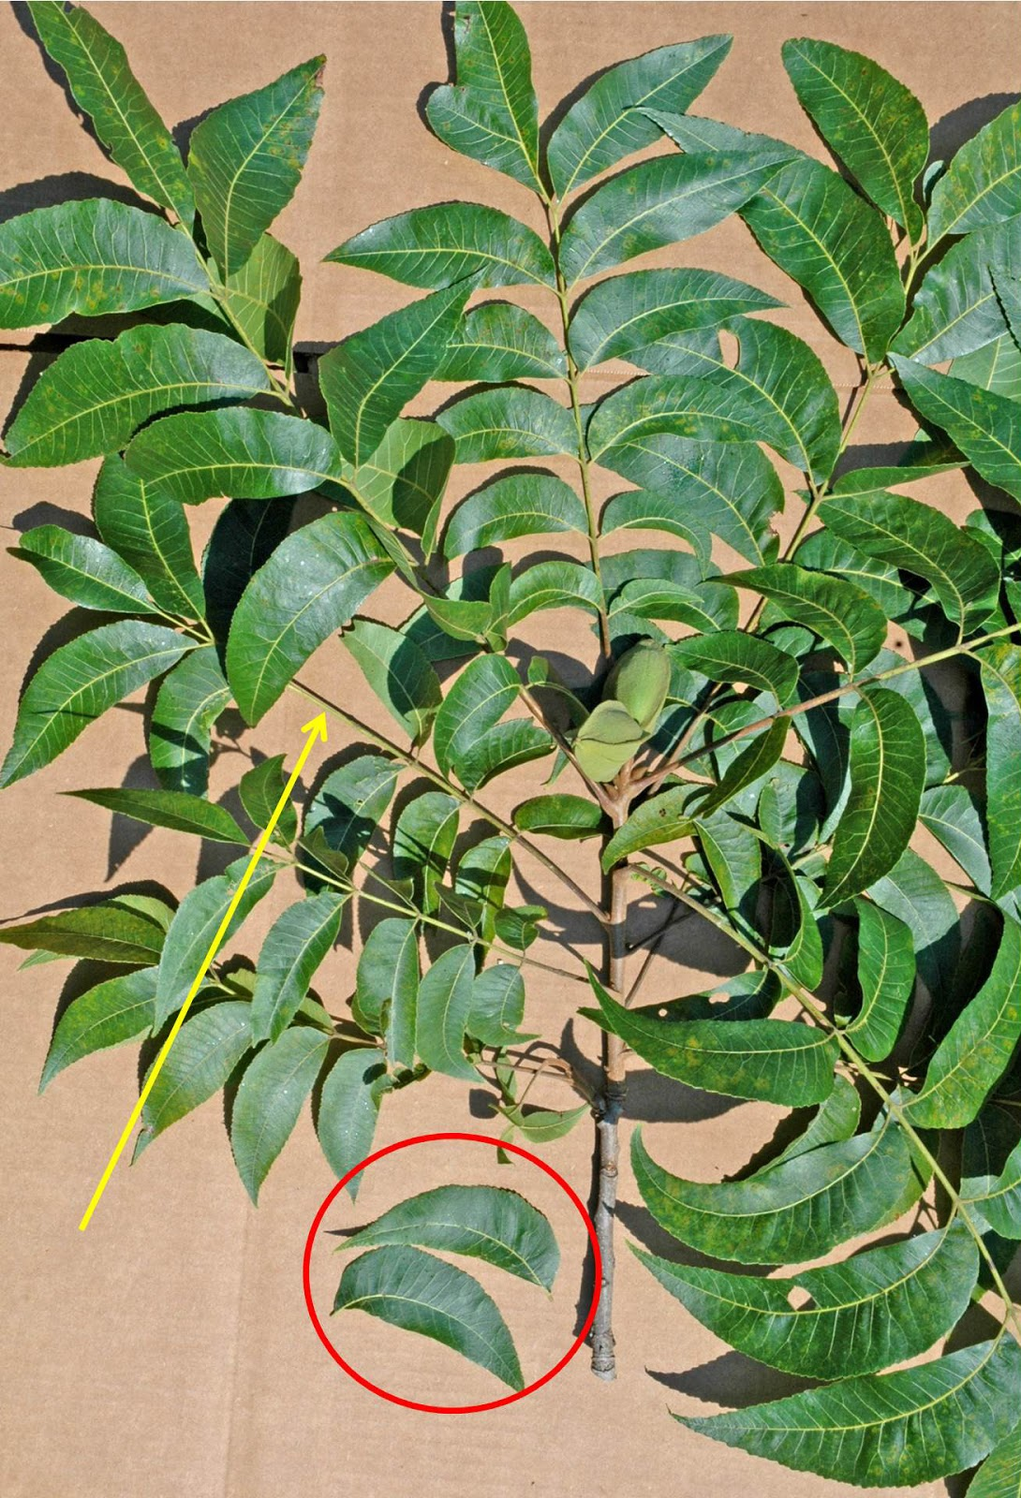
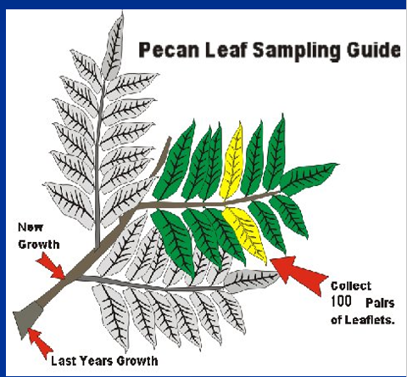
What leaves to sample?
Pair of leaflets 5 leaves back on a branch on the new growth

Slide 5
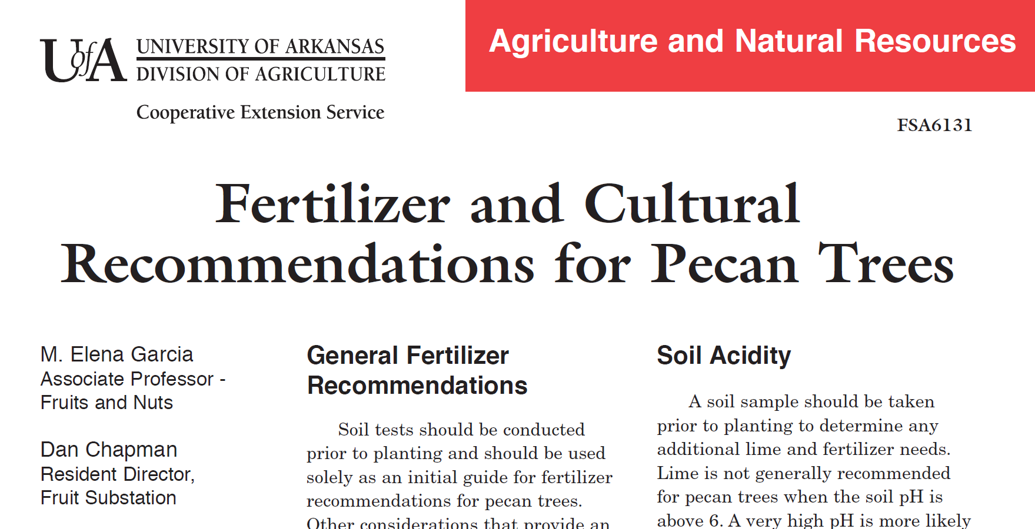
Factsheet: FSA6131

Slide 6
2019 Program
Pull samples between July 1st and July 31st 2019 off of bearing pecan trees.
Collect 40-50 pairs of leaves from at least 20 trees. See the diagram below for which leaves to sample.
  The more leaves you collect and more trees you sample from the better the results!
  Collect leaf pairs opposite each other.
Collect samples from trees of the same age
It is preferable to collect samples from trees of the same variety. But if a whole field is managed the same it is not necessary to sample varieties separately
Wipe leaves with damp paper towel, to remove any surface dirt or debris. ( or foliar Zn sprays)
Collect the sample on Monday and mail immediately!
Send leaves in paper bags
Select leaves that are healthy and exposed to sun
  Avoid leaves that are damaged, covered in dust or diseased.
Randomly select leaves
Submit the form with Form AGRI 423, and $20 per sample + $5 shipping

Slide 7
2018 AR Pecan Sampling Results
24 samples received
Average age of trees sampled: 45 years (range: 10-77)
Most common varieties: Stuart, Desirable
Soil Types
  Silt Loam, Sandy loam
Results:
  Many samples were low on Nitrogen and Phosphorus
  Some samples were low on Zn and Sulfur
  Growers were given recommendations based off of their sample results.
We want to follow up and see how growers are doing this year

Slide 8
2019 Report
A final report of trends seen from all samples collected will be presented at the AR Pecan growers association meeting in 2020 and posted on the www.uaex.edu/hortblog
  The results will be kept anonymous, no individual farms will be identified
The 2018 report, directions and AGRI 423 will be sent out today to agents.
  Contact Amanda amwhirt@uaex.edu with questions.

