Slide 1
Physical Science: Elements, Matter and Interactions; Electrical Forces
Diedre Young MAT
Soybean Science Challenge Coordinator

Slide 2
Hydrogen, Ionic, Dipole-Dipole and Dispersion Interactions
Bulk properties of substances:
Melting Point
Boiling Point
Vapor Pressure
Surface Tension
(PS1-PS1-3)

Slide 3
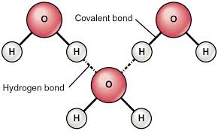
HYDROGEN BONDING
Hydrogen bonding is a special type of dipole-dipole attraction between molecules, not a covalent bond to a hydrogen atom. It results from the attractive force between a hydrogen atom covalently bonded to a very electronegative atom such as a N, O, or F atom and another very electronegative atom.
Water is both hydrogen bonded (Hydrogen to Oxygen) and a Dipole moment. The atoms act like ‘ions’ (having a charge) rather than being neutral.

Slide 4
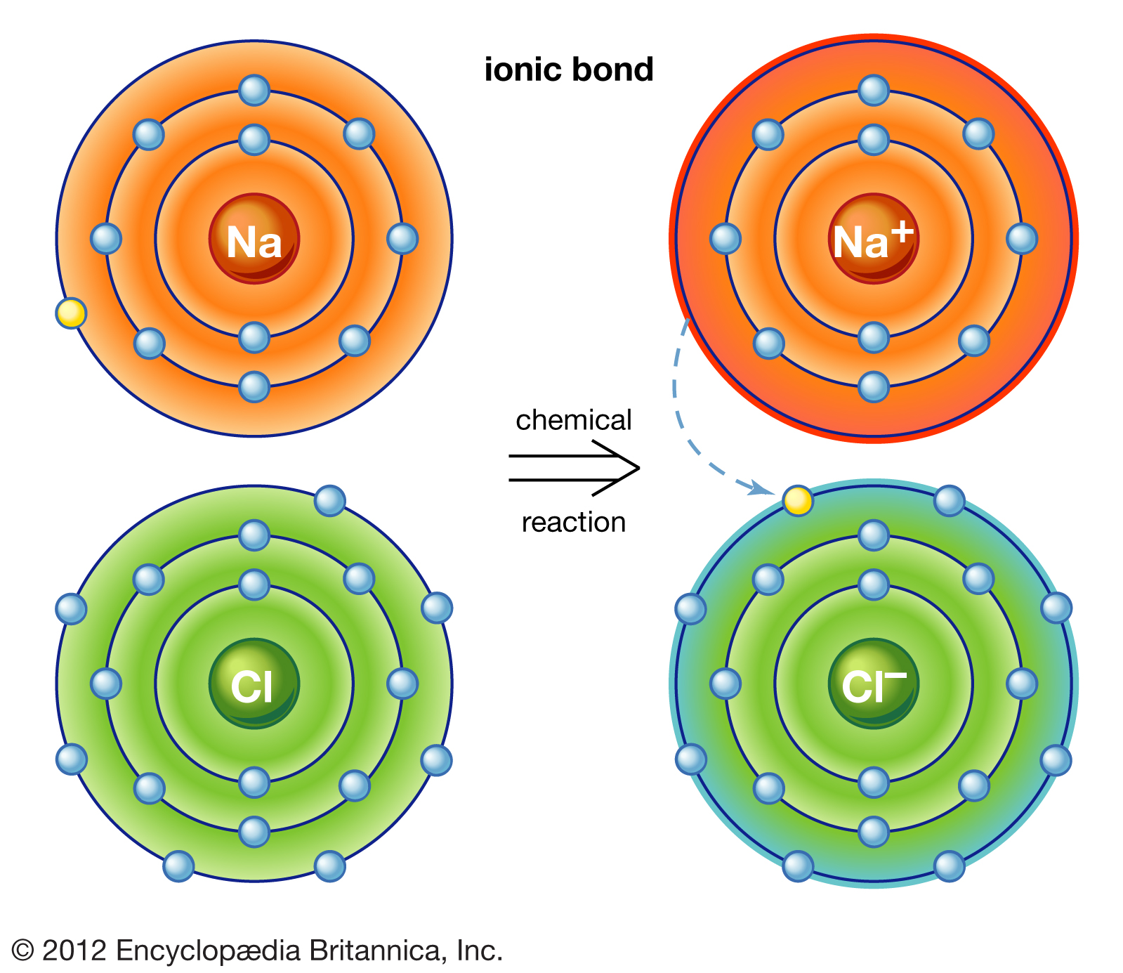
Ionic Bonds
Ionic bonding is the complete transfer of valence electron(s) between atoms. It is a type of chemical bond that generates two oppositely charged ions. In ionic bonds, the metal loses electrons to become a positively charged cation, whereas the nonmetal accepts those electrons to become a negatively charged anion. They bind together like a magnet, and the bond is very strong.

Slide 5
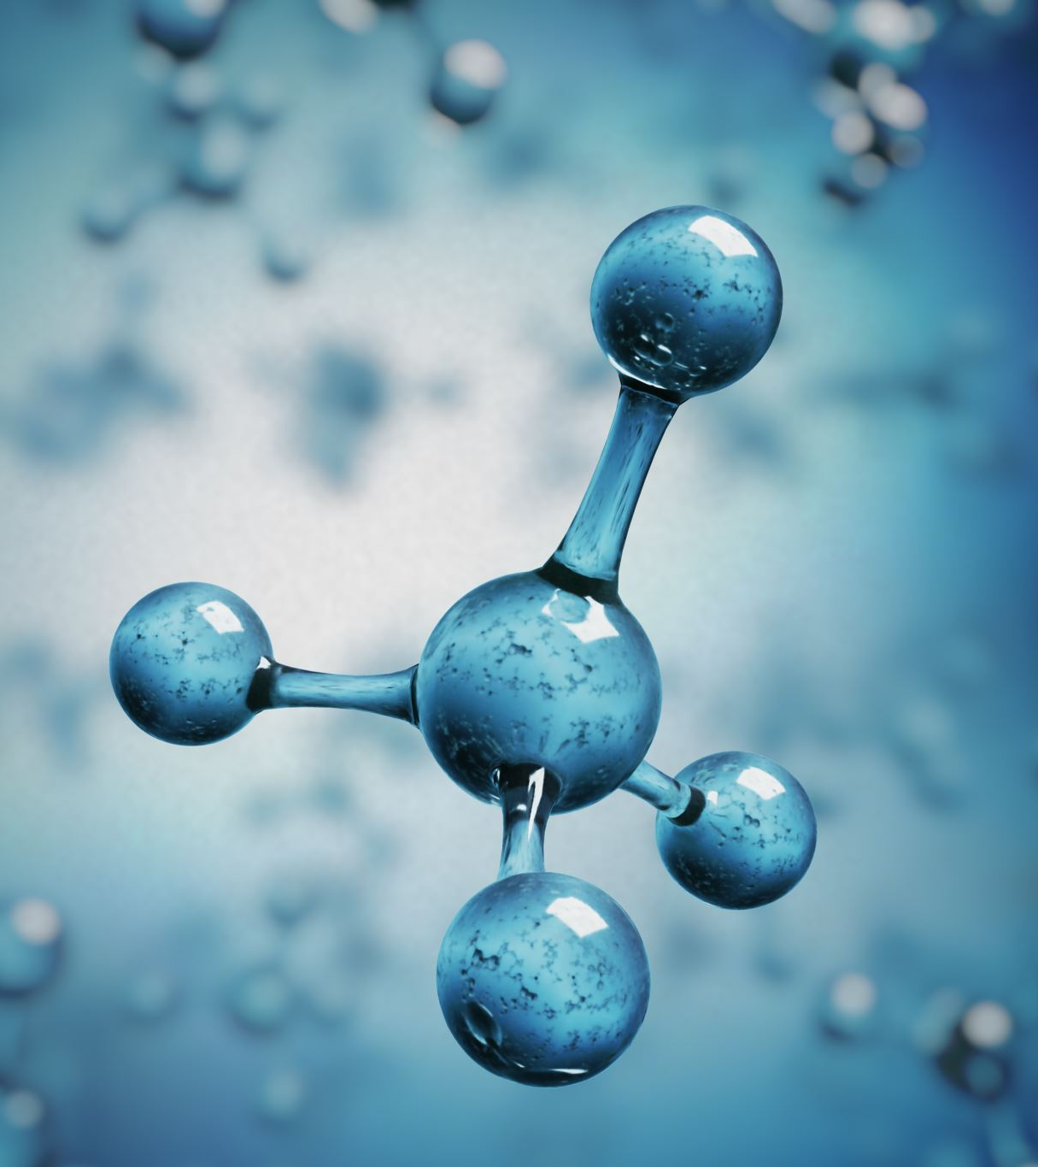
Dipole-Dipole
Dipole-dipole forces are attractive forces between the positive end of one polar molecule and the negative end of another polar molecule. Dipole-dipole forces tend to be strong. Polar molecules have a partial negative end and a partial positive end.

Slide 6
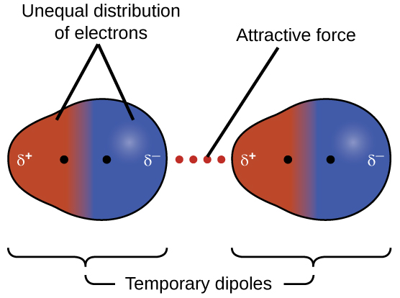
Dispersion Interactions
The London dispersion force is a temporary attractive force that results when the electrons in two adjacent atoms occupy positions that make the atoms form temporary dipoles. Dispersion forces are present between any two molecules (even polar molecules) when they are almost touching. Think two weak magnets next to each other.

Slide 7
What is the Macro affect?
Hydrogen bonds and Dipole Interactions increase bond strength, this means higher boiling points, melting points and compounds (like water) will have surface tension.
While ionic bonds are the strongest bond, the ionic lattice is easily broken when added to a dipole mixture like water. That’s why salt dissolves well in water!
London forces are present in all compounds. It is a weak bond that is easily broken.

Slide 8
So why is this important to agriculture?
The dipole/hydrogen bonding properties of water are a farmer’s friend! Water is essential to plants. Its surface tension allows water to be pulled up through roots, its solvation (due to the dipoles) allows nutrients to be dissolved and water’s high freezing point allows it to stay liquid over a broad temperature range and act as a transportation for nutrients throughout the plant!

Slide 9
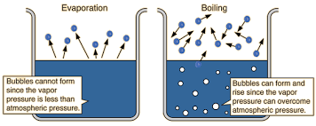
And what about vapor pressure?
The pressure exerted by the gas in equilibrium with a solid or liquid in a closed container at a given temperature is called the vapor pressure.
This is important in agriculture when there is a need to spray insecticides and/or herbicides. The vapor pressure of the chemical will determine how to spray it correctly such as nozzle size, distance from plants and outside temperature.

Slide 10
A video about water!
Check out this You Tube video about the chemical properties of water and their importance to life!
https://www.youtube.com/watch?v=z5Vm56Pu4hU

